Slide 1
Zoonotic infections
CLS 416

Slide 2
Learning outcomes after the end of the lecture students should
1) define zoonotic infections
2) for the discussed zoonotic infections,link the causative agent and compare the mode of transmission to humans
3) associate animal hosts or vectors with zoonotic infections discussed in the lecture
4) correlate the pathogen ( genus and species ) that cause the zoonotic diseases discussed in the lecture .
5) Discuss the epidemiology and describe the clinical manifestations associated with each disease condition.
6) discuss the control measures

Slide 3
Definition
Zoonotic disease (zoonoses): any infection that is transmitted from non-human sources as wild and domestic animals, to human beings.
Animal carrying the pathogen may or may not experience clinical symptoms of the infection .
Zoonoses account for over 60% of known human pathogens and 75% of emerging or re-emerging infectious diseases
Notes:
From the Greek:
Zoon: Animal
Noson: Disease

Slide 4
High-risk, human populations
Although zoonoses can affect everyone, certain populations have a higher risk of becoming infected due to increased animal contact or associated environmental exposure as a result of their job or lifestyle.
In developing countries, a large proportion of the population are frequently exposed to live animals in their daily lives.
In West Africa for example, human contact with both domestic and wild animals is common, even in urban locations, and may lead to an increased burden of zoonotic diseases when compared to developed countries.

Slide 5
Zoonoses can be classified by
Type of infectious agent
Mode of transmission
Type of reservoir host

Slide 6
Transmission of zoonotic infections may be direct (animal to man), or indirect via arthropod vectors, or from environmental foci
–Direct zoonoses –Cyclozoonoses two vertebrate hosts : intermediate & definitive host –Metazoonoses vertebrate animals to insect vectors to man –Saprozoonoses vertibrate animal---environmental development –Combination (e.g. direct & metazoonoses)

Slide 7
DIRECT ZOONOSES
Infections which can be directly or mechanically transmitted to people from animals, and which are capable of being maintained in a single species of animal
Examples:
Rabies
Pasteurellosis
Anthrax
Brucellosis
Ebola

Slide 8
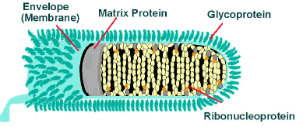
Rabies ( Animal bite) Rabies is a preventable viral disease of mammals often transmitted through the bite of a rabid animal
Etiology
Rabies virus is a member of Rhabdoviridae family
Single stranded RNA enclosed within a bullet-shape capsid
Transmission (Zoonosis)
Rabies is maintained spread in two ways . IN urban rabies, dogs are primary transmitters , and in sylvatic ( forest) rabies , many species of wildlife can serve as transmitters.
Reservoir: wild animals
Vector: wild animals and unvaccinated dogs and cats

Slide 9
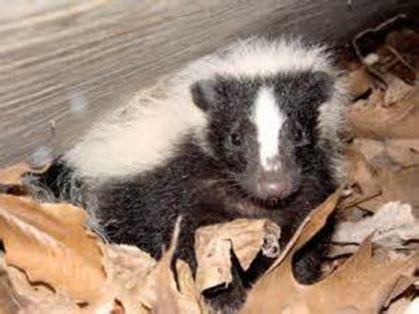
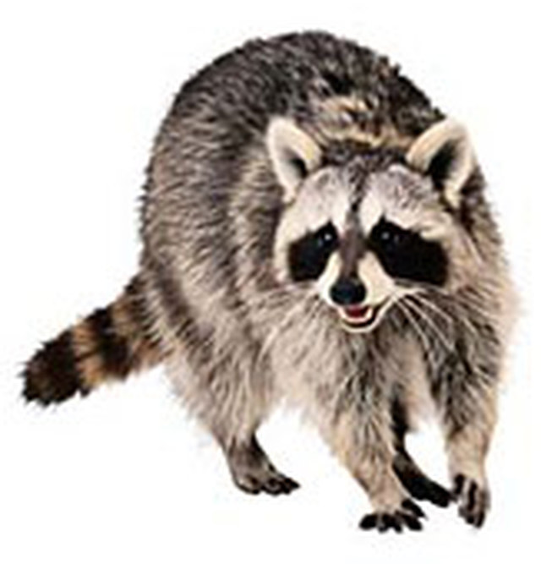
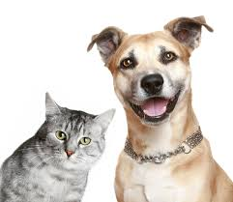
Transmission usually from the bite of wild animals such as foxes, skunks, raccoons and bats
Dogs and cats are frequently immunized therefore rarely source of human infection
In recent years, bats are the source of most cases of human rabies in the US
Source of virus :
Major: Saliva in bite of rabid animal
Minor: aerosols in bat caves containing rabid bats
Epidemiology
Rabies is nearly uniformly fatal, Anual worldwide human deaths from rabies is 50.000 ,and millions of rabied animals each year.

Slide 10
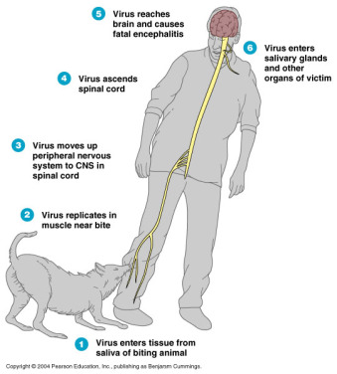
Disease mechanism
Notes:
Once inside the body, the virus travels along the nerves. Its main target is the the brain and spinal cord.

Slide 11
Clinical picture
Nonspecific symptoms: fever, anorexia, and changes in sensation at bite site
Within few days: Confusion, lethargy and increased salivation develop
Most notable: painful spasm of the throat muscles on swallowing (hydrophobia)
The disease progress to: seizures, paralysis and coma
Who is at risk?
Veterinarians and animal handlers
- person bitten by a rabid animal
- inhabitants of countries with no pet vaccination program
Notes:
Wound cleansing is especially important in rabies prevention since, in animal studies, thorough wound cleansing alone without other postexposure prophylaxis has been shown to markedly reduce the likelihood of rabies.

Slide 12
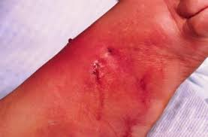
Pasteurellosis
Etiology
-Pasteurella maultocida
- pleomorphic ovoid to filamentous gram negative bacilli - present in the oral cavities of most cats and dogs
Clinical manifestations
cellulitis (due to dogs and cats bites or scratches), or by animal licking wound
- complications: sepsis, meningitis, septic arthritis, osteomylitis.

Slide 13
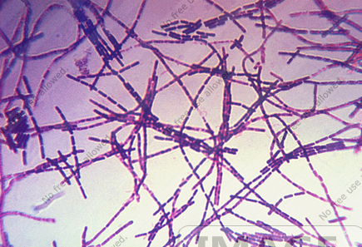
Anthrax ( wool sorters disease)
Etiology
Bacillus anthracis ( large, gram positive , spore- forming bacillus)
Reservoirs
Include anthrax-infected animals, spores that may be present in soil, animal hair, wool, animal skins and hides, and products made of them.
Transmission
Entry of endospores through breaks in skin, inhalation of spores, or ingestion of bacteria in contaminated meat. Pulmonary anthrax is not transmitted from person to person.

Slide 14
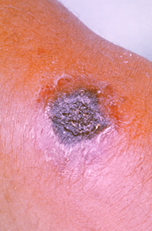
Anthrax
Human disease occurs in three main forms
Cutaneous anthrax: depressed blackened lesions called eschars form as a result of a necrotoxin
Gastrointestinal anthrax: caused by ingestion of meat or meat products contaminated with spores
Pulmonary (inhalation)anthrax: Inhaling spores( from contaminated animal products) the spores will be concentrated in the lymph node , then germinate and sepsis occurs. - the result is usually death with 24 h regardless of treatment.
Notes:
Inhalation and gastrointestinal anthrax are often fatal, but cutaneous anthrax usually is not

Slide 15
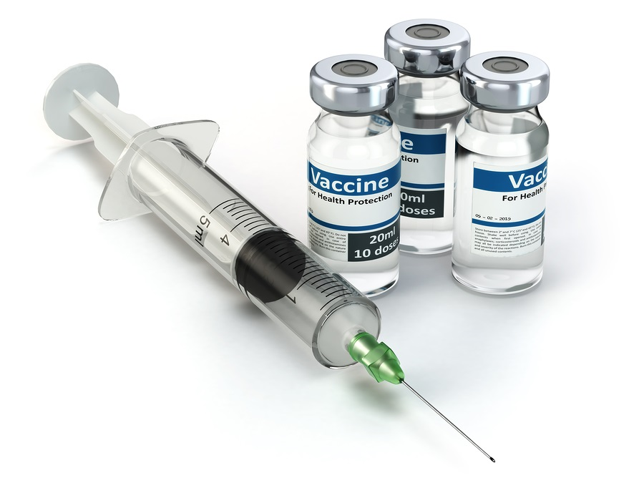
vaccines are available for humans and for cattle

Slide 16
Brucellosis ( Malta fever, Mediterranean fever, undulant fever)
Systemic infection with organisms multiplying inside the cells of the reticuloendothelial system producing a granulomatous reaction, then spread by bacteremia to cause destructive lesions in bones, joints and other tissue
Etiology
four species originate from animal reservoir
Brucella melitensis ( goats)
Brucella abortus ( cattle)
Brucella canis (canines)
Brucella suis (swine)

Slide 17
Brucellosis
Transmission:
Direct contact (farmers, vets, abattoir workers)
Unpasteurized milk or cheese
Inhalation (laboratory worker)
Clinical picture
-After incubation period of 1-3 weeks, nonspecific symptoms such as fever,chillis, fatigue, malaise, anorexia, and weight loss occur
-The undulating (rising-and-falling) fever pattern that gives the disease its name
-Enlarge lymph nodes, liver, and spleen
-Brucella melitensis is the most common agent of human brucellosis, occurs in many areas of the world ( Mexico, central and south america, Africa, Saudi Arabai)
Notes:
B. melitensis infections more sever and prolonged

Slide 18
Ebola
Ebola virus is named for the river in Zaire that was the site of an outbreak of hemorrhagic fever in 1976
Clinical picture
the incubation period, is 2 to 21 days.
Humans are not infectious until they develop symptoms. First symptoms are the sudden onset of fever, fatigue, muscle pain, headache and sore throat.
This is followed by vomiting, diarrhea, rash, symptoms of impaired kidney and liver function,
Susequently, Hemorrhage from multiple sites ( especially the gastrointestinal tract ) and death occurs as many as 90% of patients with clinically evident disease

Slide 19
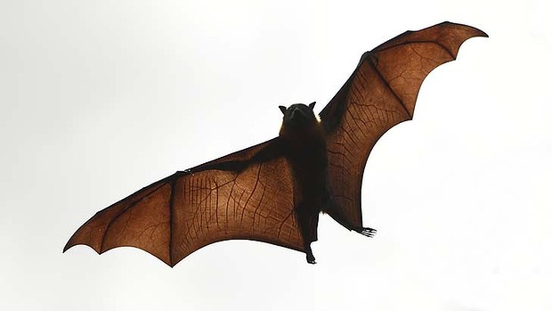
Ebola Transmission

Slide 20
Ebola Outbreak
Notes:
the largest and most complex Ebola outbreak since the Ebola virus was first discovered in 1976.

Slide 21
Ebola Treatment
Supportive care-rehydration with oral or intravenous fluids- and treatment of specific symptoms, improves survival.
There is no proven treatment available for EV. However, a range of potential treatments including blood products, immune therapies and drug therapies are currently being evaluated.
No licensed vaccines are available yet, but 2 potential vaccines are undergoing human safety testing.

Slide 22
CYCLOZOONOSES
Infections which require at least two vertebrate hosts, one of which may be human, to complete their life cycle eg. Taenia solium, Echinococcus granulosus,
Toxoplasma gondi

Slide 23
Taenia soulim

Slide 24
Human echinococcosis (hydatidosis, or hydatid disease)
caused by the larval stages of cestodes (tapeworms) of the genus Echinococcus granulosus

Slide 25
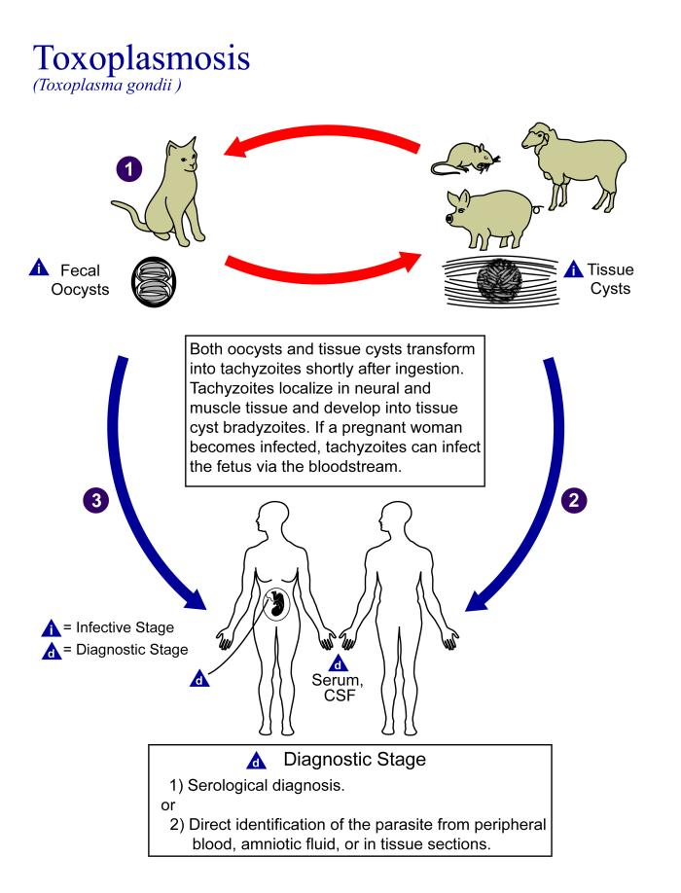

Slide 26
METAZOONOSES
Diseases of vertebrate animals which can affect man, the infectious agents of which replicate, develop in, and are transmitted by, an invertebrate vector eg. plague, rickettsiae, lyme, borreliosis.

Slide 27
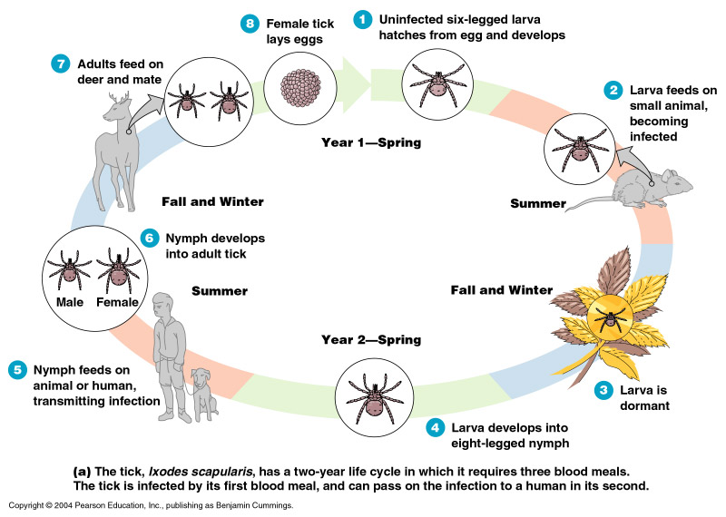
Lyme disease ( Lyme borreliosis)
Etiology:
caused by Borrelia burgdorferi
- Arthropord -borne disease in which humans are accidental hosts
Transmitted by: ticks of the genus Ixodes from mice to human
Reservoir: mice ,deer,ticks
Notes:
The disease usually has its onset in summer

Slide 28
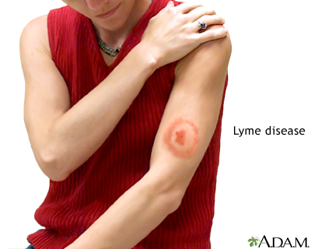
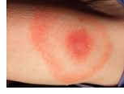
Lyme disease Clinical manifestation
Early skin lesions have an expanding ring form, often with a central clear zone ( Erythema migrans) or "bull's-eye" rash. Fever, chills, myalgia and headache are common.
Central nervous system and other complications may occur weeks or months after the onset of illness.
Arthritis may develop up to 2 years after onset.

Slide 29
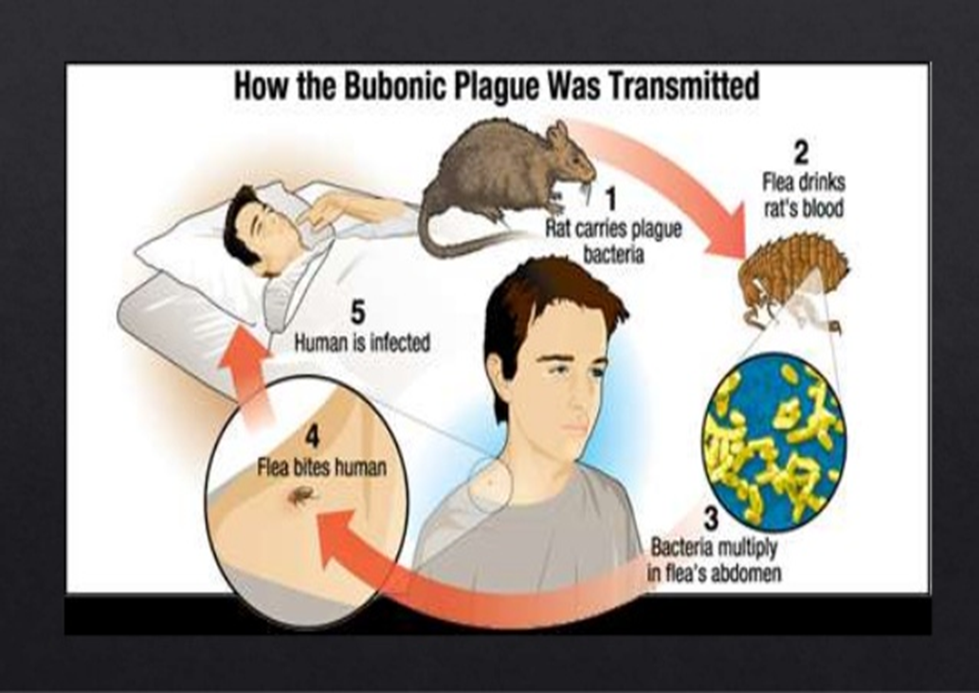
Plague
Etiology
- yersinia pestis (gram negative bacillus)
Vectors
are fleas ( Xenopsylla cheopis) - Rats are the natural host for the vectors that transmit the disease from one organism to another by means of a bite , and humans are accidental hosts.

Slide 30
Plague Clinical Picture
Bubonic plague: Patients develop sudden onset of fever, headache, chills, and weakness , tender and painful lymph nodes (called buboes). If the patient is not treated with the appropriate antibiotics, the bacteria can spread to other parts of the body.
Septicemic plague: Skin and other tissues may turn black and die, especially on fingers, toes, and the nose. Septicemic plague can occur as the first symptom of plague, or may develop from untreated bubonic plague.
Pneumonic plague: develop from inhaling infectious droplets or from untreated bubonic or septicemic plague after the bacteria spread to the lungs. may cause respiratory failure and shock. most serious form of the disease and is the only form of plague that can be spread from person to person (by infectious droplets).
Notes:
The pneumonia may cause respiratory failure and shock

Slide 31
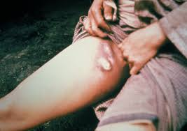
Plague
Bubonic plague

Slide 32
SAPROZOONOSES
Diseases of vertebrate animals which can affect people, the infectious agents of which are either capable of replicating in inanimate sites, or require an inanimate environment for the development of an infectious stage of their life cycle eg. histoplasmosis, Toxocariasis ,certain food-borne diseases.

Slide 33
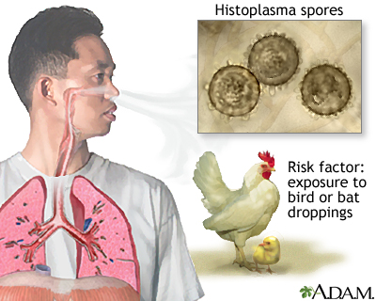
Histoplasmosis
Histoplasma is a dimorphic fungus, the filamentous mold form is found in soil with bird or bat dropping
Humans are infected by inhalation of spores that germinate to yeast form which is ingested by macrophages
The clinical disease depends on the dose inhaled, the immune state and local lung disease

Slide 34
Zoonoses can be classified by:
Bacterial zoonoses
Parasites
Viruses
Fungi

Slide 35
Bacterial zoonoses
foodborne zoonoses such as Salmonellosis and Campylobacteriosis which cause fever, diarrhoea, abdominal pain, malaise and nausea.
- anthrax
- brucellosis
- infection by verotoxigenic Escherichia coli
- leptospirosis,
- plague
- Q fever
- shigellosis
- Tularaemia.

Slide 36
Parasites
Cysticercosis/Taeniasis
- trematodosis,
- echinococcosis/hydatidosis,
- toxoplasmosis
- trichinellosis.

Slide 37
Viruses
- Rabies
- avian influenza,
-Congo hemorrhagic fever,
- Ebola
- Rift Valley fever.

Slide 38
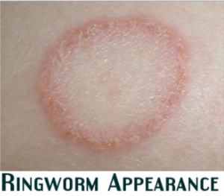
Fungi
Histoplasma
Ringworm
Dermatophytosis (tinea or ringworm) of the scalp, glabrous skin, and nails is caused by a closely related group of fungi known as dermatophytes which have the ability to utilise keratin as a nutrient source, i.e. they have a unique enzymatic capacity [keratinase].
Notes:
Dermatophytosis (tinea or ringworm) of the scalp, glabrous skin, and nails is caused by a closely related group of fungi known as dermatophytes which have the ability to utilise keratin as a nutrient source, i.e. they have a unique enzymatic capacity [keratinase].

Slide 39
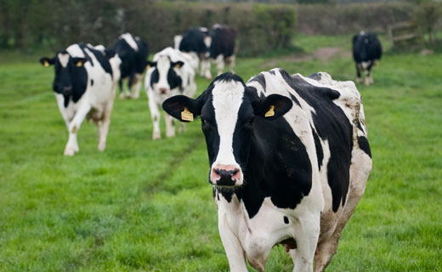
Unconventional agents
The agent of Bovine Spongiform Encephalopathy (BSE) is thought to be the cause of variant Creutzfeldt-Jakob Disease (vCJD) which is a degenerative neurological disease.
Reservoir: Cattle
Agent: Prion
(single replicating glycoprotein)
Transmission: Eating infected beef
Human symptoms: Neurological disorders that worsen over time
Notes:
these are called PRIONS, or proteinaceous infectious particles.
They contain proteins but no DNA, and are linked to a group of diseases called the TRANSMISSIBLE SPONGIFORM ENCEPHALOPATHIES = cause breakdown of the nerve cells.

Slide 40
CONTROL OF ZOONOTIC DISEASES
Massive national and international eradication programmes eg. rabies, TB, brucellosis
Slaughter inspection of food animals
Prophylactic vaccinations mainly in animals
Therapy of animals with zoonotic diseases
Control of vector and reservoir populations (arthropods, rodents)
Prevention of environmental degradation to reduce disruption of natural balances among hosts, agents and the environment.

