Slide 1
The cuttlefish – Sepia:
Kingdom: Animalia
Phylum: Mollusca
Class: Cephalopoda
Genus: Sepia
Species: savignyi
Sepia savignyi
External Features:
The body is mainly divided into a distinct head and a conical visceral hump, separated from one another by a short neck.
The head carries 2 large eyes, similar to those of vertebrates. It bears anteriorly the mouth opening surrounded by a prominent circular lip, and 2 large horny jaws project from it.

Slide 2
Eight pointed arms,each provided with 4 rows of suckers on its inner surface, and 2 much longer tentacles, carrying suckers only at their expanded tips, arise at the anterior end of the head, around the mouth opening (the tentacles are used in catching the prey and the arms for holding it while it is being devoured).
The arms and tentacles probably represent the highly modified anterior part of the foot, and hence the name Cephalopoda.
The posterior part of the foot is modified to form the large muscular funnel which you see on the ventral side of the head (through which water is forced out of the mantle cavity, causing the animal to jerk quickly backwards

Slide 3
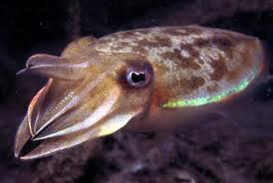

Slide 4
Kingdom: Animalia
Phylum: Echinodermata
Class: Asteroidea
Genus: Astropecten
Species: relitaris
Astropecten relitaris
(See star).
The Starfish
External Features:
The body is star-shaped consisting of a central disc prolonged radially into 5 felxible triangular arms with tapering tips.
The body is markedly flattened, with two distinct surfaces, a lower oral surface and an upper aboral surface.
On the oral surface, note the mouth opening in the centre, surrounded by-a soft membranous area, the peristome.
Five broadly open ambulacra grooves extend out from the mouth and pass each along the entire length of one of the arms.

Slide 5
Note that a series of long conical structures known as the tube feet project in 2 rows along each ambulacral groove (organs of locomotion which-are capable of great extension and contraction during life).
The terminal tube foot or tentacle, which stands at the tip of each arm, has a pigmented spot, the eye, at its base (light sensitive).
Note that very small modified spines, known as pedicellariae, project around the spines (serve to clean the body surface and ambulacral grooves from detritus and foreign objects).
Each has 2 distal ossicles working opposite each other like pincer blades,and a 3rd basal ossicle as a stalk.

Slide 6
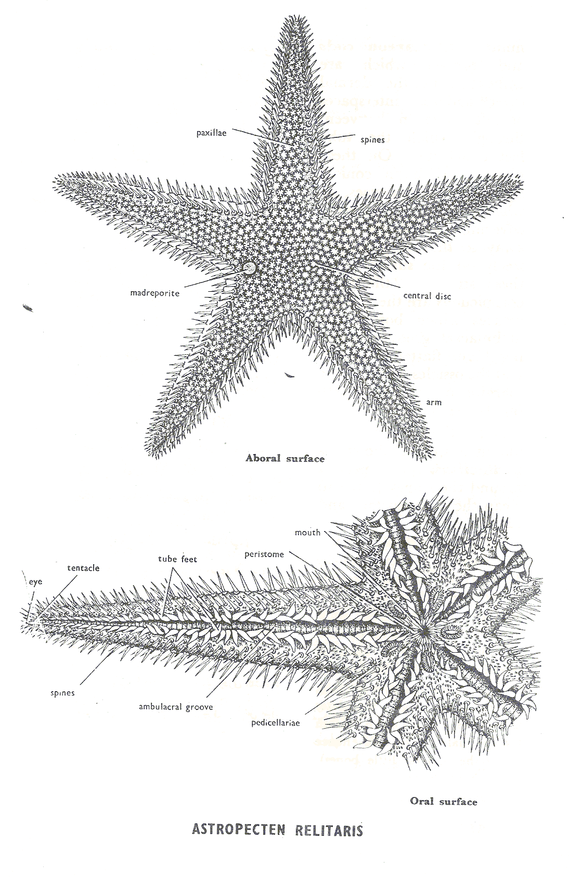

Slide 7
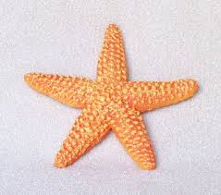

Slide 8
Thank you
for your attention

