Slide 1
Chapter 14
Basic Data Analysis

Slide 2
LEARNING OUTCOMES
Prepare qualitative data for interpretation or data analysis
Know what descriptive statistics are and why they are used
Create and interpret tabulation and cross-tabulation tables
Perform basic data transformations
Understand the basics of testing hypotheses using inferential statistics
Be able to use a p-value to make statistical inferences
Conduct a univariate t-test

Slide 3
Coding Qualitative Responses
Coding represents the way a specific meaning is assigned to a response within previously edited data
Codes represent the meaning in data by assigning some measurement symbol to different categories of responses
A code may be a number, letter, or word
The proper form of coding relates back to the level of scale measurement
Any mistakes in coding can dramatically change the conclusions

Slide 4
Structured Qualitative Responses and Dummy Variables
For statistical purposes the research may consider adopting dummy coding for dichotomous responses like yes or no
Dummy coding assigns a 0 to one category and a 1 to the other
Multiple dummy variables are needed to represent a single qualitative response that can take on more than two categories: if k is the number of categories for a qualitative variable, k – 1 dummy variables are needed to represent the variable

Slide 5
The Nature of Descriptive Analysis
Descriptive analysis is the elementary transformation of data to describe basic characteristics such as central tendency, distribution, and variability
Averages, medians, modes, variance, range and standard deviation typify descriptive statistics
Can summarize responses from large numbers of respondents in a few simple statistics
Sample descriptive statistics are used to make inferences about characteristics of the entire population of interest

Slide 6
The Nature of Descriptive Analysis (cont’d.)
Uses univariate statistics
Simple but powerful and are used very widely
The level of scale measurement influences the choice of descriptive statistics
A histogram is a graphical way of showing a frequency distribution in which the height of a bar corresponds to the frequency of a category

Slide 7
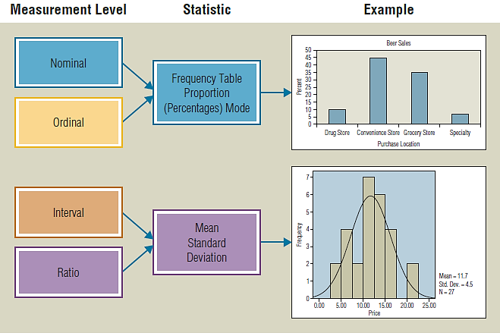
EXHIBIT 14.1 Levels of Scale Measurement and Suggested Descriptive Statistics

Slide 8
Creating and Interpreting Tabulation
Tabulation refers to the orderly arrangement of data in a table or other summary format
Tallying refers to tabulation done by hand
Counting the different ways respondents answered a question and arranging them in a simple tabular form yields a frequency table
The actual number of responses to each category is a variable’s frequency distribution
A simple tabulation of this type is sometimes called a marginal tabulation

Slide 9
Creating And Interpreting Tabulation (cont’d.)
Simple tabulation tells how frequently each response occurs, and this starting point for analysis requires the counting of responses or observations for each category or code
Frequency column: shows the tally result or the number of respondents for each category
Percent column: shows the total percentage in each category
Cumulative percentage: shows the percentage indicating either a particular category or any preceding category

Slide 10
Cross Tabulation
Tabulation of data may answer many research questions, and as long as a question deals with only one categorical variable, it is probably the best approach
Cross-tabulation is the appropriate technique for addressing research questions involving relationships among multiple less than interval variables
One key to interpreting a cross-tabulation table is comparing the observed table values with hypothetical values that would result from pure chance

Slide 11
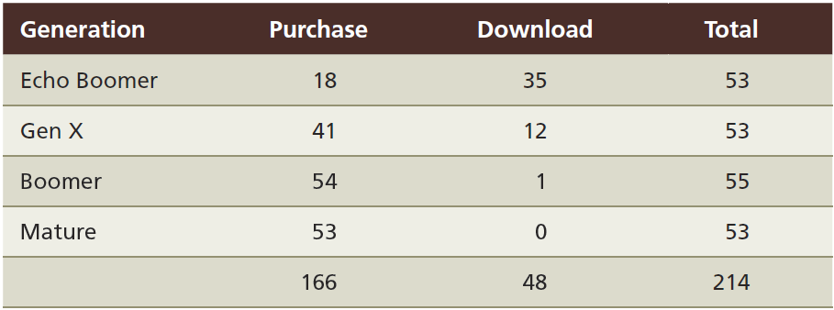
EXHIBIT 14.2 Cross-Tabulation from Consumer Ethics Survey

Slide 12
Percentage Cross-Tabulations
When data from a survey are cross-tabulated, percentages help the researcher understand the nature of the relationship by making relative comparisons simpler
The total number of respondents or observations may be used as a statistical base for computing the percentage in each cell

Slide 13
EXHIBIT 14.4 Cross-Tabulation of Marital Status, Sex, and Responses to the Question “Do You Shop at Target?”

Slide 14
How Many Cross-Tabulations?
Surveys may ask dozens of questions and hundreds of categorical variables can be stored in a data warehouse
Computer-assisted marketing researchers can “fish” for relationships by cross-tabulating every categorical variable with every other categorical variable
A researcher addressing an exploratory research question may find some benefit in such a fishing expedition

Slide 15
Data Transformation
Simple transformations
Data transformation (i.e., data conversion) is the process of changing data from their original form to a format suitable for performing a data analysis that will achieve the research objectives
Researchers often recode the raw responses into modified or new variables
Collapsing or combining adjacent categories of a variable is a common form of data transformation used to reduce the number of categories

Slide 16
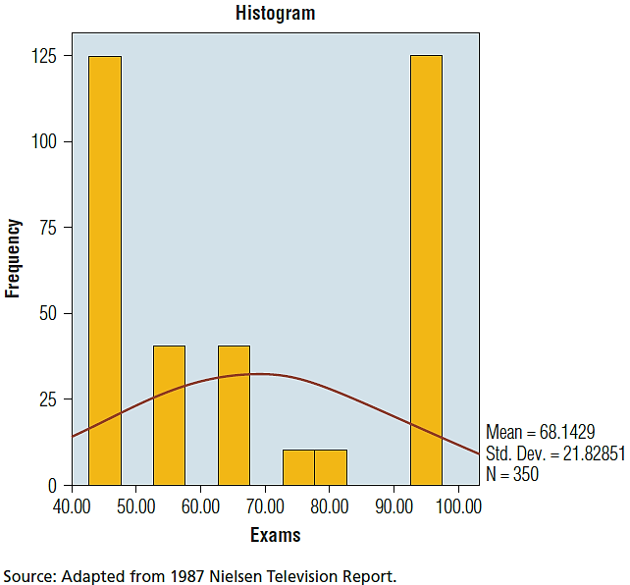
EXHIBIT 14.5 Bimodal Distributions Are Consistent with Transformations into Categorical Values

Slide 17
Problems with Data Transformations
Researchers often perform a median split to collapse a scale with multiple response points into two categories
The median split means respondents below the observed median go into one category and respondents above the median go into another
This approach is best applied only when data exhibit bimodal characteristics
When a sufficient number of responses exist and a variable is ratio, the researcher may choose to delete one-fourth to one-third of the responses around the median to effectively ensure a bimodal distribution

Slide 18
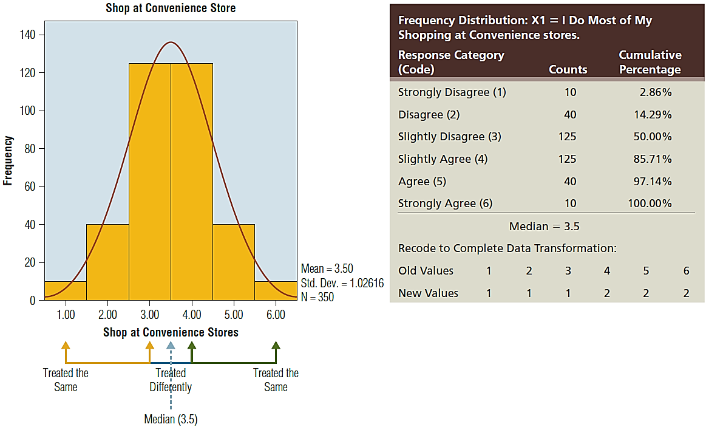
EXHIBIT 14.6 The Problem with Median Splits with Unimodal Data

Slide 19
Tabular and Graphic Methods of Displaying Data
Tables, graphs and charts can simplify and clarify data
Graphical representations of data may take a number of forms, ranging from a computer printout to an elaborate pictograph
Today’s researcher has many convenient tools to quickly produce charts, graphs, or tables
All forms facilitate summarization and communication
Bar charts (histograms), pie charts, curve/line diagrams and scatter plots are among the most widely used tools

Slide 20
Hypothesis Testing Using Basic Statistics
Empirical testing involves inferential statistics
An inference can be made about some population based on observations of a sample representing that population

Slide 21
Hypothesis Testing Using Basic Statistics (cont’d.)
Statistical analysis can be divided into several groups based on how many variables are involved
Univariate statistical analysis tests hypotheses involving only one variable.
Bivariate statistical analysis tests hypotheses involving two variables
Multivariate statistical analysis tests hypotheses and models involving multiple (three or more) variables or sets of variables and potentially involving multiple equations

Slide 22
Hypothesis Testing Procedure
The hypothesis is derived from the research objectives and should be stated as specifically as possible be theoretically sound
A sample is obtained and the relevant variables are measured
The measured value obtained in the sample is compared to the value either stated explicitly or implied in the hypothesis
The hypothesis is supported or not supported by the measured value

Slide 23
Hypothesis Testing Procedure (cont’d.)
The exact point where the hypothesis changes from not being supported to being supported depends on how much risk the researcher is willing to accept
Univariate hypotheses are typified by tests comparing some observed sample mean against a benchmark value
Is the sample mean truly different from the benchmark?
A statistical test’s significance level or p-value becomes a key indicator of whether or not a hypothesis can be supported

Slide 24
Significance Levels and p-Values
A significance level is a critical probability associated with a statistical hypothesis test
Indicates how likely it is that an inference supporting a difference between an observed value and some statistical expectation is true
p-value: probability value, or the observed or computed significance level
Low p-values mean there is little likelihood that the statistical expectation is true

Slide 25
Significance Levels and p-Values (cont’d.)
Traditionally, researchers have specified an acceptable significance level for a test prior to the analysis
Most typically, researchers set the acceptable amount of error, and therefore the acceptable significance level, at 0.1, 0.05, or 0.01
If the p-value resulting from a statistical test is less than the pre-specified significance level, the results support a hypothesis implying differences

Slide 26
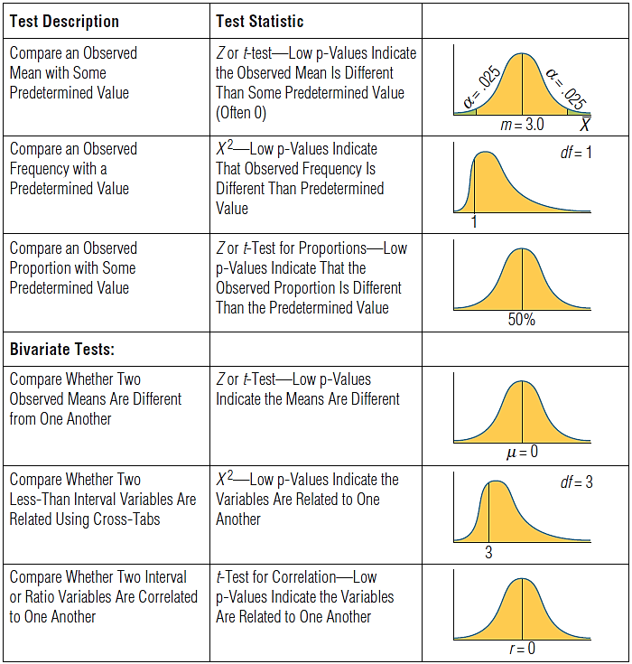
EXHIBIT 14.7 p-Values and Statistical Tests

Slide 27
EXHIBIT 14.7 p-Values and Statistical Tests (cont’d.)

Slide 28
Type I and Type II Errors
Because we cannot make any statement about a sample with complete certainty, there is always the chance that an error will be made
When a researcher makes the observation using a census, meaning that every unit (person or object) in a population is measured, then conclusions are certain
Researchers very rarely use a census; they are susceptible to two types of inferential errors

Slide 29
Type I Error
A Type I error occurs when a condition that is true in the population is rejected based on statistical observations
When a researcher sets an acceptable significance level a priori (α), he or she is determining how much tolerance he or she has for a Type I error
A Type I error occurs when the researcher concludes that there is a statistical difference based on a sample result when in reality one does not exist in the population

Slide 30
Type II Error
A Type II error is the probability of failing to reject a false hypothesis
This incorrect decision is called beta (β)
A sample does not show a difference between an observed mean and a benchmark when in fact the difference does exist in the population
For correlation type relationships, the sample data suggests that a relationship does not exist when in fact a relationship does exist
Such an occurrence is related to statistical power

Slide 31
Type II Error (cont’d.)
Unfortunately, without increasing sample size, the researcher cannot simultaneously reduce Type I and Type II errors – as they are inversely related
Thus, reducing the probability of a Type II error increases the probability of a Type I error
In marketing problems, Type I errors generally are considered more serious than Type II errors
Thus, more emphasis is placed on determining the significance level, α, than in determining ß

