Slide 1
Chapter 12
Sampling and Statistical Theory

Slide 2
LEARNING OUTCOMES
Explain reasons for taking a sample rather than a complete census
Describe the process of identifying a target population and selecting a sampling frame
Compare random sampling and systematic (nonsampling) errors with an emphasis on how the Internet is intertwined with this issue
Identify the types of nonprobability sampling, including their advantages and disadvantages
Summarize various types of probability samples
Discuss how to choose an appropriate sample design

Slide 3
Introduction
A sample is a subset or some part of a larger population
Purpose of sampling is to estimate an unknown characteristic of a population
Sampling is defined in terms of the population being studied

Slide 4
Introduction (cont’d.)
A population (universe) is any complete group sharing some common set of characteristics
The term population element refers to an individual member of the population
A census is an investigation of all the individual elements making up the population—a total enumeration rather than a sample

Slide 5
Why Sample?
Pragmatic reasons
Sampling cuts costs, reduces labor requirements, and gathers vital information quickly
Accurate and reliable results
A sample on occasion is more accurate than a census
Increased volume of work in a census may lead to interviewer mistakes, tabulation errors, and other nonsampling errors
Destruction of test units
Occurs in the process of the research project
Provides the case against using a census

Slide 6
Identifying a Relevant Population and Sampling Frame
Defining the target population
Once the decision to sample has been made, the first question concerns identifying the target population
For consumer research, the appropriate population element frequently is the household
The sample is implemented using the tangible, identifiable characteristics that also define the population
If the population members cannot be reached by an appropriate communication method, they cannot be part of a sample

Slide 7
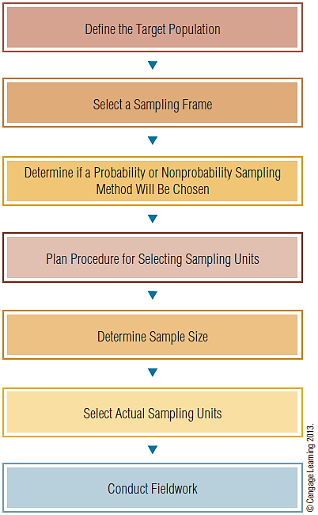
EXHIBIT 12.2 Stages in the Selection of a Sample

Slide 8
The Sampling Frame
A list of elements from which the sample may be drawn
Also called the working population
Sampling frame errors
Occur when certain sample elements are excluded or when the entire population is not accurately represented in the sampling frame
Almost every list excludes some members of the population

Slide 9
Sampling Services
Firms specializing in providing lists or databases of specific populations
Also called list brokers
Equifax City Directory provides complete, comprehensive, and accurate business and residential information
A reverse directory provides listings by city and street address or by phone number
Useful when a researcher wishes to survey only a certain geographical area

Slide 10
Online Panels
Lists of respondents who have agreed to participate in marketing research
Generally contain millions of potential respondents
The more specific the profile requested, the more expensive the panel

Slide 11
Sampling Frames for International Marketing Research
The availability of sampling frames around the world varies dramatically
Not every country’s government conducts a census of the population

Slide 12
Sampling Units
The sampling unit is a single element or group of elements subject to selection in the sample
If the target population has first been divided into units, additional terminology must be used
Primary sampling unit (PSU) designates units selected in the first stage of sampling
Secondary sampling units describes units in successive stages of sampling
When there is no list of population elements
The sampling unit is generally something other than the population element

Slide 13
Random Sampling and Nonsampling Errors
Statistical error—a difference exists between the value of a sample statistic and the value of the corresponding population parameter
Two basic causes of differences
Random sampling errors
Systematic (nonsampling) errors
Random sampling error—the difference between the sample result and the result of a census conducted using identical procedures

Slide 14
Random Sampling Error
A technical term that refers only to statistical fluctuations that occur because of chance variations in the elements selected for the sample
A function of sample size
As sample size increases, random sampling error decreases
Margin of error is determined by the sample size

Slide 15
Systematic Sampling Error
Systematic (nonsampling) errors result from nonsampling factors, primarily the nature of a study’s design and the correctness of execution
These errors are not due to chance fluctuations
Sample biases account for a large portion of errors in marketing research
Errors due to sample selection problems are nonsampling errors

Slide 16
Systematic But Not Obvious Sampling Error
Internet surveys allow researchers to reach a large sample rapidly
Both an advantage and a disadvantage
Due to the flood of online questionnaires, frequent Internet users may be more selective about which surveys they bother answering

Slide 17
Website Visitors
These unrestricted samples are clearly not random samples
May not be representative because of the haphazard manner by which many respondents arrived at a particular website or because of self-selection bias
A better technique for sampling website visitors is to randomly select sampling units

Slide 18
Website Visitors (cont’d.)
Survey software can be used to trigger a pop-up survey for every Nth visitor or on information gathered on the respondent’s Web behavior
Randomly selecting Website visitors can cause a potential problem
May over-represent the more frequent visitors to the site
Programming techniques and technologies that can help accomplish more representative sampling based on site traffic ► "cookies," registration data, or pre-screening

Slide 19
Panel Samples
Consumer panels provide a practical sampling frame in many situations
There is some concern regarding the representativeness of these samples
Researchers must take more steps to ensure that the sampling units do indeed represent the population

Slide 20
Less Than Perfectly Representative Samples
Random sampling errors and systematic errors associated with the sampling process may combine to yield a sample that is less than perfectly representative of the population
Additional errors will occur if individuals refuse to be interviewed or cannot be contacted
Such nonresponse error may also cause the sample to be less than perfectly representative

Slide 21
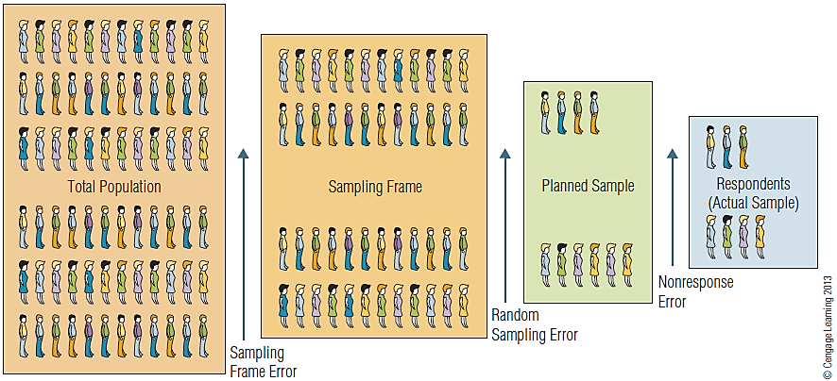
EXHIBIT 12.3 Errors Associated with Sampling

Slide 22
Probability Versus Nonprobability Sampling
Several alternative ways to take a sample are available
The main alternative sampling plans may be grouped into two categories
Probability techniques
Nonprobability techniques

Slide 23
Probability Versus Nonprobability Sampling (cont’d.)
Probability sampling—-every population element has a known, nonzero probability of selection
Simple random sample is the best-known probability sample
Nonprobability sampling—probability of any member of the population being chosen is unknown
The selection of sampling units is quite arbitrary
Nonprobability samples are pragmatic and are used in market research

Slide 24
Convenience Sampling
Sampling by obtaining people or units that are conveniently available
Used to obtain a large number of completed questionnaires quickly and economically, or when obtaining a sample through other means is impractical
Employed when research is looking for cross-cultural differences in organizational or consumer behavior

Slide 25
Judgment Sampling
A nonprobability technique in which an experienced individual selects the sample based on his or her judgment
Also called purposive sampling
The consumer price index (CPI) is based on a judgment sample
Test-market cities often are selected because they are viewed as typical cities whose demographic profiles closely match the national profile

Slide 26
Quota Sampling
Used to ensure that the various subgroups in a population are represented on pertinent sample characteristics to the exact extent that the investigators desire
In quota sampling, the interviewer has a quota to achieve
Aggregating the various interview quotas yields a sample representing the desired proportion of the subgroups

Slide 27
Quota Sampling: Possible Sources of Bias
Respondents are selected according to a convenience sampling procedure rather than on a probability basis (as in stratified sampling)
The haphazard selection of subjects may introduce bias
Quota samples tend to include people who are easily found, willing to be interviewed, and middle class

Slide 28
Advantages of Quota Sampling
The major advantages
Speed of data collection
Lower costs
Convenience
Careful supervision of the data collection may provide a representative sample for analyzing the various subgroups within a population
May be appropriate when the researcher knows that a certain demographic group is more likely to refuse to cooperate with a survey

Slide 29
Probability Sampling
Based on chance selection procedures
Eliminate the bias inherent in nonprobability sampling procedures because the probability sampling process is random
Randomness characterizes a procedure whose outcome cannot be predicted because it depends on chance
Randomness is the basis of all probability sampling techniques

Slide 30
Simple Random Sampling
A sampling procedure that assures that each element in the population will have an equal chance of being included in the sample
Sample selection when populations consist of large numbers of elements
Utilizes tables of random numbers or computer-generated random numbers

Slide 31
Systematic Sampling
An initial starting point is selected by a random process; then every nth number on the list is selected
While this procedure is not actually a random selection procedure, it does yield random results if the arrangement of the items in the list is random in character
The problem of periodicity occurs if a list has a systematic pattern, that is, if it is not random in character

Slide 32
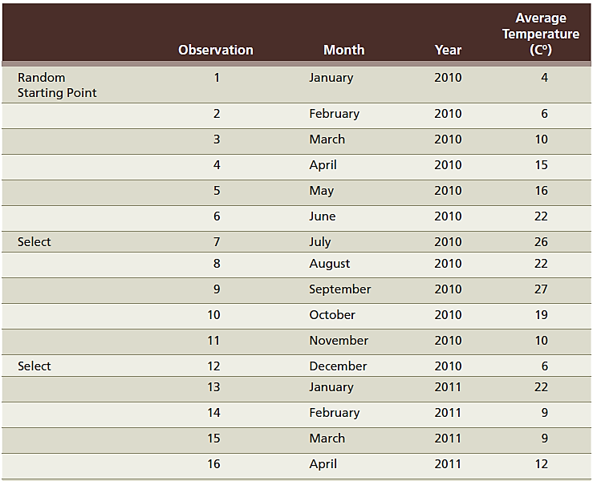
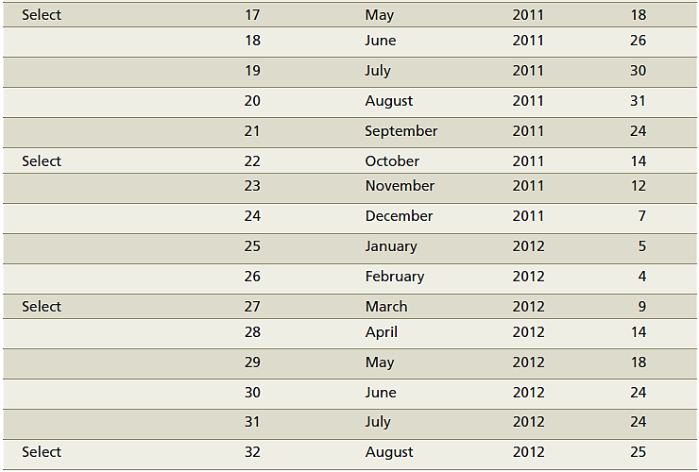
EXHIBIT 12.4 Systematically Sampling from a List

Slide 33
Cluster Sampling
The primary sampling unit is no longer the individual element in the population (e.g., grocery stores) but a larger cluster of elements located in proximity to one another (e.g., cities)
The area sample is the most popular type of cluster sample
Cluster sampling is classified as a probability sampling technique because of either the random selection of clusters or the random selection of elements within each cluster

Slide 34
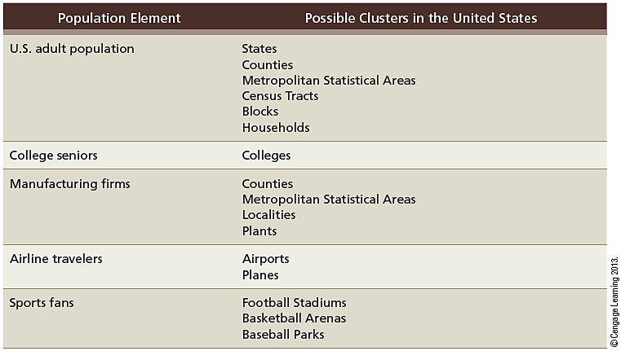
EXHIBIT 12.6 Examples of Clusters

Slide 35
Multistage Area Sampling
Involves two or more steps that combine some of the probability techniques already described
Typically, geographic areas are randomly selected in progressively smaller (lower-population) units
The Bureau of the Census provides maps, population information, demographic characteristics for population statistics, etc., by several small geographical areas
May be useful in sampling

Slide 36
What Is the Appropriate Sample Design?
Degree of accuracy
Cost savings is a trade off for a reduction in accuracy
Resources
If the researcher’s financial and human resources are restricted, certain options will have to be eliminated
Time
Time constraints restrict sampling techniques to simpler methods

Slide 37
What Is the Appropriate Sample Design? (cont’d.)
Advance knowledge of the population
A lack of adequate lists may automatically rule out systematic sampling, stratified sampling, or other sampling designs
National versus local project
Geographic proximity of population elements will influence sample design
When population elements are unequally distributed geographically, a cluster sample may become much more attractive

