Slide 1
Chapter 10
Measurement and Attitude Scaling

Slide 2
LEARNING OUTCOMES
Determine what things need to be measured to address a research question
Distinguish levels of scale measurement
Create an index or composite measure
Assess scale reliability and validity
Understand why the concept of attitude is so important in marketing research
Design a scale that measures an attitudinal concept
Implement a multi-attribute model

Slide 3
Introduction
Anyone who has ever followed a recipe knows the importance of good measurement
Just as in the culinary arts, researchers can measure business and marketing in more than one way
Researchers often may have to use imperfect measurement devices
Measure a concept poorly and the “recipe” is a likely disaster
Only in this case, the “recipe” is usually an important business decision poorly made instead of a ruined dish

Slide 4
What Needs to Be Measured?
Business and marketing concepts can often be measured in more than one way
Before the measurement process can be defined, researchers have to decide exactly what it is that needs to be produced
The decision statement, corresponding research questions, and research hypotheses can be used to decide what concepts need to be measured

Slide 5
What Needs to Be Measured? (cont’d.)
Measurement is the process of describing some property of a phenomenon of interest usually by assigning numbers in a reliable and valid way
When numbers are used, the researcher must have a rule for assigning a number to an observation in a way that provides an accurate description
All measurement systems present the potential for error

Slide 6
Concepts
Generalized ideas that represent something of meaning
Concepts such as age, sex, and number of children are relatively concrete properties and present few problems in either definition or measurement
Concepts such as brand loyalty, personality, and so on, are more abstract and are more difficult to both define and measure

Slide 7
Operational Definitions
Researchers measure concepts through a process known as operationalization
A process that involves identifying scales that correspond to variance in the concept
Scales provide:
A range of values that correspond to different values in the concept being measured
Correspondence rules that indicate that a certain value on a scale corresponds to some true value of a concept, hopefully in a truthful way

Slide 8
Variables
Researchers use variance in concepts to make diagnoses
Variables capture different concept values
Scales capture variance in concepts and as such, the scales provide the researcher’s variables
Once a research project is underway, there is little difference between a concept and a variable

Slide 9
Levels of Scale Measurement
Important because it determines the mathematical comparisons that are allowed
The four levels of scale measurement
Nominal
Ordinal
Interval
Ratio

Slide 10
Nominal Scales
Represent the simplest type of scale and assign a value to an object for identification or classification purposes
The value can be but does not have to be a number since no quantities are being represented
A qualitative scale
Useful even though they can be considered elementary
Marketing researchers use nominal scales quite often

Slide 11
Nominal Scales (cont’d.)
Arbitrary in the sense that each label can be assigned to any of the categories without introducing error
Examples
Uniform numbers
Airport terminals
School bus numbers

Slide 12
Ordinal Scales
Have nominal properties
Allow things to be arranged based on how much of some concept they possess
Include ranking scales
Are somewhat arbitrary
Example: “win,” “place,” and “show” in a horse race tells which horse was first, second, and third, but does not tell by how much a horse won

Slide 13
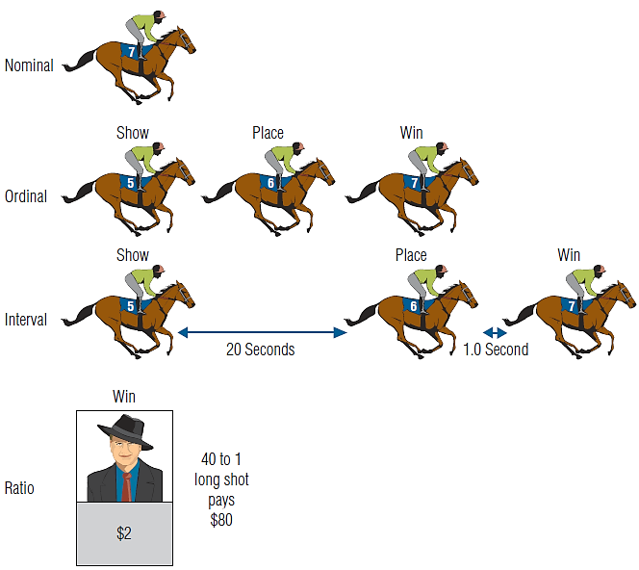
EXHIBIT 10.2 Nominal, Ordinal, Interval, and Ratio Scales Provide Different Information

Slide 14
Interval Scales
Have both nominal and ordinal properties
Capture information about differences in quantities of a concept
Classic example: Fahrenheit temperature scale:
80 degrees is hotter than 40 degrees
One cannot conclude that the 40° is twice as cold as 80°
Illustration: convert the temperatures to the Celsius scale 80° F = 26.7° C and 40° F = 4.4° C.
Do not exactly represent some phenomenon

Slide 15
Ratio Scales
Represents the highest form of measurement
Have all the properties of interval scales with the additional attribute of representing absolute quantities
Represent absolute meaning
Provide iconic measurement

Slide 16
Ratio Scales (cont’d.)
Zero, therefore, has meaning in that it represents an absence of some concept
An absolute zero is a defining characteristic in determining between ratio and interval scales
For example, money is a way to measure economic value

Slide 17
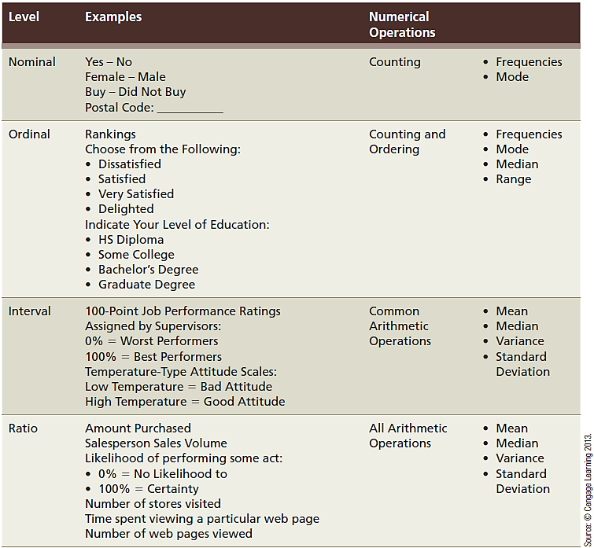
EXHIBIT 10.3 Facts About the Four Levels of Scales

Slide 18
EXHIBIT 10.3 Facts About the Four Levels of Scales (cont’d.)

Slide 19
Reliable and Valid Measures
An attribute is a single characteristic or fundamental feature of an object, person, situation, or issue
Attribute assessment is common in marketing research
The measures of attributes are often combined to represent some less concrete concept

Slide 20
Reliability
An indicator of a measure’s internal consistency
A measure is reliable when different attempts at measuring something converge on the same result
When the measuring process provides reproducible results, the measuring instrument is reliable

Slide 21
Coefficient Alpha (α)
Represents internal consistency by computing the average of all possible split-half reliabilities for a multiple item scale
The coefficient demonstrates whether or not the different items converge
Ranges in value from 0 (no consistency) to 1 (complete consistency)
0.80 - 0.96: very good reliability
0.70 - 0.80: good reliability
0.60 - 0.70: fair reliability
Below 0.60: poor reliability

Slide 22
Test-Retest Reliability
The test-retest method of determining reliability involves administering the same scale or measure to the same respondents at two separate times to test for stability
If the measure is stable over time, the test, administered under the same conditions each time, should obtain similar results
Represents a measure’s repeatability

Slide 23
Test-Retest Reliability (cont’d.)
Reliability is a necessary but insufficient condition for validity
A reliable scale may not be valid
A reliable but invalid instrument will yield consistently inaccurate results

Slide 24
Validity
Good measures should be both precise (i.e., reliable) and accurate (i.e., valid).
Validity is the accuracy of a measure or the extent to which a score truthfully represents a concept
Achieving validity is not a simple matter
Addresses the problem of whether a measure indeed measures what it is supposed to measure
When a measure lacks validity, any conclusions based on that measure are also likely to be faulty

Slide 25
Reliability versus Validity
The differences between the two are illustrated with rifle targets (see Exhibit 10.5)
A: The shots from the older gun are scattered ► low reliability
B: The shots from the newer gun are closely clustered and on target ► high reliability and validity
C: The shots from a newer gun are closely clustered but off target ► high reliability but low validity

Slide 26
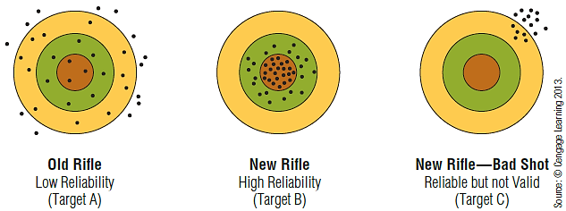
EXHIBIT 10.5 Computing a Composite Scale

Slide 27
What Is an Attitude?
An enduring disposition to respond consistently in a given manner to various aspects of the world, including persons, events, and objects
There are three components of attitude:
Affective component – expresses how much affinity someone has toward the relevant matter
Cognitive component – represents an individual’s awareness of the relevant matter
Behavioral component – represents the action that corresponds to a certain type of attitude

Slide 28
Attitude Measures and Scaling
A remarkable variety of techniques has been devised to measure attitudes, stemming in part from lack of consensus about the exact definition of the concept
The affective, cognitive, and behavioral components of an attitude may be measured by different means, i.e., direct to indirect, physiological to verbal, etc.

Slide 29
Category Scales
Rating scales that consist of several response categories, often providing respondents with alternatives to indicate positions on a continuum
Ordered categories based on a particular descriptive or evaluative dimension can provide further information
Measure attitude with greater sensitivity than a two-point response scale
Question wording is an extremely important factor in the usefulness of these scales

Slide 30
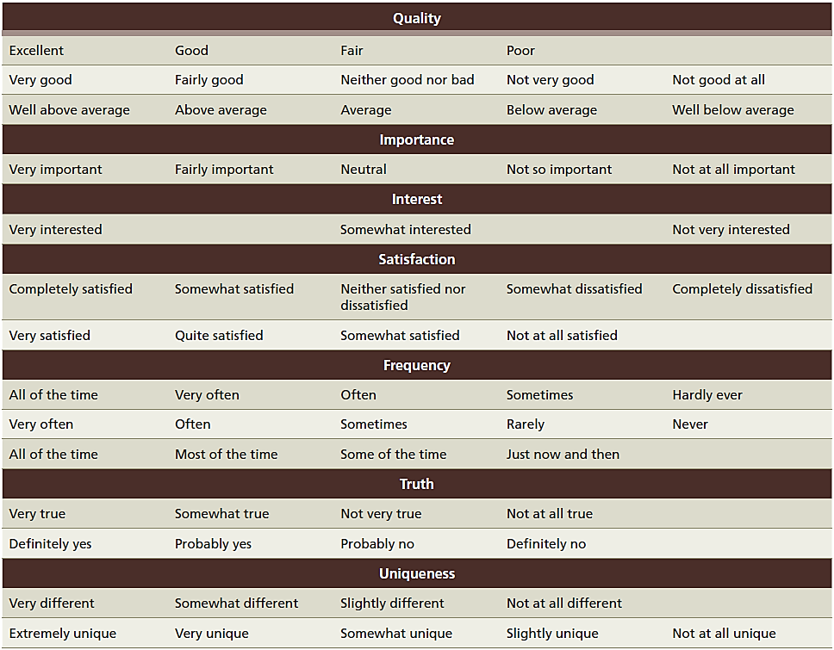
EXHIBIT 10.7 Commonly Applied Category Scale Descriptions

Slide 31
EXHIBIT 10.7 Commonly Applied Category Scale Descriptions (cont’d.)

Slide 32
The Likert Scale
Respondents indicate their attitudes by checking how strongly they agree or disagree with carefully constructed statements, ranging from very positive to very negative attitudes
Individuals generally choose from approximately five, e.g., “strongly agree,” “agree,” “uncertain,” “disagree,” and “strongly disagree”
Researchers assign scores to each possible response (e.g., 1, 2, 3, 4, and 5, respectively)
Attitude scores are at best interval and not ratio

Slide 33
Selecting Items for a Likert Scale
A researcher may use multiple items to represent a single attitudinal concept and generate a large number of statements before putting together the final questionnaire
A pretest may be conducted using these items, allowing for an item analysis to be performed
Allows for selecting items that evoke a wide response

Slide 34
Semantic Differential
A scale type that has respondents describe their attitude using a series of bipolar rating scales
Bipolar adjectives—such as “good” and “bad,” “modern” and “old-fashioned,” or “clean” and “dirty”—anchor both ends (or poles) of the scale
Semantic differentials and meaning
The validity of the semantic differential depends on finding scale anchors that are semantic opposites

Slide 35
EXHIBIT 10.8 An Example of a Semantic Differential Scale

Slide 36
Ranking
Consumers often rank order their preferences
An ordinal scale may be developed by asking respondents to rank order (from most preferred to least preferred) a set of objects or attributes
The ranking scale suffers from inflexibility in that if we know how someone ranked five out of six alternatives, we know the answer to the sixth

Slide 37
Direct Assessment of Consumer Attitudes
Attitudes, as hypothetical constructs, cannot be observed directly
One’s attitude can be inferred by the way he or she responds to multiple attitude indicators
The decision whether to use ranking, sorting, rating, or a choice technique is determined by:
The problem definition
The type of statistical analysis desired

Slide 38
How Many Scale Categories or Response Positions?
A matter of sensitivity
More categories are better than fewer
Be careful that the number category responses does not become taxing to respondents

Slide 39
Single or Multiple Items?
Depends on:
The complexity of the issue to be investigated
The number of dimensions the issue contains
The level of abstraction of the phenomenon
The researcher’s conceptual definition will be helpful in making this choice

