Slide 1
Chapter 8
Observation

Slide 2
LEARNING OUTCOMES
Discuss the role of observational technologies as marketing research tools
Know the difference between direct and contrived observation
Identify ethical issues particular to research using observation
Explain the observation of physical objects and message content
Describe major types of mechanical observation
Summarize techniques for measuring physiological reactions

Slide 3
Introduction
Scientists rely heavily on observation
Observations play a key role in discovering ideas and developing theories
Inductive learning begins with collections of observations

Slide 4
Technology and Observation in Marketing Research
Observation—the systematic process of recording the behavioral patterns of people, objects, and occurrences as they take place
Advances in technology have given a bigger role for observational research tools in marketing research

Slide 5
Technology and Observation in Marketing Research (cont’d.)
Observation can be a useful part of either qualitative or quantitative research
Scientific observation addresses a research question aimed at discovering market knowledge

Slide 6
Technological Advances and Observation
Internet, cellular, social networking and near-field technologies have fueled big data analytics
Because most of this data gathering involves no two-way communication (no survey or interview), these types of data qualify as observational
They leave behind a systematic recording of what people actually did
These technologies enable data collection to be automated

Slide 7
What Can Be Observed?
Physical movements
Verbal behavior
Expressive behavior and physiological reactions
Spatial tensions and locations
Temporal patterns
Physical objects
Verbal and pictorial records
Neurological activity
Internet activities
Geographical information
Physical distribution

Slide 8
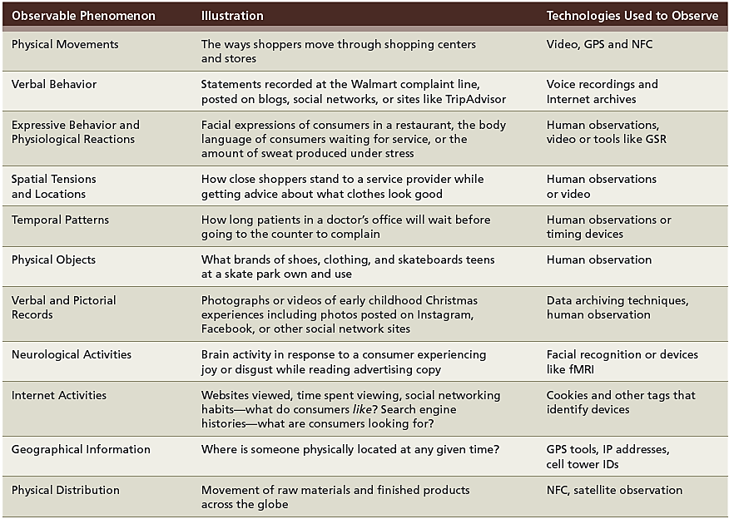
EXHIBIT 8.1 Different Types of Observable Behaviors Tracked by Marketing Research

Slide 9
Disadvantages of Observation
Behavior can be observed, but motives cannot
Analytical models do better with predicting behavior than explaining it
Observation period is often too short

Slide 10
The Nature of Observation Studies
Mechanical observation, as performed by supermarket scanners or traffic counters, can very accurately record behavior that is routine, repetitive, or programmatic
Unobtrusive observation—no communication with the person being observed is necessary so that he or she is unaware that he or she is an object of research

Slide 11
The Nature of Observation Studies (cont’d.)
Visible observation—observation in which the observer’s presence or mechanical measurement device is obviously known to the subject
Hidden observation—observation in which the subject is unaware that observation is taking place
Observations are free from nuisances such as social desirability bias or memory problems

Slide 12
Observation of Human Behavior
Behavioral scientists have recognized that nonverbal behavior can be a communication process by which individuals exchange meanings
Head nods, smiles, raised eyebrows, winks, and other facial expressions or body movements serve as communication symbols
Observation of nonverbal communication may hold considerable promise for the marketing researcher

Slide 13
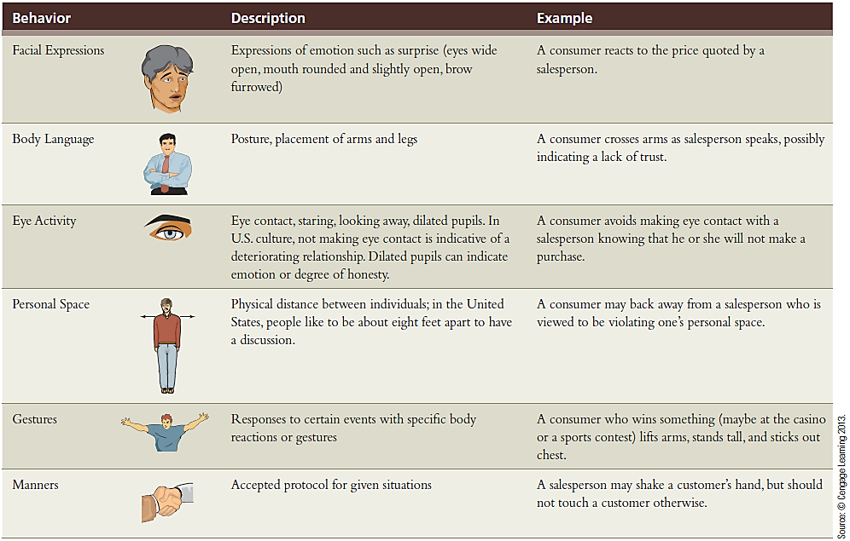
EXHIBIT 8.2 Observing and Interpreting Nonverbal Communication

Slide 14
Direct and Contrived Observation
Direct observation—a straightforward attempt to observe and record what naturally occurs
The investigator does not create an artificial situation
Contrived observation—observation in which the investigator creates an artificial environment in order to test a hypothesis
Can increase the frequency of certain behavior patterns
If situations are not contrived, the research time spent waiting and observing would expand considerably

Slide 15
Why Use Direct Observation?
Straightforward
Economical
Obtain data quickly and easily
Often the most accurate way to gather data
Has limited flexibility because not all phenomena are observable

Slide 16
Errors Associated with Direct Observation
When human observers record behaviors, the observer may record events subjectively
Observer bias—a distortion of measurement resulting from the cognitive behavior or actions of a witnessing observer
The observer should record as much detail as possible
Pace of events, observer’s memory, observer’s writing speed, and other factors limit the detail of what can be recorded

Slide 17
Ethical Issues in the Observation of Humans
Observation is sometimes akin to spying
Raises the question of the respondent’s right to privacy
If the researcher obtains permission to observe someone, the subject may not act naturally
New technologies afford opportunities to observe behaviors of interest to marketing managers
Deep-packet inspection refers to the ability of an Internet service provider to read data transmitted by users

Slide 18
Ethical Issues in the Observation of Humans (cont’d.)
Four questions to address ethics:
Is the behavior being observed commonly performed in public?
Is the behavior performed in a setting in which the anonymity of the person being observed is assured?
Has the person agreed to be observed?
Has the person been adequately notified that their behavior (including data transfers) is being observed?
If the answer to these questions is “yes”, then the study is probably ethical
If the answer is “no”, input from IRB is needed

Slide 19
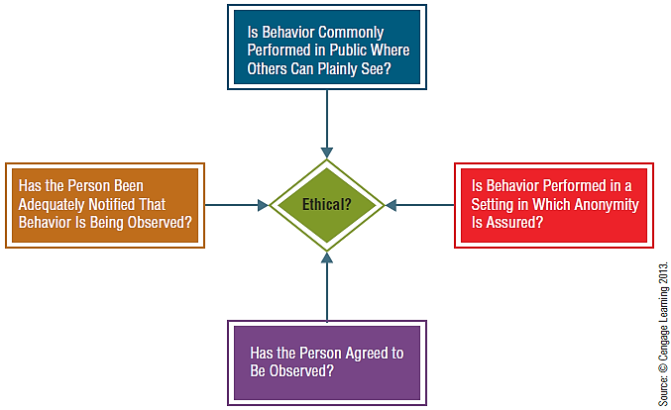
EXHIBIT 8.3 Is the Observation Ethical?

Slide 20
Mechanical Observation
Types:
Television, radio, and digital monitoring
Monitoring web traffic
Scanner-based research
Camera surveillance
Smartphones

Slide 21
Monitoring Web Traffic
Web traffic and buzz
Click-through rate—proportion of people who are exposed to a hyper-linked Internet ad who actually click on its hyperlink to enter the website
Conversation volume—measure of the amount of Internet postings that involve a specific name or term
CTR and online advertising
Applying the CTR to the amount spent on the advertisement gives the advertiser a cost per click
If the company makes more than fifty cents per customer clicking through, the ads are effective

Slide 22
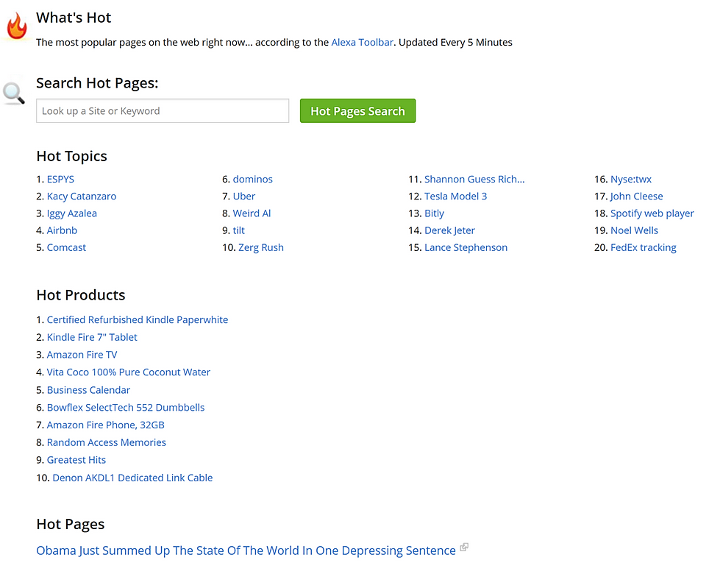
EXHIBIT 8.4 Using Web Stat Providers

Slide 23
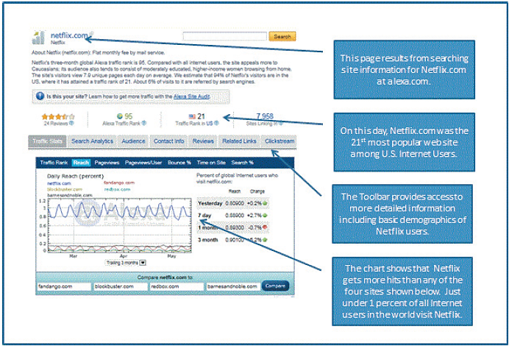
EXHIBIT 8.4 Using Web Stat Providers (cont’d.)
Source: www.netflix.com

Slide 24
Scanner-Based Research
Scanner-based consumer panel—a type of consumer panel in which participants’ purchasing habits are recorded with a laser scanner rather than a purchase diary
Scanner data—mechanical observation form that requires no input from customers

Slide 25
Camera Surveillance
Cameras planted inconspicuously in places can be useful in marketing research
Shopping center security video can help identify problems with merchandising and the types of things that attract consumers to come into and remain in an environment

Slide 26
Smartphones
Observations from smartphones might reveal:
When people are happy based on their message content
Their political opinions
When the customer may be unhappy with their smartphone or service provider
Where a person likes to party on the weekend
What types of websites a person likes
Like other areas, technology may outpace the ethics of using this type of data

Slide 27
Measuring Physiological Reactions
Eye-tracking—used to observe eye movements
Pupilometer—used to observe and record changes in the diameter of a subject’s pupils
Psychogalvanometer—measures galvanic skin response, a measure of involuntary changes in the electrical resistance of the skin
Voice-pitch analysis—a physiological measurement technique that records abnormal frequencies in the voice that are supposed to reflect emotional reactions to various stimuli

