Slide 1
Chapter 7
Survey Research

Slide 2
LEARNING OUTCOMES
Define surveys and describe the type of information that may be gathered in a survey
Identify sources of error in survey research
Summarize the ways researchers gather information through personal interviews
Know the advantages and disadvantages of conducting surveys using personal interviews, telephone calls, smartphone, tablet or PC
Appreciate the importance of pretesting questionnaires
Describe ethical issues that arise in survey research

Slide 3
Introduction
Respondents are the people who answer questions during a survey
A survey represents a way of describing public opinion by collecting primary data through communicating directly with individual sampling units
A sample survey is a more formal term for a survey emphasizing that respondents’ opinions presumably represent a sample of the larger target population’s opinion

Slide 4
The Types of Information Gathered Using Surveys
Questions about product use, desirable features, and Web habits help with product development and advertising messages
Surveys gather information to assess consumer knowledge and awareness of products, brands, or issues and to measure consumer attitudes, feelings and behaviors
Certain aspects of surveys may be qualitative

Slide 5
Advantages and Disadvantages of Survey Research
Advantages
Quick
Inexpensive
Efficient
Accurate
Flexible
Disadvantages
Can have errors, which cause misleading results

Slide 6
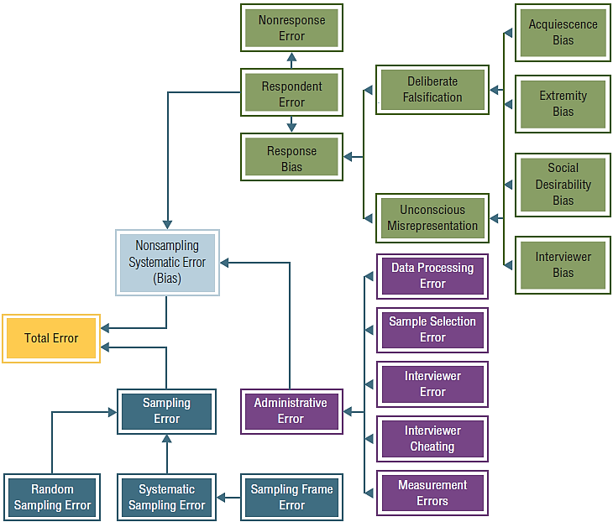
EXHIBIT 7.1 Source of Survey Error That Distract from Representativeness

Slide 7
Sources of Error in Surveys
Random versus systematic sampling error
Sampling error—error arising because of inadequacies of the actual respondents to represent the population of interest
Systematic error—error resulting from some imperfect aspect of the research design
Population parameter—refers to some true value of a phenomenon within a population
Sample bias—a persistent tendency for the results of a sample to deviate in one direction from the true value of the population parameter

Slide 8
Respondent Error
A category of sample bias resulting from some respondent action such as lying or inaction
Two major categories
Nonresponse error bias
Response bias

Slide 9
Nonresponse Error
The statistical difference between a survey that includes those who responded and those who failed to respond
Nonrespondents—sample members who are mistakenly not contacted or who refuse to provide input in the research
No contacts—potential respondents who do not receive the request to participate in the research
Refusals—people who are unwilling to participate
Self-selection bias—people who feel strongly about a subject are more likely to respond

Slide 10
Response Bias
A bias that occurs when respondents either consciously or unconsciously answer questions with a certain slant that misrepresents the truth
Can include two broad categories:
Deliberate falsification
Unconscious misrepresentation

Slide 11
Administrative Error
An error caused by the improper administration or execution of the research task
Types:
Data processing error—incorrect data entry, incorrect computer programming, or other procedural errors during data analysis
Sample selection error—improper sample design or sampling procedure execution
Interviewer error—mistakes made by interviewers
Interviewer cheating—filling in fake answers or falsifying questionnaires during an interview

Slide 12
Ways Marketing Researchers Conduct Survey Interviews
Interactive survey approaches
Communication that allows spontaneous two-way interaction between the interviewer and the respondent
Noninteractive media
Two-way communication by which respondents give answers to static questions that do not allow a dynamic dialog

Slide 13
Conducting Personal Interviews
Interactive face-to-face communication in which an interviewer asks a respondent to answer questions
Advantages of personal interviews
Opportunity for feedback
Probing complex answers
Length of interview
Completeness of questionnaire
Props and visual aids
High participation rate

Slide 14
Conducting Personal Interviews (cont’d.)
Disadvantages of personal interviews
Interviewer bias
Respondents act differently with different interviewers
Interviewer’s tone of voice and appearance are influential
Lack of anonymity of respondent
Cost: personal interviews are expensive

Slide 15
Other Interview Types
Mall intercepts
Personal interviews conducted in a shopping center
Door-to-door interviews
Personal interviews conducted at respondents’ doorsteps in an effort to increase the participation rate in the survey
Callbacks
Attempts to try and contact those sample members missed in the initial attempt
CATI—acronym for computer-assisted telephone interviews

Slide 16
Telephone Interviews: Landline Phones
No call legislation
Marketers cannot call phone numbers listed on the do-not-call registry
Robocalls— a phone call conducted by an autodialer and using recorded voice message system
Ownership
Coverage bias—misrepresentation of a population by survey results that disproportionately represent one group over another

Slide 17
Telephone Interviews: Mobile Phones
In the United States, telemarketing toward mobile phone numbers is prohibited unless the user opts in
The area codes for mobile phones are not necessarily geographic
The phones have varying abilities for automated responses and differing keypads

Slide 18
Phone Interview Characteristics
Random digit dialing
Landline versus mobile phone results
Speed
Cost
Absence of face-to-face contact
Cooperation
Incentives to respond
Lack of visual medium

Slide 19
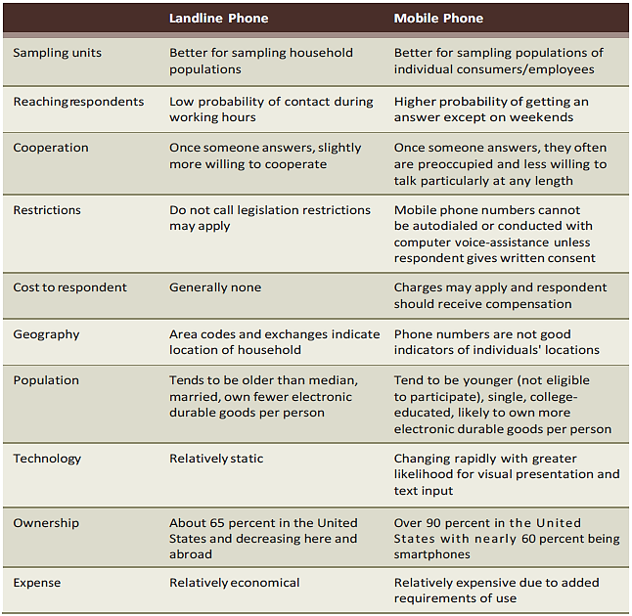
EXHIBIT 7.2 Comparing and Contrasting Landline and Mobile Phones

Slide 20
EXHIBIT 7.2 Comparing and Contrasting Landline and Mobile Phones (cont’d.)

Slide 21
Surveys Using Self-Administered Questionnaires
Self-administered questionnaires—surveys in which the respondent takes the responsibility for reading and answering the questions without having them stated orally by an interviewer

Slide 22
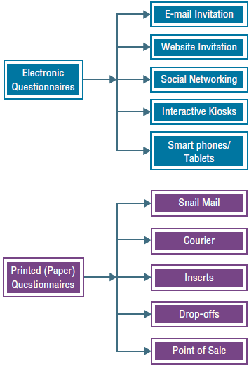
EXHIBIT 7.3 Options for Self-Administered Questionnaires

Slide 23
Mail Questionnaires
Geographic flexibility
Cost
Respondent convenience
Respondent anonymity
Absence of interviewer
Standardized questions
Time is money
Length of mail questionnaire—10 minutes or less

Slide 24
Response Rates
The number of questionnaires returned and completed divided by the number of sample members
Increasing response rates for mail surveys
Include a cover letter
Provide incentives
Give advance notification
Keep survey sponsorship anonymous
Keying mail questionnaires with codes - the researcher knows who has responded and remove them from the sample list

Slide 25
E-Mail Surveys
Survey requests distributed through e-mail
Can include:
Survey in the body of an e-mail
Survey as an attachment
A hyperlink to a Web-based survey
Sampling and e-mail
Most people can be sampled via e-mail

Slide 26
Advantages and Disadvantages of E-Mail
Advantages
Speed
Lower cost
Faster turn around time
More flexibility
Less manual processing
Candid responses
Disadvantages
Possible lack of anonymity
Spam filters
Problems with successful delivery

Slide 27
Internet Surveys
Advantages
Speed and cost-effectiveness
Visual appeal and interactivity
Respondent participation and cooperation
Crowdsourcing—inviting many, many people; even a small percentage generates a usable sample
Accurate real-time data capture
Callbacks
Should not be used for anonymous surveys
Personalized and flexible questioning
Respondent anonymity

Slide 28
Improving Response Rates
Click-through rate
The portion of potential respondents exposed to a hyperlink to a survey who actually click through to view the questionnaire
Incentives:
Increase response rates
Prepaid incentives do better than promised incentives
Response rates increase with the size of incentive
Can influence what type of person responds
Maximizing response rate does not guarantee sample representativeness

Slide 29
Response Quality
Internet surveys are still in their infancy in many ways
Web-based survey approaches produce data that is as good as traditional landline phone surveys

Slide 30
Choosing an Appropriate Survey Approach
Questions to determine the approach
Is the assistance of the interviewer necessary?
Are respondents interested in the issues being investigated?
Will cooperation be easily attained?
How quickly is the information needed?
Will the study require a long and complex questionnaire?
How large is the budget?
Mixed-mode survey—more than one survey medium

Slide 31
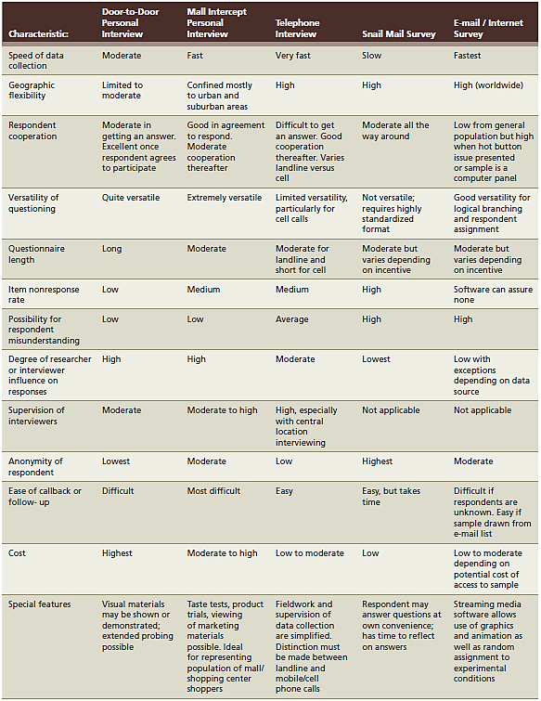
EXHIBIT 7.6 Advantages and Disadvantages of Different Survey Approaches

Slide 32
EXHIBIT 7.6 Advantages and Disadvantages of Different Survey Approaches (cont’d.)

Slide 33
Pretesting Survey Instruments
Pretesting—screening procedure that involves a trial run with a group of respondents to iron out fundamental problems in the survey design
Researchers benefit by spotting problems in the pretest
Three ways of pretesting:
Ask colleagues to screen the survey for problems
Ask the manager who asked for the survey to screen it for problems
A true pretest, or trial run, of the survey

Slide 34
Ethical Issues in Survey Research
Participants’ right to privacy
The use of deception
Respondents’ rights to be informed about the purpose of the research
The need for confidentiality
The need for honesty in collecting data
The need for objectivity in collecting data

