Slide 1
Chapter 4
The Role of Marketing Research

Slide 2
LEARNING OUTCOMES
Know when research should be conducted externally and when it should be done internally
Understand the career opportunities and career paths available within the marketing research industry
Become sensitive to the often conflicting relationship between marketing management and researchers
Understand marketing ethics and ways that researchers can face ethical dilemmas

Slide 3
LEARNING OUTCOMES (cont’d.)
Appreciate the rights and obligations of (a) research respondents—particularly children, (b) research clients or sponsors, (c) marketing researchers, and (d) society
Avoid situations involving a conflict of interest in performing marketing research

Slide 4
Who Should Do the Research?
Outside agency
  An independent research firm contracted by the company that actually will benefit from the research
In-house research
  Research performed by employees of the company that will benefit from the research

Slide 5
Do It Yourself or Let Your Fingers Do the Walking?
When to use an outside agency
  To get a fresh perspective
  To have objectivity
  When special expertise is needed
  When local expertise is needed
When to use in-house research
  When the project needs to be done quickly
  When the project needs employee collaboration
  To save money
  If secrecy is a major concern

Slide 6
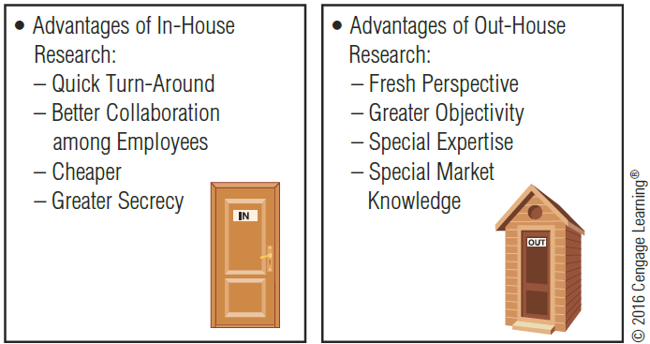
EXHIBIT 4.1 Advantages and Disadvantages of Outhouse Research

Slide 7
Working in the Marketing Research Field
Marketing research jobs are among the top career fields for recent college graduates
About three-fourths of all U.S. organizations have a department or individual responsible for marketing research
Often the term “client” is used by the research department to refer to line management—the entity for whom services are being performed

Slide 8
Research Suppliers and Contractors
Research suppliers
  Commercial providers of marketing research services
Syndicated service
  A marketing research supplier that provides standardized information for many clients in return for a fee
Standardized research services
  Companies that develop a unique methodology for investigating a specific business specialty area

Slide 9
Limited Research Service Companies and Custom Research
Limited-service research suppliers
  Specialize in particular research activities, such as syndicated service, field interviewing, data warehousing, or data processing
  Full-service research suppliers sometimes contract limited-service research suppliers companies for ad hoc marketing research projects
Custom research
  Projects that are tailored specifically to a client’s unique needs

Slide 10
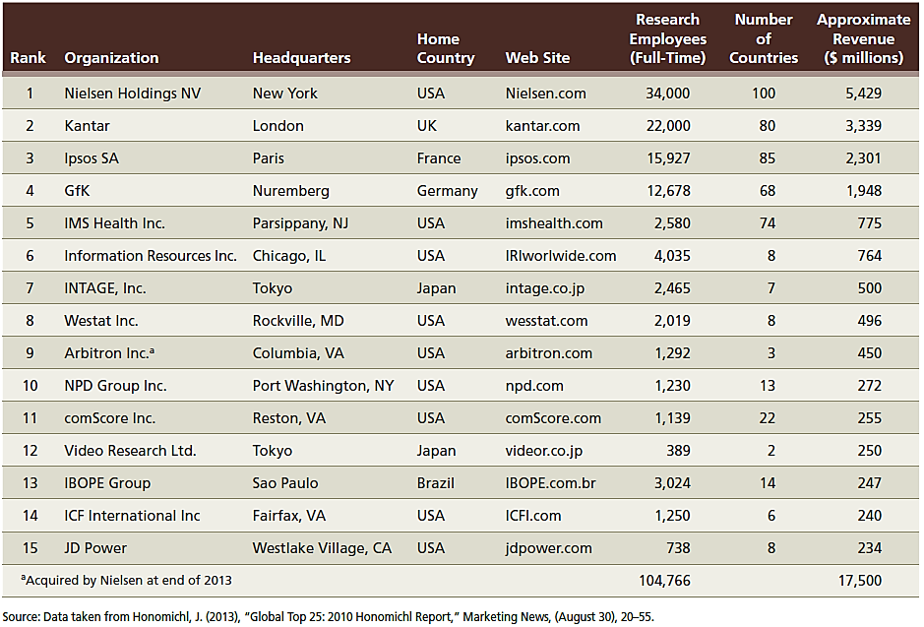
EXHIBIT 4.2 The World’s Largest Research Firms

Slide 11
Size of the Marketing Research Firm
Small firms
  Less than 100 employees
  VP of marketing may be in charge of all significant marketing research
Mid-sized firms
  100 to 500 employees
Large firms
  More than 500 employees

Slide 12
Mid-Sized Firms
Typically includes a director of marketing research
A research analyst
  Responsible for client contact, project design, preparation of proposals, selection of research suppliers, and supervision of data collection, analysis, and reporting activities
Research assistants (or associates)
  Provide technical assistance

Slide 13
Mid-Sized Firms (cont’d.)
Manager of decision support systems
  Supervises the collection and analysis of customer relationship management (CRM) data
A forecast analyst
  Provides technical assistance, e.g., generating a sales forecast

Slide 14
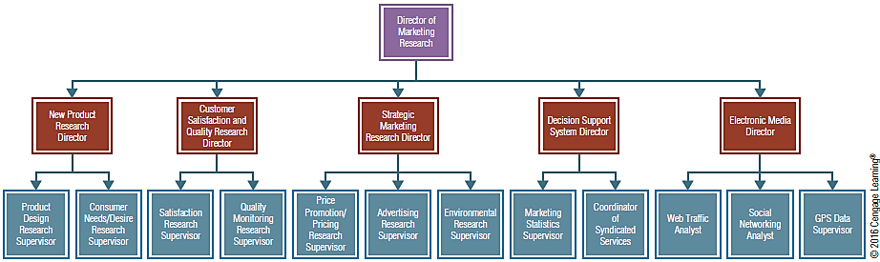
EXHIBIT 4.3 Example of a Large Market Research Firm’s Organizational Chart

Slide 15
The Director of Marketing Research as a Manager
Problems in directing research
  Skilled research professionals like conducting research better than managing people
  The research management role often is not formally recognized
  Outstanding research professionals often have trouble delegating responsibility

Slide 16
Conflict Between Marketing Management and Marketing Research
Sources of conflict
  Research that implies criticism
  Money
  Time
Sources of error when studies are rushed
  Conducting a study that is not needed
  Addressing the wrong issue
  Sampling difficulties
  Inadequate data analysis

Slide 17
Conflict Between Marketing Management and Marketing Research (cont’d.)
Intuitive decision making
  Managers sometimes resist research because results may prove counter to managerial intuition or desires
  Intuition is not a replacement for informed market intelligence
Future decisions based on past evidence
  Managers wish to predict the future, but researchers measure only current or past events
  Researchers use the past to predict the future

Slide 18
Reducing Conflict between Management and Researchers
Ways to reduce conflict
  Involve researchers and decision-makers working closely together
  State clear job descriptions
  Implement better planning and an annual statement of the research program
  Communicate research findings and research designs

Slide 19
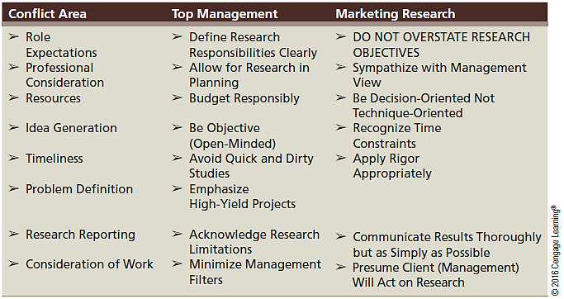
EXHIBIT 4.4 Improving Two-Way Communication to Reduce Conflict

Slide 20
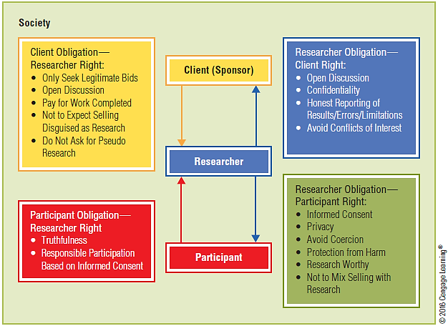
EXHIBIT 4.5 The Rights and Obligations of Marketing Research

Slide 21
Rights and Obligations of the Research Participant
Participant’s right to privacy
  Informed consent means that the individual understands what the researcher wants him or her to do and agrees to be a participant in the research study
  The ethical responsibilities vary depending on whether participation is active or passive

Slide 22
The Obligation to Be Truthful
When someone willingly consents to participate actively, the researcher assumes he or she will provide truthful answers
Honest cooperation is the primary obligation of the research participant
The subject has the right to expect confidentiality
  Confidentiality means that researchers will not share any individual’s information others

Slide 23
Protection from Harm
Questions to ask to avoid harming a participant
  Has the research subject provided consent to participate in an experiment?
  Is the research subject subjected to substantial physical or psychological trauma?
  Can the research subject be easily returned to his or her initial state?
Human subjects review committee: sometimes called the Institutional Review Board (IRB)
  Reviews proposed research designs to ensure that no harm can come to any research participant

Slide 24
Rights and Obligations of the Client Sponsor (User)
Issues in the client-researcher relationship
  Ethical behavior between buyer and seller
  An open relationship with research suppliers
  An open relationship with interested parties
    Advocacy research—research undertaken to support a specific claim in a legal action or represent some advocacy group
  Privacy rights of research participants

Slide 25
Rights and Obligations of the Researcher
Marketing research firms and marketing research departments should practice good business ethics
Professional organizations with codes of ethics for marketing researchers
  American Marketing Association
  The European Society for Opinion and Market Research
  The Marketing Research Society

Slide 26
Rights and Obligations of the Researcher (cont’d.)
The researcher should not:
  Represent a sales pitch as marketing research
  Provide the name of anonymous respondents
  Breach the confidentiality of the research client or research participant
  Do research for multiple firms competing in the same market
  Disseminate false or misleading results
  Plagiarize the work of other researchers
  Violate the integrity of data gathered in the field

Slide 27
Research That Isn’t Research
Misrepresentation of research
  Honesty in presenting results
Honesty in reporting errors and limitations
  Researchers should not keep any major error occurring during the course of the study a secret
  The researcher should point out the key limitations in the research report and presentation
Confidentiality
  The researcher must abide by any confidentiality agreement with research participants

Slide 28
The Role of Society at Large
Marketing research offers benefits for individual members of and for society at large
The potential benefits of the research should always outweigh the burdens placed on members of society
Business, society and individuals all have ethical responsibilities
Marketing research value is diminished when any party breeches a responsibility

Slide 29
The Researcher and Conflicts of Interest
Conflict of interest
  Occurs when one researcher works for two competing companies

