Slide 1
Chapter 3
The Marketing
Research Process

Slide 2
LEARNING OUTCOMES
Apply marketing research in making better marketing decisions
Classify marketing research as either exploratory research, descriptive research, or causal research
List the major phases of the marketing research process and the steps within each
Understand the concepts of theory and hypothesis and the critical role they play in research
Know the difference between a research project and a research program

Slide 3
Introduction
Key ways in which researchers contribute to decision making
Helping to better define the organization’s current situation
Identifying useful decision statements and related research questions
Defining the firm’s meaning—how consumers, competitors, and employees view the firm
Providing ideas for product improvements or possible new product development

Slide 4
Introduction: Researcher’s Contributions (cont’d.)
Testing ideas that will assist in implementing marketing strategy including innovations
Examining how well a marketing theory describes marketing reality

Slide 5
Decision Making and Marketing Research
Decision making
The process of developing and deciding among alternative ways of resolving a problem or choosing from among alternative opportunities
Research’s role in the decision making process
Recognizing the nature of the problem or opportunity
Identifying how much information is currently available and how reliable it is
Determining what information is needed to better deal with the situation

Slide 6
Classifying a Decision Making Situation: A Problem or an Opportunity?
Market opportunity
A situation that makes some potential competitive advantage possible
Market problem
A situation that makes some significant negative consequence more likely
Problems are inferred from symptoms—observable cues that serve as a signal of a problem because they are caused by that problem

Slide 7
Decision Making Situation: Characterized by the Amount of Certainty or Ambiguity
Certainty
The decision maker has all the information needed to make an optimal decision
Uncertainty
The manager grasps the general nature of desired objectives, but the information about alternatives is incomplete
Ambiguity
The nature of the problem itself is unclear such that objectives are vague and decision alternatives are difficult to define

Slide 8
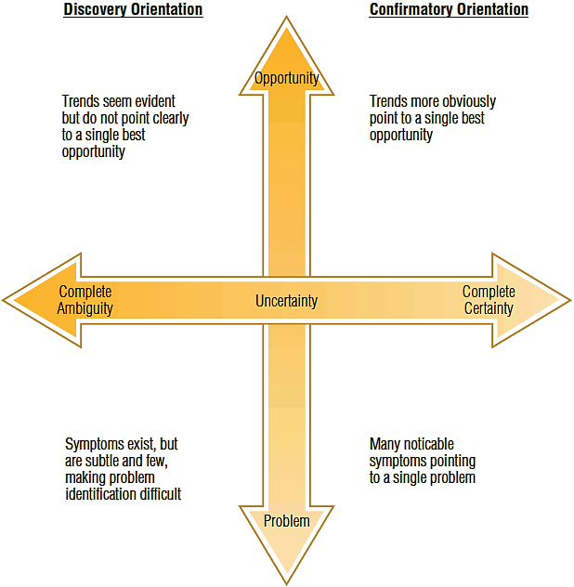
EXHIBIT 3.1 Describing Decision-Making Situations

Slide 9
Types of Marketing Research
Exploratory
Descriptive
Causal

Slide 10
Exploratory Research
Purposes of exploratory research
Clarify ambiguous situations
Discover ideas that may be potential business opportunities
Initial research clarifies and defines the nature of a problem
Does not provide conclusive evidence
Assumes and expects subsequent research

Slide 11
Exploratory Research (cont’d.)
Innovation and exploratory research
Useful in product development
Exploratory research and problem solving
Helps identify symptoms

Slide 12
Descriptive Research
Describes characteristics of objects, people, groups, organizations, or environments
Addresses who, what, when, where, why, and how questions
Accuracy: critically important
Involves considerable understanding of the nature of the problem
Does not provide direct evidence of causality

Slide 13
Descriptive Research (cont'd.)
Diagnostic analysis
Seeks to diagnose reasons for market outcomes
Focuses specifically on the beliefs and feelings consumers have about and toward competing products

Slide 14
Descriptive Research: An Example
Organic food sales
Annual global organic food sales are $80 billion
Fruits and vegetables (i.e., fresh produce) account for 40 percent of those sales
Organic meat, poultry, and fish sales are increasing rapidly
Organic coffee and tea account for 35 percent of the global organic beverage market

Slide 15
Causal Research
Allows causal inferences to be made—they identify cause-and-effect (x brought about y) relationships
Critical pieces of causality
Temporal sequence—the appropriate causal order of events
Concomitant variation—two phenomena vary together
Nonspurious association—an absence of alternative plausible explanations

Slide 16
Degrees of Causality
Absolute causality
The cause is necessary and sufficient to bring about the effect
Conditional causality
A cause is necessary but not sufficient to bring about an effect
Contributory causality
A cause need be neither necessary nor sufficient to bring about an effect
Weakest form of causality

Slide 17
Experiments
Experiment
A carefully controlled study in which the researcher manipulates a proposed cause and observes any corresponding change in the proposed effect
Experimental variable
Represents the proposed cause and is controlled by the researcher by manipulating it
Manipulation
The researcher alters the level of the variable in specific increments

Slide 18
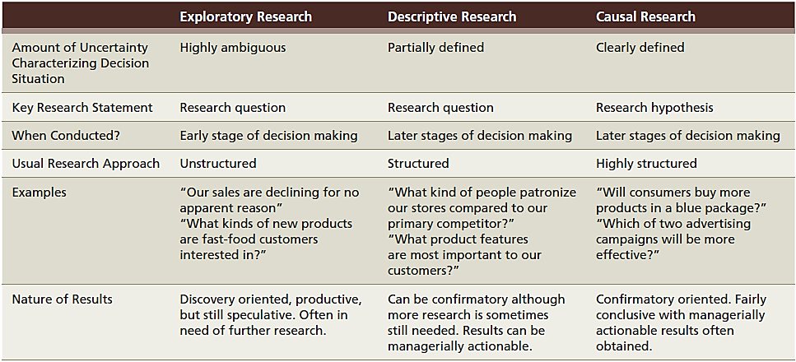
EXHIBIT 3.4 Characteristics of Different Types of Marketing Research

Slide 19
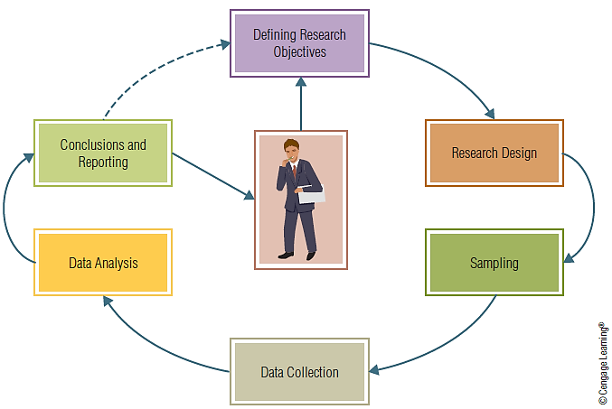
EXHIBIT 3.5 Stages of the Research Process

Slide 20
Alternatives in the Research Process
The researcher must choose among a number of alternatives during each stage of the research process
When there are severe time constraints, these constraints override validity, resulting in choosing the fastest alternative
When money and human resources are more plentiful, the appropriate path differs and likely emphasizes validity over speed

Slide 21
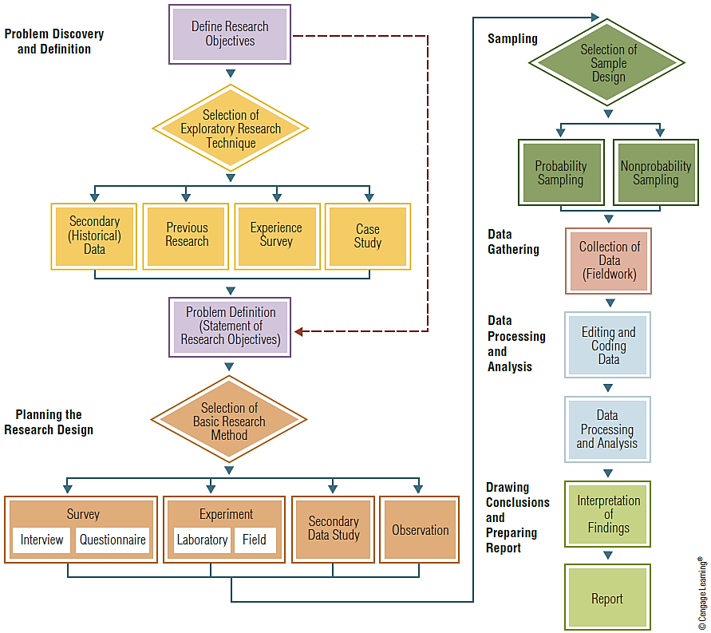
EXHIBIT 3.6 Flowchart of the Marketing Research Process
Note: Diamond-shaped boxes indicate stages in the research process in which a choice of one or more techniques must be made. The dotted line indicates an alternative path that skips exploratory research.

Slide 22
Defining the Research Objectives
Research objectives
The goals to be achieved by conducting research
Deliverables
The consulting term used to describe research objectives to a research client
Defining the managerial decision situation
The summary of the managerial decision situation, the research objectives and/or deliverables, and a basic description of the research process represent key elements of a research proposal

Slide 23
Exploratory Research
Helps researchers discover and define the decisions themselves
Techniques for obtaining insights and gaining a clearer idea of the problem
Previous research
Pilot studies
Case studies
Experience surveys

Slide 24
Exploratory Research (cont’d.)
Previous research
Check for reports of previous research within the company archives
Literature review
A directed search of published works
Reports may discuss theory and/or present empirical results relevant to the research objectives

Slide 25
Exploratory Research: Pilot Studies
Small-scale research projects that collect data from respondents similar to those to be used in the full study
Pretest
A small-scale study in which the results are preliminary and only intended to assist in design of a subsequent study
Focus group
A small group discussion about some research topic led by a moderator who guides discussion among the participants

Slide 26
Stating Research Objectives
Research objectives must be stated formally
Delineate the type of research needed
Indicate what intelligence may result
Research objectives drive the rest of the research process

Slide 27
What is a Theory?
Theory
A formal, logical explanation of some event(s) that includes predictions of how things relate to one another
The logical explanation helps the researcher know:
What variables need to be included in the study
How the variables may relate to one another

Slide 28
What is a Hypothesis?
Hypothesis
A formal statement, derived from theory, explaining some specific outcome
Empirical testing
Comparing a hypothetical proposition, e.g., a hypothesis, against reality using data
Correlation between the data and the hypothesis
“The hypothesis is supported”
OR
“The hypothesis is not supported”

Slide 29
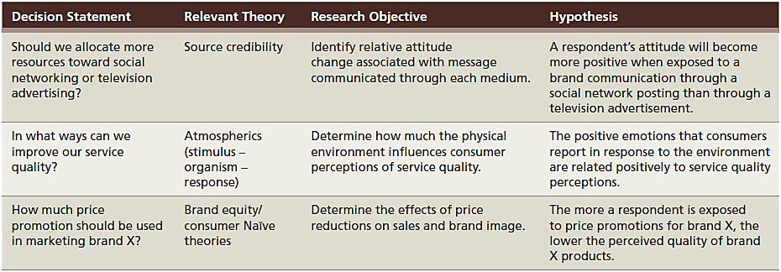
EXHIBIT 3.7 Examples of Decision Statements, Objectives, and Hypotheses

Slide 30
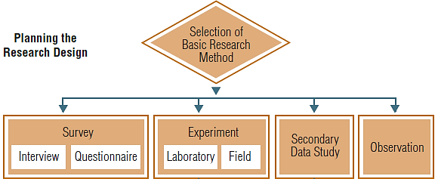
Planning the Research Design
Research design
The methods and procedures for collecting and analyzing the needed information
Provides a framework or plan of action for the research
Notes:
Portion of Exhibit 3.6

Slide 31
Selection of the Basic Research Method
Survey
A research technique in which a sample is interviewed in some form or the behavior of respondents is observed and described
Mystery shoppers act like customers while observing and recording data

Slide 32
The “Best” Research Approach
No single best research design fits all situations
Researchers often have several alternatives that can achieve a stated research objective
The ability to select the most appropriate way to implement a research project develops with experience
Inexperienced researchers often jump to the conclusion that a survey methodology is usually the best design because they are most comfortable with this method

Slide 33
Planning a Sample
Sampling
Involves any procedure that draws conclusions based on measurements of a portion of the population
Sampling decisions
Who to sample?—target population
What size should the sample be?—how big is big enough?
How to select the sampling units?—random sample or cluster-sample

Slide 34
Collecting Data
Unobtrusive methods
Methods in which research respondents do not have to be disturbed for data to be gathered
It is important to minimize errors in the data gathering process

Slide 35
Editing and Coding
Editing
Involves checking the data collection forms for omissions, legibility, and consistency in classification
Codes
Rules for interpreting, categorizing, recording, and transferring the data to the data storage media

Slide 36
Analyzing Data and Drawing Conclusions
Data analysis
The application of reasoning to understand the data that have been gathered
Conclusions:
Are determined from data analysis
Speak directly to the research questions
Are presented in a formal report and in oral or electronic presentations

Slide 37
The Research Program Strategy
Research project
A single study that addresses one or a small number of research objectives
Uses specific techniques for solving one-dimensional problems, e.g., as identifying market segments
Research program
Numerous related studies that come together to address multiple, related research objectives
Because research is a continuous process, management should view marketing research at a strategic planning level

