Slide 1
Chapter 1
The Role of Marketing Research

Slide 2
LEARNING OUTCOMES
Know what marketing research is and what it does for business
Understand the difference between basic and applied marketing research
Understand how the role of marketing research changes with the orientation of the firm
Be able to integrate marketing research results into the strategic planning process
Know when marketing research should and should not be conducted
Appreciate the way technology and internationalization are changing marketing research

Slide 3
What Is Marketing Research?
Key questions in business and marketing research
What do we sell?
How do consumers view our company?
What does our company/product mean?
What do consumers desire?

Slide 4
Marketing Research Defined
The application of the scientific method in searching for the truth about marketing phenomena
The process includes:
Idea and theory development
Problem definition
Information gathering
Analyzing data
Communicating the findings and their implications

Slide 5
Marketing Research Defined (cont’d.)
This definition suggests that marketing research information is:
Not intuitive or haphazardly gathered
Accurate and objective
Relevant to all aspects of the marketing mix
Limited by one’s definition of marketing
We explore marketing research as it applies to all organizations and institutions engaging in some form of marketing activity
Can have an applied or basic research focus

Slide 6
Applied Marketing Research
Conducted to address a specific marketing decision for a specific firm or organization
Example:
Should Green Mountain Coffee add cola to its array of pod-based beverages?

Slide 7
Basic Marketing Research
Conducted without a specific decision in mind and usually does not address the needs of a specific organization
Attempts to expand the limits of marketing knowledge in general
Not aimed at solving a pragmatic problem
Can test the validity of a general marketing theory (one that applies to all of marketing) or can be used to learn more about some market phenomenon, e.g., social networking

Slide 8
The Scientific Method
The method by which researchers go about using knowledge and evidence to reach objective conclusions about the real world
Marketing researchers apply the scientific method to understand marketing phenomena

Slide 9
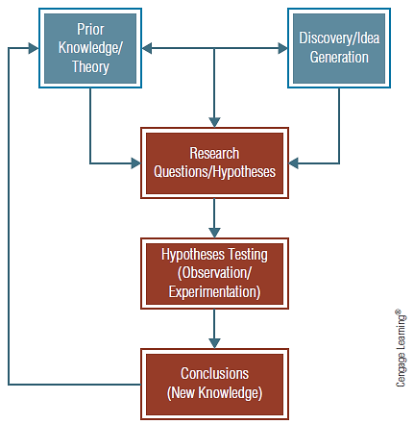
EXHIBIT 1.1 The Scientific Method

Slide 10
Marketing Research and Strategic Management Orientation
Types of strategic management orientations provide a common theme for decision-making
Product-oriented
Production-oriented
Marketing-oriented

Slide 11
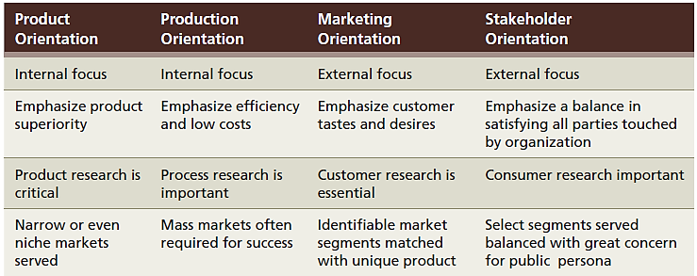
EXHIBIT 1.2 Types of Business Orientations

Slide 12
The Marketing Concept
Focuses on how a firm provides value to customers more than on the physical product or production process
A marketing-oriented firm must:
Be customer-oriented—makes decisions with a conscious awareness of their effect on the consumer
Emphasize long-run profitability—ensures continuity of firm
Adopt a cross-functional perspective—integrate marketing across other business functions

Slide 13
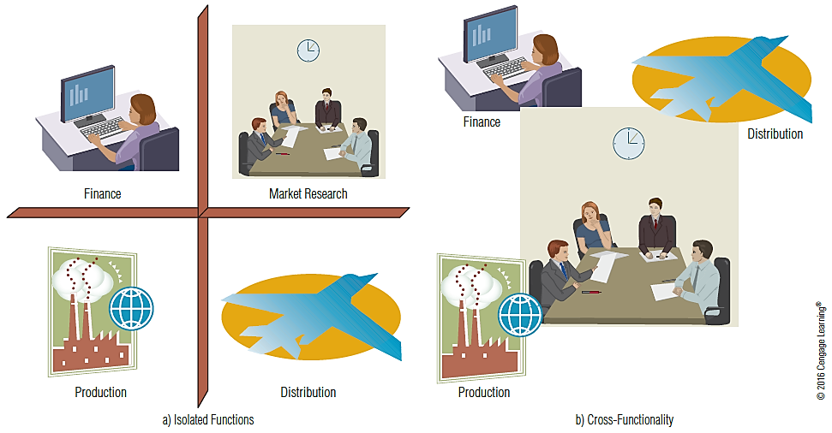
EXHIBIT 1.3 Isolation versus Cross-Functionality of Marketing in a Firm

Slide 14
Keeping Customers and Building Relationships
Relationship marketing
The idea that a major goal of marketing is to build long-term relationships with the customers contributing to their success
Views a sale not as the end of a process but as the start of the organization’s relationship with a customer—marketers want customers for life
Satisfied customers will return to a company that has treated them well

Slide 15
Marketing Research: A Means For Implementing the Marketing Concept
Tracking trends
Forecasting sales volume
Test market experiments—test new products before launch
Analysis of existing data
Use sales data to offer customers product suggestions

Slide 16
Marketing Research and Marketing Management
Developing and implementing a marketing strategy involves four stages:
Identifying and evaluating market opportunities
Analyzing market segments and selecting target markets
Planning and implementing a marketing mix that will provide value to customers and meet organizational objectives
Analyzing firm performance

Slide 17
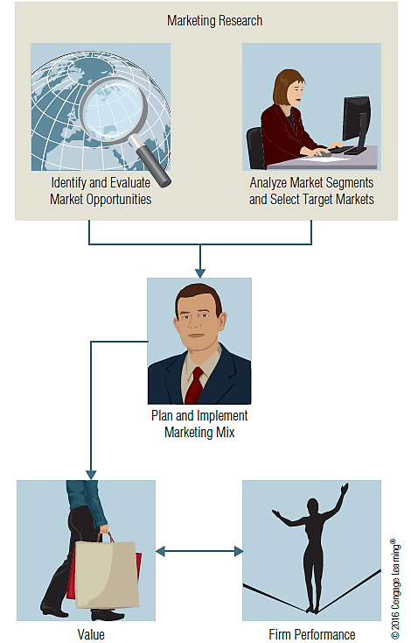
EXHIBIT 1.4 Marketing Research Cuts Decision Risk with Input That Leads to Value

Slide 18
Identifying and Evaluating Opportunities
Monitoring the competitive environment for signals indicating a business opportunity
Helps managers recognize problems and identify opportunities for enriching marketing efforts
Motivates a firm to take action to address consumer desires in a way that is beneficial to both the customers and to the firm
Identifies changes in customer needs, uses, and demand for products

Slide 19
Analyzing and Selecting Target Markets
Geo-demographics
Information describing the demographic profile of consumers in a particular geographic region
Once the company knows the geo-demographics of a market segment, it can effectively communicate with those customers by choosing media that reach that particular profile
Example: Architectural Digest magazine

Slide 20
Planning and Implementing a Marketing Mix
Marketing research can be used to support specific decisions about aspects of the marketing mix
It is essential that an overall research plan involves all elements of marketing strategy

Slide 21
Types of Marketing Mix Research: Product Research and Pricing Research
Product research
Designed to evaluate and develop new products and to learn how to adapt existing product lines
Concept testing
Product testing
Brand-name evaluation
Package testing
Pricing research
Involves finding the amount of monetary sacrifice that best represents the value customers perceive in a product after considering various market constraints

Slide 22
Types of Marketing Mix Research: Distribution Research
Distribution research
Studies aimed at selecting retail sites or warehouse locations in support of the distribution channel
Marketing channel
A network of interdependent institutions that perform the logistics necessary for consumption to occur
Supply chain
Another term for a channel of distribution, meaning the link between suppliers and customers

Slide 23
Types of Marketing Mix Research: Promotion Research
Promotion research
Investigates the effectiveness of advertising, premiums, coupons, sampling, discounts, public relations, and other sales promotions
Promotion—the communication function of the firm responsible for informing and persuading buyers

Slide 24
The Integrated Marketing Mix
Integrated marketing communication
All promotional efforts (advertising, public relations, personal selling, event marketing, and so forth) are coordinated to communicate a consistent image
Integrated marketing mix
Research studies often investigate the effects of various combinations of marketing mix elements on important outcomes like sales and image

Slide 25
Analyzing Marketing Performance
Total value management
Trying to manage and monitor the entire process by which consumers receive benefits from a company
Performance-monitoring research
Research that regularly, sometimes routinely, provides feedback for evaluation and control of marketing activity
Most common forms: market-share analysis and sales analysis

Slide 26
Analyzing Marketing Performance (cont’d.)
Marketing metrics
Quantitative ways of monitoring and measuring marketing performance

Slide 27
When is Marketing Research Needed?
The determination of the need for marketing research centers on:
Time constraints
The availability of data
The nature of the decision
Benefits versus costs—the value of the research information in relation to costs

Slide 28
When is Marketing Research Needed? (cont’d.)
Questions to consider when deciding whether to make a decision without research or to postpone the decision in order to conduct research
Will the payoff or rate of return be worth the investment?
Will the information improve the quality of the marketing decision enough to warrant the expenditure?
Is the proposed research expenditure the best use of the available funds?

Slide 29
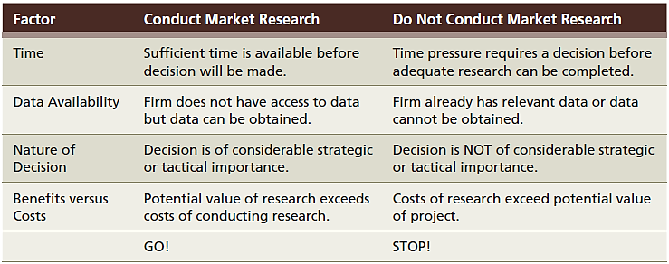
EXHIBIT 1.5 Should We Conduct Marketing Research?

Slide 30
Marketing Research in the Twenty-First Century
Communication technologies
Always “connected”—time, place, and distance are irrelevant
Decreases in information acquisition, storage, access, and transmission costs

Slide 31
Marketing Research in the Twenty-First Century (cont’d.)
Global marketing research
Business research is increasingly global
Market knowledge is essential
General information about a country’s economic conditions and political climate
Cross-validation of cultural and consumer factors
Market and competitive conditions—demand estimation

