Slide 1
Introduction to XHTML
Cont:

Slide 2
Forms
XHTML provides forms for collecting information from users
Forms contain visual components, such as buttons, that users interact with
Forms may also contain nonvisual components, called hidden inputs, which are used to store any data that needs to be sent to the server, but is not entered by the user

Slide 3
Forms Cont.
A form begins with the form element
Attribute method specifies how the form’s data is sent to the web server
The action attribute of the form element specifies the script to which the form data will be sent

Slide 4
Forms Cont.
The input element provides data to the script that processes the form
The text input inserts a text box into the form, which allows the user to input data
The label element provides users with information about the input element’s purpose
The size attribute specifies the number of characters visible in the input element
Optional attribute maxlength limits the number of characters input into a text box
The submit input submits the data entered in the form to the web server for processing
Most web browsers create a button that submits the form data when clicked
The reset input allows a user to reset all form elements to their default values

Slide 5
Appends form data to the browser request
No URL is used to process this form’s data
Creates hidden inputs not visible to the user

Slide 6
Creates a label for the text field
Inserts a text box called “name” with 25 characters visible and a 30 character limit
Inserts a submit button with “Submit” written on it
Inserts a reset button with “Clear” written on it
Ends the XHTML form

Slide 7
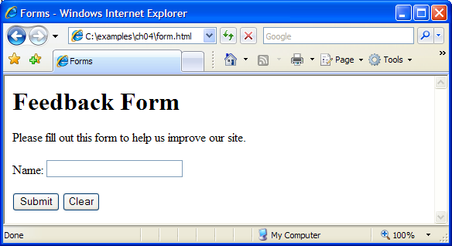

Slide 8
Forms Cont.
The textarea element inserts a multiline text box, called a text area, into a form
The number of rows in the text area is specified with the rows attribute
The number of columns (i.e., characters per line) is specified with the cols attribute
The password input inserts a password box into a form
Allows users to enter sensitive information, such as credit card numbers and passwords, by “masking” the information input with another character, usually asterisks
The actual value input is sent to the web server, not the asterisks that mask the input

Slide 9
Forms Cont.
The checkbox input allows the user to make a selection
When the checkbox is selected, a check mark appears in the checkbox. Otherwise, the checkbox is empty
Checkboxes can be used individually and in groups. Checkboxes that are part of the same group have the same name
A radio button is similar in function and use to a checkbox, except that only one radio button in a group can be selected at any time
All radio buttons in a group have the same name attribute but different value attributes.
The select input provides a drop-down list of items
The name attribute identifies the drop-down list
The option element adds items to the drop-down list

Slide 10
Forms Cont.
The br element causes most browsers to render a line break
Any markup or text following a br element is rendered on the next line

Slide 11
Hidden text field

Slide 12
Inserts a text area with 4 rows and 36 columns, whose initial text is “Enter comments here.”
Inserts an input field that displays entered text as asterisks (or another character)
Inserts several checkboxes with different labels

Slide 13
Initially sets this radio button as selected
Inserts a group of radio buttons, only one of which can be selected

Slide 14
Create a drop-down list named “rating”
Sets “Amazing” as the initially selected option

Slide 15
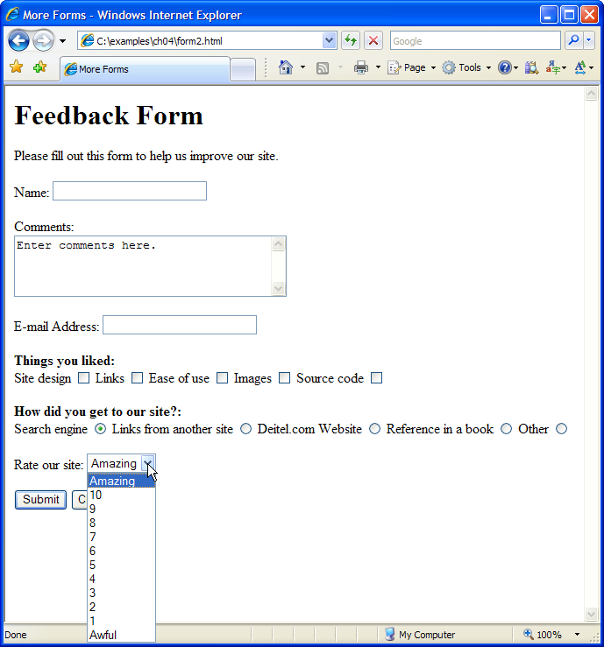

Slide 16
Internal Linking
The a tag can be used to link to another section of the same document by specifying the element’s id as the link’s href.
To link internally to an element with its id attribute set, use the syntax #id.

Slide 17
Sets the id attribute for the h1 element
Creates a link to the element in this document with id = bugs

Slide 18
Sets the id attribute for this h1 element
Creates a link to the element in this document with id = features

Slide 19
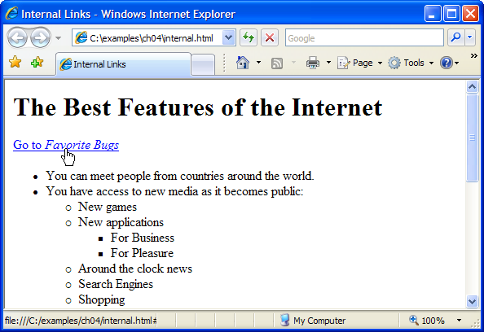
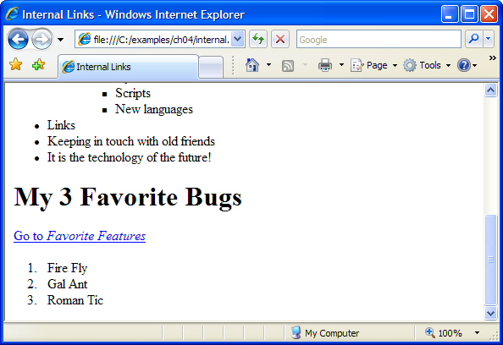

Slide 20
meta Elements
One way that search engines catalog pages, is by reading the meta element’s contents.
The name attribute identifies the type of meta element
The content attribute
keywords meta element: provides search engines with a list of words that describe a page, which are compared with words in search requests
description meta element: provides a three- to four-line description of a site in sentence form, used by search engines to catalog your site. This text is sometimes displayed as part of the search result

Slide 21
Provides keywords describing the page for a search engine
Provides the site’s description in sentence form for a search engine

Slide 22
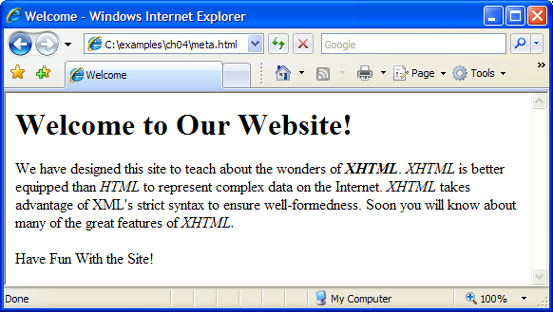

Slide 23
Software Engineering Observation
meta elements are not visible to users and must be placed inside the head section of your XHTML document. If meta elements are not placed in this section, they will not be read by search engines.

