Slide 1
X-ray film basic structure
2^{ed} Lecture
Alhanouf Alshedi
Email: aalshedi@ksu.edu.sa

Slide 2
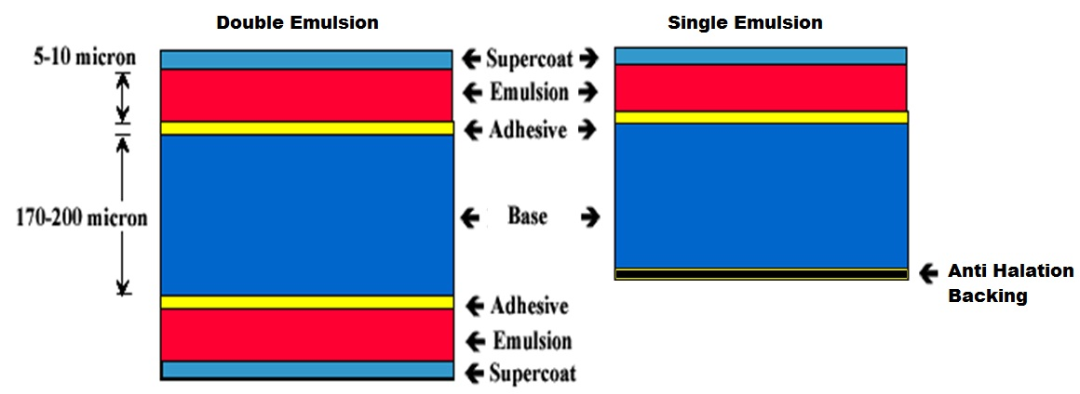
Basic structure of the film
Cross-section through a double/single emulsion film

Slide 3
X-Ray film construction
1-Film base:
The film base provides the structural support to the emulsion layer and it transmit light so image can be viewed .
Characteristics of film base :
1- Strong but flexible
2-Transparent to light
3-Uniform in thickness and color
4- Made recently from cellulose triacetate and polyester.

Slide 4
2-The emulsion layer:
Is the most important components of X-ray films
Emulsion layer consist of sensitive silver halide crystals suspended in gelatin
The crystals are tiny sand like made of two types, silver bromide (Br) and silver iodide (Ag). a mixture of 10% silver iodide and 90% silver bromide are used in medical x-ray films.
The emulsion is coated on both sides in case of double emulsion x-ray film.

Slide 5
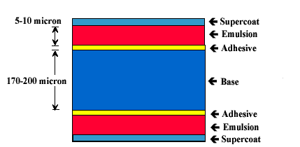
3- Adhesive (subbing layer) : is a thin layer applied between the base and the emulsion made from pure gelatin glue and some color dye this binds the emulsion layer to the film Base.
4- Super-coat layer (protective layer) : Covering the emulsion is a thin layer of pure and clear gelatin that serves to protect the emulsion from mechanical damage.

Slide 6
Characteristic of a X-ray film is a graph in which a film or film screen system responds to different amount of exposure.
Characteristics of X-ray Film:
1) FILM SPEED: Is the film’s ability to respond to light or x-ray, it describes the sensitivity of the film emulsion to exposure
2) LATITUDE: Is the film’s ability to record an acceptable range of densities (deferent variation in exposure between different parts of the object)
3) CONTRAST: Is the film ability to record differences in density across the film.
As a Film latitude increases the film contrast decreases.

Slide 7
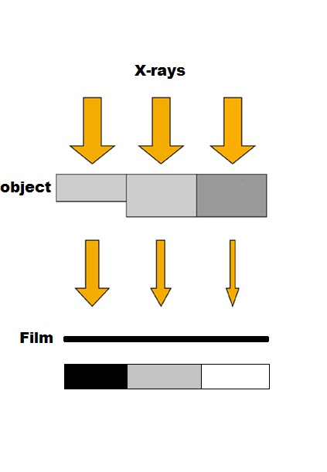
How is the image produced ?
When a radiograph of an object is made on a film, x-ray must pass through parts of different thickness. The area of the x-ray film located underneath the thick parts will receive less radiation, causing less exposure to the halide crystals and producing light areas on the finished radiographs. so the amount of radiation transmitted determines the amount of density (opacity) on the film.

Slide 8
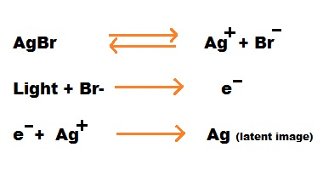
Cont.
- When x-rays, or light strike the
crystals of the sensitive silver
halide (AgBr) in the emulsion,
some of the Br- ions are liberated
and captured by the Ag+ ions.
- This change is invisible so called a "latent (hidden) image." However, the exposed grains are now more sensitive to the reduction process when exposed to a chemical solution (developer), and the reaction results in the formation of Gray, metallic silver.

Slide 9
Handling of films
The film should be handled carefully by the edges to avoid physical strains.
Hands must be clean, dry and free of lotions, etc.
Film should not be dropped or slide across a surface
Film should not be bent or pinched
Film should be opened in opened in dark room using recommended safelight system
The best conditions of usage should be: Temperature: 18-24 c, humidity: 50%RH-65%RH.

Slide 10
Storage conditions of x-ray films
The films should be kept in cool ,dry and dark place
Keep films away from dust, high temperature, any bad effective gases, x-ray, gamma ray or any other penetrating rays.
Store vertically to avoid any harmful effect caused by pressure
Each packet of film has a date of expiry, after this date film will not give a satisfactory results.

Slide 11
Film selection The selection of a film when exposing any particular component depends on a number of different factors. Listed below are some of the factors that must be considered when selecting a film
Composition, shape, and size of the part being examined .
Kilo voltages (kv) available with the x-ray equipment or Relative importance of high radiographic detail.
Selecting the proper film and developing the optimal radiographic technique usually involves arriving at a balance between a number of opposing factors. For example, if high resolution and contrast sensitivity is of overall importance, a slower and finer grained film should be used in place of a faster film.

Slide 12
Any Question?
Thank You

