Slide 1
International Business: The Challenges of Globalization
Ninth Edition, Global Edition
Chapter 1
Globalization
Copyright © 2019 Pearson Education Ltd.
Notes:
If this PowerPoint presentation contains mathematical equations, you may need to check that your computer has the following installed:
1) MathType Plugin
2) Math Player (free versions available)
3) NVDA Reader (free versions available)
This chapter defines the scope of international business and introduces us to some of its most important topics.

Slide 2
Learning Objectives
1.1 Identify the types of companies active in international business.
1.2 Explain globalization and how it affects markets and production.
1.3 Detail the forces that drive globalization.
1.4 Outline the debate about globalization’s impact on jobs and wages.
1.5 Summarize the debate about income inequality.
1.6 Outline the debate about culture, sovereignty, and the environment.
1.7 Identify how this course will help you to develop skills for your career.
Notes:
This chapter defines the scope of international business and introduces us to some of its most important topics. We begin by identifying the key players in international business today. We then present globalization, describing its influence on markets and production and the forces behind its growth. Next, we analyze each main argument in the debate over globalization in detail. This chapter closes with a model that depicts international business as occurring within an integrated global business environment.

Slide 3
Making Ray-Ban Great Again
Iconic sunglasses
Globalization
Produce and sell worldwide with little or no modification (standardization)
Large global market share keeps production and marketing costs low
Challenges
Seasonal demand
Counterfeit goods
Notes:
Before the iPhone, people needed to carry cameras to take casual photos and needed a special device for viewing GPS maps. Today the business models of some firms, like transportation company Lyft, are based on the smartphone
Globalization allows Ray-Ban to produce and sell many of its products worldwide with little or no modification. This approach reduces Ray-Ban’s production and marketing costs while supporting its global brand strategy.
Despite the benefits of globalization, Ray-Ban still encounters issues in other markets that complicate the business including the seasonal nature of sunglasses leading to uneven production and sales. Counterfeit goods are also a major issue for Ray-Ban in some markets.

Slide 4
International Business
International Business
Commercial transaction that crosses the borders of two or more nations
Imports
Goods and services purchased abroad and brought into a country
Exports
Goods and services sold abroad and sent out of a country
Notes:
Each of us experiences the results of international business transactions as we go about our daily routines. A quick glance at the “Made in” tags on your jacket, backpack, watch, wallet, or other items with you right now will demonstrate the pervasiveness of international business transactions.
International business is any commercial transaction that crosses the borders of two or more nations.
No matter where you live, you’ll be surrounded by imports—goods and services purchased abroad and brought into a country. Your counterparts around the world will undoubtedly spend some part of their day using your nation’s exports—goods and services sold abroad and sent out of a country.

Slide 5
Key Players in International Business
Large companies from the wealthiest nations
Firms from emerging markets
Small and medium-sized companies
Multinational corporation (M N C)
Born global firm
Notes:
Companies of all types and sizes and in all sorts of industries become involved in international business, yet they vary in the extent of their involvement.
Large companies from the wealthiest nations still dominate international business. But firms from emerging markets (such as Brazil, China, India, and South Africa) now vigorously compete for global market share.
Small and medium-sized companies are also increasingly active in international business, largely because of advances in technology.
A multinational corporation (MNC) is a business that has direct investments (in the form of marketing or manufacturing subsidiaries) abroad in multiple countries
International business competition has given rise to a new entity, the born global firm—a company that adopts a global perspective and engages in international business from or near its inception.

Slide 6
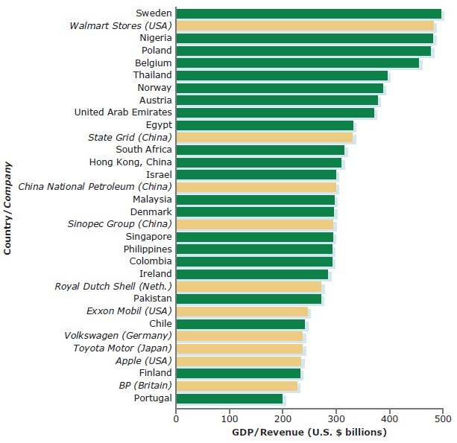
Figure 1.1 Comparing the World’s Largest Companies with Select Countries
Source: Based on data obtained from “Fortune Global 500: The 500 Largest Corporations in the World,” (fortune.com/global500/), July 2016; World Bank data set (data.worldbank.org).
Notes:
This graphic illustrates the relative power of the world’s largest multinational corporations.
If Walmart were a country, it would rank fourth behind Norway in terms of economic power.

Slide 7
Quick Study 1
What is the value of goods and services that all nations of the world export every year?
A business that has direct investments in marketing or manufacturing subsidiaries in multiple countries is called a what?
A born global firm engages in international business from or near its inception and does what else?

Slide 8
What is Globalization? (1 of 4)
Globalization: Trend toward greater economic, cultural, political, and technological interdependence among national institutions and economies
Globalization is characterized by denationalization
Globalization is different from internationalization
Notes:
Globalization is the name we give to this trend toward greater economic, cultural, political, and technological interdependence among national institutions and economies. Globalization is characterized by denationalization (national boundaries becoming less relevant) and is different from internationalization (entities cooperating across national boundaries).
Globalization of markets refers to the convergence in buyer preferences in markets around the world.
Globalization of production refers to the dispersal of production activities to locations that help a company achieve its cost-minimization or quality-maximization objectives for a good or service. This includes the sourcing of key production inputs (such as raw materials or products for assembly) as well as the international outsourcing of services.

Slide 9
What is Globalization? (2 of 4)
Globalization of Markets
Convergence in buyer preferences in markets around the world
Globalization of Production
Dispersal of production activities worldwide to minimize costs or maximize quality
Notes:
Globalization of markets refers to the convergence in buyer preferences in markets around the world.
Globalization of production refers to the dispersal of production activities to locations that help a company achieve its cost-minimization or quality-maximization objectives for a good or service. This includes the sourcing of key production inputs (such as raw materials or products for assembly) as well as the international outsourcing of services.

Slide 10
What is Globalization? (3 of 4)
Globalization of Markets
Benefits of Globalization of Markets
Reduces marketing costs
Creates new market opportunities
Levels uneven income streams
Local buyers’ needs
Global sustainability
Notes:
Reduces marketing costs: Companies that sell global products can reduce costs by standardizing certain marketing activities. Companies can achieve further cost savings by keeping an ad’s visual component the same for all markets but dubbing TV ads and translating print ads into local languages.
Creates new market opportunities: A company that sells a global product can explore opportunities abroad if its home market is small or becomes saturated.
Levels uneven income streams: A company that sells a product with universal, but seasonal, appeal can use international sales to level its income stream.
Local buyers’ needs: In the pursuit of the potential benefits of global markets, managers must constantly monitor the match between the firm’s products and markets in order to not overlook the needs of buyers. The benefit of serving customers with an adapted product may outweigh the benefit of a standardized one.
Global sustainability: Another need that multinationals must consider is the need among all the world’s citizens for sustainability—development that meets the needs of the present without compromising the ability of future generations to meet their own needs.

Slide 11
What is Globalization? (4 of 4)
Globalization of Production
Benefits of Globalization of Production
Access lower-cost workers
Access technical expertise
Access production inputs
Notes:
Access lower-cost workers: Global production activities allow companies to reduce overall production costs through access to low-cost labor.
Access technical expertise: Companies also produce goods and services abroad to benefit from technical know-how.
Access production inputs: Globalization of production allows companies to access resources that are unavailable or more costly at home. The quest for natural resources draws many companies into international markets.

Slide 12
Quick Study 2
Globalization causes the institutions and economies of nations to become what?
What benefits might companies obtain from the globalization of markets?
Sustainability is development that meets present needs without compromising what?

Slide 13
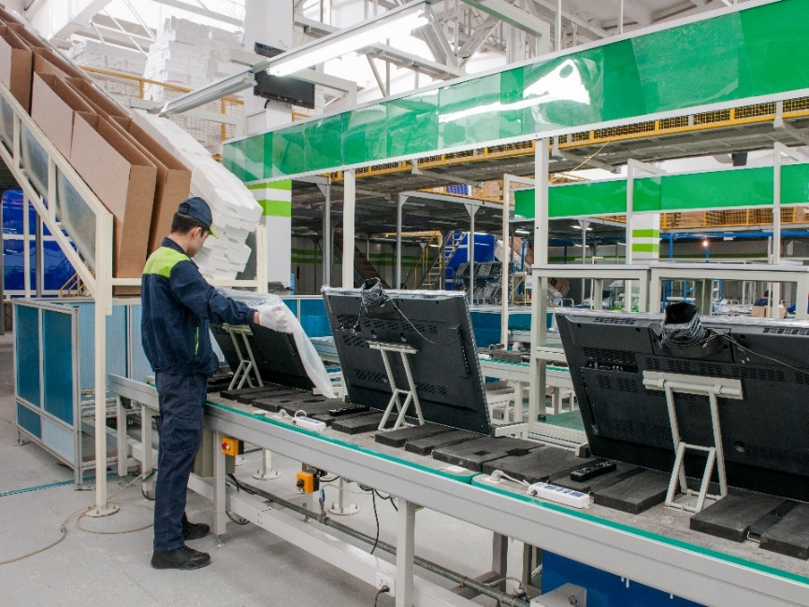
Forces Driving Globalization (1 of 3)
Falling Barriers to Trade and Investment
General Agreement on Tariffs and Trade (G A T T)
World Trade Organization (W T O)
Other
International organizations
The World Bank
The International Monetary Fund (I M F)
Regional trade agreements
Trade and national output
Notes:
Today, companies can go almost anywhere in the world to tap favorable business climates. Here, an employee at an Asian subsidiary of a global television maker packages TVs headed for global export markets. US businesses use technology to subcontract work to Chinese companies that write computer code and then email their end product to the US clients. Companies use such tactics to lower costs, increase efficiency, and grow more competitive. How else might technology and global talent facilitate international business activity?

Slide 14
Forces Driving Globalization (2 of 3)
Technological innovation
E-business (E-commerce)
Email and Videoconferencing.
Internet
Company Intranets and Extranets
Advancements in Transportation Technologies
Notes:
Although falling barriers to trade and investment encourage globalization, technology is accelerating its pace. Innovations in information technology and transportation methods are making it easier, faster, and less costly to move data, goods, and equipment around the world.
When businesses or consumers use technology to conduct transactions, they engage in e-business (e-commerce)—the use of computer networks to purchase, sell, or exchange products; to service customers; and to collaborate with partners. E-business is making it easier for companies to make their products abroad, not simply to import and export finished goods. Let’s examine several innovations that have had a considerable impact on globalization.
E-mail and videoconferencing: Operating across borders and time zones complicates the job of coordinating and controlling business activities. But technology can speed the flow of information and ease the tasks of coordination and control. E-mail is an indispensable tool that managers use to stay in contact with international operations and to respond quickly to important matters. Videoconferencing allows managers in different locations to meet in virtual face-to-face meetings.
The Internet: Companies use the Internet to quickly and inexpensively contact managers in distant locations. They also use the Internet to achieve longer-term goals, such as sharpen their forecasting, lower their inventories, and improve communication with suppliers. Additional gains arise from the ability of the Internet to cut postproduction costs by decreasing the number of intermediaries a product passes through on its way to the customer. Eliminating intermediaries greatly benefits online sellers of all sorts of products, including books, music, travel services, software, and so on. Some innovative companies use online competitions to attract fresh ideas from the brightest minds worldwide.
Company intranets and extranets: Internal company websites and information networks (intranets) give employees access to company data using personal computers.
Advancements in transportation technologies: Innovation in the shipping industry is helping globalize markets and production by making shipping more efficient and dependable.

Slide 15
Forces Driving Globalization (3 of 3)
Measuring Globalization Table 1.1 Globalization’s Top 10
Country | Overall Rank | Economic Rank | Social Rank | Political Rank
Netherlands | 1 | 4 | 4 | 5
Ireland | 2 | 2 | 3 | 25
Belgium | 3 | 6 | 6 | 3
Austria | 4 | 16 | 5 | 7
Switzerland | 5 | 22 | 2 | 10
Denmark | 6 | 15 | 9 | 11
Sweden | 7 | 17 | 16 | 4
United Kingdom | 8 | 20 | 13 | 6
France | 9 | 30 | 11 | 1
Hungary | 10 | 7 | 23 | 23
Source: Based on the 2017 K O F Index of Globalization, (www.globalization.kof.ethz.ch). April 20,2017.
Notes:
Although we intuitively feel that our world is becoming smaller, researchers have created ways to measure the extent of globalization scientifically. One index of globalization is the one created by the KOF Swiss Economic Institute (www.kof.ethz.ch). This index ranks nations on 23 variables within three dimensions: economic globalization (trade and investment volumes, trade and capital restrictions), social globalization (dissemination of information and ideas), and political globalization (political cooperation with other countries).

Slide 16
Quick Study 3
What global organizations have helped expand globalization?
What technological innovations are helping to propel globalization?
What nations rank high in terms of globalization?

Slide 17
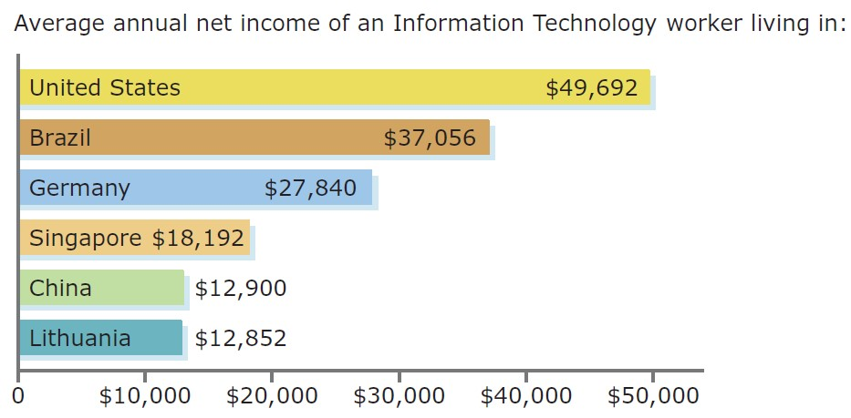
Debate About Jobs and Wages (1 of 2)
Against Globalization
Eliminates jobs in developed nations
Lowers wages in developed nations
Exploits workers in developing nations
Comparing Salaries of Information Technology Workers
Notes:
So far, we have read how globalization benefits companies and nations. But not everyone views globalization as having only positive effects.
Groups opposed to globalization blame it for eroding standards of living and ruining ways of life. Specifically, they say globalization eliminates jobs and lowers wages in developed nations and exploits workers in developing countries. Let’s explore each of these arguments.
Eliminates jobs in developed nations: Some groups claim that globalization eliminates manufacturing jobs in developed nations. They criticize the practice of sending good-paying manufacturing jobs abroad to developing countries where wages are a fraction of the cost for international firms.
Lowers wages in developed nations: Opposition groups say globalization causes worker dislocation that gradually lowers wages. They allege that, when a manufacturing job is lost in a wealthy nation, the new job (assuming new work is found) pays less than the previous one. Those opposed to globalization say this decreases employee loyalty, employee morale, and job security. They say this causes people to fear globalization and any additional lowering of trade barriers.
Exploits workers in developing nations: Critics charge that globalization and international outsourcing exploit workers in low-wage nations.
Figure 1.2 illustrates that western firms can outsource such work to emerging markets for a fraction of what they pay at home. So long as such economic disparities exist, international outsourcing will continue to be popular. The salary of a programmer in the United States is nearly four times that of one in some eastern European nations, including Lithuania.

Slide 18
Debate About Jobs and Wages (2 of 2)
For Globalization
Increases wealth and efficiency in all nations
Generates labor market flexibility in developed nations
Advances the economies of developing nations
Notes:
Supporters of globalization credit it with improving standards of living and making possible new ways of life. They argue that globalization increases wealth and efficiency in all nations, generates labor market flexibility in developed nations, and advances the economies of developing nations.
Increases wealth and efficiency in all nations: Globalization supporters believe globalization increases wealth and efficiency in both developed and developing nations. They argue that openness to international trade increases national production (by increasing efficiency) and raises per capita income (by passing savings on to consumers).
Generates labor market flexibility in developed nations: Globalization supporters believe globalization creates positive benefits by generating labor market flexibility in developed nations.
Advances the economies of developing nations: Those in favor of globalization argue that globalization and international outsourcing help to advance developing nations’ economies.

Slide 19
Quick Study 4
In the debate over jobs and wages, opponents of globalization say that it does what?
In the debate over jobs and wages, supporters of globalization say that it does what?

Slide 20
Debate About Income Inequality
Inequality Within Nations
Wage gap between white-collar and blue-collar occupations in rich nations
Inequality Between Nations
Widening the gap in average incomes between rich and poor nations
Global Inequality
Widening income inequality between all people of the world
Notes:
Perhaps no controversy swirling around globalization is more complex than the debate over its effect on income inequality. Here, we focus on three main aspects of the debate: inequality within nations, inequality between nations, and global inequality.
Inequality within nations: The first aspect of the inequality debate is whether globalization is increasing income inequality among people within nations. Opponents of globalization argue that freer trade and investment allows international companies to close factories in high-wage, developed nations and to move them to low-wage, developing nations. They argue that this increases the wage gap between white-collar and blue-collar occupations in rich nations.
Inequality between nations: The second aspect of the inequality debate is whether globalization is widening the gap in average incomes between rich and poor nations.
Global inequality: The third aspect of the inequality debate is whether globalization is increasing global inequality—widening income inequality between all people of the world, no matter where they live.
Summary of the income inequality debate: For the debate over inequality within nations, studies suggest that developing nations can boost incomes of their poorest citizens by embracing globalization and integrating themselves into the global economy. In the debate over inequality between nations, nations open to world trade and investment appear to grow faster than rich nations do. Meanwhile, economies that remain sheltered from the global economy tend to be worse off. Finally, regarding the debate over global inequality, although experts agree inequality has fallen in recent decades, they disagree on the extent of the drop.

Slide 21
Quick Study 5
Evidence suggests that globalization can help developing nations boost incomes for their poorest citizens in what part of the debate over inequality?
In the debate over inequality between nations, evidence suggests that developing nations that are open to trade and investment do what?
Regarding the debate over global inequality, experts tend to agree on what?

Slide 22
Debate About Culture, Sovereignty, and the Environment (1 of 3)
Globalization and Culture
Advantages
Allows us to profit from our differing circumstances and skills
Disadvantages
Homogenizes our world and destroys our rich diversity of cultures
Notes:
Globalization and Culture: National culture is a strong shaper of a people’s values, attitudes, customs, beliefs, and communication. Whether globalization eradicates cultural differences between groups of people or reinforces cultural uniqueness is a hotly debated topic.
Globalization’s detractors say that it homogenizes our world and destroys our rich diversity of cultures.
Supporters argue that globalization allows us all to profit from our differing circumstances and skills. Trade allows countries to specialize in producing the goods and services they can produce most efficiently. Nations can then trade with one another to obtain goods and services they desire but do not produce.

Slide 23
Debate About Culture, Sovereignty, and the Environment (2 of 3)
Globalization and National Sovereignty
Disadvantages
Menace to democracy? Empowers supranational institutions at the expense of national governments
Advantages
Guardian of democracy? Globalization spreads democracy worldwide
Notes:
National sovereignty generally involves the idea that a nation-state (1) is autonomous, (2) can freely select its government, (3) cannot intervene in the affairs of other nations, (4) can control movements across its borders, and (5) can enter into binding international agreements.
Globalization: menace to democracy? A main argument leveled against globalization is that it empowers supranational institutions at the expense of national governments.
Globalization: guardian of democracy? Globalization supporters argue that an amazing consequence of globalization has been the spread of democracy worldwide.

Slide 24
Debate About Culture, Sovereignty, and the Environment (3 of 3)
Globalization and Environment
Advantages
Most international firms today support reasonable environmental laws
Disadvantages
“Race to the Bottom”
Notes:
Some environmental groups say globalization causes a “race to the bottom” in environmental conditions and regulations. Yet, studies show that pollution-intensive U.S. firms tend to invest in countries with stricter environmental standards.
Most international firms today support reasonable environmental laws because (if for no other reason) they want to expand future local markets for their goods and services. They recognize that healthy future markets require a sustainable approach to business expansion.

Slide 25
Quick Study 6
People opposed to globalization say that it does what to national cultures?
Regarding national sovereignty, opponents of globalization say that it does what?
With regard to the physical environment, what do globalization supporters argue?

Slide 26
Developing Skills for Your Career
Critical thinking
Business ethics and social responsibility
Communication skills
Knowledge application and analysis
Notes:
This course will help you develop highly useful capabilities we can employability skills.
Critical thinking involves purposeful and goal-directed thinking used to define and solve problems, make decisions, or form judgments related to a set of circumstances
Business ethics and social responsibility are sets of guiding principles that influence the way individuals and organizations behave within society.
Communication is the use of oral, written, and nonverbal language and technology to communicate ideas effectively and to listen effectively. International business means doing business across national borders, across languages, and across cultures.
Knowledge application and analysis refers to your ability to learn a concept and appropriately apply that knowledge in another setting to achieve a higher level of understanding.

Slide 27
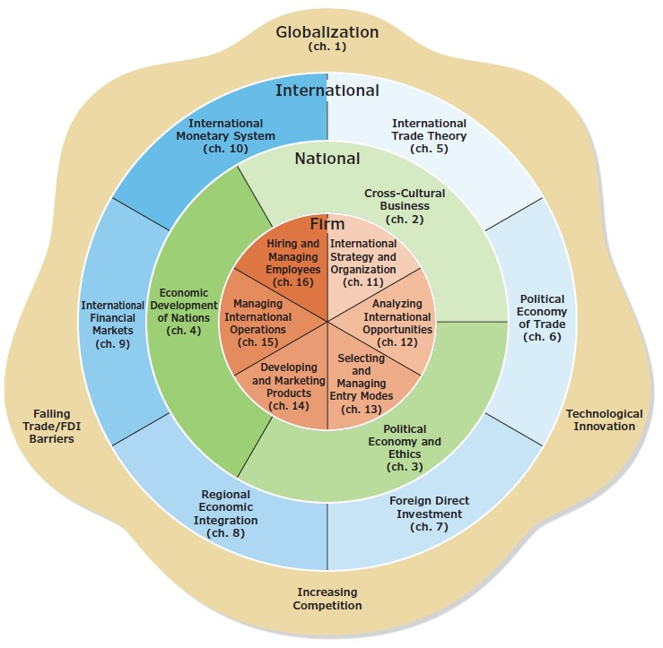
Figure 1.3 The Global Business Environment
Notes:
The model in Figure 1.3 identifies each of the four main components in the global business environment and their subparts. Thinking about international business as occurring within this global system helps us to understand the complexities of international business and the interrelations between its distinct elements.
International business differs greatly from business in a purely domestic context. The most obvious contrast is that different nations can have entirely different societies and commercial environments. The best way to explain what makes international business special is to introduce a model unique to this book—a model we call the global business environment. This model weaves together the following four distinct elements.
The forces of globalization: globalization is a potent force transforming our societies and commercial activities in countless ways.
The international business environment: influences how firms conduct their operations in both subtle and not-so-subtle ways. No business is entirely immune to events in the international business environment, as evidenced by the long-term trend toward more porous national borders. Companies today must keep their fingers on the pulse of the international business environment to see how it may affect their business activities.
Many national business environments: each national business environment is composed of unique cultural, political, economic, and legal characteristics that define business activity within that nation’s borders. This set of national characteristics can differ greatly from country to country.
International firm management: is vastly different from the management of a purely domestic business. Companies must abide by the rules in every market in which they choose to operate. Therefore, the context of international business management is defined by the characteristics of national business environments.

Slide 28
Quick Study 7
What employability skills will this course help you to develop?
It helps to think about international business as four elements that occur within a what?
How does managing an international firm differ from managing a purely domestic business?

Slide 29
Copyright

