Slide 1
Introductory
Probing & Define Terms
WELCOME MY LEARNERS TO THE 2nd Session 13 Sept 2020
Pages 11_27
Notes:
Society and Social Terms

Slide 2
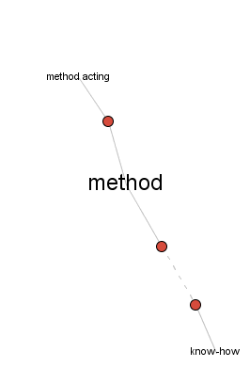
HE METHODOLOGIES – DEFINING & REASONING
http://www.visualthesaurus.com/app/view
Synonyms of Method :
Approach ; How ; Strategy; Style; System; Tack - Way; Tactics…
Origin of METHOD:
Middle English, prescribed treatment, from Latin methodus,from Greek methodos, from meta + hodos way
First Known Use: 15th century
Method is
- A way of doing something
- A careful or organized plan that controls the way something is done
Notes:
= Create A Concept Map Figure of Methodology meanings
Define Methodology and Method

Slide 3
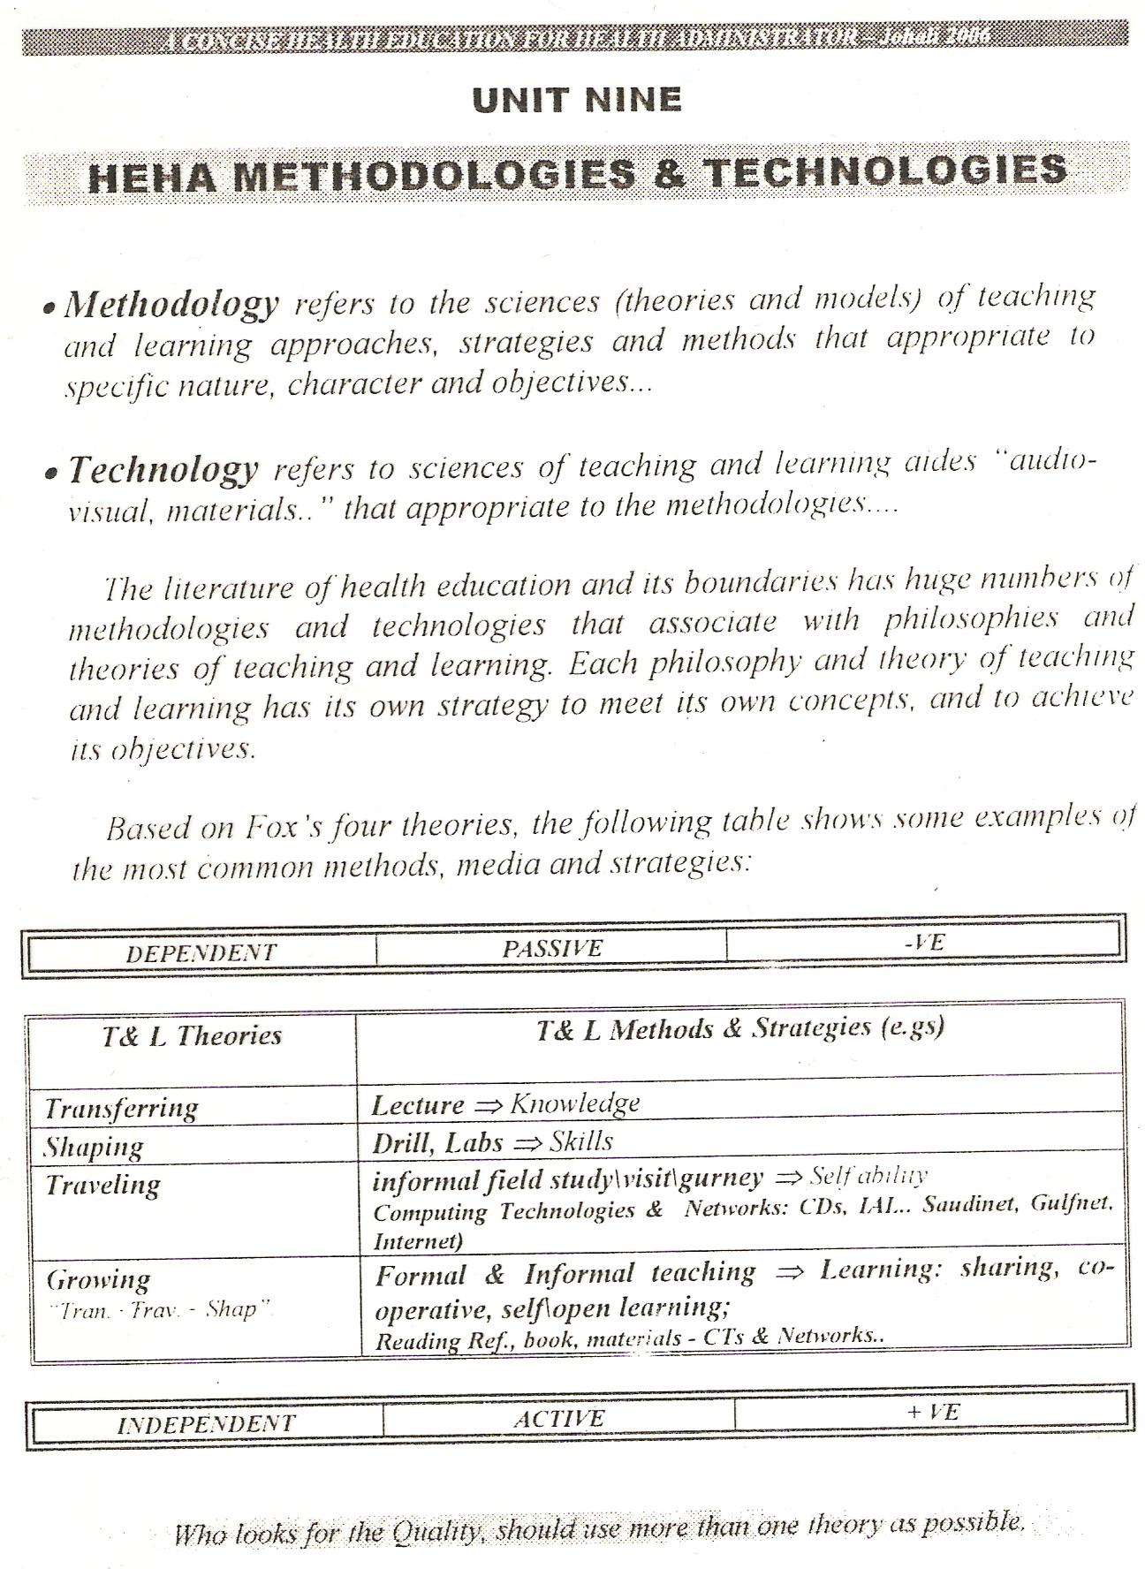
HE METHODOLOGIES – DEFINING & REASONING
Medical – Teaching definitions and uses;
A systematic procedure, technique, or mode of inquiry employed by or proper to a particular discipline or art
A systematic plan followed in presenting material for instruction
A way, technique, or process of or for doing something
A body of skills or techniques
http://www.visualthesaurus.com/app/view
Examples of METHOD:
He claims to have developed a new method for growing tomatoes.
Their teaching method tries to adapt lessons to each student.
We need to adopt more modern methods of doing things.
Methodology is the systematic, theoretical analysis of the methods applied to a field of study, or the theoretical analysis of the body of methods and principles ..
http://www.merriam-webster.com/dictionary/method
Notes:
Method refers to the science of teaching and learning approach
Create A Concept Map Figure of Methodology meanings
History of Health Education Methodology

Slide 4
People
“Learning - Learners”
Through
Ages
How People Learn Through Age Stages
Philosophical - Scientific Bases
Notes:
Society and Social Terms

Slide 5
Remember Ages “Maslow & Coleman - Do You ? If You Don’t You Have To Lear Again !!!?
How People Learn Throughout Age Stages
While Crawford D. (2004) concludes ""The literature supports the idea that adults are very capable of learning well into their seventies which is a good reason to accept ‘Andragogy” the lifelong learning as more than just a pleasant mantra", the Arab and Islamic world have more evidence in their well known Proverb:
طلبوا العلم من المهد إلى اللحد
Seek education from the cradle to the grave.
Keep learning from when you're born until you die
http://simple.wikiquote.org/wiki/Arabic_proverbs
This Proverb indicates that “people can and have to learn over all ages from fetus to death using best methods suite their different abilities and characters”.
So it necessary to realize these differences in order to decide the best ' HE approaches, methodologies and strategies appropriate for every ages stages, you can use Maslow and Coleman Models that you have learn early courses, mainly CHS 282 and 382.

Slide 6
Knowing Brainstorming
Do You Know What You Don’t Know
This move, from "knowing that you don't know" to "knowing that you know" is what most learning and hence teaching is all about.
Donald Rumsfeld - Known and Unknown
http://www.youtube.com/watch?v=xWqFYF6BDns
Be Ready To Take Smart Note ‘terms-draw
Your child's education: What you don't know can hurt you
http://www.youtube.com/watch?v=W6BZiNJo7LM
Hosted by Bridgeway Academy, a leading provider of academic programs for K-12 students worldwide, this educational summit will increase public awareness of the full range of educational options available to students, no matter what their learning style.
Attendees will have the opportunity to submit questions during the presentation which will be answered by the education experts during a Q&A session. All will leave with an in depth understanding of their educational options as well as an exclusive opportunity to receive a Learning Style Assessment (LSA)—a highly intuitive assessment that allows parents to gain a firm understanding of their child's individual learning style.
In addition, attendees will learn about the 3 Cs of education including:
• Taking back Control: How and when to advocate, and when to say enough is enough
Know your Choice
Customize for your child
Notes:
In the 3Cs, how and when to advocate is a part of taking back control

Slide 7
Knowing Brainstorming
Do You Know What You Don’t Know
This move, from "knowing that you don't know" to "knowing that you know" is what most learning and hence teaching is all about.
In Knowing, the two senses are those of:
Awareness of self, (represented by the vertical red line in the diagram below) and
Knowledge of the world (the horizontal blue line)
If I don't know I don't know
I think I know
If I don't know I know
I think I don't know
Laing R D (1970) Knots Harmondsworth; Penguin (p.55)
"He that knows not,
and knows not that he knows not
is a fool.
Shun him
He that knows not,
and knows that he knows not
is a pupil.
Teach him.
He that knows,
and knows not that he knows
is asleep
Wake him.
He that knows,
and knows that he knows
is a teacher.
Follow him."
(Arabic proverb)
NEIGHBOUR R (1992) The Inner Apprentice London; Kluwer Academic Publishers. p.xvii
"We know what we know, we know that there are things we do not know, and we know that there are things we don't know we don't know"
Donald Rumsfeld (4 Sept 2002) (Woodward, 2004: 171. Video here.) It is ironic, perhaps, that the initial insight is allegedly Arabic.
Notes:
Draw
Do You Know What You Don’t Know

Slide 8
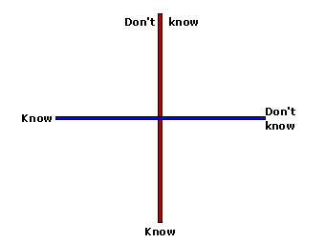
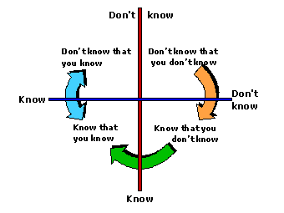
Knowing Brainstorming
Do You Know What You Don’t Know
This move, from "knowing that you don't know" to "knowing that you know" is what most learning and hence teaching is all about.
Notes:
Draw
Do You Know What You Don’t Know

Slide 9
How People Learn Through Age Stages
A group of 50 year olds were given IQ tests that had taken 31 years earlier.
They made higher scores on every part except math reasoning.
Wechsler found test scores increased until 35 then declined very slowly after that.
IQ = Intelligence Quotient (proportion)
http://uk.askmen.com/money/body_and_mind_150/174_better_living.html
http://mentalhealthdaily.com/2013/04/24/11-ways-to-increase-your-iq-score-intelligence-quotient/
http://curiosity.discovery.com/question/can-you-increase-iq-score
Next Question

Slide 10

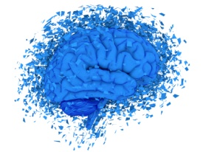
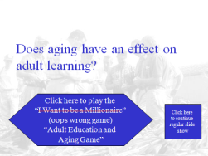


Does aging have an effect on adult learning?
Discover Characteristics
Click here to play the
“I Want to be a Millionaire”
(oops wrong game)
“Adult Education and Aging Game”
IQ in Adults
A. Decreases about 1% a
year after the age of 30.
B. Increases about 1% a
year until the age of 65.
C. Doesn’t materially
change during adulthood
D. Starts dropping off
significantly after the age of 65.
Hide Answer !! After your answer change color
The Correct Answer is C.
Contrary to popular opinion, IQ doesn’t decline remarkably with age.
Notes:
Answer

Slide 11
The Correct Answer is B.
Physical strength reaches a peak around the age of 30.
How People Learn Through Age Stages
Physical Strength in Adults
A. Peaks around the age of 20.
B. Peaks around the age of 30.
C. Peaks around the age of 40.
D. Peaks around the age of 50
Hide Answer !! After your answer change color
In England, Galton set up a booth at a National Fair and tested over 7,000 people for physical strength, his research and later research reveals 30 is the peak.
However, physical strength declines slowly. Research at Harvard found physical strength dropped dramatically between 70 and 75.
Next Question

Slide 12
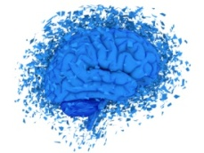
In youth there is a correlation between intelligence and speed in learning.
In adulthood, this is not true.
How People Learn Through Age Stages
Intelligence - Hearing
There is a relationship between intelligence
and speed of learning
A. In youth.
B. In adults.
C. In both youth and adults.
D. In neither youth
or adults
Hide Answer !! After your answer change color
The correct answer is A
Notes:
The relation between intelligence and hearing

Slide 13
The Correct Answer is A
Peak Performance in Hearing Occurs Before Age 15
How People Learn Through Age Stages
Hearing
The ability to hear peaks before
A. Age 15
B. Age 30
C. Age 45
D. Age 60
Hide Answer !! After your answer change color
Gradual decline until 65, then more rapid.
Older people
  Hear less and
  Hear slower

Slide 14
COMMON SENSE PRACTICE FOR MINIMIZING HEARING LOSS
Hearing
As people age:
  - Men lose ability to hear high sounds.
  Women lose ability to hear low sounds.
  This is one of the reasons why women talk more with women and men talk more with men in the older years
Sit people where they can see everyone’s face.
Use small groups.
Teacher should stand still.
Teacher should speak, clearly, distinctly, and loudly
Use more than one sense while teaching.
Observe faces of students.
Eliminate outside noises.
Ask people to speak out if they can’t hear.
Repeat questions and answers.

Slide 15
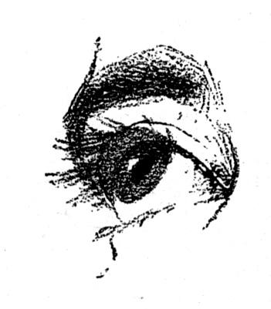
Common Sense Practices For Minimizing Losses Associated With Age - Vision
Vision
The most acute decline in vision occurs
A. Between 13 and 18
B. Between 18 and 40
C. Between 40 and 55
D. After 55
Hide Answer !! After your answer change color
The Correct answer is C.
Older Eyes Suffer
  Vision loss in dim light
  Narrowing field of vision
  Slow adaptation to dark
  Cataracts
  Defective color vision
SO………..
Vision
  13-18 Continuous gain
  18-40 Gradual decline
  40-55 Sharp decline
  55 On Gradual decline
Illumination
  More Direct Light
  Don’t Face Direct Light
Eliminate glare
White or Chalk Boards
  Keep Clean
  Use Large Writing
Media
  Use Sharp Color Contrast
  Enlarged Type or Print
  Avoid Abbreviations
Seating
  Seat People Close to Board
Notes:
Minimized Use abbreviation

Slide 16
GROWTH AND DEVELOPMENT
Maslow & Coleman ?
Begins with birth
Ends with death
Classifying 7 Stages
Infancy- birth to 1 year
Early childhood - 1 -6 years
Late childhood - 6-12 years
Adolescence - 12 -20 years
Early adulthood - 20 - 40 years
Middle adulthood - 40 - 65 years
Late adulthood - 65 and up
4 TYPES OF GROWTH AND DEVELOPMENT
Physical: Body growth
Mental: development of mind
Emotional: feelings
Social: interactions & relationship
www.ebsummit.info/.../LifeStages.ppt
Plus; http://cte.sfasu.edu/wp-content/uploads/2013/02/Four-Areas-of-Development-Preschool-to-School-Age-PPT.pdf

Slide 17
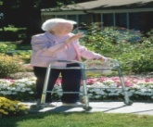
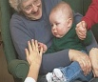
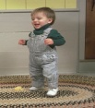

How People Learn Via Age Stages
Child and Adult Learning Characteristics
Children 1-5-11 | Adults 12-65 | Aging 65 +
Rely on others to decide what is important to be learned. | Decide for themselves what is important to be learned. | Keep Reading; Writing ….
Accept the information being presented at face value. | Need to validate the information based on their beliefs and values.
Expect what they are learning to be useful in their long-term future. | Expect what they are learning to be immediately useful.
Have little or no experience upon which to draw, are relatively "blank slates." | Have substantial experience upon which to draw. May have fixed viewpoints.
Little ability to serve as a knowledgeable resource to teacher or fellow classmates. | Significant ability to serve as a knowledgeable resource to the trainer and fellow learners. | Maintain & Adjustment
Both ‘child-adult’ are sometimes “fatigued \ exhaustion” when they attend classes, old age more.
Adults attend classes often with a Mixed set of motives - educational, social, recreational - and sometimes out of an overdeveloped puritanical sense of duty.
http://www.mysdcc.sdccd.edu/Staff/Instructor_Development/Content/HTML/Adult_Learning_Page1.htm
Notes:
Child Adult and Old Age Learning Characteristics
The 1 – 5 years old patients decide fort themselves

Slide 18


After review taxonomy of LO Interest Patients \ Learners Characters
What People Remember
10 % of what is read
20 % of what is heard
30 % of what is seen
50 % of what they see & hear
ok
70 % what they say as they do a task
90% of what they teach
https://www.osha.gov/dte/.../training_techniques2.ppt
Notes:
In OSHA the bad news found that only 30% of the students are listening while 70% are talking,
Interest Patients \ Learners Characters
OSHA found only 30% of students are listening to lectures and 70% are talking مشتت سرحor playing with mobile يفكر
chew

