Slide 1
General Introduction Male Role to FP
https://www.youtube.com/watch?v=NF3A0r5JHYo حذف
https://www.youtube.com/user/FPNSW
Family Planning NSW is the state's leading provider of reproductive and sexual health services. We provide clinical services, information and health promotion activities, education and training for health professionals and allied groups, research and advocacy.
Myth _ Reality
International Family Planning 101 ركز واكتب
https://www.youtube.com/watch?v=fKFZuRHaX2o
Male involvement in Family Planning TV Funny
https://www.youtube.com/watch?v=C4QKO4OVUpw
Notes:
History of Family Planning Myth _ Reality

Slide 2
General Introduction Male Role to FP
Luqman Ali 11011518-078; 4.
Notes:
History of Family Planning

Slide 3
The Concept of Family Planning

Slide 4
The Concept of Family Planning
Misconceptions ( sterilization and birth control)
Family welfare Program. The concept of welfare is very comprehensive and is basically related to quality of life.
The family welfare program aims at improving quality of life.
So, family planning is not synonymous with birth control, but family planning includes:
Welfare = perfect healthy, wellness, happiness

Slide 5
The Concept of Family Planning
Marriage counseling.
Prior Marriage Test
Education for parenthood.
Proper spacing and limitation of births.
Advice on sterility.
Sex education.
Screening for pathological conditions related to reproductive system.
Genetic counseling.
Premarital consultation and examination.
Carrying out pregnancy test.
The preparation of couples for the arrival of their first child.
Teaching home economics and nutrition.
Draw in A One Smart Conceptual Model

Slide 6
The Concept of Family Planning
Quality
CFP
Marriage . HE
Pregnancy HE
Generic HE
Birth HE
P_Home HE
Couple Relation HE
Sterility HE
Reproductive HE
Draw Yours First
Draw in A One Smart Conceptual Model

Slide 7
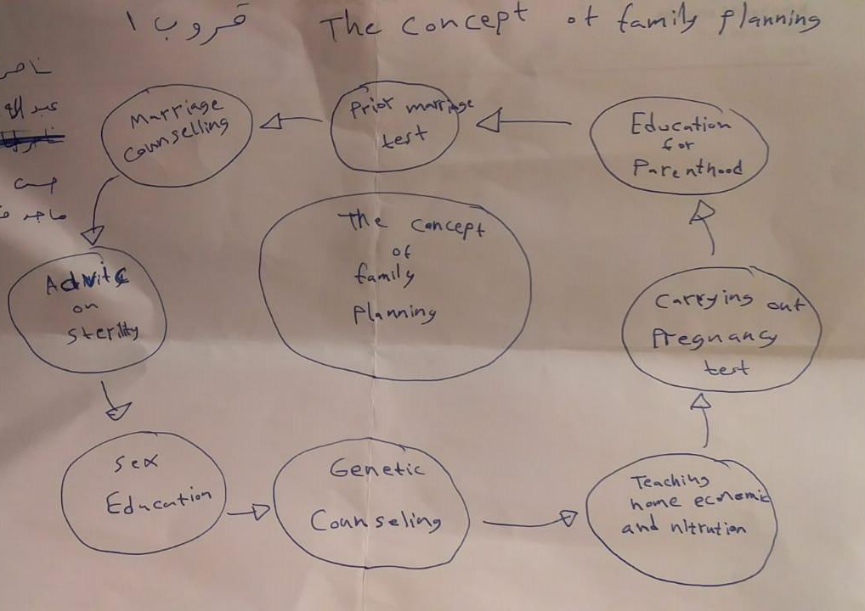
The Concept of Family Planning
The Concept of Family Planning Student Creative Model 2018

Slide 8
The Concept of Family Planning
Family planning refers to the planning of why, how and when to have children, and to the use of birth control.
WHO Definition:
Family Planning allows individuals and couples to anticipate and have their desired number of children, and to achieve healthy spacing and timing of their births (WHO Definition)
It is achieved through use of contraceptive methods and the treatment of involuntary 'infertility.

Slide 9
Definition
Practices that help individuals or couples to attain certain objectives: to avoid unwanted births, to bring about wanted births, to regulate the intervals between pregnancies, to control the time at which births occur in relation to the ages of the parent, and to determine the number of children in the family”.
A way of thinking and living adopted voluntarily, upon the basis of knowledge, attitudes and responsible decisions by individuals and couples, in order to promote the health and welfare of the family group and thus contribute effectively to the social development of a country”.
Johali FaPHE definition…think why its HE ?!

