Slide 1
1) C program development 2) Selection structure- IF statement

Slide 2
1. ALGORITHM
Before writing a program to solve a particular problem, we must have a thorough understanding of the problem and a carefully planned solution approach.
The solution to any computing problem involves executing a series of actions in a specific order.
A procedure for solving a problem in terms of
the actions to be executed, and
the order in which these actions are to be executed
is called an algorithm.
Correctly specifying the order in which the actions are to be executed is important.
Specifying the order in which statements are to be executed in a computer program is called program control.
Dr. Soha S. Zaghloul 2 Copyright © Pearson, Inc. 2013. All Rights Reserved.

Slide 3
1. ALGORITHM
Before writing the code you must:
ANALYZE the program : identify the input , process and output.
DESIGN the algorithm , which is done in two steps:
First: Write pseudocode
Second : Draw flow chart
Dr. Soha S. Zaghloul 3 Copyright © Pearson, Inc. 2013. All Rights Reserved.

Slide 4
2. Pseudocode
Pseudocode is an artificial and informal language that helps you develop algorithms.
similar to everyday English; it’s convenient and user friendly although it is not an actual computer programming language.
not executed on computers.
Rather, they merely help you “think out” a program before attempting to write it in a programming language like C.
Pseudocode consists only of action statements—those that are executed when the program is been converted from pseudocode to C. Then, the C program is written.
Definitions are not executable statements. They’re simply messages to the compiler.
Dr. Soha S. Zaghloul 4 Copyright © Pearson, Inc. 2013. All Rights Reserved.

Slide 5
3. flowchart
After writing the algorithm and the pseudocode, we draw a flowchart of the program.
Flow chart: is a diagram that uses graphic symbols to show the nature and flow of the steps in a process and a program.
In a flowchart, every action has its own symbol that are connected with arrows to show directions:
Start or End
Read or Print
Assignment or Calculation statement
START
END
READ X
PRINT X
Y = 7
A = B + C
Dr. Soha S. Zaghloul 5

Slide 6
4. eXAMPLE: Adding Two Integers
ALGORITHM
ALGORITHM
Get the values of two numbers from the user
Add the two numbers
Store the result
Print the result
PROBLEM
Write a program that read two numbers from user and print their sum
Dr. Soha S. Zaghloul 6

Slide 7
5. eXAMPLE: Adding Two Integers
FLOWCHART
ALGORITHM
START
Get the values of two numbers from the user
Add the two numbers
Store the result
Print the result
Read number1
Read number2
sum = number1 + number2
Print sum
END
FLOWCHART
Dr. Soha S. Zaghloul 7

Slide 8
6. eXAMPLE: Adding Two Integers
PSEUDOCODE
ALGORITHM
START
Get the values of two numbers from the user
Add the two numbers
Store the result
Print the result
Read number1
Read number2
sum = number1 + number2
PSEUDOCODE
Scanf integer1
Scanf integer2
sum = integer1 + integer2
Printf sum
Print sum
END
FLOWCHART
Dr. Soha S. Zaghloul 8

Slide 9
7. eXAMPLE: Adding Two Integers
CODE
scanf (“%d”, &integer1); //read integer1
PSEUDOCODE
Scanf integer1
Scanf integer2
sum = integer1 + integer2
Printf sum
Dr. Soha S. Zaghloul 9

Slide 10
7. eXAMPLE: Adding Two Integers
CODE
printf (“Enter first integer: \n”); //prompt
scanf (“%d”, &integer1); //read integer1
PSEUDOCODE
Scanf integer1
Scanf integer2
sum = integer1 + integer2
Printf sum
Dr. Soha S. Zaghloul 10

Slide 11
7. eXAMPLE: Adding Two Integers
CODE
int integer1; //declaration of first number
printf (“Enter first integer: \n”); //prompt
scanf (“%d”, &integer1); //read integer1
PSEUDOCODE
Scanf integer1
Scanf integer2
sum = integer1 + integer2
Printf sum
Dr. Soha S. Zaghloul 11

Slide 12
7. eXAMPLE: Adding Two Integers
CODE
int integer1; //declaration of first number
int integer2; //declaration of second number
printf (“Enter first integer: \n”); //prompt
scanf (“%d”, &integer1); //read integer1
printf (“Enter second integer: \n”); //prompt
scanf (“%d”, &integer2); //read integer2
PSEUDOCODE
Scanf integer1
Scanf integer2
sum = integer1 + integer2
Printf sum
Dr. Soha S. Zaghloul 12

Slide 13
7. eXAMPLE: Adding Two Integers
CODE
int integer1; //declaration of first number
int integer2; //declaration of second number
int sum; //total of the two numbers
printf (“Enter first integer: \n”); //prompt
scanf (“%d”, &integer1); //read integer1
printf (“Enter second integer: \n”); //prompt
scanf (“%d”, &integer2); //read integer2
sum = integer1 + integer2; //add the 2 numbers
PSEUDOCODE
Scanf integer1
Scanf integer2
sum = integer1 + integer2
Printf sum
Dr. Soha S. Zaghloul 13

Slide 14
7. eXAMPLE: Adding Two Integers
CODE
#include <stdio.h>
// function main begins program execution
int main (void)
{
int integer1; //declaration of first number
int integer2; //declaration of second number
int sum; //total of the two numbers
printf (“Enter first integer: \n”); //prompt
scanf (“%d”, &integer1); //read integer1
printf (“Enter second integer: \n”); //prompt
scanf (“%d”, &integer2); //read integer2
sum = integer1 + integer2; //add the 2 numbers
printf (“Total is %d \n”, sum); //print total
} // end of main function
PSEUDOCODE
Scanf integer1
Scanf integer2
sum = integer1 + integer2
Printf sum
Dr. Soha S. Zaghloul 14

Slide 15
7. eXAMPLE: Adding Two Integers
CODE
PSEUDOCODE
Scanf integer1
Scanf integer2
sum = integer1 + integer2
Printf sum
Dr. Soha S. Zaghloul 15 Copyright © Pearson, Inc. 2013. All Rights Reserved.

Slide 16
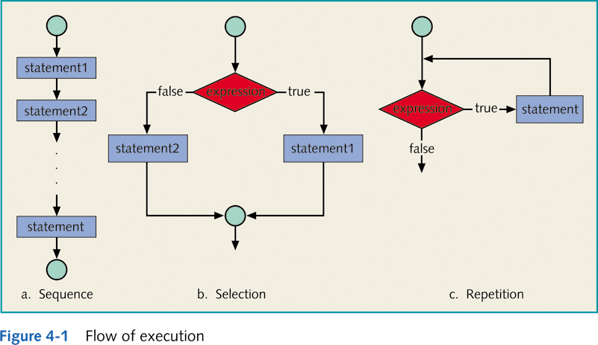
8. Flow of execution
Dr. Soha S. Zaghloul 16 Copyright © Pearson, Inc. 2013. All Rights Reserved.

Slide 17
8. Control structures
All the examples we studied till now execute in a “sequential” way.
Control structures control the flow of execution in a program. In other words, the flow of execution is not necessarily sequential.
The control structure enables you to combine individual instructions into a single logical unit with one entry point and one exit point.
Two control structure are essential in C:
The decision making control
The repetition control
Dr. Soha S. Zaghloul 17 Copyright © Pearson, Inc. 2013. All Rights Reserved.

Slide 18
9. Decision Making – the if statement
Executable C statements either perform actions (such as calculations and input or output of data) or make decisions.
We might make a decision in a program, for example, to determine whether a person’s grade on an exam is greater than or equal to 60 and whether the program should print the message “Congratulations! You passed.”
This section introduces a simple version of C’s if statement that allows a program to make a decision based on the truth or falsity of a statement of fact called a condition.
Dr. Soha S. Zaghloul 18 Copyright © Pearson, Inc. 2013. All Rights Reserved.

Slide 19
10. The if statement
Decision making tests a condition and specifies its flow of execution accordingly.
It enables you to combine individual instructions into a single logical unit with one entry point and one exit point (see Figure 1).
Condition?
True
False
Block of Statements (1)
Block of Statements (2)
Block of Statements (3)
END
Dr. Soha S. Zaghloul 19 Copyright © Pearson, Inc. 2013. All Rights Reserved.

Slide 20
12. The if statement
If the condition is true (i.e., the condition is met) the “block of statements 1” in the body of the if statement is executed.
If the condition is false (i.e., the condition isn’t met) the “block of statements 2” is not executed.
Whether the body statement is executed or not, after the if statement completes, execution proceeds with the next statement after the if statement, which are “block of statements 3”.
Conditions in if statements are formed by using the equality operators (== !=) and relational operators (< <= > >=).
Dr. Soha S. Zaghloul 20 Copyright © Pearson, Inc. 2013. All Rights Reserved.

Slide 21
12. The if statement - sYNTAX
an IF statement can have one statement:
If (condition)
statements 1;
OR multiple statement:
If (condition)
{
block of statements 1;
}
Dr. Soha S. Zaghloul 21

Slide 22
13. The if statement - example
Write a program that prints the message “Congratulations! You passed.” in case a person’s grade on an exam is greater than or equal to 60.
ALGORITHM
Get the person’s grade from the user
Check if the grade is greater than or equal to 60
If the grade is greater than or equal to 60 print the “congratulations” message
If the grade is less than 60 do nothing
End the program
Dr. Soha S. Zaghloul 22

Slide 23
14. The if statement - flowchart
ALGORITHM
Get the person’s grade from the user
Check if the grade is greater than or equal to 60
If the grade is greater than or equal to 60 print the “congratulations” message
If the grade is less than 60 do nothing
End the program
START
READ grade
grade >= 60?
True
Print “Congratulations! You passed ☺
False
END
FLOWCHART
Dr. Soha S. Zaghloul 23

Slide 24
15. The if statement - pseudocode
PSEUDOCODE
Scanf grade
If (grade >= 60)
Condition true: Printf “Congratulations! You passed”
End of the program
START
READ grade
grade >= 60?
True
Print “Congratulations! You passed ☺
False
END
FLOWCHART
Dr. Soha S. Zaghloul 24

Slide 25
15. The if statement - code
scanf (“%d”, &grade); //read grade from user
PSEUDOCODE
Scanf grade
If (grade >= 60)
Condition true: Printf “Congratulations! You passed”
End of the program
Dr. Soha S. Zaghloul 25

Slide 26
15. The if statement - code
printf (“Enter your grade: \n”); //prompt
scanf (“%d”, &grade); //read grade from user
PSEUDOCODE
Scanf grade
If (grade >= 60)
Condition true: Printf “Congratulations! You passed”
End of the program
Dr. Soha S. Zaghloul 26

Slide 27
15. The if statement - code
int grade; //declaration of grade
printf (“Enter your grade: \n”); //prompt
scanf (“%d”, &grade); //read grade from user
PSEUDOCODE
Scanf grade
If (grade >= 60)
Condition true: Printf “Congratulations! You passed”
End of the program
Dr. Soha S. Zaghloul 27

Slide 28
15. The if statement - code
int grade; //declaration of grade
printf (“Enter your grade: \n”); //prompt
scanf (“%d”, &grade); //read grade from user
if (grade >= 60)
printf (“Congratulations! You passed ☺ \n”); //Congratulations message
PSEUDOCODE
Scanf grade
If (grade >= 60)
Condition true: Printf “Congratulations! You passed”
End of the program
Dr. Soha S. Zaghloul 28

Slide 29
15. The if statement - code
#include <stdio.h>
//program begins execution at main function
int main (void)
{
int grade; //declaration of grade
printf (“Enter your grade: \n”); //prompt
scanf (“%d”, &grade); //read grade from user
if (grade >= 60)
printf (“Congratulations! You passed ☺ \n”); //Congratulations message
} //end of program
PSEUDOCODE
Scanf grade
If (grade >= 60)
Condition true: Printf “Congratulations! You passed”
End of the program
Dr. Soha S. Zaghloul 29

Slide 30
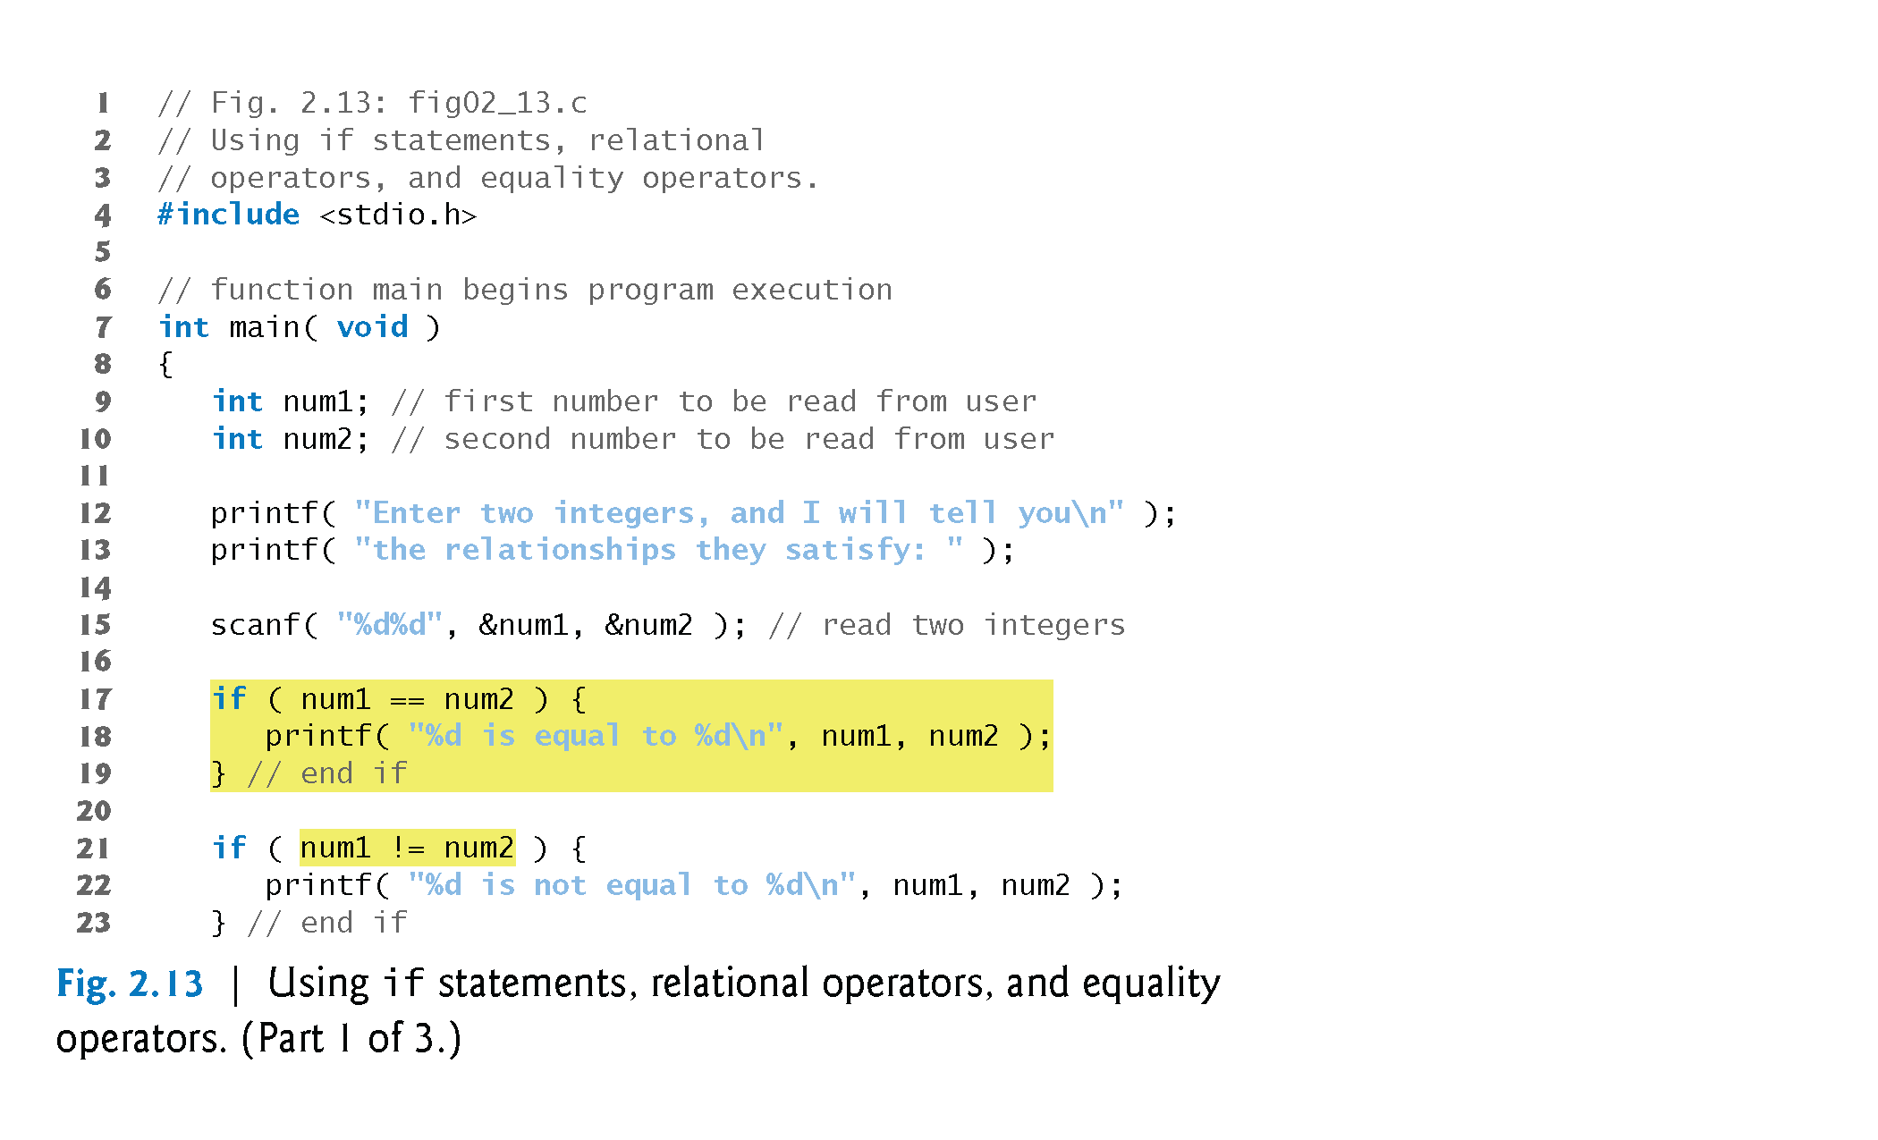
16. A SAMPLE PROGRAM:
Relationship between two numbers
Dr. Soha S. Zaghloul 30 Copyright © Pearson, Inc. 2013. All Rights Reserved.

Slide 31
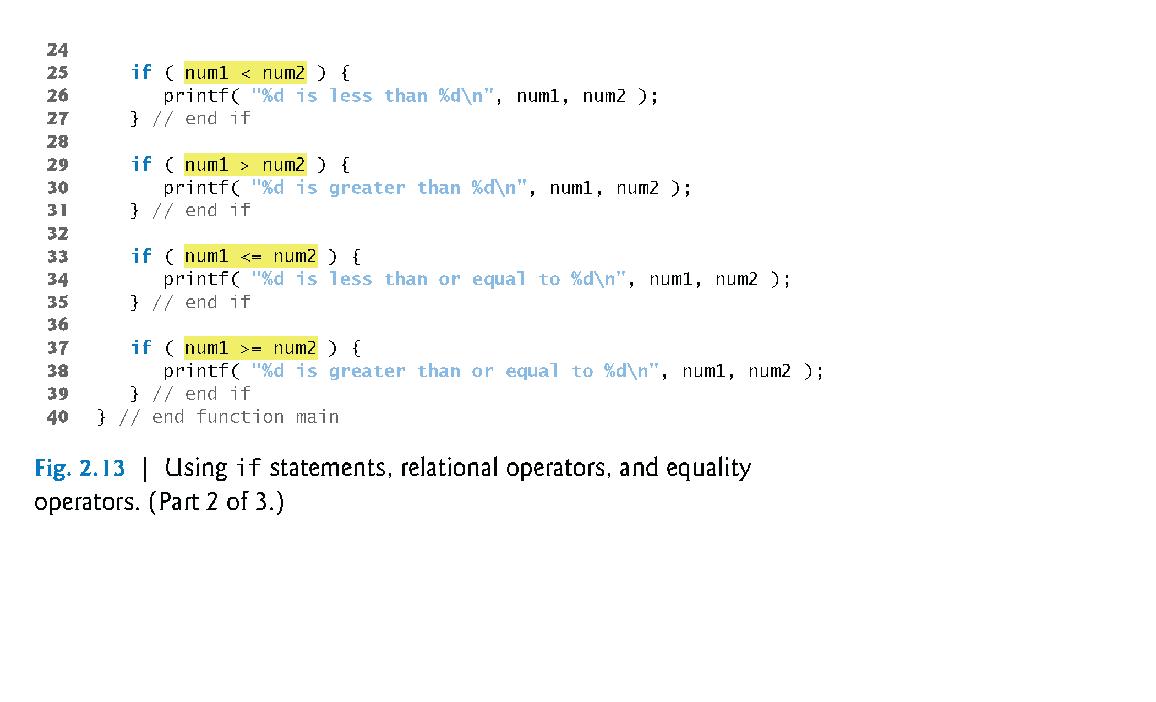
16. A SAMPLE PROGRAM:
Relationship between two numbers (Cont’d)
Dr. Soha S. Zaghloul 31 Copyright © Pearson, Inc. 2013. All Rights Reserved.

Slide 32
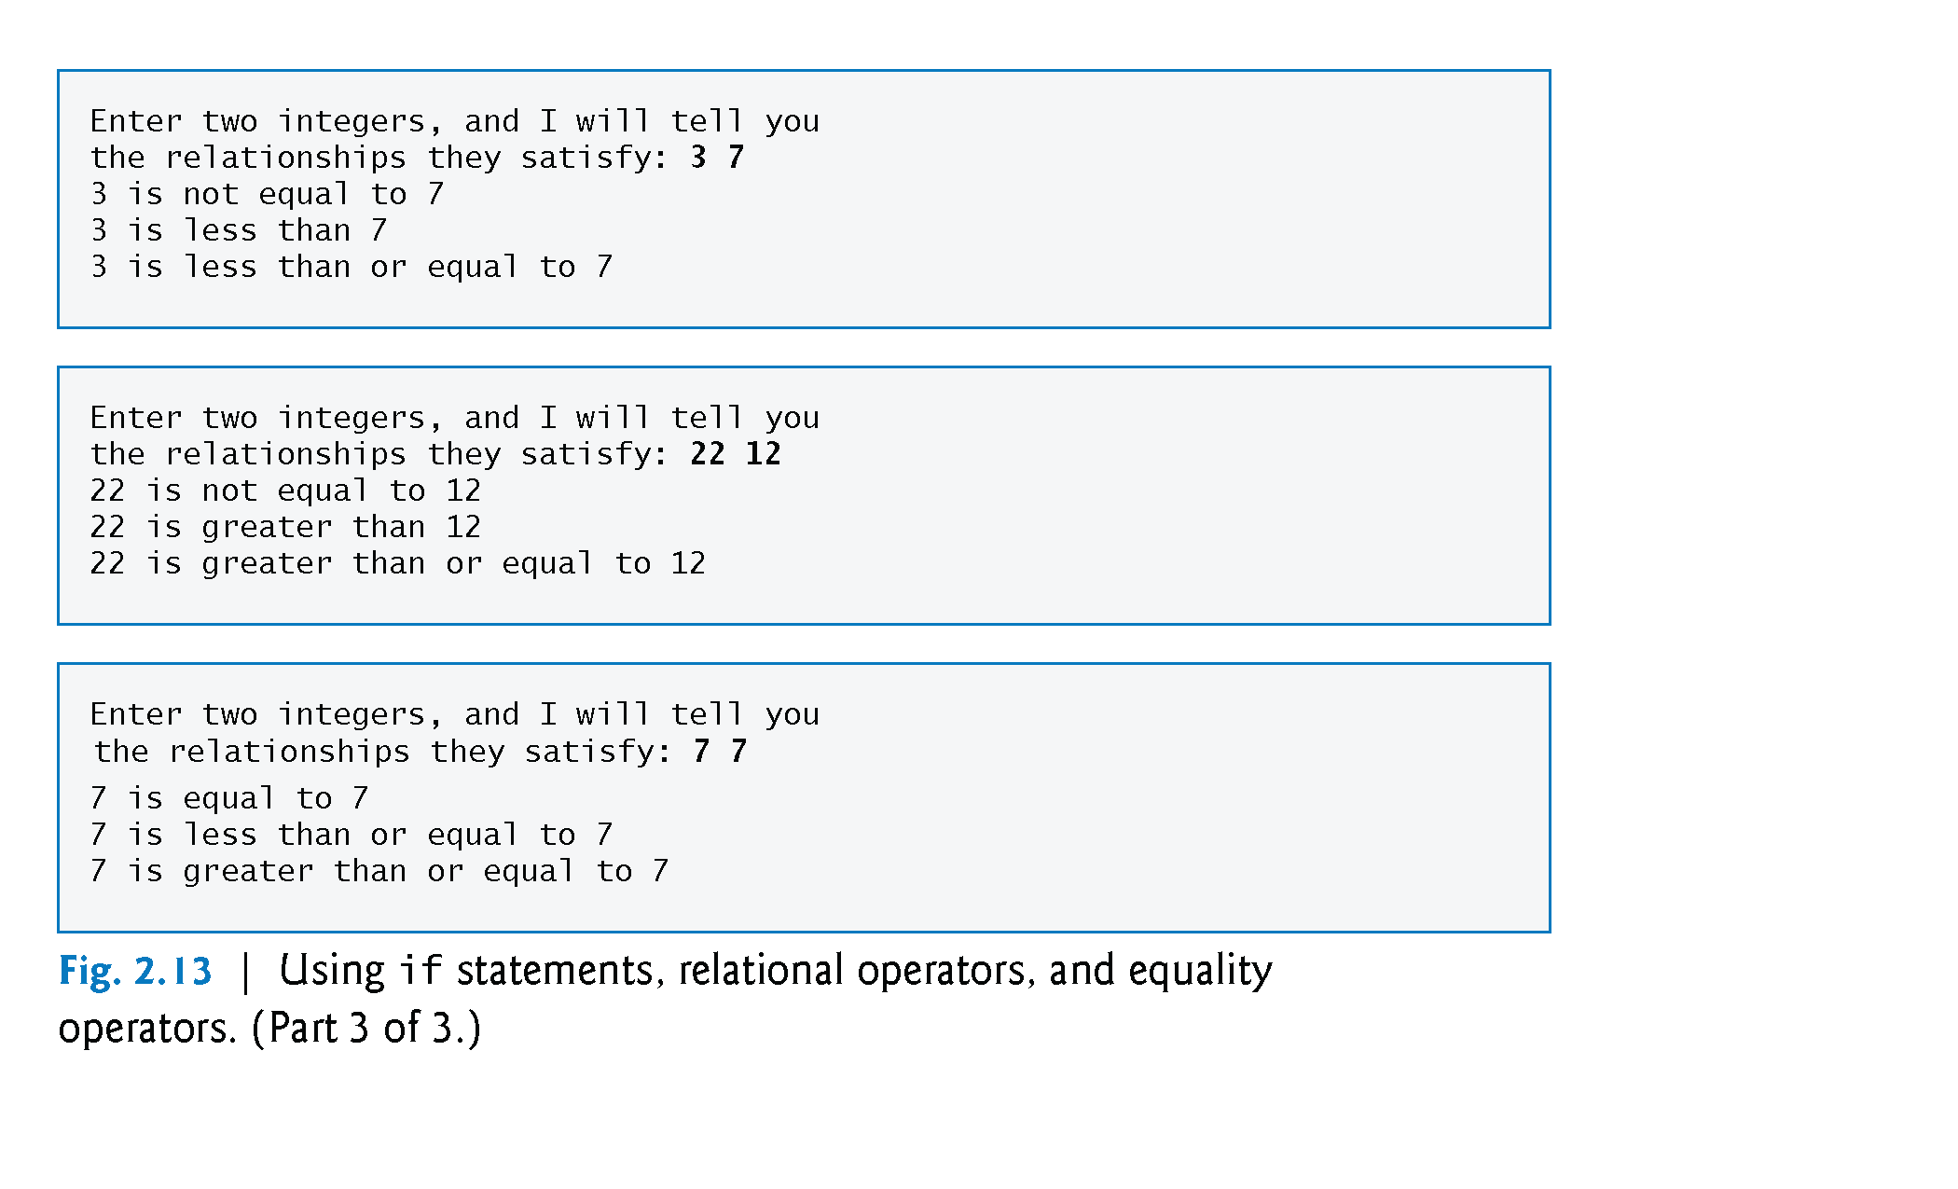
16. A SAMPLE PROGRAM:
Relationship between two numbers - OUTPUT
Dr. Soha S. Zaghloul 32 Copyright © Pearson, Inc. 2013. All Rights Reserved.

Slide 33
16. A SAMPLE PROGRAM (Cont.)
Comparing Numbers
The if statement in lines 17–19
if ( num1 == num2 ) {
printf( "%d is equal to %d\n", num1, num2 );
}
compares the values of variables num1 and num2 to test for equality.
If the values are equal, the statement in line 18 displays a line of text indicating that the numbers are equal.
If the conditions are true in one or more of the if statements starting in lines 21, 25, 29, 33 and 37, the corresponding body statement displays an appropriate line of text.
Indenting the body of each if statement and placing blank lines above and below each if statement enhances program readability.
Dr. Soha S. Zaghloul 33 Copyright © Pearson, Inc. 2013. All Rights Reserved.

Slide 34
16. A SAMPLE PROGRAM (Cont.)
A left brace, {, begins the body of each if statement (e.g., line 17).
A corresponding right brace, }, ends each if statement’s body (e.g., line 19).
Any number of statements can be placed in the body of an if statement.
Dr. Soha S. Zaghloul 34 Copyright © Pearson, Inc. 2013. All Rights Reserved.

Slide 35
Dr. Soha S. Zaghloul 35 Copyright © Pearson, Inc. 2013. All Rights Reserved.

