Slide 1
SELECTION STATEMENTS (1)
if
if…else
GC 201

Slide 2
Outline
1. Introduction
2. One-way selection: The if statement
2.1 With a single statement
2.2 With a block of statements
3. Two-way selection: The if…else statement
3.1 With a single statement
3.2 With a block of statements

Slide 3
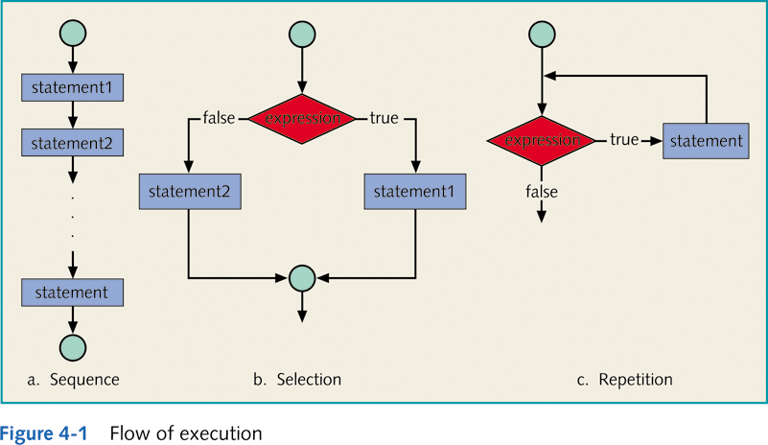
Selection

Slide 4
1. Introduction
By default, the flow of a program is sequential.
Selection statements alters the flow of execution depending on one or more specific conditions.
The condition(s) is/are specified by the programmer.
In Java, the selection statements include:
The if statement
With a single statement
With a block of statements
The if…else statement
With a single statement
With a block of statements
The nested if
The conditional operator ?
The switch statement

Slide 5
2. The if Statement
With a single statement
SYNTAX
if (logical expression) statement1;
FLOWCHART
1
Expression referred to as decision maker.
Statement referred to as action statement.
Logical Expression?
True
If the logical expression is true:
Statement 1
Statement 1 is executed
False
Execution continues at point 2
If the logical expression is false:
2
Statement 1 is NOT executed
Execution continues at point 2

Slide 6
Write a program that read the grade of the student and if it is more than or equal 60; print “Pass”
Algorithm
Start
Read the grade G
If G more than or equal to 60
Print “Pass”
End
Start
Read G
If
G >= 60
False
True
Print “pass”
End

Slide 7
Code
import java.util.*; public class grade { static Scanner console = new Scanner (System.in); public static void main(String[] args) { double grade; System.out.println("Enter Grade"); grade = console.nextDouble(); if (grade >= 60) System.out.println(“PASS"; } }

Slide 8
3.1 The if…else Statement
With a single statement
SYNTAX
if (logical expression)
Statement1;
else
Statement2;
FLOWCHART
1
Logical Expression?
If the logical expression is true:
True
False
Statement 1 is executed
Execution continues at point 2
Statement 1
Statement 2
If the logical expression is false:
Statement 2 is executed
Execution continues at point 2
2

Slide 9
3.1 The if…else Statement
With a single statement – PROGRAM 2: ANALYSIS
Write a program that read two numbers and print the largest one
INPUT
Number1 : (variable: num1, type: int)
Number2 : (variable: num2, type: int)
OUTPUT
Largest number
PROCESS
if (num1 > num2) print num1;
if (num2 > num1) print num1;

Slide 10
3.1 The if…else Statement
With a single statement – PROGRAM 3: Algorithm - Flowchart
Start
Read first number (num1)
Read second number (num2)
If num1 is larger than num2
Print num1
else
Print num2
Start
Read num1
Read num2
If
num1 > num2
False
True
Print num2
Print num1
End

Slide 11
3.1 The if…else Statement
With a single statement - PROGRAM 3: CODE
1
2
3
4
5
6
7
8
9
10
11
12
13
14
15
16
17
18
19
20
21
22
// import necessary libraries
import java.util.*; //contains the class Scanner
public class ifElseStatement1
{
// instantiate the object console from the class Scanner
static Scanner console = new Scanner (System.in);
public static void main (String[] args)
{
// Declaration section: to declare needed variables
int num1, num2;
// Input section: to enter values of used variables
System.out.println (“Enter number1”); //prompt
num1 = console.nextInteger();
System.out.println (“Enter number2”); //prompt
num2 = console.nextInteger();
// Processing section: processing statements
if (num1 > num2)
System.out.println (num1);
else
System.out.println (num2);
// Output section: display program output
} // end main
} // end class

Slide 12
Two-Way Selection
Example 4-14
//The following statement shows an example of a syntax error… WHY ?
if (hours > 40.0); //Line 1
wages = 40.0 * rate + 1.5 * rate *(hours - 40.0); //Line 2
else //Line 3
wages = hours * rate; //Line 4
Because a semicolon follows the closing parenthesis of the if statement (Line 1), the else statement stands alone.
The semicolon at the end of the if statement (see Line 1) ends the if statement.
The statement at Line 2 separates the else clause from the if statement. That is, else is by itself.
Because there is no separate else statement in Java, this code generates a syntax error.

Slide 13
2.2 The if Statement
With a block of statements
SYNTAX
if (logical expression)
{
statement 1;
statement 2;
…
statement n;
}
FLOWCHART
1
Logical Expression?
True
If the logical expression is true:
Statements 1 & 2 are executed
Statement 1
Execution continues at point 2
Statement 2
False
If the logical expression is false:
Execution continues at point 2
2

Slide 14
Write a program that read the grade of the student and if it is more than or equal 60; print “Pass” and the grade
Algorithm
Start
Read the grade G
If G more than or equal to 60
Print “Pass”
Print G
End
Start
Read G
If
G >= 60
False
True
Print “pass”
Print G
End

Slide 15
Code
import java.util.*; public class grade { // Class start static Scanner console = new Scanner (System.in); public static void main(String[] args) { // method start double grade; System.out.println("Enter Grade"); grade = console.nextDouble(); if (grade >= 60)
{ // if block start System.out.println(“PASS“);
System.out.println(grade); } // if block end } // method end } // Class end

Slide 16
3.2 The if…else Statement
With a block of statements
SYNTAX
if (logical expression)
{
Statement i;
Statement i+1;
…
Statement m;
}
else
{
Statement j;
Statement j+1;
…
Statement n;
}
FLOWCHART
1
Logical Expression?
True
False
Statement i
Statement j
Statement i+1
Statement j+1
2

Slide 17
3.2 The if…else Statement
With a block of statements – PROGRAM 4: ANALYSIS
Write a program that assigns a special discount to an item according to its price, then calculates the net price as follows:
If the price is greater than 1,000 SR then the customer is given a VIP status and the item is given a 15% discount; otherwise, the item is given an 18% discount. The program should also display the customer status if VIP.
INPUT
Price of the item (variable: price, type: double)
OUTPUT
Discount (variable: discount, type: double)
Net Price (variable: netPrice, type: double)
Customer Status (variable: vip, type: boolean)
PROCESS
if (price > 1000) ➔ 1) discount = 0.15
2) vip = true
if (price <= 1000) ➔ 1) discount = 0.18
2) vip = false
netPrice = (1 – discount) * price

Slide 18
3.2 The if…else Statement
With a block of statements - PROGRAM 4: CODE
1
2
3
4
5
6
7
8
9
10
11
12
13
14
15
16
17
18
19
20
21
22
23
24
25
26
27
28
29
30
// import necessary libraries
import java.util.*; //contains the class Scanner
public class ifElseStatementN
{
// instantiate the object console from the class Scanner
static Scanner console = new Scanner (System.in);
public static void main (String[] args)
{
// Declaration section: to declare needed variables
double price, discount, netPrice;
boolean vip;
// Input section: to enter values of used variables
System.out.println (“Enter the price of the item”); //prompt
price = console.nextDouble();
// Processing section: processing statements
if (price > 1000.0) // price is double
{
discount = 0.15;
vip = true;
} //end if(price > 1000.0)
else
{
discount = 0.18;
vip = false;
} //end else if(price > 1000)
netPrice = (1 – discount) * price;
// Output section: display program output
System.out.printf (“Discount = %.2f, Net price = %.2f, vip = %5s“, discount, netPrice, vip);
} // end main
} // end class

Slide 19
2. CONDITIONAL OPERATOR ?
Also known as the ternary operator.
SYNTAX
Variable =
(LogicalExpression1) ? Expression2: Expression3;
If expression1 = true, then the result of the condition is expression2.
Otherwise, the result of the condition is expression3.
int x = 3, y = 5, min;
min = (x <= y) ? x : y;
max = (x >= y) ? x: y;
System.out.println (min);
System.out.print (max);
Example
Output
1
2
3
5_

Slide 20
2. CONDITIONAL OPERATOR ?
Example
int x = 3, y = 5, min;
min = (x <= y) ? x : y;
System.out.print (min);
The above example is equivalent to the following code:
1
2
3
4
if (x <= y)
min = x;
else
min = y;

Slide 21
Self-Check Exercises
Write a complete Java program that identifies the students whose grades are B.
Write a complete Java program that reads two integer numbers num1 & num2, and performs a division if num2 is not equal to zero.
Write a complete Java program that reads two integer numbers num1 & num2, and prints the smaller one.
Write a complete Java program that identifies a negative number.
Write a complete Java program that identifies an even number.
W5.1 if + if…else

