Slide 1
Virtual LAN VLAN Trunking Protocol and Inter-VLAN Routing

Slide 2
VLAN Virtual Local Area Network
VLAN exists when two or more ports are connected physically or grouped together by some piece of network that supports VLAN functionalities.
A VLAN Concept is similar to subnetting.
Implementing VLAN can be done by using two different methods: Static or Dynamic memberships (VLAN memberships).

Slide 3
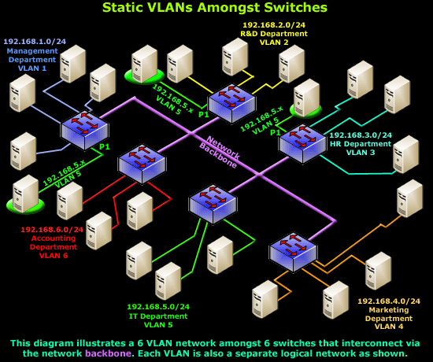
Static VLANs
How Static VLAN works?
Static VLANs occur when a switch port is manually assigned by the network administrator. Each port is associated with a specific VLAN. By default, all ports are originally assigned to VLAN 1

Slide 4
VLAN Trunking Protocol (VTP)
Trunk is a point to point link between network interface
For example, switch with a switch, or a switch with a router.
Carries multiple VLAN over one link.
Allows you to extend VLANs over a single network
Layer 2 messaging protocol.
Manages VLAN additions, deletions and name changes.
Useful for maintaining the VLAN from having Duplicate names, or incorrect VLAN specifications

Slide 5
VTP Pruning
Block other VLAN ports on the switch to restrict flooding. (only servers can do it)

Slide 6
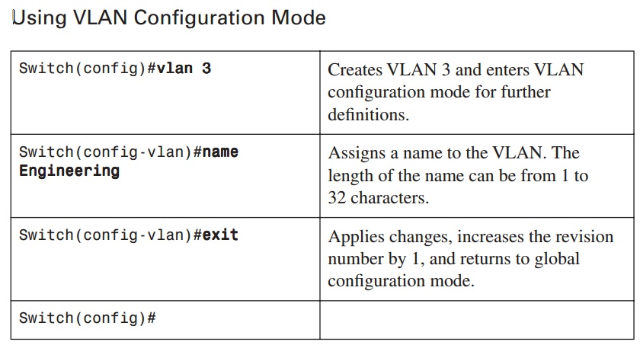
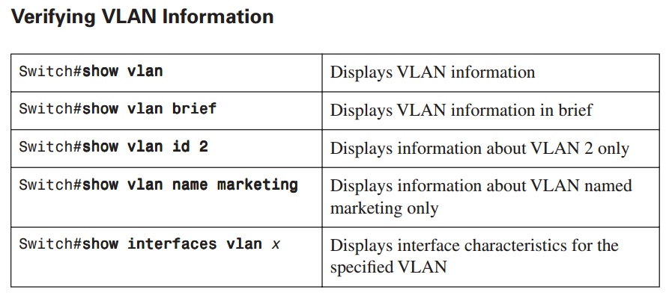
Static configuration

Slide 7
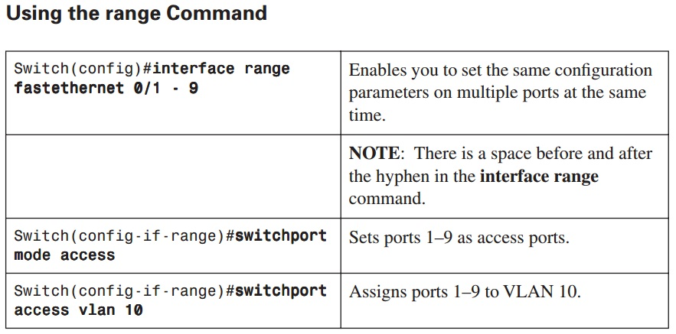

Slide 8
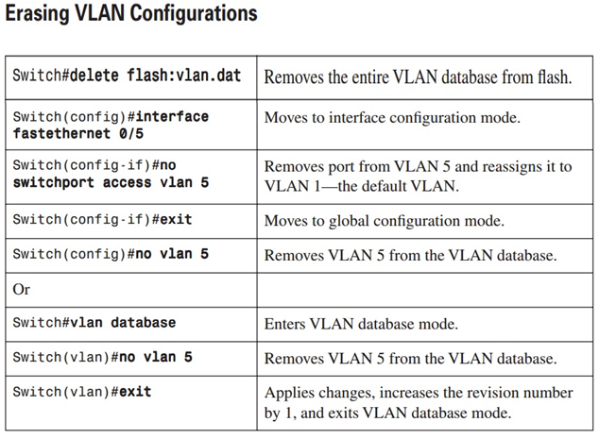

Slide 9
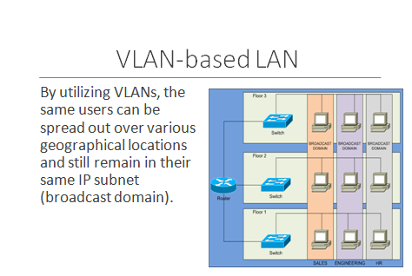

Slide 11
Inter VLAN Routing
The main propose is to allow different VLAN to communicate with each other.
The routing process is done using a router.
common inter-VLAN routing architectures are used in modern LAN networks today:
Router-on-a-stick

Slide 12
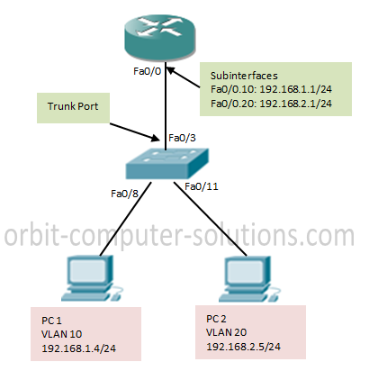
Router-on-a-Stick with Trunking
A router is simply connected to each VLAN and forwards inter-VLAN traffic between the appropriate VLANs.

