Slide 1
Vertical
Alignment
Geometric Design
of Railway Track
CE 435
Railway Engineering
Dr. Walied A. Elsaigh
welsaigh@ksu.edu.sa
Asst. Prof. of Civil Engineering

Slide 2
Vertical Alignment
Curve Length
Railway vertical curves – old formula:
L = D / R
D = algebraic difference of grade (ft. per 100-ft. station)
R = rate of change per 100-ft. station
0.05 ft. per station for crest on main track
0.10 ft. per station for sag on main track
Secondary line may be twice those for main line

Slide 3
Vertical Alignment
Curve Length
Old railway formula developed in 1880’s for “hook and pin” couplers in those days
Present day couplers can accommodate shorter vertical curves
New formula developed in recent years:
L = 2.15 V² D / A
V = train speed in mph
D = algebraic difference of grade in decimal
A = vertical acceleration in ft./sec²
0.1 ft./ sec² for freight, 0.6 ft./ sec² for passenger or transit

Slide 4
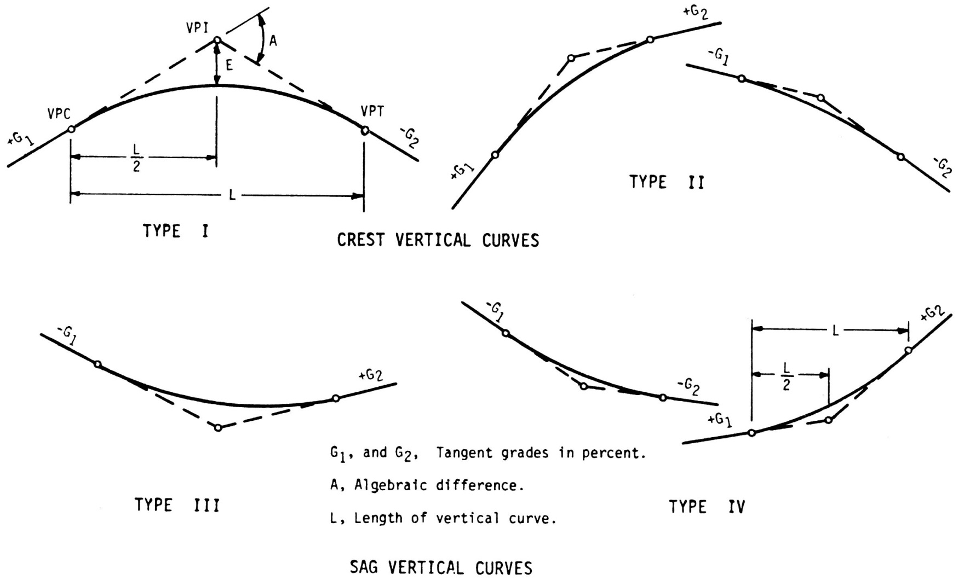
Types of Crest and Sag Vertical Curves

Slide 5
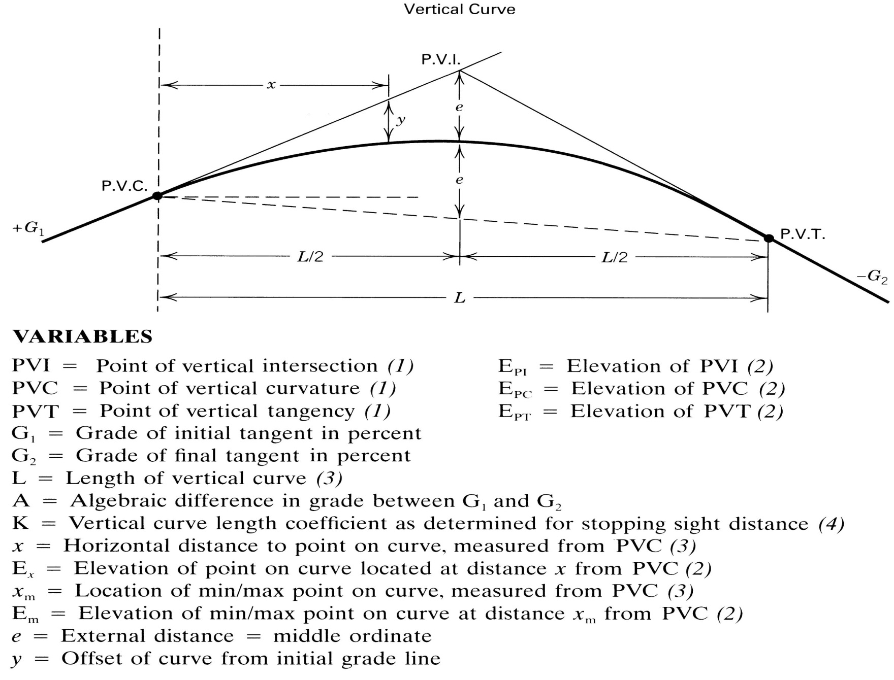
Properties of Typical Vertical Curve

Slide 7
EXAMPLE-1
A plus 3.0 percent grade intersects a minus 2.0 percent grade at station 3 + 20 and at an elevation of 320.40 ft. Given that a 180-ft length of curve is utilized,
Determine the station and elevation of the PVC and PVT.
Calculate elevations at every even 25-ft station
Compute the station and elevation of the high point of the curve

Slide 8
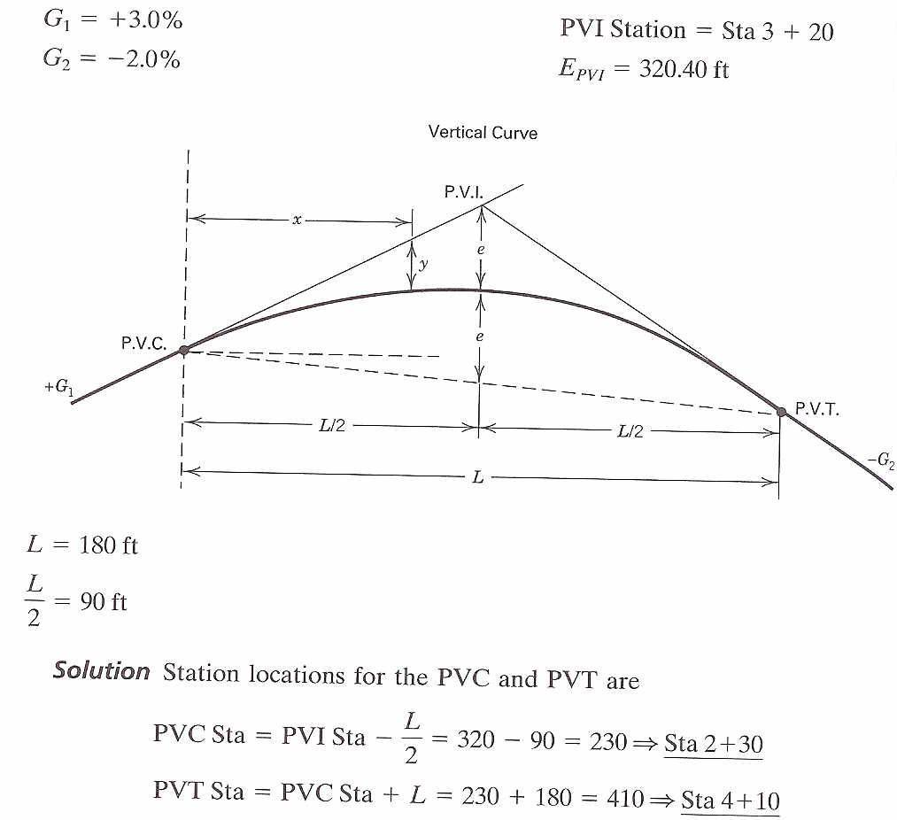
Solution

Slide 9
EXAMPLE (continued)
E_{PVC} = E_{PVI} - (G₁/100)(L/2) = 320.40 - 0.03(90) = 317.70 ft
E_{PVT} = E_{PVI} - (G₂/100)(L/2) = 320.40 - 0.02(90) = 318.60 ft
Location of high point:
High point Sta = PVC Sta + X_{m} = 230 + 108 = 338 → Sta 3+ 38
Elevation of high point:

Slide 10
Calculations for point elevations at even 25-ft stations along the vertical curve
Station | x (feet) | Elevation on Initial Tangent | y | Final Elevation on Curve (Elev on tan - y)
2 + 50 | 20 | 318.30 | -0.06 | 318.24
2 + 75 | 45 | 319.05 | -0.28 | 318.77
3 + 00 | 70 | 319.80 | -0.68 | 319.12
3 + 25 | 95 | 320.55 | -1.25 | 319.30
3 + 50 | 120 | 321.30 | -2.00 | 319.30
3 + 75 | 145 | 322.05 | -2.92 | 319.13
4 + 00 | 170 | 322.80 | -4.01 | 318.79
4 + 10 | 180 | 323.10 | -4.50 | 318.60

