Slide 1

Verbal Communication
CHS 446
Communication Skills for the
Healthcare Professional
Mohammed S. Alnaif, Ph.D.
alnaif@ksu.edu.sa

Slide 2
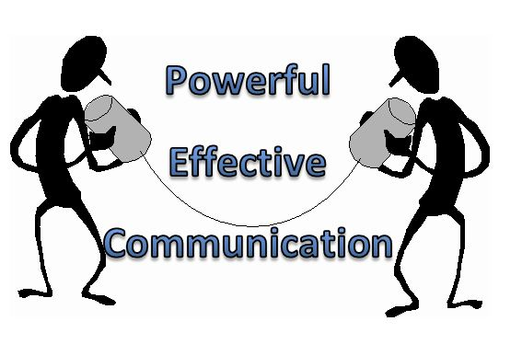
Verbal Communication
Objectives
Explain the purpose of using clear language for effective verbal communication with patient.
Identify practices for effective verbal communication with patients and other healthcare providers.
Develop skills for listening and paraphrasing.
Explain why providing empathy and understanding to the patient is so important

Slide 3
Verbal Communication
The lack of effective communication is the single most common cause of patient complaints. As a healthcare professional (HCP), you simply must have good verbal communication skills.
From the initial job interview through the promotion process, a professional’s ability to communicate verbally is continually assessed by hiring committees and supervisors.

Slide 4
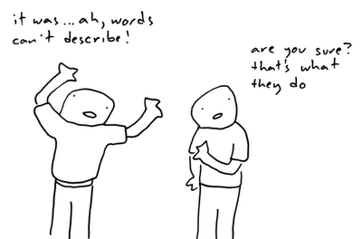
Verbal Communication
Most important, is that an HCP who has strong communication skills will always be more effective in helping patients.
However, it is important also to remember that being a good verbal communicator is not simply a matter of having a large vocabulary or the ability to use highly technical language.

Slide 5
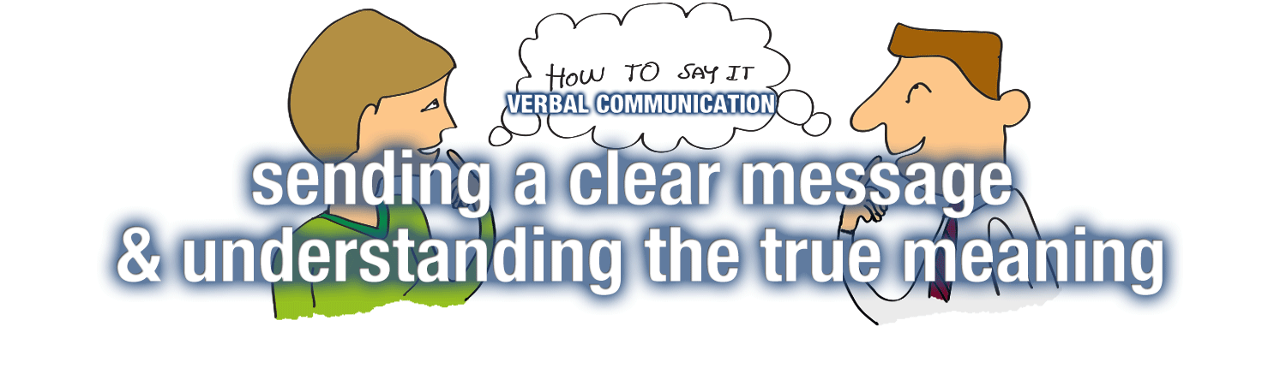
Verbal Communication
Being a good communicator consists of maximizing the effectiveness with which you understand what others are trying to till you and accurately conveying what you want to say.
As a future HCP, you can not afford to have weak verbal communication skills.

Slide 6
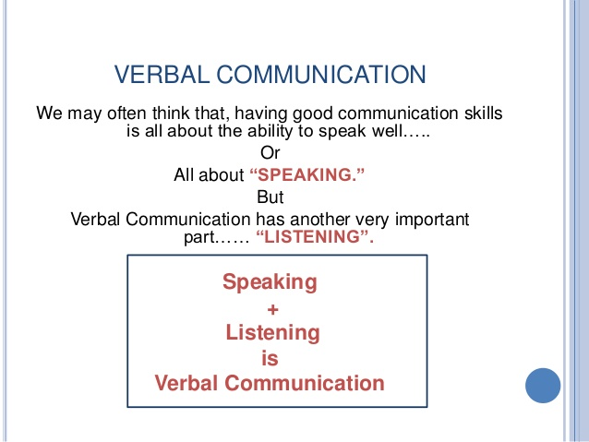
Verbal Communication
verbal communication is the use of spoken words and sounds to successfully transfer a message from the sender to the receiver.

Slide 7
Verbal Communication
Content and Word Choice
The content must be as clear as possible, and this means that the speaker must have a clear understanding of what they mean to say.
The speaker should avoid unclear, ambiguous, or unnecessarily technical language.
The HCP professional who communicate effectively will have a clear sense of what they want to say and they will say it using appropriate word choice

Slide 8
Verbal Communication
Grammar and Pronunciation
Incorrect grammar can obstruct the clarity of message , and just As important, can diminish the confidence the listener has the speaker knows what they are talking about.
The same holds for pronunciation. Incorrect pronunciation inhibits understanding and can cause mistrust.

Slide 9
Verbal Communication
Tone
The tone with which the HCP speaks to the patient is vital to the therapeutic relationship because it indicates an understanding of the patient’s needs and enhances the HCP’s ability to meet those needs.
Generally speaking, the tone the HCP uses should be relaxed and conversational, helping to establish a connection with the patient.

Slide 10

Verbal Communication
Three types of Tone
Expressive Tone is spontaneous, emotional, and uninhibited. We use this tone, for instance, when we express our feelings, tell jokes, or complain-when we socialize.
This is generally not a tone of voice the HCP should use when speaking to patients, because it takes the focus of the discussion off the patient and puts it on the HCP

Slide 11

Verbal Communication
Three types of Tone
The HCP should make every effort to let the patient know that the patient’s needs are the reason for the visit.
Research indicates that patients do not usually appreciate an emotional or even joking tone from their HCPs.

Slide 12

Verbal Communication
Directive Tone
A directive tone is authoritative and judgmental. This the tone one uses to give orders, exert leadership, or pass judgment.
The directive tone is an indication that there exists a difference in professional rank between the speaker and the listener.

Slide 13

Verbal Communication
Directive Tone
The directive tone is generally not an appropriate tone for the HCP to use when speaking to patients.
Patients come into the practice seeking expert treatment that include understanding and empathy on the part of the healthcare team.

Slide 14
Verbal Communication
Directive Tone
Consider the following two examples involving a nurse whose patient has an upper respiratory infection.
The patient’s doctor has prescribed an antibiotic to fight the infection. In the first example, the nurse orders the patient to comply, and in the second, instructs the patient about the benefits of compliance

Slide 15

Verbal Communication
Directive Tone
Ordering the patient: “I am telling you. Do not miss a single dose of this pill. If you do, you infection won’t go away and you ‘ll feel even worse”.
Explaining to the patient: “taking these pills regularly will achieve the best results. You ‘ll do a better job of fighting the infection.

Slide 16

Verbal Communication
Problem Solving Tone
The problem solving tone is rational, objective, and unbiased. This is the tone we use to indicate to the listener that we are using the analytical portion of our brains to come to the correct answer about a certain set of circumstances.
This is the tone the HCP uses most frequently when serving patients’ needs.

Slide 17
Verbal Communication
Problem Solving Tone
A significant part of the allied health professional’s job consists of verbally collecting important information from the patient and providing explanations and solutions to the patient.
The problem solving tone is what the patient rightfully expect from the HCP.

Slide 18

Verbal Communication
Emphasis
By this time, it should be clear that how you something is often just as important as what you want to say. Even within a sentence, the emphasis you place on certain words or parts of a sentence can lead to vastly different interpretations by the patient.

Slide 19
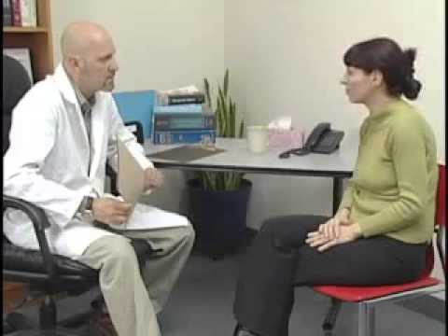
Verbal Communication
Small Talk
Small talk is what we say to each other before we begin to discuss the business at hand. Small talk is talk about the weather, the local sports team, and traffics and why the patient was late getting to the doctor’s office.
Small talk is not talk about emotional, personal, or controversial subjects.

Slide 20

Verbal Communication
Small Talk
An HCP can use small talk to help a nervous patient feel more at ease, taking some of the feelings of pressure off the patient.
When the patient is more comfortable, they will be able discuss their case.
Small talk should be viewed and used as a tool for building a bond with the patient.

Slide 21
Verbal Communication
Using Commentary
Sometimes the HCP must focus on some task that is part of the care process but is not part of directly engaging the patient in questions and answers.
These tasks can range from the unpleasant, such as changing a colostomy bag, or cleaning an infected intravenous (IV) site, or entering data into the patient’s file on a computer.

Slide 22
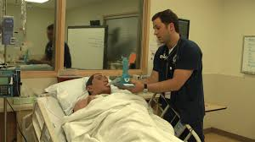
Verbal Communication
Using Commentary
It is helpful to the process if the HCP briefly comments on what they are doing, just to keep the interaction alive and allow the patient to remain engaged in the active role they take in their care.
Such commenting, moreover, can ease fear and reduce anxiety for the patient.

Slide 23
Verbal Communication
Using Commentary and Small Talk
One should remember, though, that strategies such as small talk and commentary are best used to build and strengthen rapport with patients.
When used too frequently or for excessive amounts of time these techniques can become distracting to the patient.

Slide 24

Verbal Communication
Important Practice for Effective Verbal Communication with Patients and Other HCPs
Send a Clear Message
An effective message is a clear message, it is crucial that the information you provide to the patient is clear and unambiguous.

Slide 25
Verbal Communication
Important Practice for Effective Verbal Communication with Patients and Other HCPs
Use standard language and not a slang
A patient comes to a practice expecting to receive expert care, and the use of the standard language by the HCP is a signal that expert care is, in fact, what the patient will receive.

Slide 26
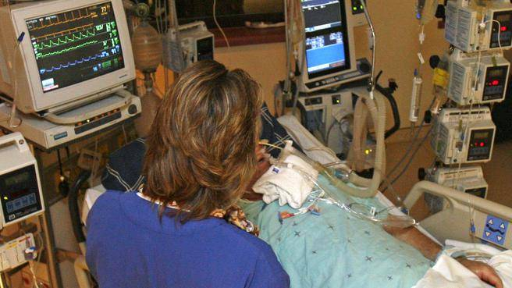
Verbal Communication
Important Practice for Effective Verbal Communication with Patients and Other HCPs
Avoid Using Medical Jargon When Speaking to the Patient
Many professions have specialized language that is used primarily by those who work in the profession when communicating among themselves. Such a specialized language is called jargon.

Slide 27

Verbal Communication
Important Practice for Effective Verbal Communication with Patients and Other HCPs
Talk to the Patient, not at the Patient, and Be a Good Listener
Making sure that you talk to the patient and not at them is a way of showing respect for the patient and their concerns. This involves providing some nonverbal cues to the patient, such as facing the patient directly and making appropriate eye contact, letting them know that when they speak you are listening carefully.

Slide 28
Verbal Communication
Important Practice for Effective Verbal Communication with Patients and Other HCPs
Help the Patient to Be a Good Listener
This begins with speaking in a conversational and relaxed manner, and by using vocabulary and language that are appropriate.
Use your own words to repeat back to the patient what they have told you to verify that they agree with their own version.

Slide 29
Verbal Communication
Developing Skills for Listening and Paraphrasing What the Patient Says
To paraphrase is to use your own words to repeat what someone else has said.
Good Paraphrasing skills are essential to effective communication.
A HCP should use Paraphrasing for several reasons.
  A test of the message for the HCP
  A test of the message for the Patient
  A building of Rapport—a Human Connection
  Focusing on the Patient and Keeping the Patient Talking

Slide 30

Verbal Communication
Developing Skills for Listening and Paraphrasing What the Patient Says
A test of the message for the HCP
  Paraphrasing back to the patient what the patient has said provides the HCP with an opportunity to verify that they have understood what the patient has said.
A test of the message for the Patient
  The patient listen to their HCP’s Paraphrase, checking to see that the
  Paraphrase is what the patient intended to say and that the HCP understand.

Slide 31
Verbal Communication
Developing Skills for Listening and Paraphrasing What the Patient Says
A building of Rapport—a Human Connection
  Paraphrasing what the patient says helps to build trust between the patient and the HCP.
  The HCP shows engagement with the patient’s case, validating the patient’s concerns.
  The patient understands from this interaction that the HCP is focused on the patient and cares about them.
  The patient is then more likely to slow down and listen carefully to the HCP.

Slide 32
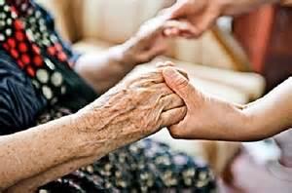
Verbal Communication
Developing Skills for Listening and Paraphrasing What the Patient Says
Focusing on the Patient and Keeping the Patient Talking
  Paraphrasing what the patient says reinforcing the point that the healthcare encounter is occurring for the purpose of helping the patient.
  When the patient clearly understands this, the patient will feel more comfortable and open up.
  Patients typically have a lot to say about their own case, even if they do not seem to at first.

Slide 33
Verbal Communication
Developing Skills for Listening and Paraphrasing What the Patient Says
Listening
Receiver’s role is to listen.
Hearing and listening are two distinct activities.
    Hearing is biophysical
    Listening is an active process
Effective listening skills are necessary and a major part of your expertise as an HCP.
A good listener gains the confidence of the speaker.

Slide 34
Verbal Communication
Developing Skills for Listening and Paraphrasing What the Patient Says
Focusing on the Patient and Keeping the Patient Talking
Three steps to good listening:
    Focus attention on the speaker and what is being said
    Interpret what is said to understand
    Restate what you thought you heard (Paraphrasing)
Being a good listener means being receptive and open, but not playing the role of advisor.

Slide 35

Verbal Communication
Providing Empathy and Understanding to the Patient
  To show empathy to the patient is to show that you understand how the patient feels.
  The patient will almost always tell you how they are feeling, even when they are trying not to.
  Either through nonverbal or verbal means, the patient will communicate, which means that the HCP must be an effective listener and observer.

Slide 36
Verbal Communication
The Difference between Empathy and Sympathy.
  Empathy is sometimes confused with sympathy, but there are important differences between these two concepts.
  To feel empathy is to feel what another person is feeling
  To feel sympathy is to have an awareness of what another person is feeling, and to feel sadness, pity, or sorry for that other person.
  Showing empathy for a patient can build rapport between the HCP and the patient.

Slide 37
Verbal Communication
The Difference between Empathy and Sympathy.
Sympathy goes beyond empathy because it involves an emotional response.
Empathy is intellectually but not emotionally identifying with feelings, thoughts, or attitudes of another person.
Learn to provide compassionate care without emotionally exhausting yourself.
Being empathic helps to keep distance so you can think and act in your patient’s best interest.

Slide 38
Verbal Communication
Writing
A significant way of communicating information in health care
Charting as a direct influence on patient care
    Give facts, not opinions
    Use approved abbreviations

Slide 39
Verbal Communication
Questioning the Patient
  The HCP has three types of questions they can use to elicit information from the patient
  Open-ended Questions
  Closed Questions
  Multiple Choice Questions

Slide 40
Verbal Communication
Questioning the Patient
Open-ended Questions lead to the kinds of answers that the HCP will want to Paraphrase, that is, longer answers with more detail and emotions.
We use Open-ended Questions when we want to hear the whole story.
Open-ended Questions most frequently begin with the words “how” “what”.

Slide 41
Verbal Communication
Questioning the Patient
Open-ended Questions encourage the patient to further discuss issues of concern.
Open-ended Questions are important for a complete understanding of the patient’s needs.
How often does this occur?
Why you did not take your medications?

Slide 42
Verbal Communication
Questioning the Patient
  Closed Questions
  There are times when an HCP wants very specific information from the patient and at these times the HCP may use Closed Questions.
  Closed Questions prompt a short and focused answer, frequently just a “yes” or “no” or perhaps a one-word answer.
  These type of questions are especially helpful in filling the gaps in what the patient says

Slide 43
Verbal Communication
Questioning the Patient
  Closed Questions
  Consider the following examples of Closed Questions
  Which arm hurts?
  What city do you live in?
  Can you hear me?
  How many times a day?

Slide 44
Verbal Communication
Questioning the Patient
  Multiple Choice Questions provide the patient with alternative options from which to choose.
  These can be helpful in allowing the patient to collaborate with the HCP in the management of their care, thereby helping patients to feel more empowered in making care-related decisions.
  Multiple Choice Questions can also be helpful when working with patients who are withdrawn, depressed, or anxious, in that they aid the patients in taking steps in prioritizing their actions.

Slide 45
Verbal Communication
Questioning the Patient
  Multiple Choice Questions
  Consider the following example, in which a nurse’s aide works with a geriatric patient living in an assisted living facility.
  HCP: “What would you like to do first this morning Mr. Saleh?”
    “Would you like to eat breakfast, bathe, or watch television?”
  Patient: “I want to watch television while eating breakfast. I can take a bath later.”

Slide 46
Verbal Communication
Questioning the Patient
  Multiple Choice Questions
  One possible disadvantage to Multiple Choice Questions is that they can sometimes feel too complicated to the patient, which can leads to the patient’s confusion or frustration.

Slide 47
Verbal Communication
Some Do’s and Don’ts of Verbal Communication
Use the patient’s name
Do not interrupt the patient
Do not talk about yourself instead of talking about the patient
Ask questions to show interest related to what is being said
Be courteous, interested, and nonjudgmental
Ineffective communication skills can lead to errors in patient care.

Slide 48
Verbal Communication
Some Do’s and Don’ts of Verbal Communication
Pay close attention to what patients say, and how they say it
  Avoid emotional conversations
  Do not tell the patient you know how they feel.
  Respect patients and address them as they prefer
  Be honest to develop trust
  Ask questions requiring more than “yes” or “no”
  Restate what you thought you heard

Slide 49
Thank You

