Slide 1
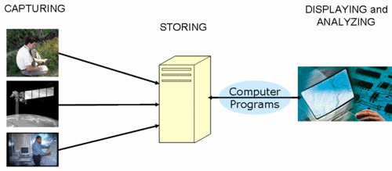
Unit 4: data analysis
Geo 382: Geographical Information Systems
Geology and Geophysics Department
King Saud University

Slide 2
What is spatial analysis
The true power of GIS lies in the ability to perform analysis.
Spatial analysis is a process in which you model problems geographically, derive results by computer processing, and then explore and examine those results.
Geographic information systems uses spatial analysis in order to understand geographic questions.
This type of analysis has proven to be highly effective for evaluating the geographic suitability of certain locations for specific purposes, estimating and predicting outcomes, interpreting and understanding change, detecting important patterns hidden in your information, and much more.

Slide 3
What is spatial analysis
What types of relationships exist between geographic features, and how do we express them?
Properties of spatial features and/or relationships between them: size, distribution, pattern, contiguity, neighborhood, shape, scale, orientation.
GIS analysis can be used to answer questions like: Where’s the most suitable place for a housing development?
A handful of seemingly unrelated factors: land cover, relative slope, distance to existing roads and streams, and soil composition: can each be modeled as layers, and then analyzed together

Slide 4
What role does GIS play in Spatial Analysis?
GIS is a tool with unique capabilities:
Can handle geographically-referenced data
Spatial/attribute data entry/update capabilities
Data conversion functions
Storage and organization of a variety of spatial and attribute data
Manipulation of spatial and attribute data (encompasses many different operations)
Presentation/display capabilities
Spatial analysis tools (many tools may be used in combination)

Slide 5
Analysis in GIS
Traditionally, geographic information systems are considered to perform four basic functions: input/updating, data conversion, storage/organization, manipulation, spatial analysis and output (presentation/display). Analysis module usually contain four important functions:
Selection is a rather simple operation, but it is important because all subsequent work is based on the results of the selection process.
Manipulation has to do with aggregation, buffering, overlaying and interpolation.
Exploration is the first step in discovering any kind of pattern or cluster in a data set. Explorative spatial data analysis (ESDA) uses the data in an inductive way to get new insight about spatial patterns and relations - "we let the data speak for themselves”.
Confirmation can be seen as tools for estimation of process models, simulation and forecasting,

Slide 6
Analysis Procedure
Before starting any analysis, one needs to assess the problem and establish an objective.
The following steps outline the basic procedure for geographical analysis:
1. Establish the objectives and criteria for the analysis: Define the problem and then identify a sequence of operations to produce meaningful results.
2. Prepare the data for spatial operations: Prepare all map coverages for the proposed data analysis. Add one or more attributes to coverages in the database if necessary.

Slide 7
Analysis Procedure
3. Perform the spatial operations: Perform the spatial operations and combine the coverages, e.g. creating buffering zones around features, manipulating spatial features and performing polygon overlay.
4. Prepare the derived data for tabular analysis: Make sure the feature attribute table contains all the items needed to hold the new values to be created.
5. Perform the tabular analysis: Calculation and query the relational database using the model defined in step 1.
6. Evaluate and interpret the results: Examine the results and determine whether the answers are valid. Simple map displays and reports can help in this evaluation.
7. Refine the analysis if needed and repeat the analysis.

Slide 8
Gis spatial analysis
GIS data description answers the question "where?"
GIS data analysis answers the question "why is it there?“.
GIS Analysis is the process of deriving information from one or more layers of spatial data.
It can involve multiple steps and processes and it is perhaps the most important capability of a GIS.
It allows discovering relationships between various spatial data that might not have been apparent otherwise.

Slide 9
GIS SPATIAL Analysis
Spatial Analysis in GIS involves three types of operations: attribute queries (also known as aspatial queries), spatial queries, and generation of new data sets from the original database.
The scope of spatial analysis ranges from simple query about the spatial phenomenon to complicated combinations of attribute queries, spatial queries, and alterations of original data.
They characteristically include techniques such as single layer (horizontal operations) and multiple layer operations/vertical operations (analytical procedures that operate on multiple data layers).

Slide 10
Gis spatial analysis
These operations provide the most fundamental tools for the manipulation of the data organized on separate layers and the examination of the relationship among different features.
They can be classified according to functionality into: overlay analysis (it involves the logical connection and manipulation of spatial data on separate layers);
Proximity analysis deals with operational procedures that are based on distance measurement between features on different layers;
Spatial correlation analysis is useful for revealing the relation between features of different types, spatial querying, point-in-polygon operation, buffering, and intersection, dissolving, etc.

Slide 11
Spatial Relationships
The term spatial relationships is the use of knowledge about the physical location of the objects, measure the distance between them and examine their attributes, it is achieved through cartography (cartography is to view maps as a form of visual communication: a special-purpose language for describing spatial relationships.
The types of spatial objects are points, lines, areas (for vector), raster cells (for raster); these object types are digital representations of phenomena and are defined by their dimensionality.
An entity type is a type of phenomenon (e.g. building) and the same entity type may be represented by different types of objects at different scales e.g. a city may be a point at one scale, an area at another.

Slide 12
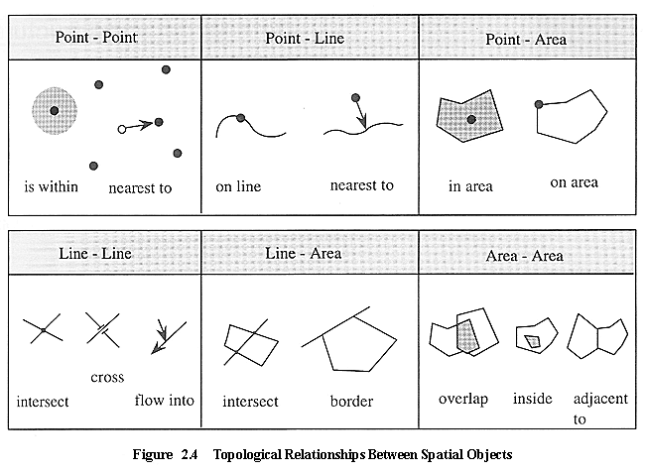
Spatial relationships
A primary function of a GIS is to determine the spatial relationships between features: Do they overlap? Is one contained by the other? Does one cross the other.

Slide 13
Types of spatial analysis
Single layer operations are GIS procedures which correspond to attribute queries, spatial queries, and alternations of data that operate on a single data layer,.
Multiple-layer operations are useful for manipulation of spatial data on multiple data layers.
Spatial modeling involves the construction of explanatory and predictive models for statistical testing
Point pattern analysis deals with the examination and evaluation of spatial patterns and the processes of point features.
Network analysis, designed specifically for line features organized in connected networks, typically applies to transportation problems and location analysis.
Surface analysis deals with the spatial distribution of surface information in terms of a three-dimensional structure
Grid analysis involves the processing of spatial data in a spatial, regularly spaced form, spatial overlay, Boundary analysis, Proximity analysis, and Buffer analysis.

Slide 14
Types of spatial analysis
The raster data model supports a wide variety of analysis methods including: Neighborhood operations, Connectivity functions, Query, Classification and Measurement functions
Analysis functions with vector-based GIS are not quite the same as with raster GIS.
There are more operations deal with objects and measurements such as area have to be calculated from coordinates of objects instead of counting cells as in raster GIS.
In vector system most of the analyses like find are done by direct search in the database.

Slide 15
Types of spatial analysis
Compared with raster GIS, some of the vector GIS operations are more accurate (e.g. estimates of area based on polygons are more accurate than counts of pixels; and estimates of perimeter of polygon are more accurate than counting pixel boundaries on the edge of a zone), some are slower (e.g. overlaying layers and finding buffers) and some are faster (e.g. finding path through road network).
By using a traditional kind of 2-D co-ordinate system, with a ‘continuous’ number system for the co-ordinate values, we can obtain a very high resolution very efficiently.
The idea of a vector representation is that we represent objects in the real world by points, lines and polygons in the GIS.

Slide 16
Identifying a nuclear waste disposal site

Slide 17
Raster overlays: (a) point-in-polygon (using add); (b) line-in-polygon (using add); (c) polygon-on-polygon (using add); (d) polygon-on-polygon (Boolean alternatives)

Slide 18
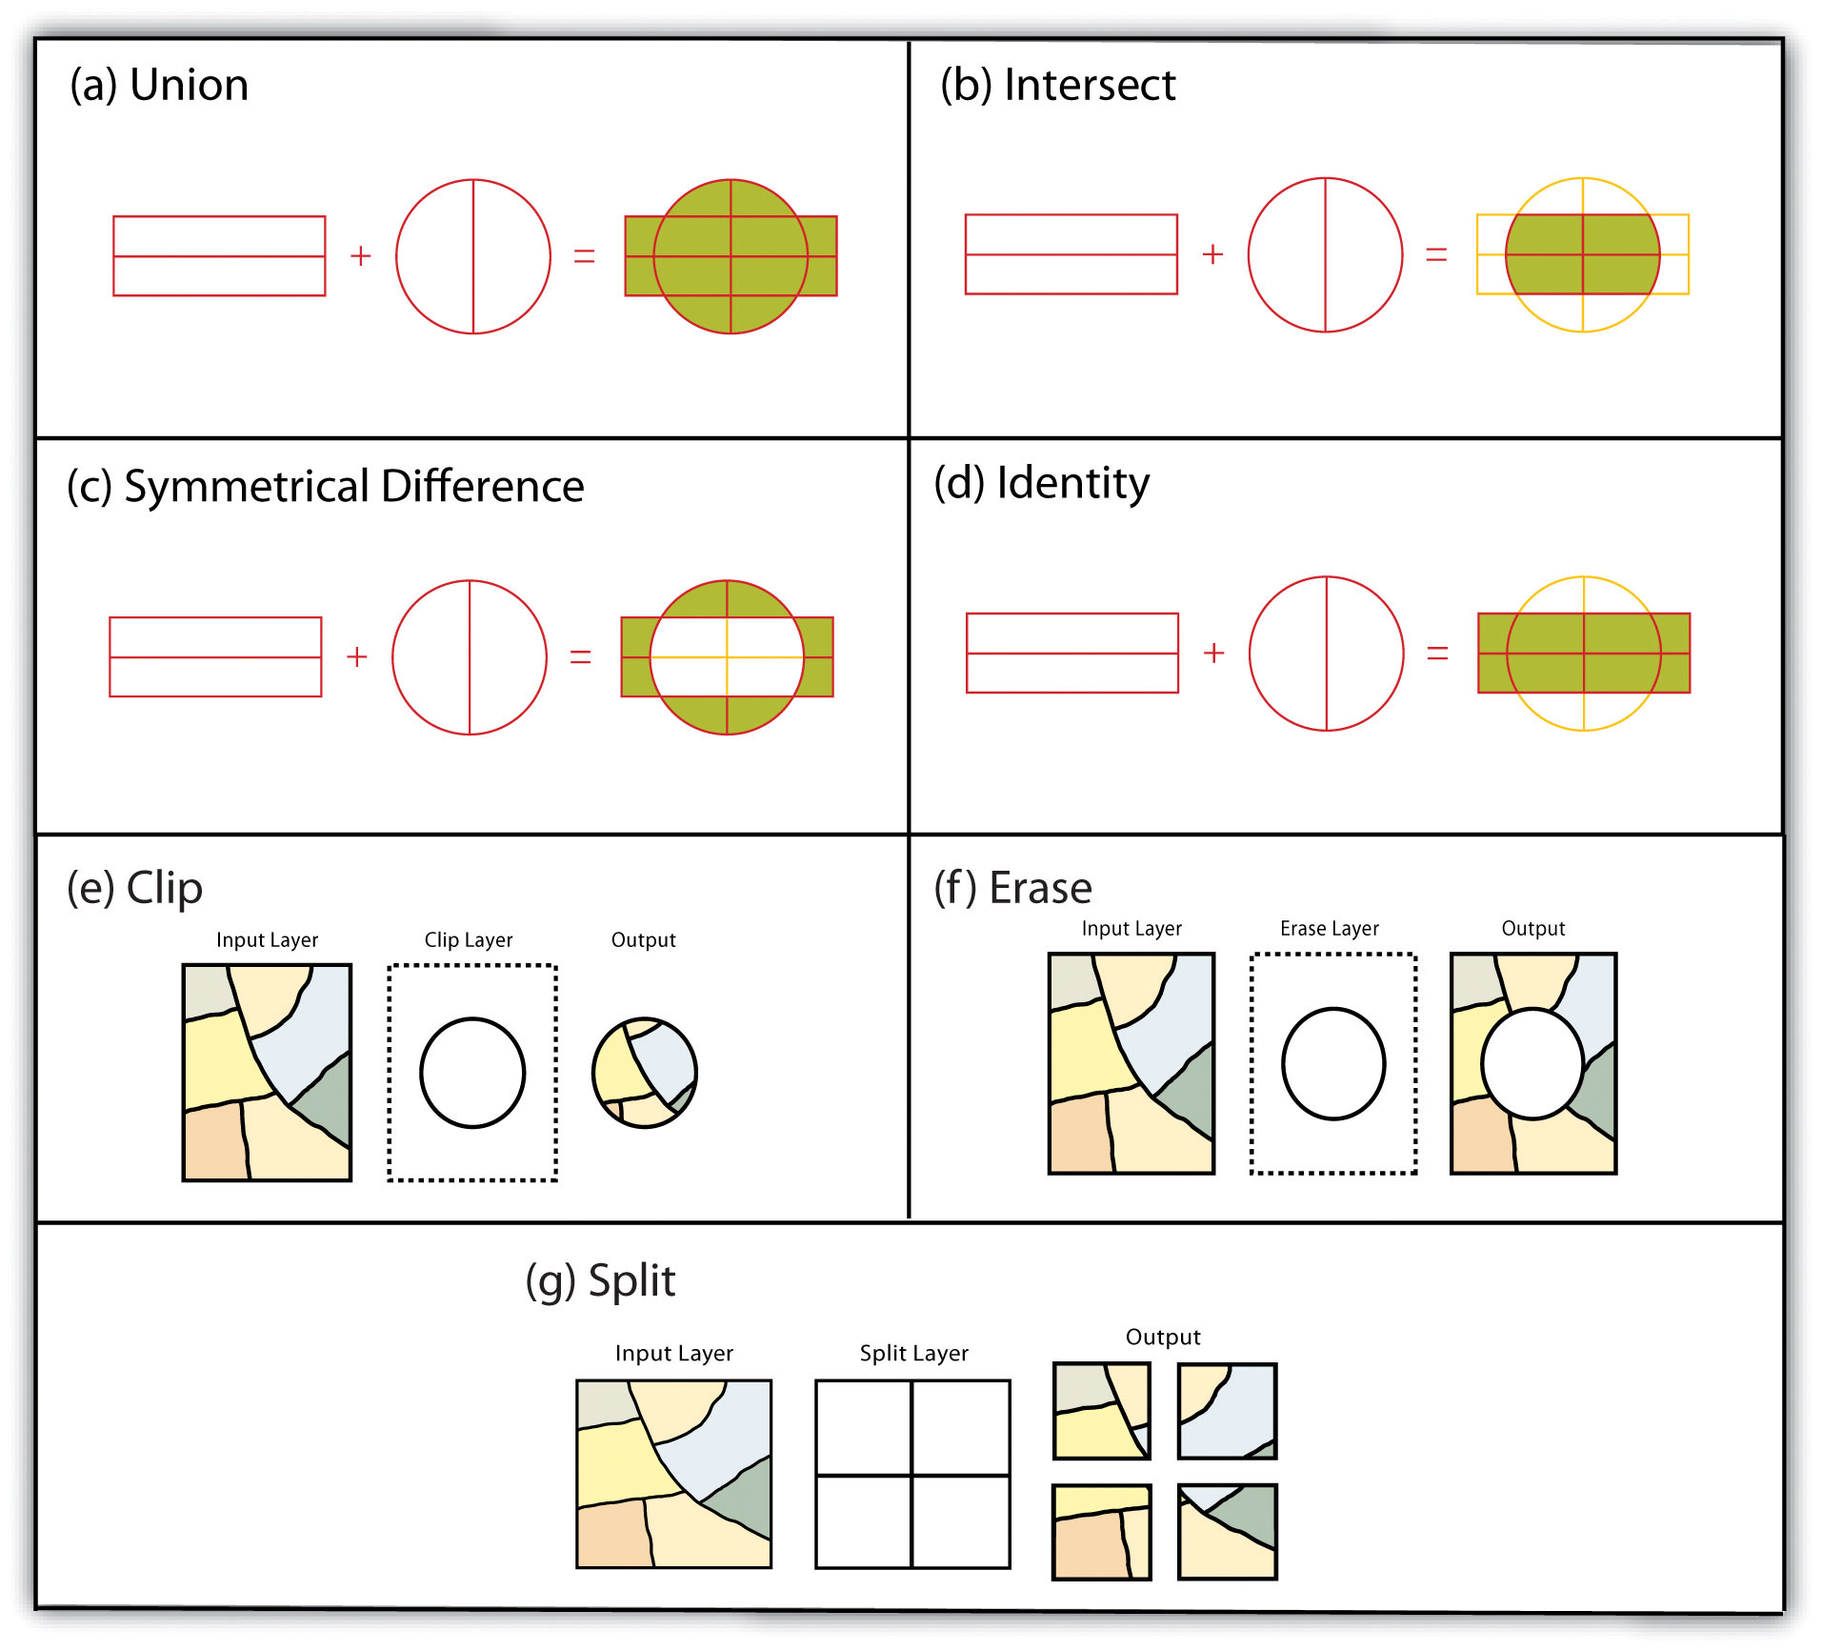
OVERLAY OPERATIONS IN gis (VECTOR DATA)

Slide 19
OVERLAY OPERAIONS IN GIS (RASTER DATA)

Slide 20
OVERLAY OPERAIONS IN GIS (RASTER DATA)

Slide 21
Map overlay in gis

