Slide 1
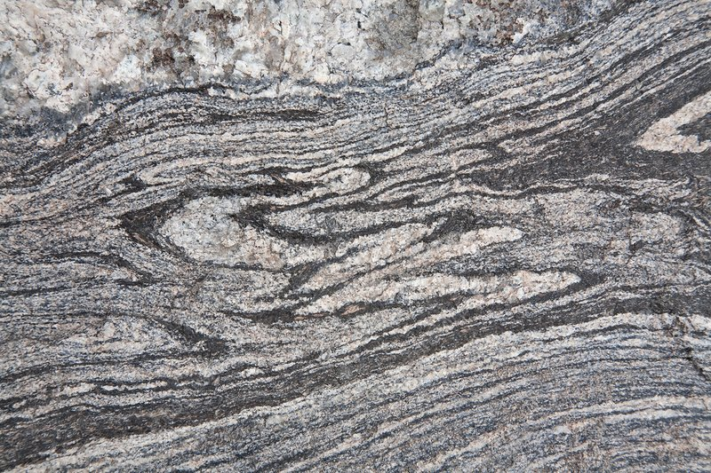
Unit 2d: minerals & rocks: Metamorphic ROCKS
Geo 281: geology for engineers
Geology and Geophysics Department
King Saud University

Slide 2
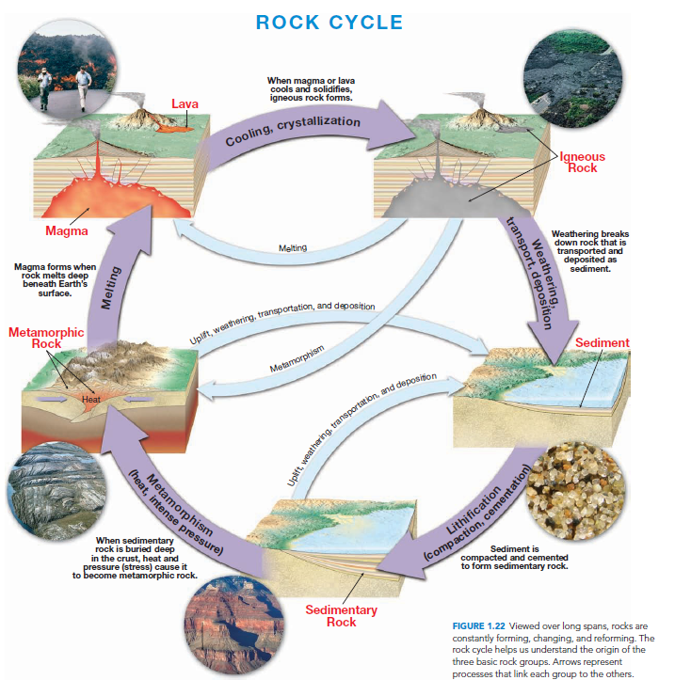

Slide 3
What is metamorphism
Metamorphism is the transformation of one rock type into another.
Metamorphic rocks are produced from preexisting igneous, sedimentary, or even other metamorphic rocks.
Thus, every metamorphic rock has a parent rock—the rock from which it was formed.
Metamorphism, which means to “change form,” is a process that leads to changes in the mineral content, texture, and sometimes the chemical composition of rocks.
Metamorphism takes place where preexisting rock is subjected to new conditions, usually elevated temperatures and pressures, that are significantly different from those in which it initially formed.
In response to these new conditions, the rock gradually changes until a state of equilibrium with the new environment is achieved.

Slide 4
Agents of metamorphism
Heat contributes to the process in two ways. First, atoms may combine differently at different temperatures.
This means that a mineral stable at one temperature might become unstable at a higher (or lower) temperature and be converted to a different mineral with a more stable atomic structure.
This may or may not involve changing the exact elemental composition.
Second, heat makes practically all chemical reactions go faster, meaning that mineral transformations are much easier at higher temperature.

Slide 5
Agents of metamorphism
Pressure also has two effects. As with heat, it can also control which minerals or forms of minerals are stable.
Some minerals may be converted to minerals with similar composition but different atomic packing simply because pressure is increased.
The exact nature of the pressure is not important in this case. Only the amount is important. Thus the confining or lithostatic pressure created by deep burial of rocks under sediment may have this effect as well as the directed pressure during mountain building processes.
The second effect of pressure is to reorient minerals with linear or platy structure or to create a preferred orientation of them as they form.

Slide 6
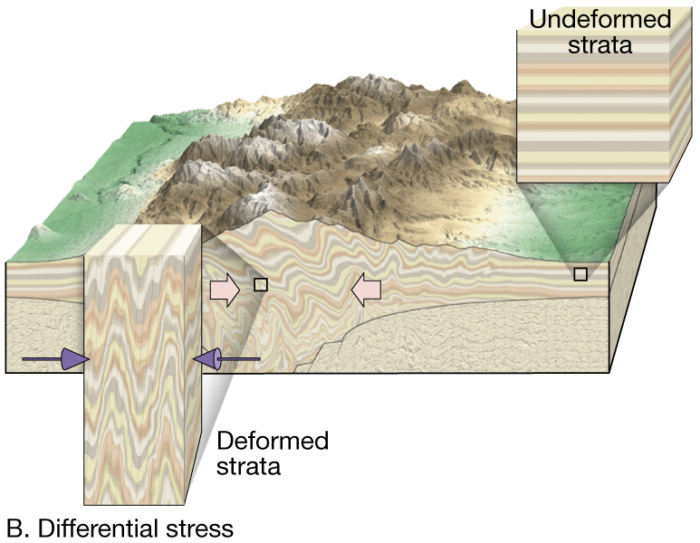
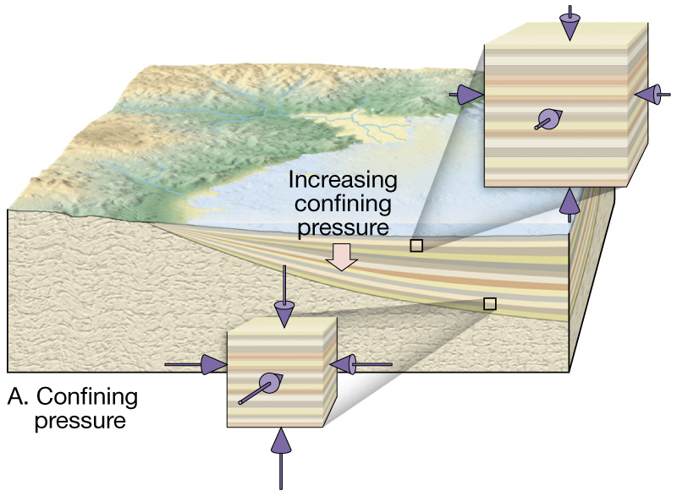
Agents of metamorphism
Confining Pressure and Directed Pressure

Slide 7
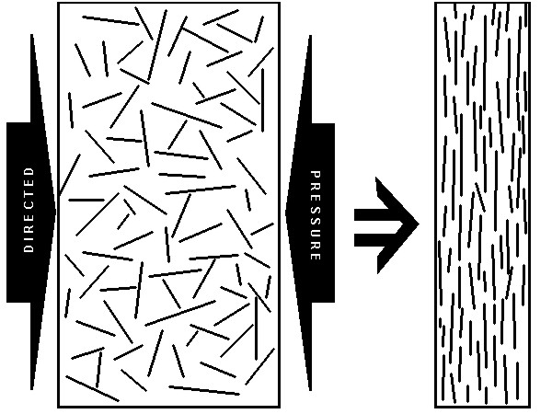
Agents of metamorphism
Thus elongate minerals such as amphiboles, or platy minerals such as clays or micas tend to align themselves parallel to each other when under pressure.
This only happens when there is directed pressure; confining pressure does not accomplish it.
The diagram illustrates the effect.
A texture of this sort in a metamorphic rock is called foliation and the rocks are said to be foliated.

Slide 8
Agents of metamorphism
Fluids serve only to speed up other metamorphic processes, or perhaps even allow them to happen at all.
Chemical reactions require water, and most proceed much faster as the amount of water goes up.
Dissolved ions in the fluid also make those mineral transformations that require chemical changes in the minerals to occur, whether by supplying needed ions or flushing away excess ones.

Slide 9
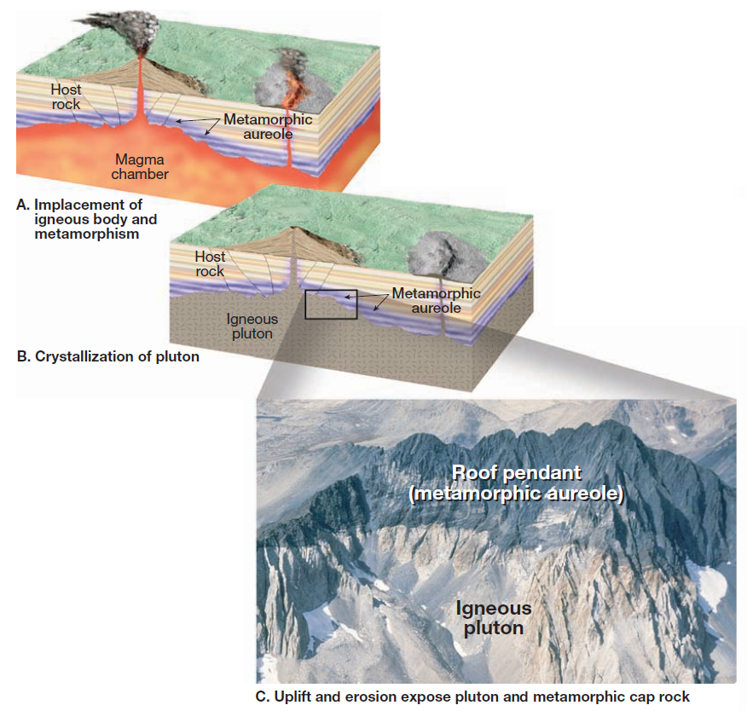
Metamorphic environment contact or thermal metamorphism
Contact or thermal metamorphism occurs when rocks immediately surrounding a molten igneous body are “baked” and therefore altered from their original state.
The altered rocks occur in a zone called a metamorphic aureole.
The size of the magma body, the mineral composition of the host rock and the availability of water greatly affect the size of the aureole produced.
High heat is the main factor which brings about metamorphism.

Slide 10
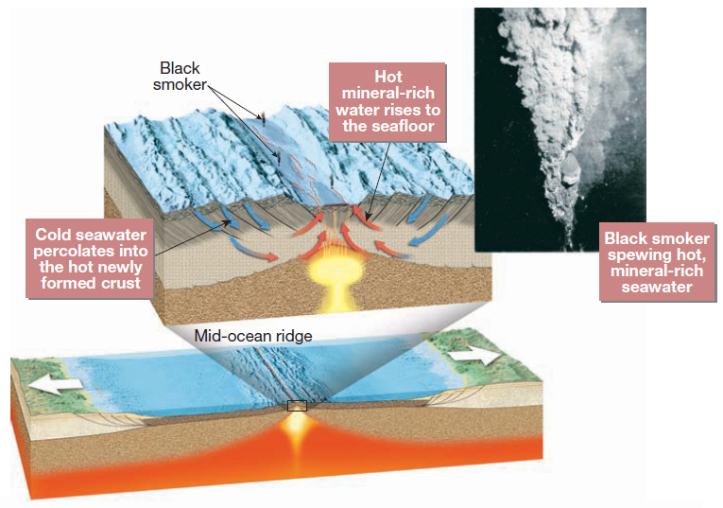
Metamorphic environment hydrothermal metamorphism
When hot, ion-rich fluids circulate through fissures and cracks in rock, a chemical alteration called hydrothermal metamorphism occurs.
If the host rocks are permeable and highly reactive, such as the carbonate rock limestone, silicate rich hydrothermal solutions react to produce a variety of calcium-rich silicate minerals.
Heat and fluids are the main factors.

Slide 11
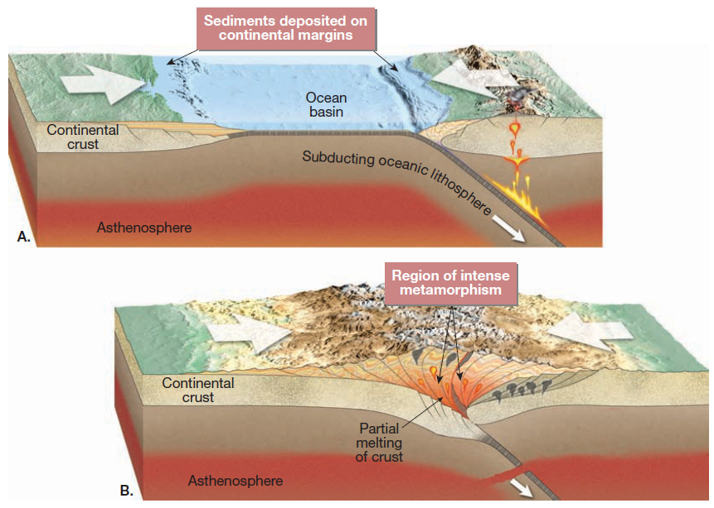
Metamorphic environment regional metamorphism
Most metamorphic rock is produced by regional metamorphism during mountain building when large segments of Earth’s crust are intensely deformed.
This activity occurs most often during continental collisions.
Sediments and crustal rocks that form the margins of the colliding continental blocks are folded and faulted, causing them to shorten and thicken like a rumpled carpet.
Pressure is the main factor responsible for the formation of metamorphic rocks.

Slide 12
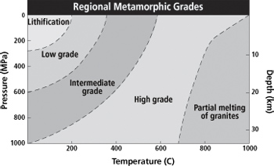
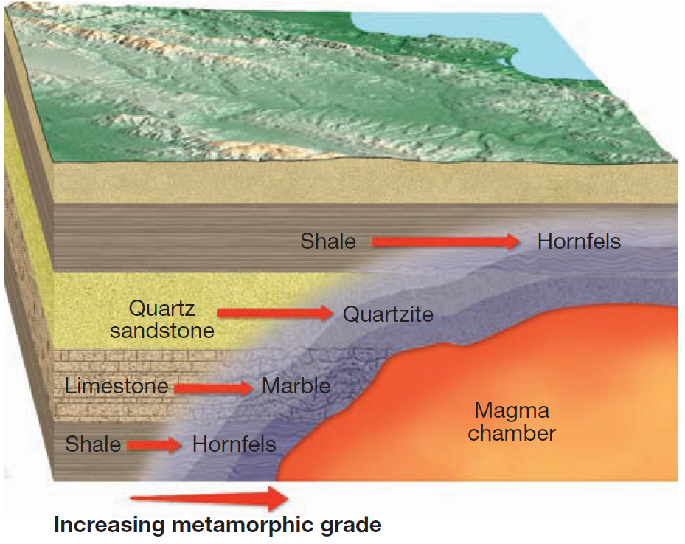
Grade of Metamorphism
Different locations in the crust experience different levels of heat and pressure as result the rocks may experience different grades of metamorphism.
The changes that occur during metamorphism are recorded in the form of texture and mineral assemblages.
High grade metamorphic rocks are greatly altered from its original form and often have a completely different mineralogy than the parent rock.

Slide 13
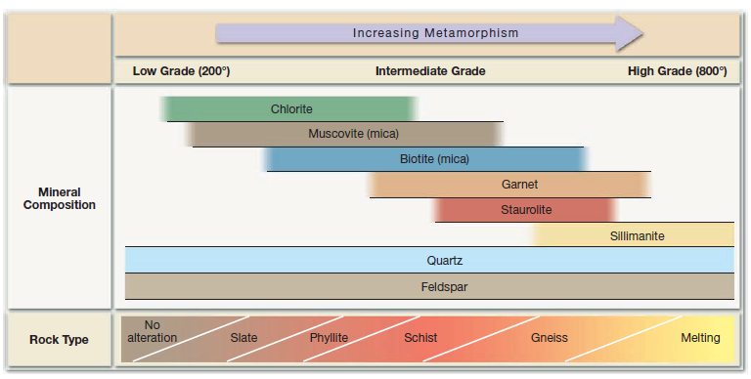
Index minerals
Through the study of metamorphic rocks it has been found that some minerals are good indicators of the metamorphic environment in which they formed. These minerals are known as index minerals.
Using these index minerals, geologists distinguish among different zones of regional metamorphism.
For example, the mineral chlorite begins to form when temperatures are relatively low, less than 200 °C Thus, rocks that contain chlorite are referred to as low-grade.
By contrast, the mineral sillimanite only forms in extreme environments where temperatures exceed 500 °C, and rocks containing it are considered high-grade.
Quartz and Feldspar also appear in metamorphic products but since they are found in both low and high grade metamorphic rocks, they are not considered as index minerals.

Slide 14
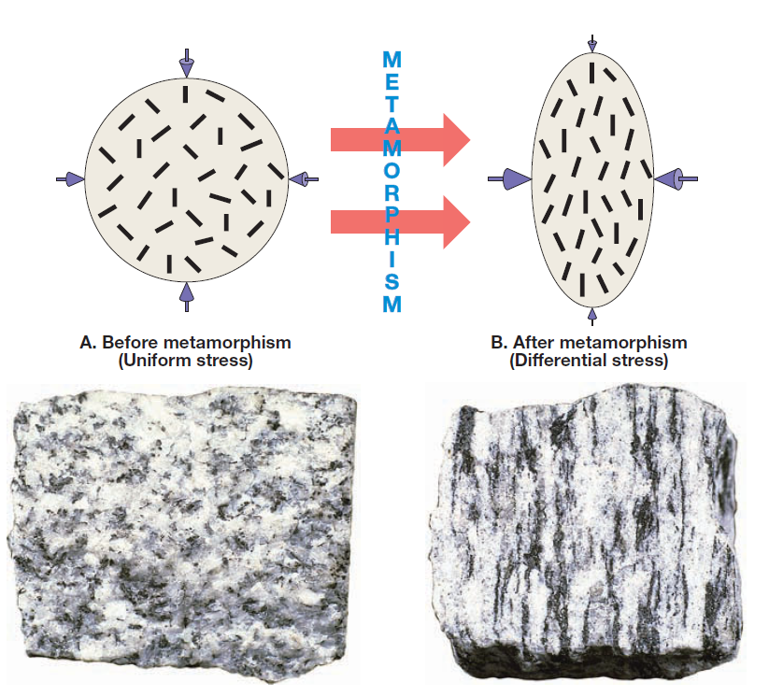
Metamorphic textures
Recall that the term texture is used to describe the size, shape, and arrangement of grains within a rock.
Deformed metamorphic rocks that contain platy minerals (micas) and/or elongated minerals (amphiboles), typically display some kind of preferred orientation in which the mineral grains exhibit a parallel to subparallel alignment.
A rock that exhibits a preferred orientation of its minerals is said to possess foliation.
The term foliation refers to any planar (nearly flat) arrangement of mineral grains or structural features within a rock.
Although foliation may occur in some sedimentary and even a few types of igneous rocks, it is a fundamental characteristic of regionally metamorphosed rocks—that is, rock units that have been strongly deformed.

Slide 15
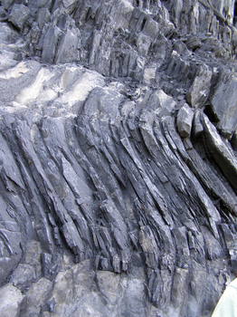
Foliated texture
ROCK OR SLATY CLEAVAGE: Rock cleavage refers to closely spaced, flat surfaces along which rocks split into thin slabs when hit with a hammer.
Rock cleavage develops in various metamorphic rocks but is best displayed in slates, which exhibit an excellent splitting property called slaty cleavage.
In a low-grade metamorphic environment, rock cleavage is known to develop where beds of shale (and related sedimentary rocks) are strongly folded and metamorphosed to form slate.

Slide 16
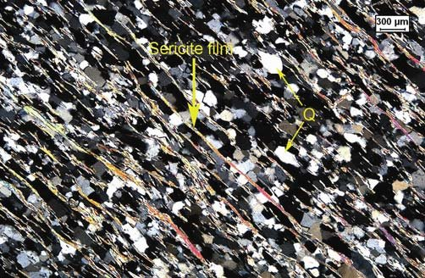
Foliated texture
SCHISTOSITY: Under higher temperature pressure regimes, the minute mica and chlorite crystals in slate begin to grow.
When these platy minerals are large enough to be discernible with the unaided eye and exhibit a planar or layered structure, the rock is said to exhibit a type of foliation called schistosity.
Rocks having this texture are referred to as schists.
In addition to platy minerals, schists often contain deformed quartz and feldspar crystals that appear flat or lens-shaped and are hidden among the mica grains.

Slide 17
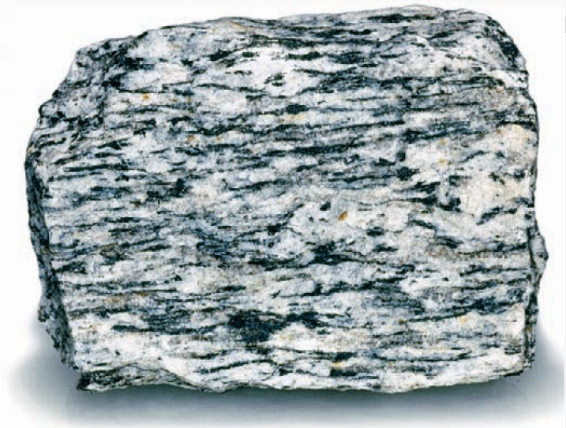
Foliated texture
GNEISSIC TEXTURE: During high-grade metamorphism, ion migration can result in the segregation of minerals.
The dark biotite crystals and light silicate minerals (quartz and feldspar) separate, giving the rock a banded appearance called gneissic texture.
A metamorphic rock with this texture is called gneiss (pronounced “nice”).
Although foliated, gneisses will not usually split as easily as slates and some schists.

Slide 18
Other metamorphic texture
Not all metamorphic rocks exhibit a foliated texture.
Those that do not are referred to as nonfoliated.
Nonfoliated metamorphic and the parent rocks are composed of minerals that exhrocks typically develop in environments where deformation is minimal and the parent rocks are composed of minerals that exhibit equidimensional crystals, such as quartz or calcite.
For example, when a fine-grained limestone (made of calcite) is metamorphosed by the intrusion of a hot magma body, the small calcite grains recrystallize to form larger interlocking crystals.
The resulting rock, marble, exhibits large, equidimensional grains that are randomly oriented, similar to those in a coarse-grained igneous rock.

Slide 19
Common metamorphic rocks

Slide 20
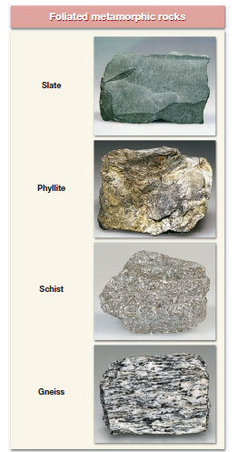
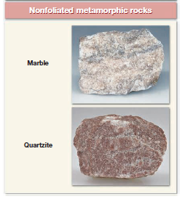
Common Metamorphic Rocks
Metamorphic Rocks are divided into two basic divisions
1. Foliated/Banded
2.Non-Foliated (also, granular or equidimensional)

Slide 21
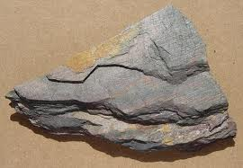
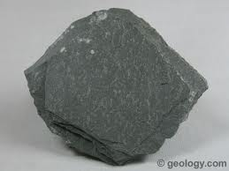
Foliated metamorphic rocks
Slate is a fine grained (less than 0.5 mm) foliated rock composed of mica flakes.
Slate is dull colored and closely resembles shale.
The most important characteristic of shale is its tendency to break into flat slabs.
Slate is generally formed by low grade metamorphism of shale, mudstone or siltstone.
Color of slate depends upon its mineral composition.
Black slate contains organic material. Red slate contains Iron Oxide.
Green slate contains chlorite.

Slide 22
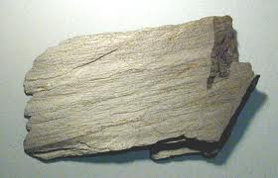
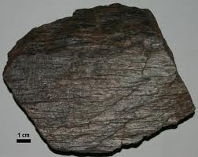
Foliated metamorphic rocks
Phyllite: It represents a degree of metamorphism in between slate and schist.
Its constituent platy minerals are larger than those in slate but still not large enough to be identified with the naked eye.
Phyllite appears similar to slate but can be distinguished from slate by its glossy sheen and wavy surface.
Phyllite also breaks as a flat surface and is composed of fine crystals of muscovite or chlorite or both.

Slide 23
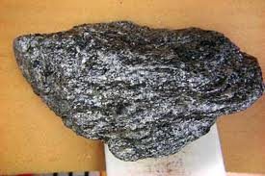
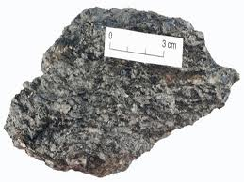
Foliated metamorphic rocks
Schists are medium to coarse grained metamorphic rocks in which platy minerals predominate.
These minerals include muscovite and biotite.
These platy minerals are arranged in a planar fashion that gives the rock its foliated texture.
In addition to mica, schist also contains other minerals such as quartz and feldspars.
Like slate, the parent rock for many schists are also shale which has undergone medium to high grade metamorphism during the process of mountain building.

Slide 24
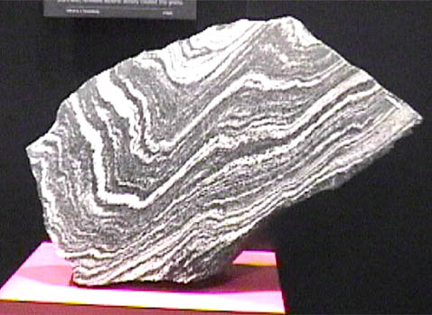
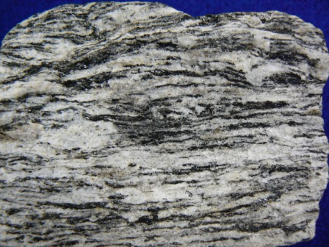
Foliated metamorphic rocks
Gneiss is the term applied to medium or coarse grained banded metamorphic rocks in which granular and elongated minerals predominate.
The most common minerals in gneiss are Quartz. Potassium feldspar, Na feldspar.
Gneiss also contains smaller amounts of biotite, muscovite and amphibole that develop a preferred orientation.
During the high grade metamorphism the dark and light colored minerals segregate giving the gneisses their typical banded or layered appearance.

Slide 25
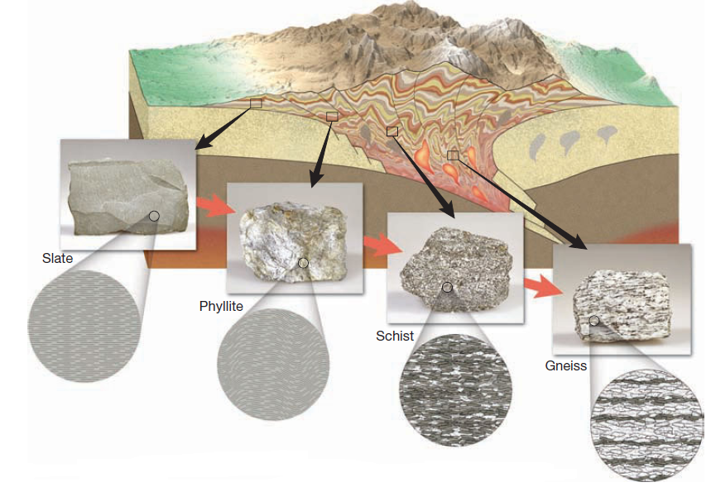
Foliated metamorphic rocks

Slide 26
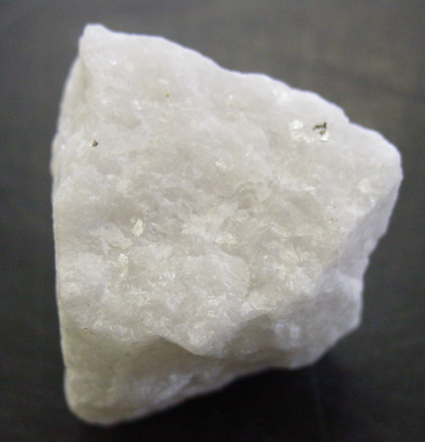
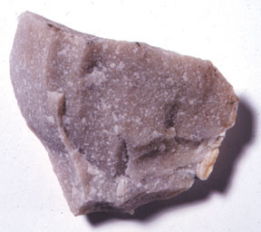
Non-foliated metamorphic rocks
Marble: It is a coarse grained crystalline rock whose parent rock was limestone or dolostone.
Pure marble is white and is composed entirely of the mineral calcite.
The parent rocks from which marbles are formed often contain some impurities and this imparts color to marble.
Marble can be pink, gray or even black in color.
Quartzite: It is a very hard metamorphic rock formed from quartz sandstone.
They are formed under moderate to high grade metamorphism.
The crystals of quartz fuse together when they undergo metamorphism and as result the crystal size for quartzite is much bigger than its parent rock.

