Slide 1
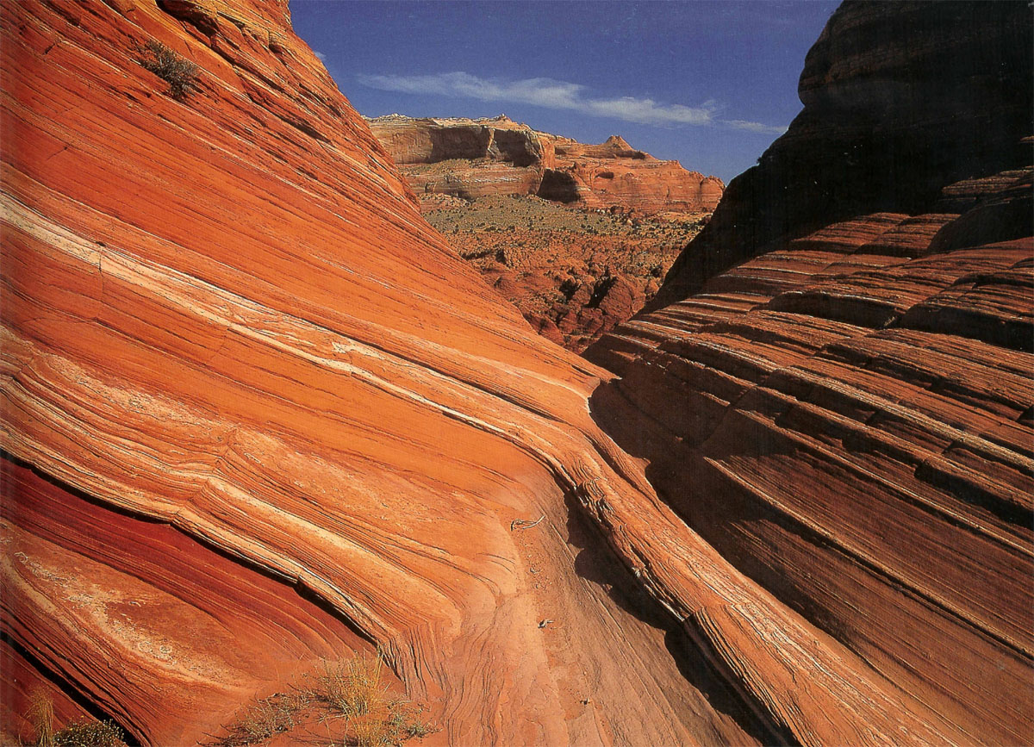
Unit 2C: minerals & rocks: SEDIMENTARY ROCKS
Geo 281: geology for engineers
Geology and Geophysics Department
King Saud University

Slide 2
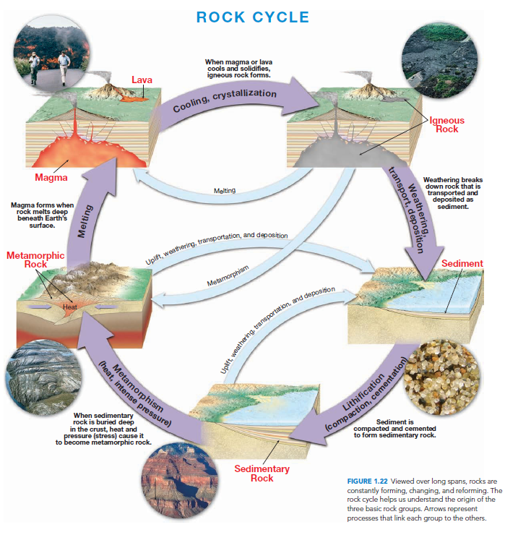

Slide 3
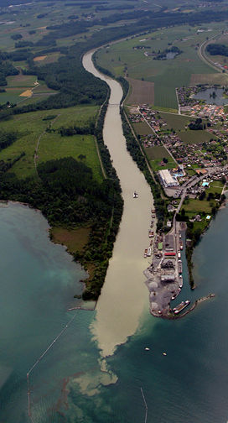
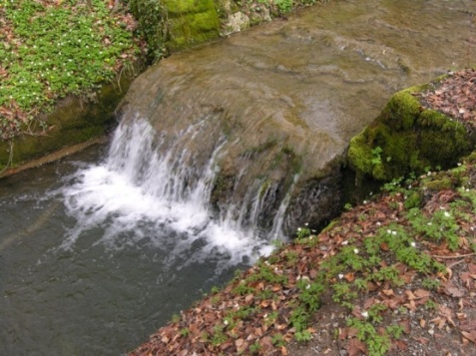
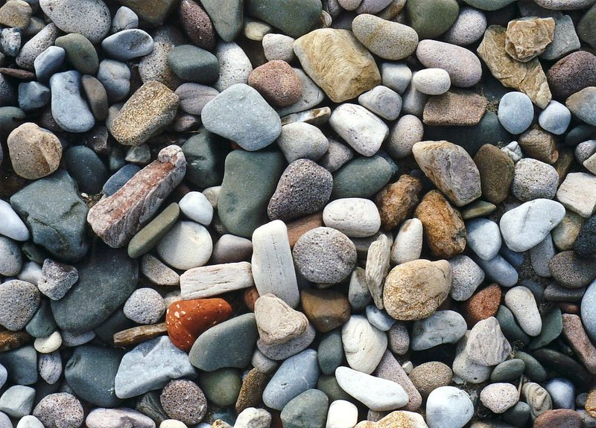
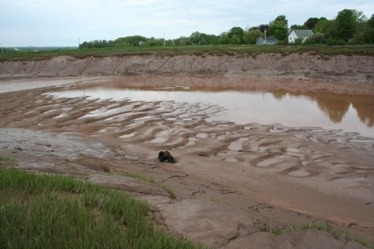
What are Sediments
Sediments are loose Earth materials (unconsolidated materials) such as sand which are transported by the action of water, wind, glacial ice and gravity.
These materials are accumulate on the land surface, (such as in river and lake beds), and / or on the ocean floor and form sedimentary rocks

Slide 4
Formation of Sedimentary rocks
Weathering begins the process. It involves the physical disintegration and chemical decomposition of preexisting igneous, metamorphic, and sedimentary rocks.
Then they are eroded from the site of weathering and moved downslope by gravity, a process termed mass wasting and are transported by wind, water, ice, and mass wasting.
Transportation moves these materials from the sites where they originated to locations where they accumulate.
Finally sediment settles out and accumulates after transport : This process is known as deposition.
As deposition continues, older sediments are buried beneath younger layers and are gradually converted to sedimentary rock by compaction and cementation. This and other changes are referred to as diagenesis (Changes that take place in texture, composition, and other physical properties after sediments are deposited).

Slide 5
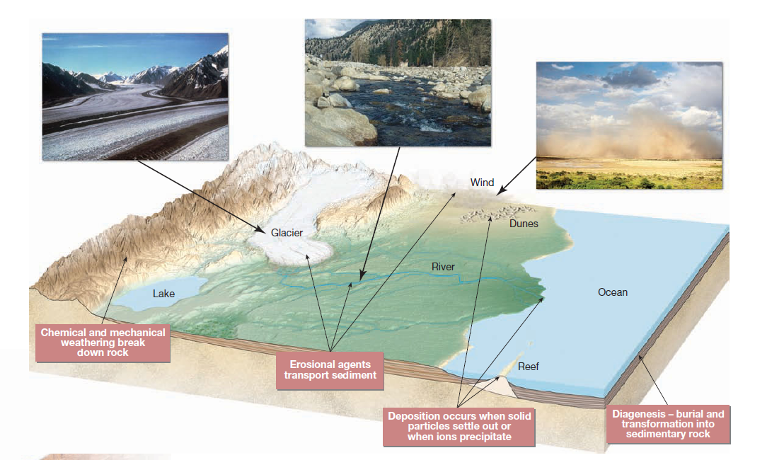
formation of Sedimentary Rocks
WEATHERING
TRANSPORTATION
DEPOSITION
DIAGENESIS
COMPACTION
CEMENTATION

Slide 6
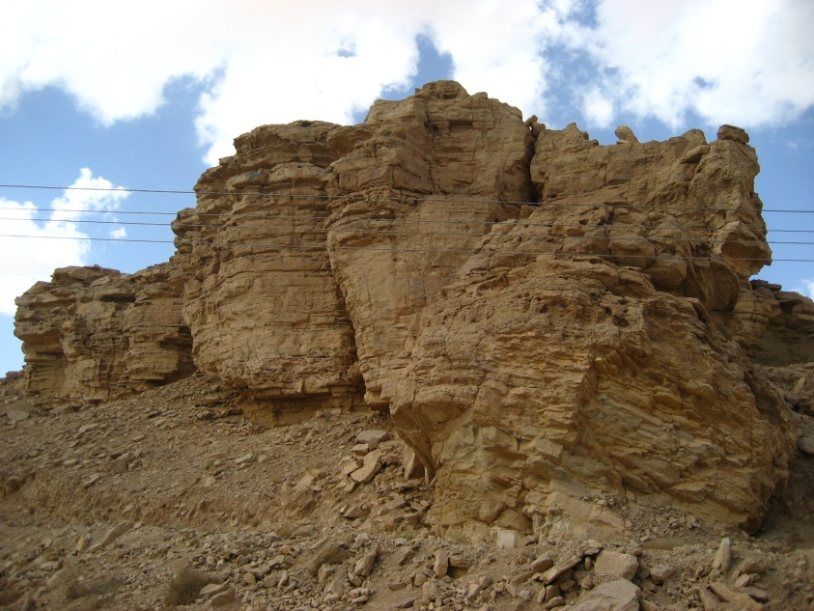
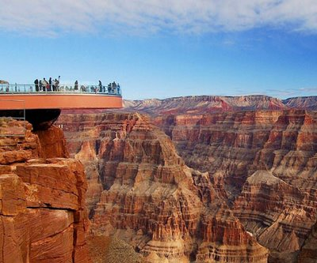
What are Sedimentary Rocks
The loose sediments after their deposition become compact and hard to form sedimentary rock.
Sedimentary rocks make up only about 5 percent of the Earth’s crust but since they are formed on the Earth’s surface, they cover about 75 percent of continents.

Slide 7
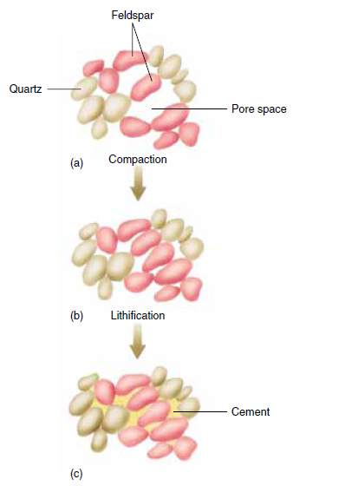
Diagenesis
Diagenesis refers to all of the physical, chemical, and biological changes that occur after sediments are deposited and during and after the time they are turned into sedimentary rock.
Diagenesis includes lithification.
Burial promotes diagenesis because as sediments are buried, they are subjected to increasingly higher temperature and pressure.
Diagenesis occurs within the upper few kilometers of earth’s crust as temperatures that are generally less than 150 degree C to 200 degree C.
Lithification refers to processes that convert loose sediment to hard rock
Two of the most important processes involved in lithification are compaction and cementation.

Slide 8
Types of Sedimentary Rocks
Because there are a variety of ways that the products of weathering are transported, deposited, and transformed into solid rock, three categories of sedimentary rocks are recognized.
As the overview reminded us, sediment has two principal sources. First, it may be an accumulation of material that originates and is transported as solid particles derived from both mechanical and chemical weathering. Deposits of this type are termed detrital, and the sedimentary rocks that they form are called detrital sedimentary rocks.
The second major source of sediment is soluble material produced largely by chemical weathering. When these ions in solution are precipitated by either inorganic or biologic processes, the material is known as chemical sediment, and the rocks formed from it are called chemical sedimentary rocks.
The third category is organic sedimentary rocks. The primary example is coal. This black combustible rock consists of organic carbon from the remains of plants that died and accumulated on the floor of a swamp.

Slide 9
Clastic/Detrital sedimentary rocks
Detrital sedimentary rocks consists of grains and particles that were eroded from weathered rocks and then were transported and deposited in loose, unconsolidated layers at the Earth’s surface.
Detrital sediments are named according to particle size.
Gravel includes all rounded particles larger than 2 millimeters in diameter.
Sand ranges from 1/16 to 2 millimeters in diameter.
Silt varies from 1/256 to 1/16 millimeter.
Clay is less than 1/256 millimeter in diameter. Mud is wet silt and clay.

Slide 10
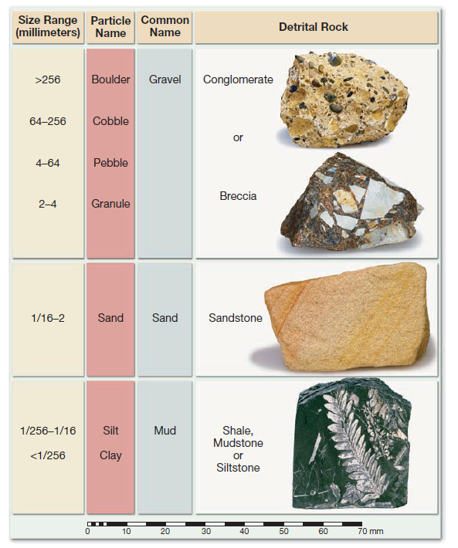
Particle size classification of detrital rocks

Slide 11
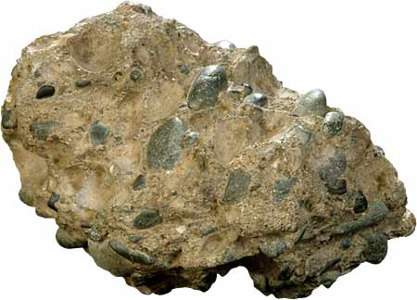
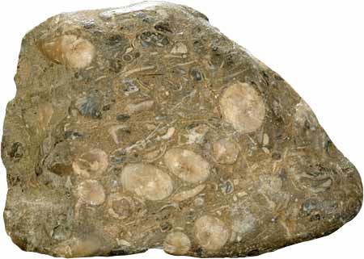
Common detrital sedimentary rocks
Conglomerate consists largely of gravels.
The particle size in conglomerate varies from 2 mm to more than 256 mm.
In a conglomerate the particles are rounded.
Conglomerates are poorly sorted and the openings between the particles are filled with sand or mud.

Slide 12
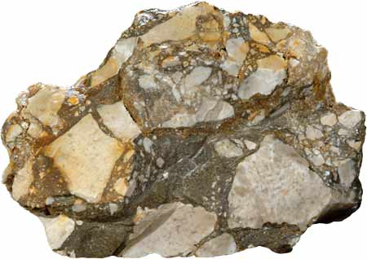
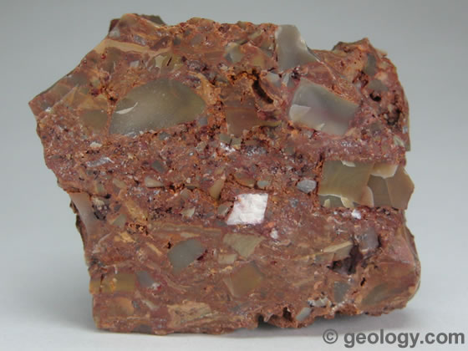
Common detrital sedimentary rocks
If the large particles are angular rather than rounded, the rock is called breccia.

Slide 13
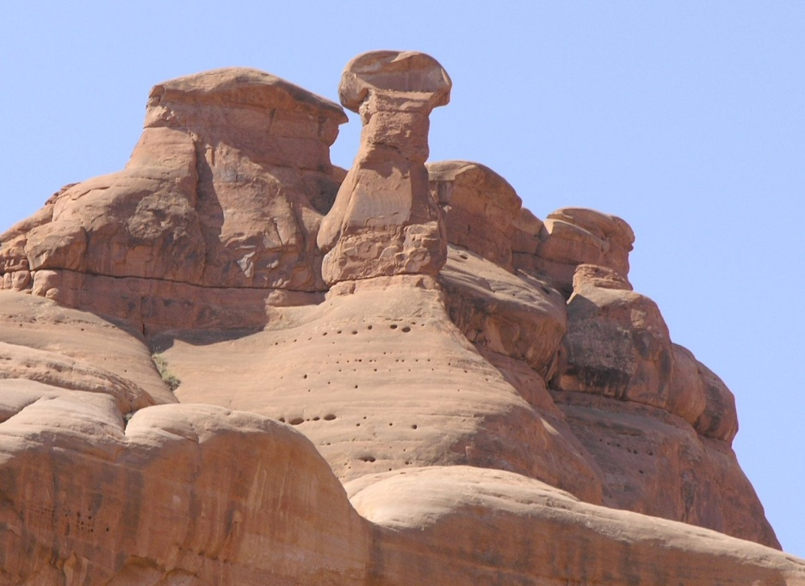
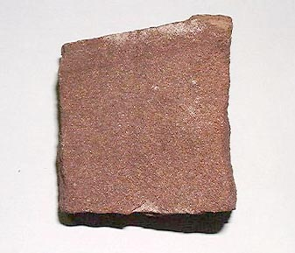
Common detrital sedimentary rocks
Sandstone is the name given to any rock in which sand size particles are dominant.
Most sandstones are quartz sandstone and contain more than 90 percent quartz.
Arkose is a sandstone comprising 25 percent or more feldspar grains, with most of the remaining grains being quartz.
Graywacke is poorly sorted sandstone with considerable quantities of silt and clay in its pores.

Slide 14
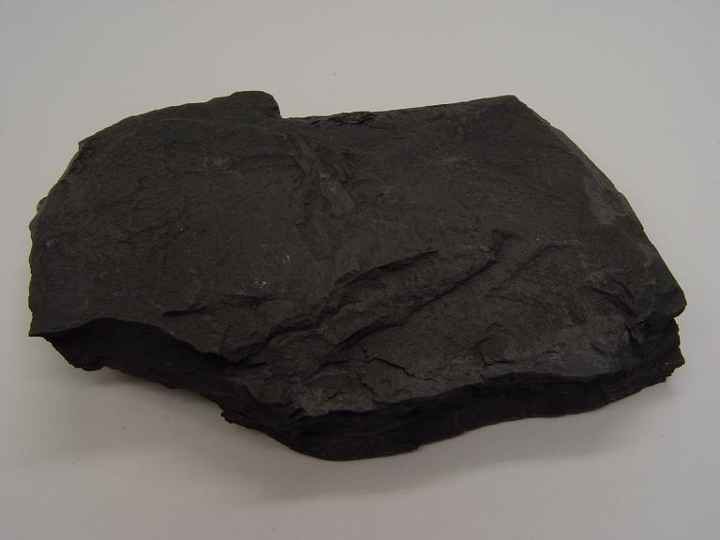
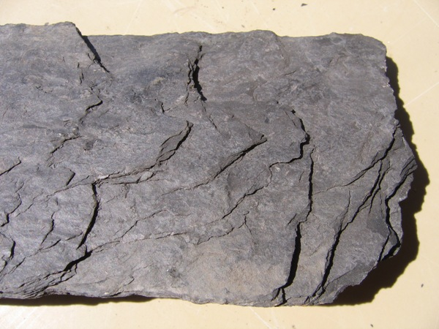
Common detrital sedimentary rocks
Shale is a sedimentary rock consisting of silt and clay sized particle. They consist of clay minerals and small amount of quartz.
The tiny particles in shale indicate that deposition has taken place in water in a very quiet and non turbulent environment.
Shale has a finely layered structure called fissility, along which the rock splits easily.
The layered structure in shale is also sometimes known as laminae.

Slide 15
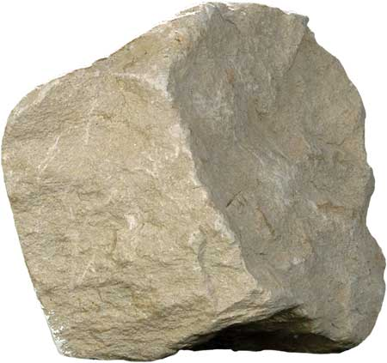
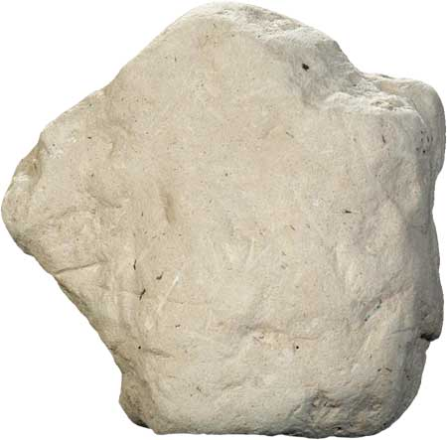
Common detrital sedimentary rocks
Mudstone also has the same particle size as that of shale but is a non-fissile and breaks as chunks or blocks.

Slide 16
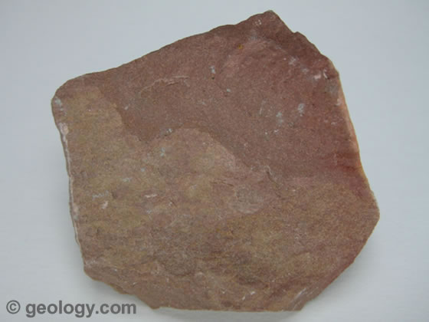
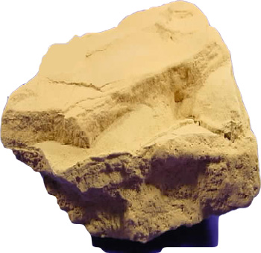
Common detrital sedimentary rocks
Siltstone is lithified silt.
The main component of most siltstones is quartz, although clays are also commonly present.
Siltstones often show layering but lack the fine fissility of shales because of their lower clay content.

Slide 17
Particle size and shape of detrital sedimentary rocks
Particle size of a detrital sedimentary rock indicates the depositional environment and the strength of the transporting water current.
Shallow environment and strong currents will result in the formation of coarse grained sedimentary rocks.
Calm and deep depositional environment will help in the formation of fine grained sedimentary rocks.

Slide 18
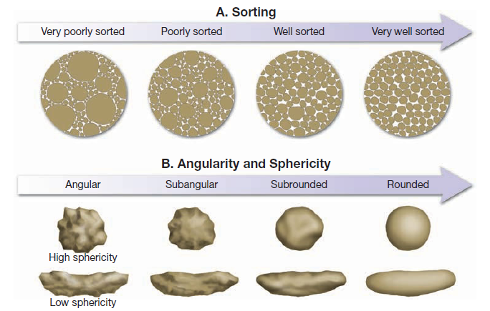
Particle size and shape of detrital sedimentary rocks
Particle shape in detrital sedimentary rocks determines how far the particles travelled before getting deposited to form sedimentary rocks.
Round particles will indicate long transportation where as angular particles indicate a short transportation history.

Slide 19
Chemical sedimentary rocks
In contrast to detrital sedimentary rocks which form from the solid product of weathering, chemical sedimentary rocks are formed from materials that is carried in solution to lakes and seas.
Chemical sediments form from water which are saturated with dissolved cations and anions. Crystallization occurs when these ions develop covalent or ionic bonds and thus create chemical compounds, producing minerals such as calcite and salt.
The precipitation of the material can take place in two ways.
Organic processes such as activities of water dwelling organisms.
Inorganic processes such as evaporation and chemical activities.

Slide 20
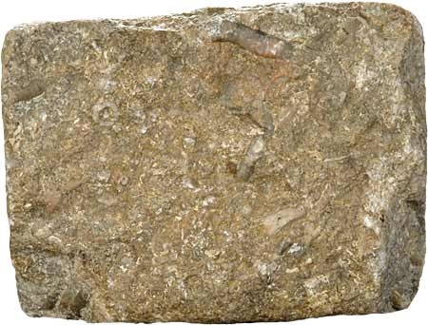
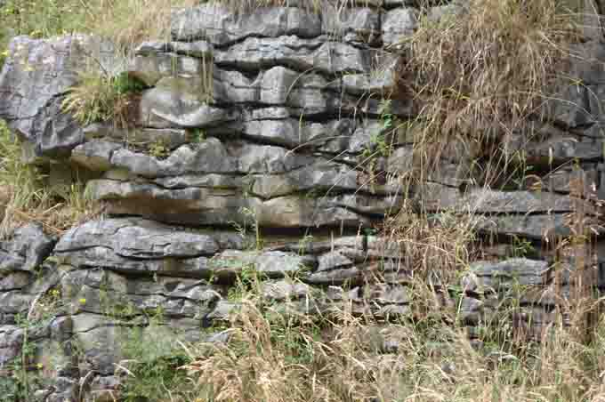
Chemical sedimentary rocks
Limestone represents about 10 percent of the total volume of all sedimentary rocks and is the most abundant in chemical sedimentary rocks.
It is composed mainly of the mineral calcite (CaCO₃) and can be formed either by inorganic means or as a result of biochemical processes.

Slide 21
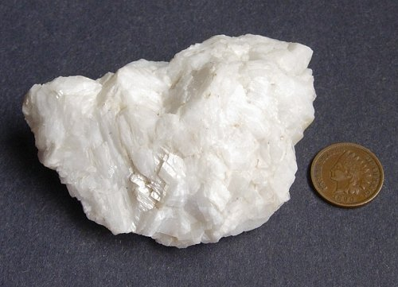
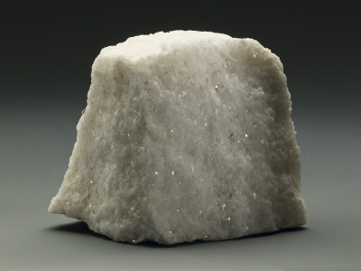
Chemical sedimentary rocks
Dolostone is closely related to limestone and consists mainly of the mineral dolomite which is calcium magnesium carbonate.
Although dolostone can form by direct precipitation from seawater, it is thought that most of them are formed when magnesium in the sea water replaces some of the calcium in limestones.

Slide 22
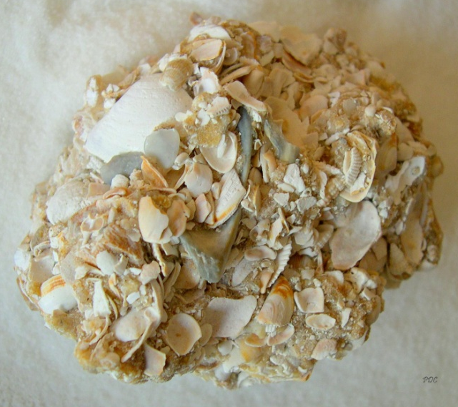
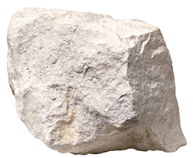
Chemical sedimentary rocks
Coquina is bioclastic limestone consisting wholly of coarse shell fragments cemented together.
Chalk is a very fine-grained, soft, white bioclastic limestone made of the shells and skeletons of microorganisms that float near the surface of the oceans.
When they die, their remains sink to the bottom and accumulate to form chalk.

Slide 23
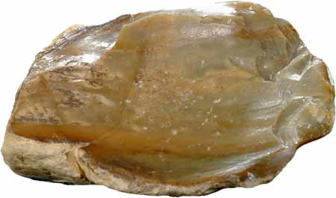
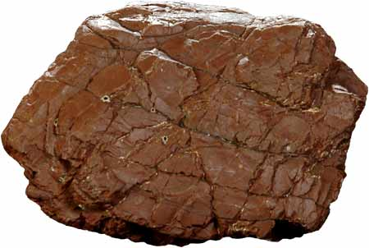
Chemical sedimentary rocks
Chert is a name used for a number of very compact and hard rock made up of microcrystalline silica.
Microscopic examination of bedded chert often shows that it is made up of the remains of tiny marine organisms that make their skeletons of silica rather than calcium carbonate.

Slide 24
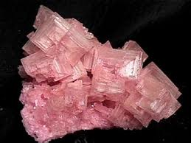
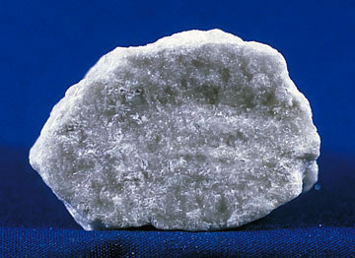
Chemical sedimentary rocks
Evaporites form when evaporation concentrates dissolved ions to the point at which they precipitate from solution.
The most common minerals found in evaporite deposits are gypsum (CaSO4.2H2O) and halite (NaCl).

Slide 25
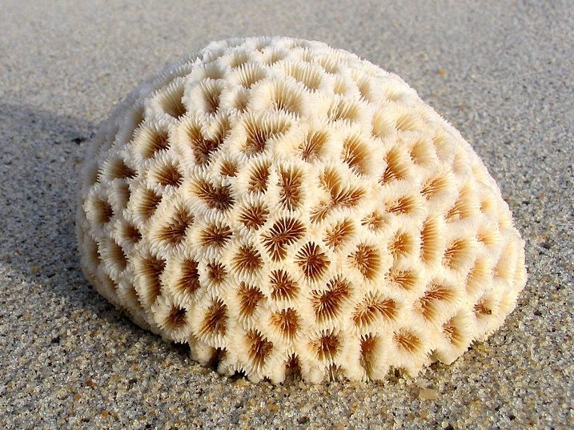
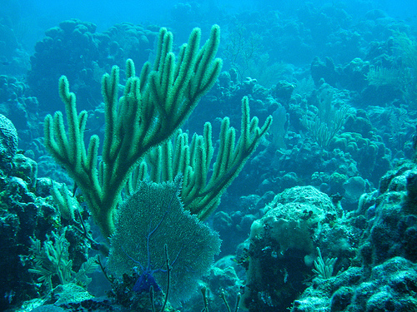
Chemical sedimentary rocks
Corals are an example of organisms that are capable of creating large quantities of marine limestones.
Corals are capable of forming massive structures which are known as coral reefs.

Slide 26
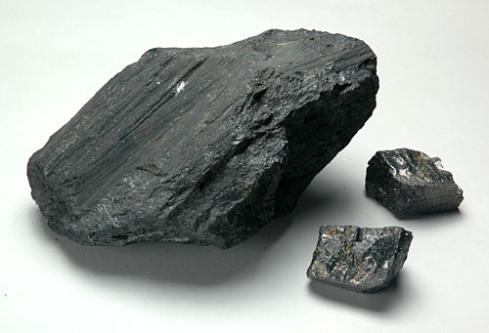
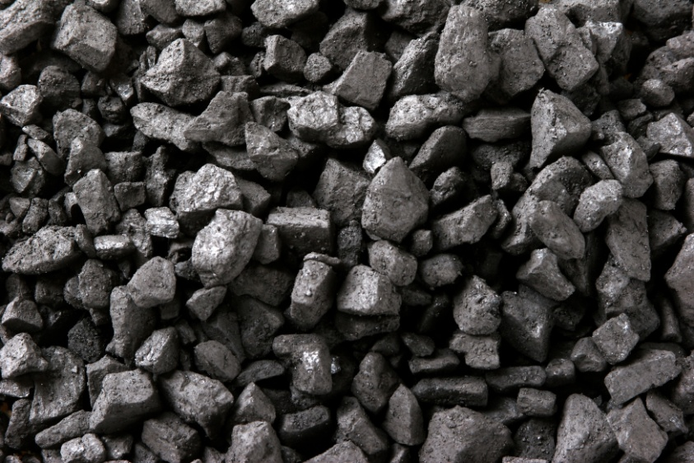
Organic sedimentary rocks
When plants die, their remains usually decompose by reaction with oxygen.
However, in warm swamps and in other environments where plant growth is rapid, dead plants accumulate so rapidly that the oxygen is used up long before the decay process is complete.
The undecayed or partially decayed plant remains form peat.
As peat is buried and compacted by overlying sediments, it converts to coal, a hard, black, combustible rock.

Slide 27
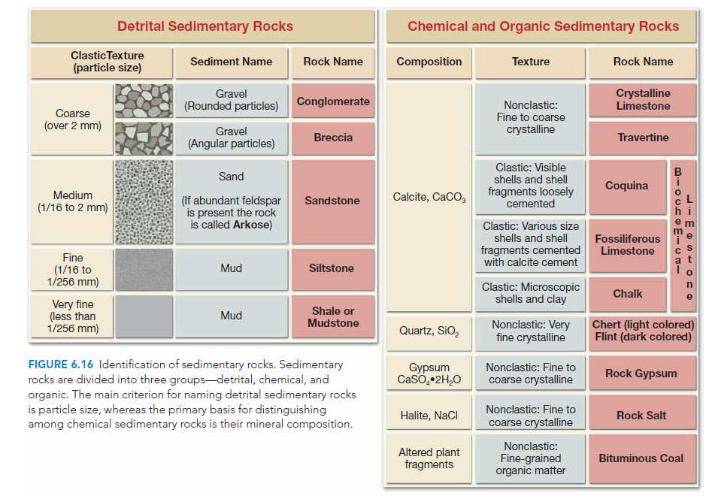

Slide 28
Sedimentary Structures
Nearly all sedimentary rocks contain sedimentary structures, features that developed during or shortly after deposition of the sediment.
These structures help us understand how the sediment was transported and deposited.

Slide 29
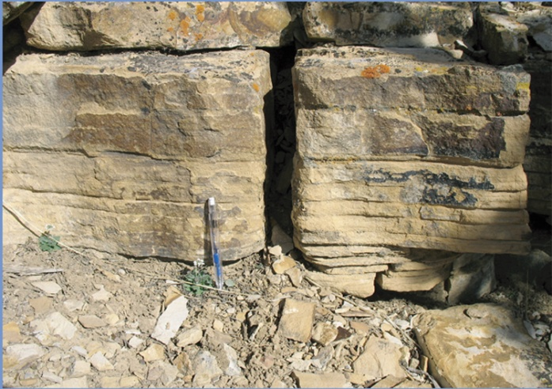
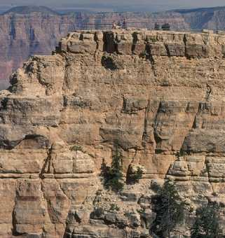
Bedding or Stratification
Sedimentary rocks form as layer upon layer of sediment accumulates in various depositional environments.
These layers, called strata or beds, are probably the single most common and characteristic feature of sedimentary rocks.
Each stratum/layer is unique. The variations in texture, composition, and thickness reflect the different conditions under which each layer was deposited.

Slide 30
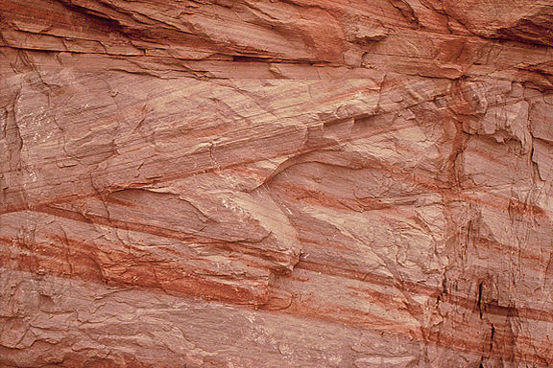
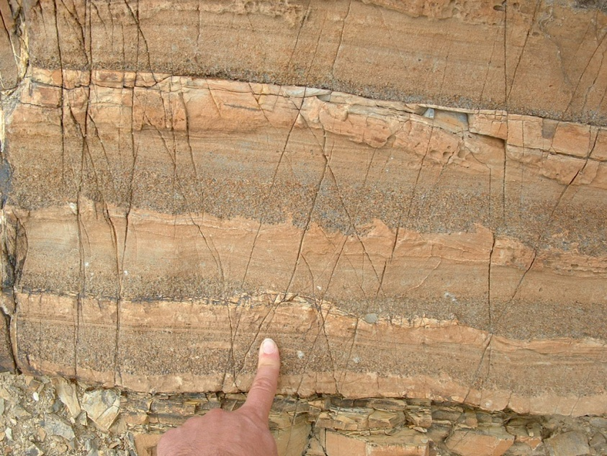
Cross bedding and Graded Bedding
Sediments usually accumulate as particles that settle from a fluid, most strata are originally deposited as horizontal layers.
There are circumstances, however, when sediments do not accumulate in horizontal beds and are inclined to the horizontal.
When this occurs, it is called cross-bedding and is most characteristic of sand dunes, river deltas.
Graded beds represent another special type of bedding. In this case the particles within a single sedimentary layer gradually change from coarse at the bottom to fine at the top.
Graded beds are most characteristic of rapid deposition from water containing sediment of varying sizes.

Slide 31
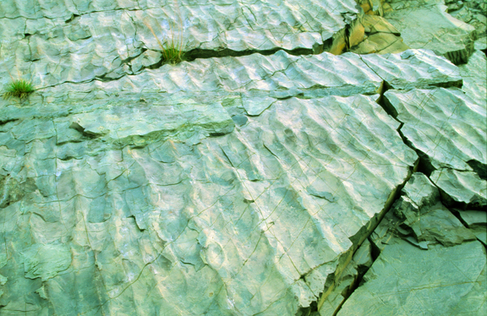
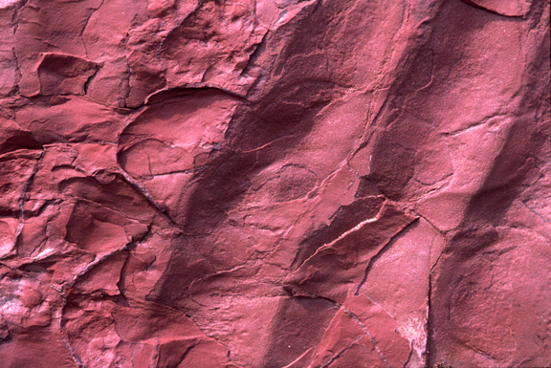
Ripple Marks
Ripple marks are small, nearly parallel sand ridges and troughs that are also formed by moving water or wind.
They are like dunes and sand waves, but smaller.
If the water or wind flows in a single direction, the ripple marks become asymmetrical, like miniature dunes.
In other cases, waves move back and forth in shallow water, forming symmetrical ripple marks in bottom sand.
Ripple marks are often preserved in sandy sedimentary rocks.

Slide 32
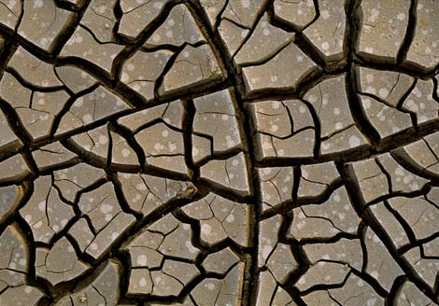
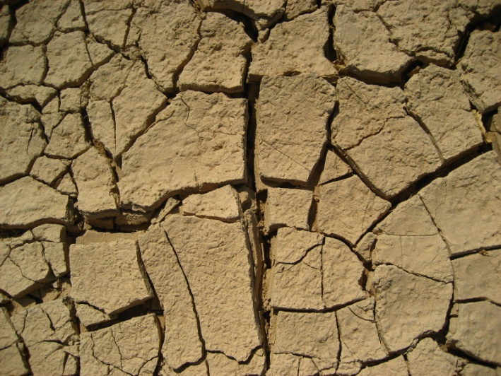
Mud cracks
Mud cracks are polygonal cracks that form when mud shrinks as it dries.
They indicate that the mud accumulated in shallow water that periodically dried up.

Slide 33
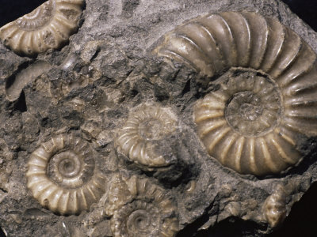
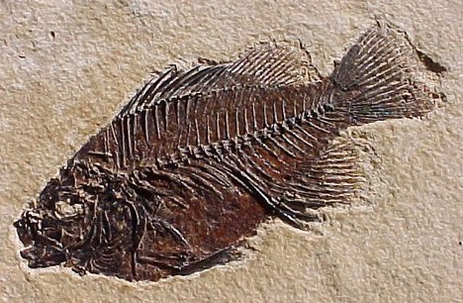
Fossils
Fossils are another feature of the sedimentary rocks that are formed during the time of deposition of these rocks.
Fossils are the remains or impressions of plants or animals that were persevered in the crust of the earth due to natural causes.
They are important tools for interpreting the geologic past.
Knowing the nature of the life forms that existed at a particular time helps researchers decipher past environmental conditions.
Further, fossils are important time indicators and play a key role in correlating rocks that are of similar ages but are from different places.

