Slide 1
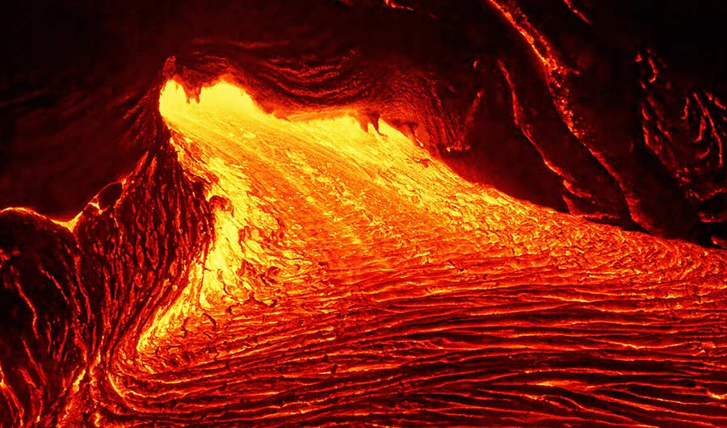
Unit 2b: minerals & rocks: Igneous rocks
Geo 281: geology for engineers
Geology and Geophysics Department
King Saud University

Slide 2
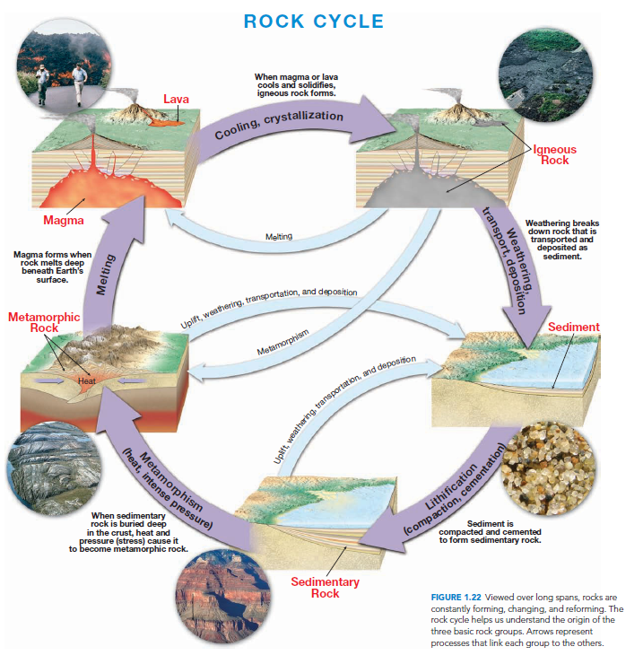

Slide 3
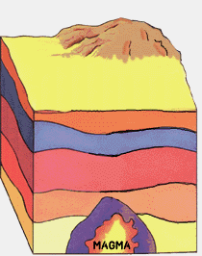
Rock Types
The Earth is almost entirely rock to a depth of 2900 kilometers, where the solid mantle gives way to the liquid outer core.
Geologists group rocks into three categories on the basis of how they form:
Igneous rocks,
Sedimentary rocks, and
Metamorphic rocks

Slide 4
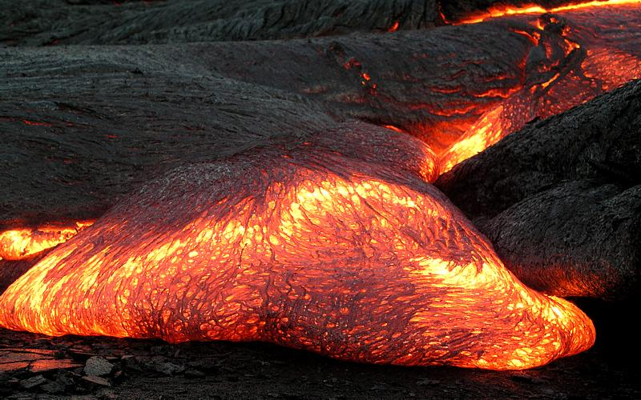
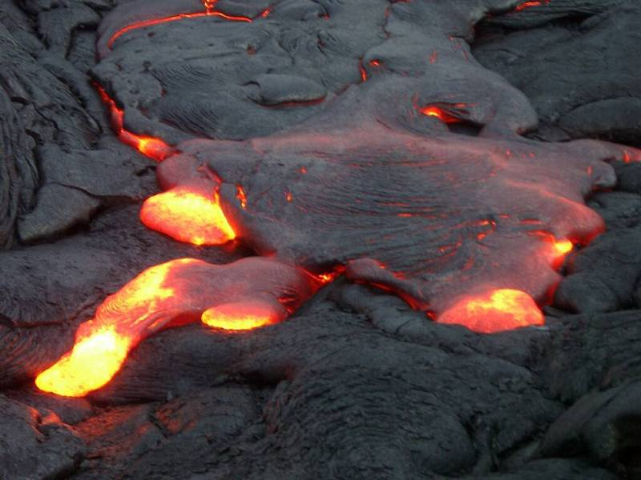
Formation of Magma
Under certain conditions, rocks of the upper mantle and lower crust melt, forming a hot liquid called magma.
An igneous rock forms when magma becomes solid.
About 95 percent of the Earth’s crust consists of igneous rock and metamorphosed igneous rock.
Granite and Basalt are two common and familiar igneous rocks.

Slide 5
Formation of Magma
Three different factors may cause melting of the rocks in the crust and mantle
rising temperature,
decreasing pressure and
addition of water

Slide 6
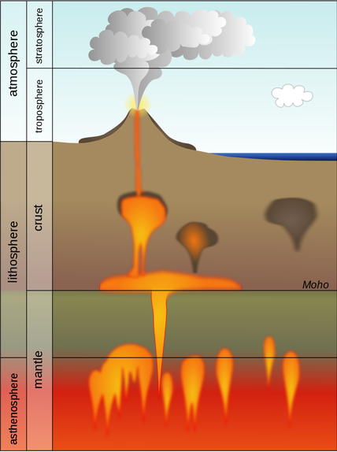
Nature of Magma
Magma is the completely or partially molten material, which on cooling solidifies to form an igneous rock.
Once a magma is formed it rises towards the surface as its is less dense than the surrounding rocks.
Sometimes these magma may reach the earth’s surface in the form of volcanoes. Magma that reaches the earth’s surface is known as Lava.

Slide 7
Components of the magma
Most magma consists of 3 distinct parts: a liquid component, a solid component and a gaseous phase.
The melt is mostly made up of the ions of Silicon and Oxygen which readily combines to form Silica (SiO₂). Less amounts of Aluminum, Potassium, Calcium, Sodium, Iron and Magnesium are also found.
The solid component if any are silicate minerals that have already crystallized from the melt.
The gases include Water (H₂O), carbon dioxide (CO₂) and Sulfur Dioxide (SO₂). Theses gaseous components also known as the volatiles are dissolved within the melt.

Slide 8
Characteristics of the Magma
Temperature: The temperature of magma varies from about 600ºC to 1400ºC, depending on its chemical composition and the depth at which it forms.
Generally, basaltic magma forms at great depth and has a temperature near the high end of this scale.
Granitic magmas, which form at shallower depths, tend to lie near the cooler end of the scale.
Composition | Source Material | Viscosity | Temperature
Basaltic Magma | Upper Mantle | Low | 1200 °C
Andesitic Magma | Oceanic Crust | Inetermediate | 800-1000 °C
Granitic Magma | Continental Crust | High | 750-850 °C

Slide 9
Evolution of Magma
A large variety of Igneous rocks are found on the earth but a single magma can lead to the formation of different types of igneous rocks.
This idea was first investigated by geologist Norman L. Bowen (1887–1956).
The order of crystallization of the different minerals from the magma came to be known as the Bowen Reaction series which allows geologists to predict chemical composition and texture based upon the temperature of a cooling magma.

Slide 10
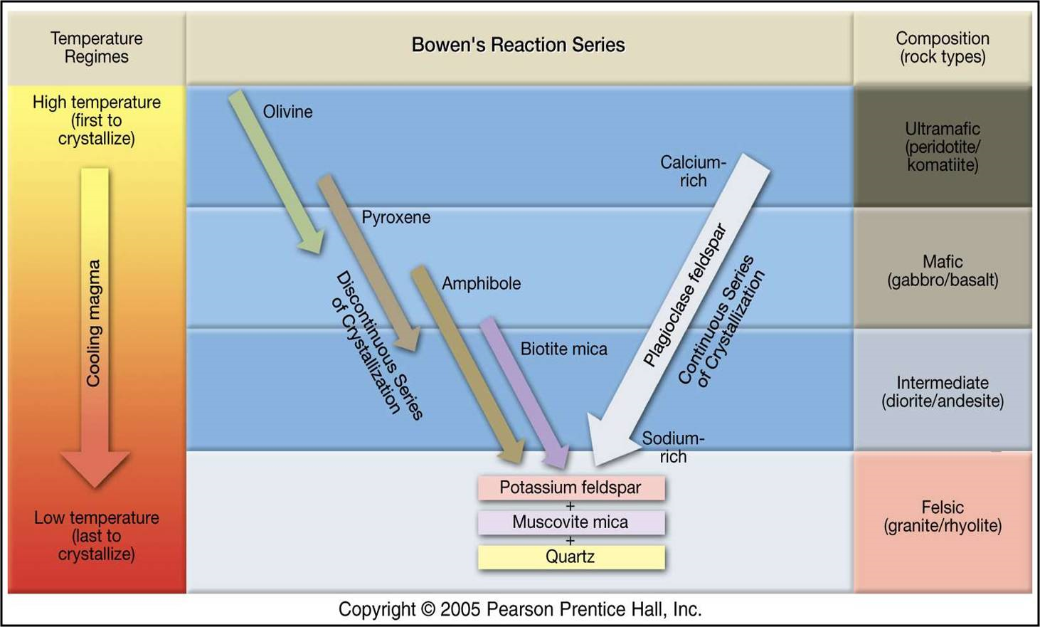
Evolution of Magma

Slide 11
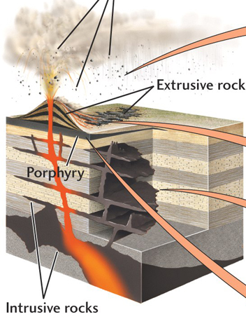
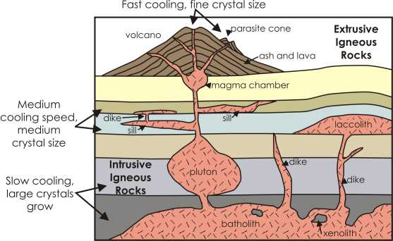
igneous rocks TYPES
Igneous rocks which are formed when the molten magma solidifies at the earth’s surface are known as Extrusive Igneous Rocks or Volcanic Rocks.
Sometimes the magma loses its mobility before reaching the surface and crystallizes at depths. Igneous rocks which are formed by the crystallization of the molten magma beneath the earth’s surface or at depths are known as Intrusive Igneous Rocks or Plutonic Rocks.

Slide 12
Texture of Igneous Rocks
The texture of a rock refers to the size, shape, and arrangement of its mineral grains, or crystals.
Some igneous rocks consist of mineral grains that are too small to be seen with the naked eye; others are made up of thumb-size or even larger crystals.
Volcanic /extrusive igneous rocks are usually fine grained, whereas plutonic/intrusive igneous rocks are medium or coarse grained.

Slide 13
Factors affecting crystal size
A magma at depths, slowly loses its heat to the surrounding. The cooling of the magma may take tens or even thousands of years as fewer but large crystals are formed.
On the other hand if the magma cools rapidly for example on the earth’s surface, the crystals do not get time to increase in size and the result is a rock with small crystals.
Sometimes the magma cools so rapidly that the ions do not get time to arrange themselves and the magma solidifies to form glass. There is no internal arrangement of ions in Glass.

Slide 14
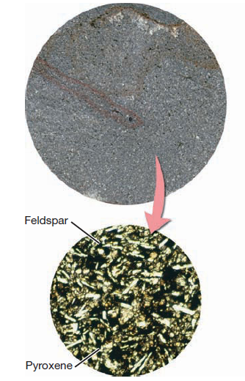
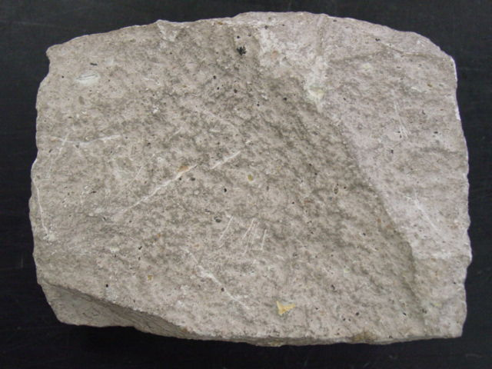
Aphanitic Texture
When the magma reaches the earth’s surface, it undergoes rapid cooling as a result the crystals do not get a chance to grow in size.
The resulting igneous rocks have a fine grained texture which is known as Aphanitic texture.
The mineral grains in rocks having Aphanitic texture are so small that they can be seen only with the aid of a microscope

Slide 15
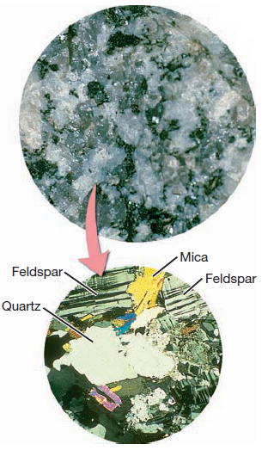
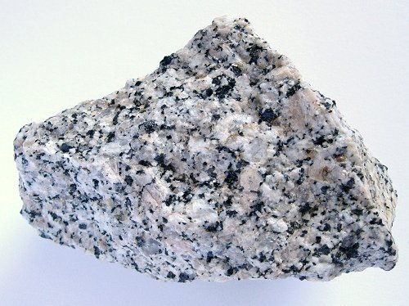
Phaneritic texture
Phaneritic textured rocks are comprised of large crystals that are clearly visible to the eye with or without a hand lens or binocular microscope.
The entire rock is made up of large crystals, which are generally 1/2 mm to several centimeters in size; no fine matrix material is present.
This texture forms by slow cooling of magma deep underground in the plutonic environment.

Slide 16
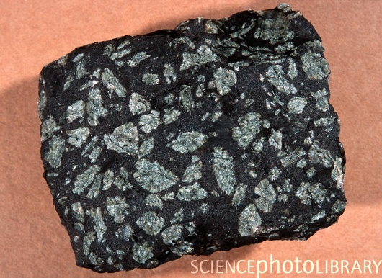
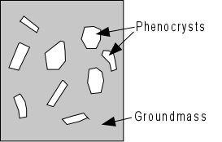
Porphyritic texture
If magma rises slowly through the crust before erupting, some crystals may grow while most of the magma remains molten.
If this mixture of magma and crystals then erupts onto the surface, it solidifies quickly, forming porphyry, a rock with the large crystals, called phenocrysts, embedded in a fine-grained matrix/ground mass. Such a texture is known as porphyritic texture

Slide 17
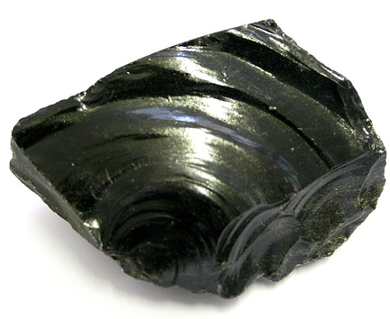
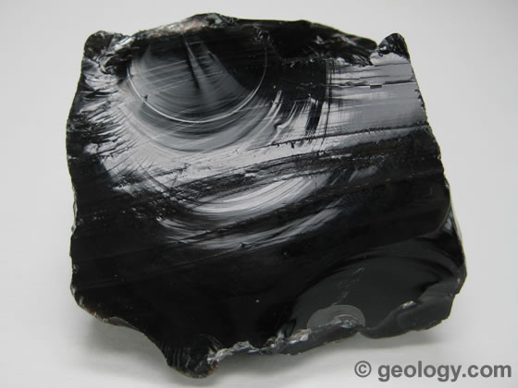
Glassy Texture
Glassy textured igneous rocks are non-crystalline meaning the rock contains no mineral grains.
Glass results from cooling that is so fast that minerals do not have a chance to crystallize.
This may happen when magma or lava comes into quick contact with much cooler materials near the Earth's surface.
Pure volcanic glass is known as obsidian.

Slide 18
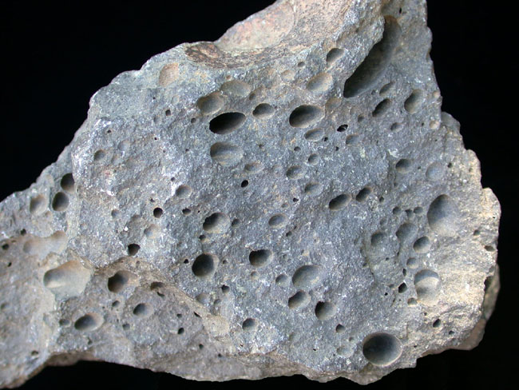
Vesicular Texture
Vesicular texture refers to vesicles (holes, pores, or cavities) within the igneous rock.
Vesicles are the result of gas expansion (bubbles), which often occurs during volcanic eruptions.
Pumice and scoria are common types of vesicular rocks.
The image to the right shows a basalt with vesicles, hence the name "vesicular basalt".

Slide 19
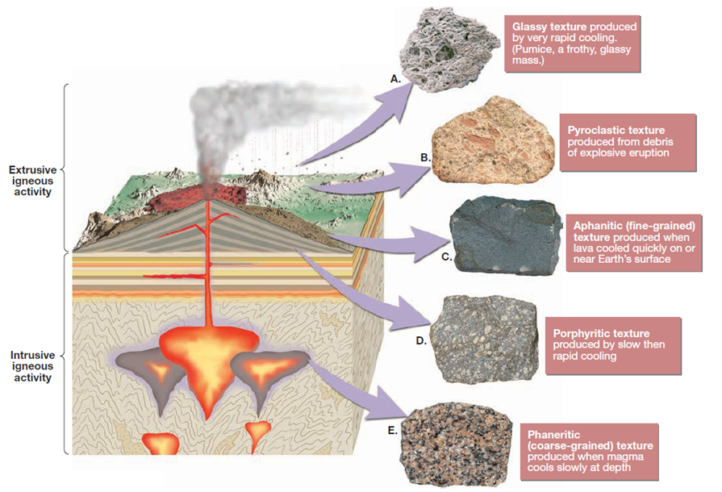
TEXTURE OF IGNEOUS ROCKS

Slide 20
Naming Igneous Rocks
Geologists use both the minerals and texture to classify and name igneous rocks.
The various igneous textures result mainly from the different cooling histories, whereas the mineral composition of an igneous rock is the result of the chemical makeup of the parent magma.
Two igneous rocks having the same mineral composition but different textures will have a different name.

Slide 21
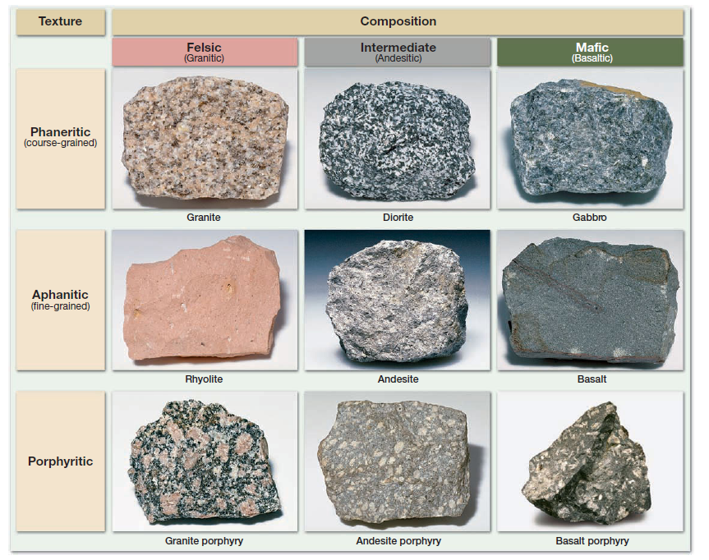
Classification of Igneous Rocks

Slide 22
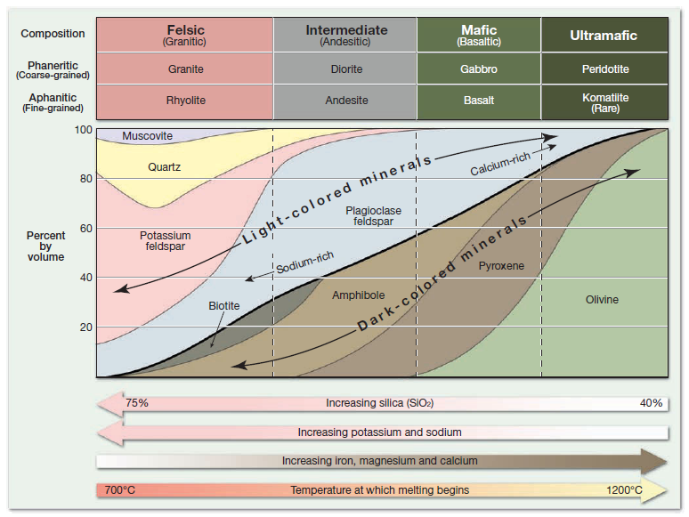
MINERALOGY OF COMMON IGNEOUS ROCKS

Slide 23
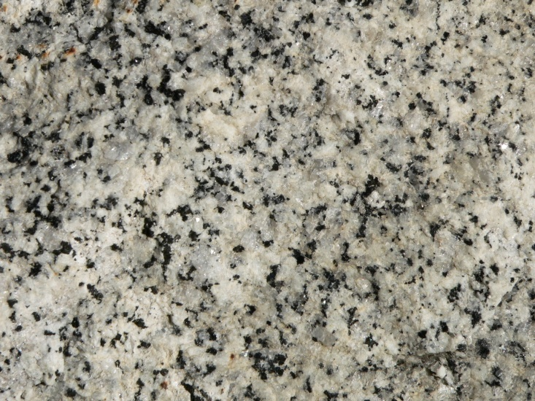
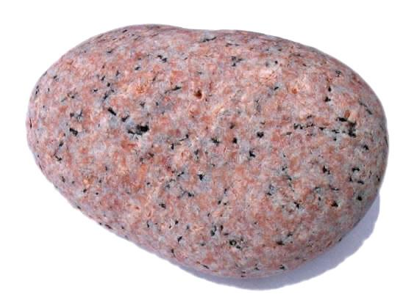
Felsic (Granitic) Igneous Rocks
Granite is the best known of all igneous rocks.
Granite (and metamorphosed granitic rocks) are the most common rocks in continental crust.
Granite has a phaneritic texture and is composed up of 25 percent Quartz and about 65 percent feldspar mostly the potassium and sodium rich varieties.
The remaining 10 percent is made up of muscovite, biotite and some amphibole.

Slide 24
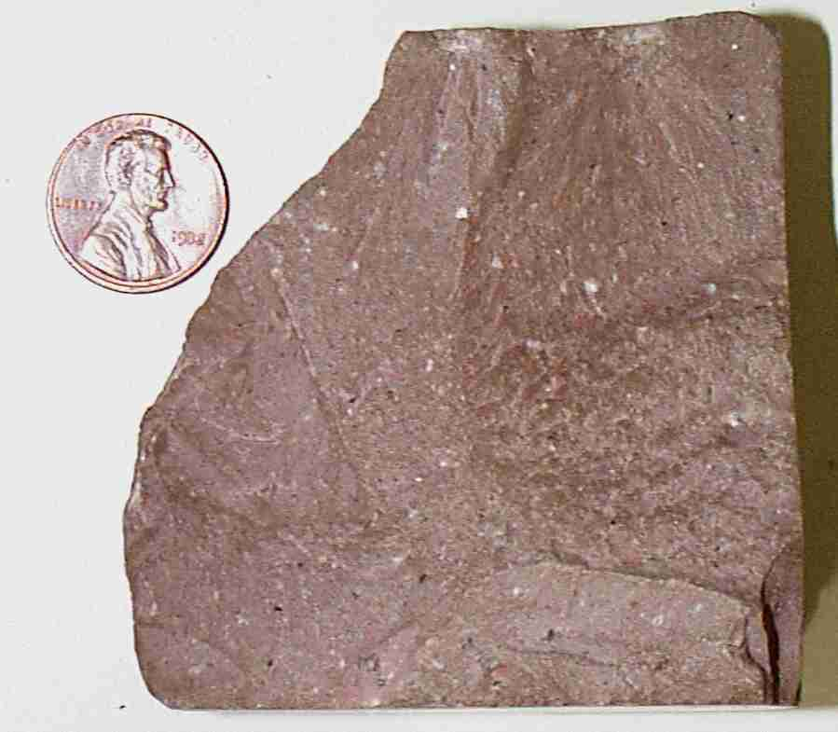
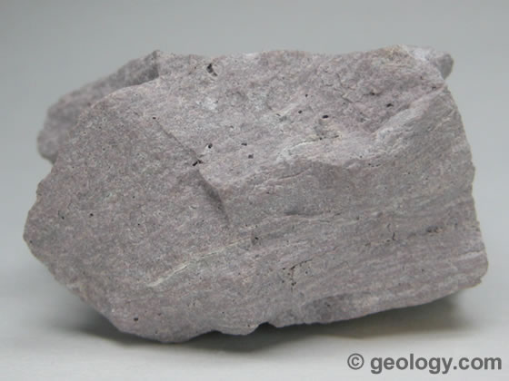
Felsic (Granitic) Igneous Rocks
Rhyolite is the extrusive equivalent of granite and like granite is composed essentially of light colored silicate minerals.
Rhyolite has an aphanitic texture and frequently contains glass fragments and voids indicating rapid cooling in the surface environment.

Slide 25
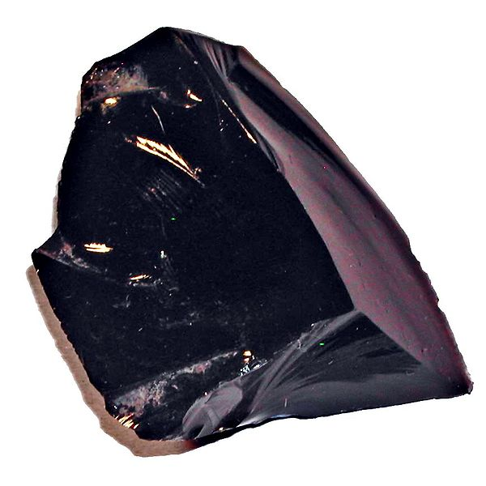
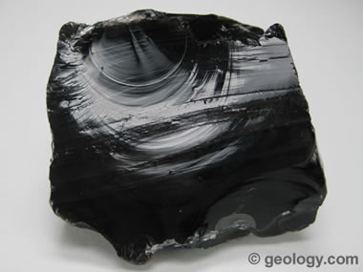
Felsic (Granitic) Igneous Rocks
Obsidian is a dark colored glass rock that usually forms when silica rich lava is quenched quickly.
This means that there is no crystals formation in obsidian and it consists of unordered ions.
Though obsidian appears dark in color but its chemical composition is similar to that of granites.

Slide 26
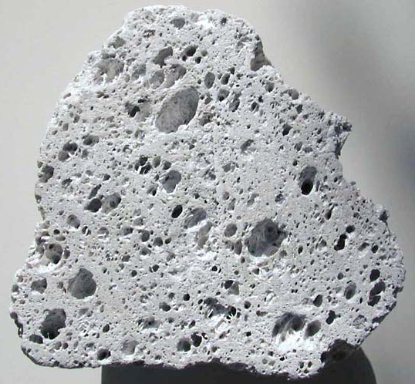
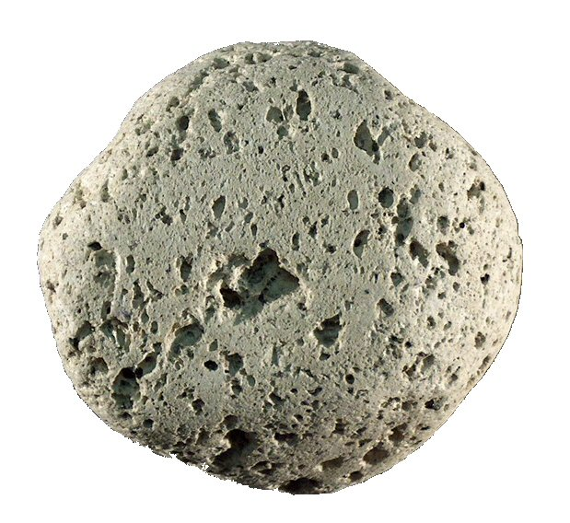
Felsic (Granitic) Igneous Rocks
Pumice is a volcanic igneous rock that like obsidian has a glassy texture but is formed when large amounts of gas escape through lava.
Because of the large percentage of voids, many samples of pumice will float when placed in water.

Slide 27
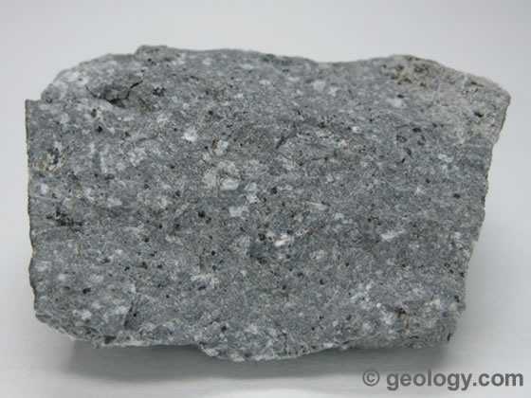
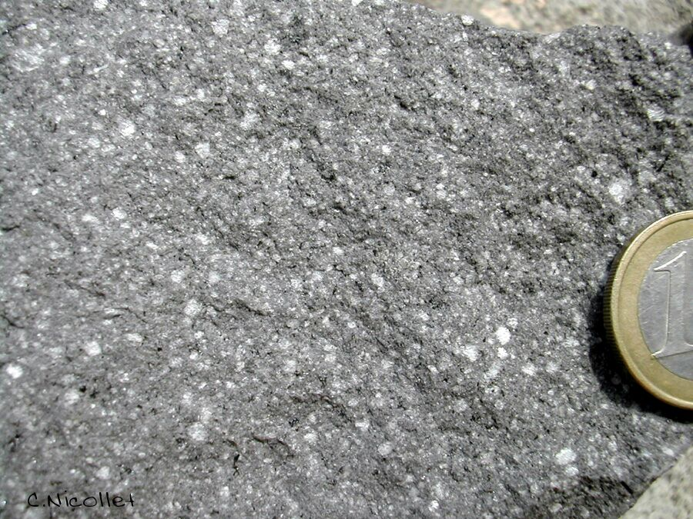
Intermediate (Andesitic) Igneous Rocks
Andesite is a volcanic rock intermediate in composition between basalt and granite.
It is commonly gray or green and consists of plagioclase and dark minerals (usually biotite, amphibole, or pyroxene).
Andesite is a volcanic rock and is typically very fine grained.
Andesite and Rhyolite sometimes appear similar but microscopic examination shows that Rhyolite is composed up of about 25 percent quartz whereas Andesite contains only minor amount of Quartz.

Slide 28
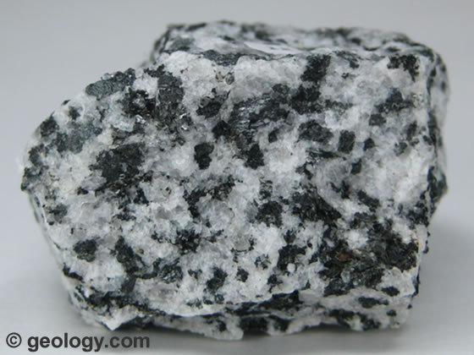
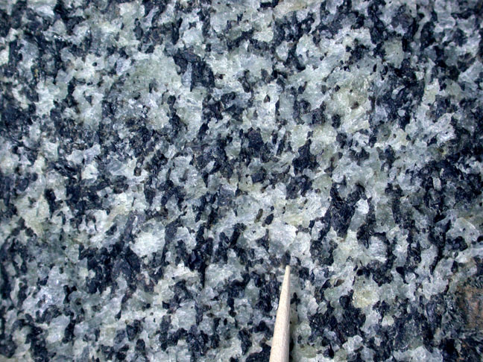
Intermediate (Andesitic) Igneous Rocks
Diorite is the plutonic equivalent of andesite.
It is a coarse grained intrusive igneous rock that forms from the same magma as andesite.
It can be distinguished from granite by the absence of visible Quartz crystals and because it contains a higher percentage of dark silicate minerals.
The mineral makeup of diorite is primarily sodium rich plagioclase feldspar and amphibole, with lesser amounts of biotite.

Slide 29
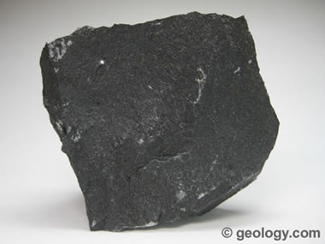
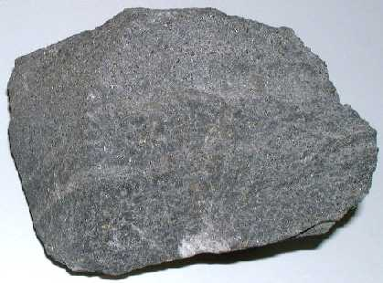
Mafic (Basaltic) Igneous Rocks
Basalt is a very dark green to black fine-grained volcanic rock.
It is composed primarily of pyroxene and calcium-rich plagioclase feldspar, with lesser amounts of olivine and amphibole present.
Basalt is the most common extrusive igneous rock.

Slide 30
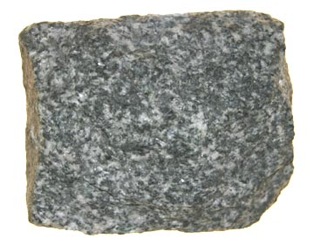
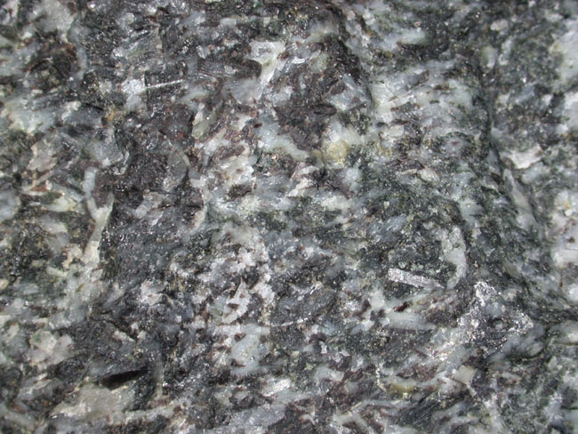
Mafic (Basaltic) Igneous Rocks
Gabbro is the intrusive equivalent of basalt.
Like basalt, it is very dark green to black in color and composed primarily of pyroxenes and calcium rich plagioclase feldspars.
Gabbro is uncommon at the Earth’s surface, although it is abundant in deeper parts of oceanic crust, where basaltic magma crystallizes slowly.

Slide 31
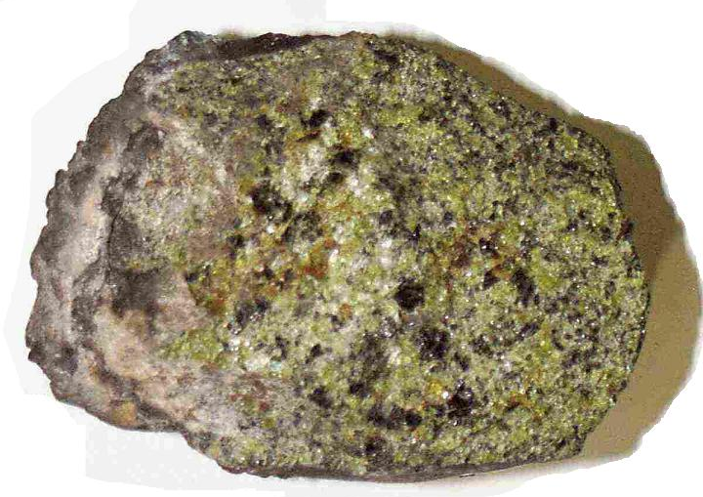
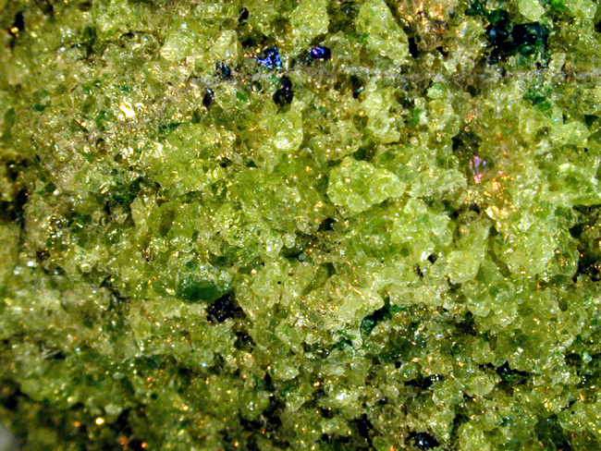
Ultramafic Igneous Rocks
Peridotite is an ultramafic igneous rock that makes up most of the upper mantle but is rare in the Earth’s crust.
It is coarse grained and composed of olivine, and it usually contains pyroxene, amphibole, or mica but no feldspar.

Slide 32
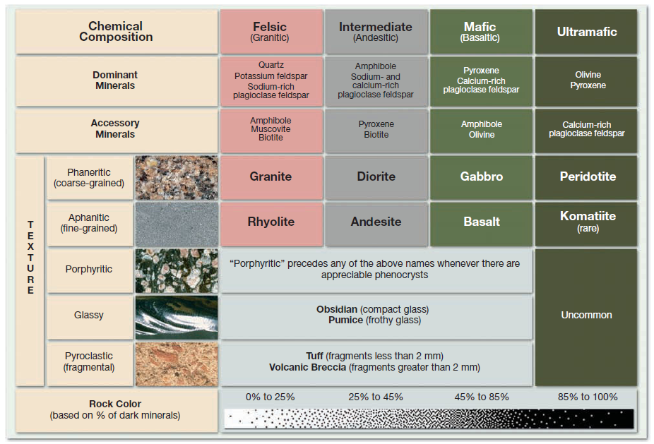
NAMING IGNEOUS ROCKS

