Slide 1
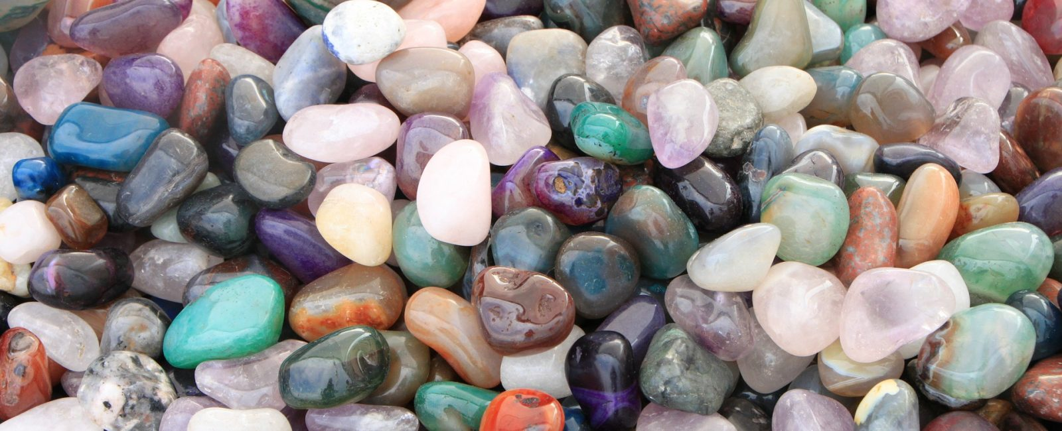
Unit 2a: minerals & rocks: MINERALS
Geo 281: geology for engineers
Geology and Geophysics Department
King Saud University

Slide 2
Minerals: Building Blocks of Rocks
We begin our discussion of Earth materials with an overview of mineralogy (mineral = mineral and Logy=Study) because minerals are the building blocks of rocks.
Geologists define mineral as any naturally occurring inorganic solid that possesses an orderly crystalline structure and can be represented by a chemical formula.
Rocks on the other hand are collections of one or more minerals.
In order to understand how rocks vary in composition and properties, it is necessary to know the variety of minerals that commonly occur in them, and to identify a rock it is necessary to know which minerals are present in it.

Slide 3
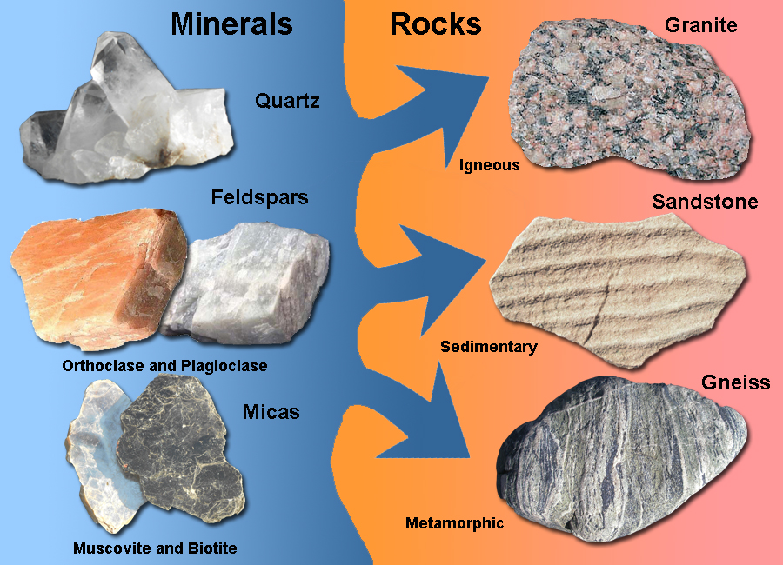
Mineral versus rocks

Slide 4
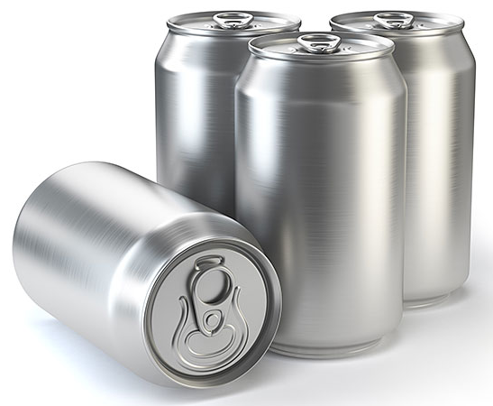
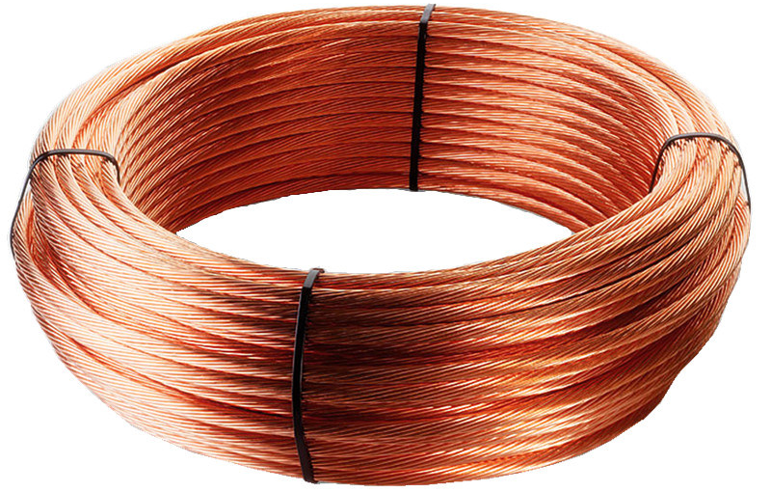
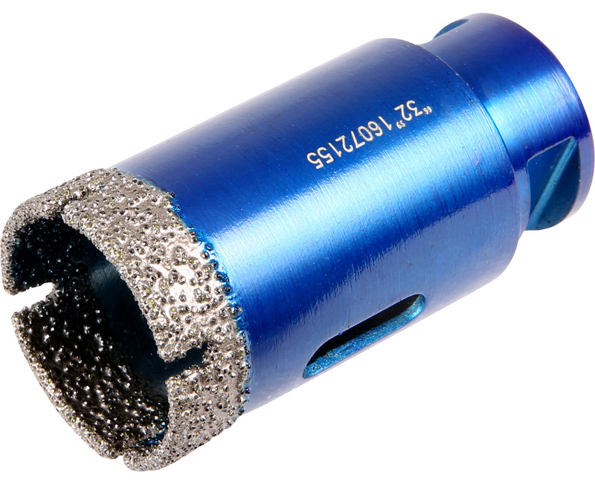
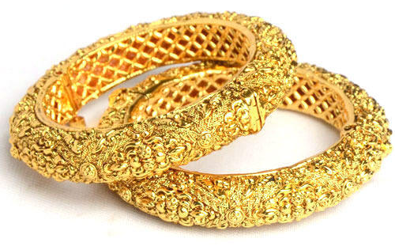

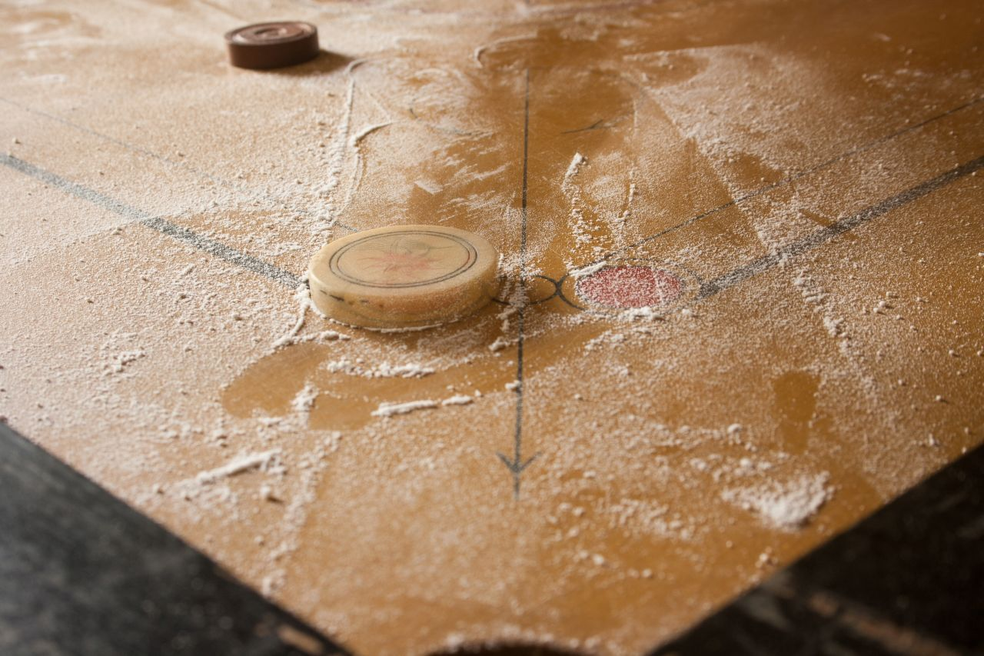
Common minerals in daily life
Earth's crust is a source of variety of useful and essential minerals.
Most people are familiar with the common uses of many basic metals, including aluminum in beverage cans, copper in electrical wiring, and gold and silver in jewelry.
But some people are not aware that pencil lead contains the greasy feeling mineral graphite and that bath powders and many cosmetics contain the mineral talc.
Moreover, many do not know that drill bits impregnated with diamonds are employed by dentists to drill through tooth enamel, or that the common mineral quartz is the source of silicon for computer chips. In fact, practically every manufactured product contains materials obtained from minerals.

Slide 5
What is a mineral
Any material should fulfil the following five criteria to be called as a mineral:
Naturally occurring: Minerals form by natural, geologic processes. Synthetic materials, meaning those produced in a laboratory or by human intervention, are not considered minerals.
Solid substance: Only solid crystalline substances are considered minerals. Ice (frozen water) fits this criterion and is considered a mineral, whereas liquid water and water vapor do not. The exception is mercury, which is found in its liquid form in nature.

Slide 6
What is a mineral
Generally inorganic. Inorganic crystalline solids, such as ordinary table salt (halite), that are found naturally in the ground are considered minerals. (Organic compounds, on the other hand, are generally not.
Orderly crystalline structure: Minerals are crystalline substances, which means their atoms are arranged in an orderly, repetitive manner. This orderly packing of atoms is reflected in the regularly shaped objects called crystals.
Can be represented by a chemical formula: Most minerals are chemical compounds having compositions that can be expressed by a chemical formula.
For example, the common mineral quartz has the formula SiO2, which indicates that quartz consists of silicon (Si) and oxygen (O) atoms in a ratio of one-to-two.
This proportion of silicon to oxygen is true for any sample of pure quartz, regardless of its origin.

Slide 7
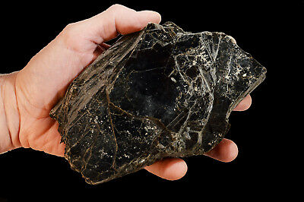
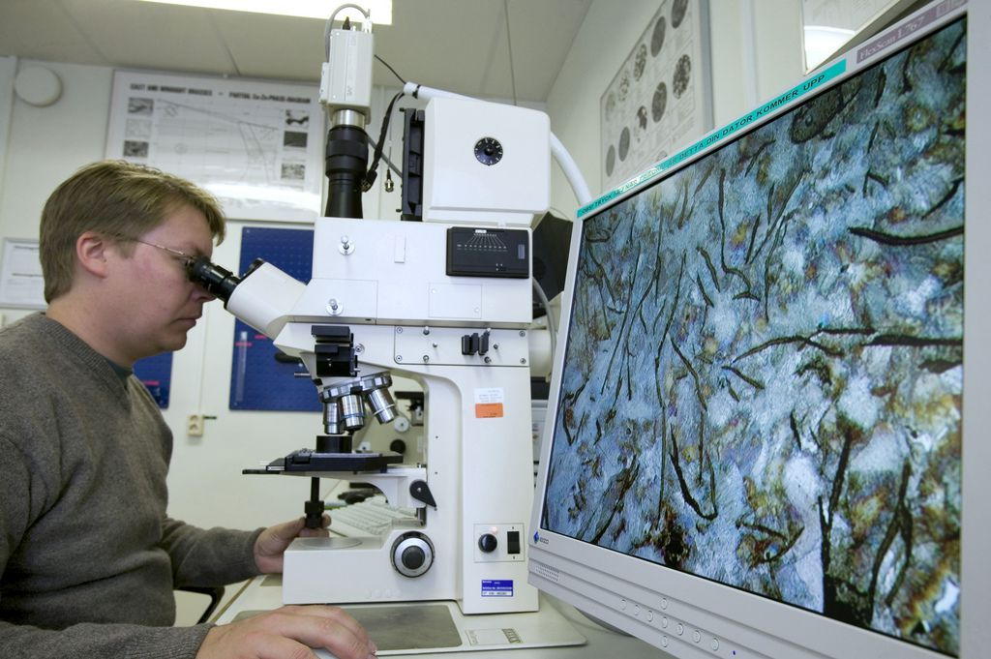
Techniques to identify minerals
Two techniques are employed to identify minerals:
the study of a hand specimen of the mineral, or the rock in which it occurs, using a hand lens (×8 or ×10) and observing diagnostic features; and
the examination of a thin slice of the mineral, ground down to a thickness of 0.03 mm, using a microscope, the rock slice being mounted in transparent resin on a glass slide.
The former method is by far the most useful to an engineer

Slide 8
Physical properties of minerals in hand specimen
Minerals have definite crystalline structures and chemical compositions that give them unique sets of physical and chemical properties shared by all samples of that mineral. For example, all specimens of halite have the same hardness, the same density, and break in a similar manner.
Because a mineral’s internal structure and chemical composition are difficult to determine without the aid of sophisticated tests and equipment, the more easily recognized physical properties are frequently used in identification.

Slide 9
Physical properties of minerals
1. COLOR
The color of a mineral is that seen on its surface by the naked eye.
It may depend on the impurities present in light-colored minerals, and one mineral specimen may even show gradation of color or different colors.
For these reasons, color is usually a general rather than specific guide to which mineral is present. Iridescence is a play of colors characteristic of certain minerals.
2. STREAK
The streak is the color of the powdered mineral. This is most readily seen by scraping the mineral across a plate of unglazed hard porcelain and observing the color of any mark left. It is a diagnostic property of many ore minerals.
For example, the lead ore, galena, has a metallic grey color but a black streak.

Slide 10
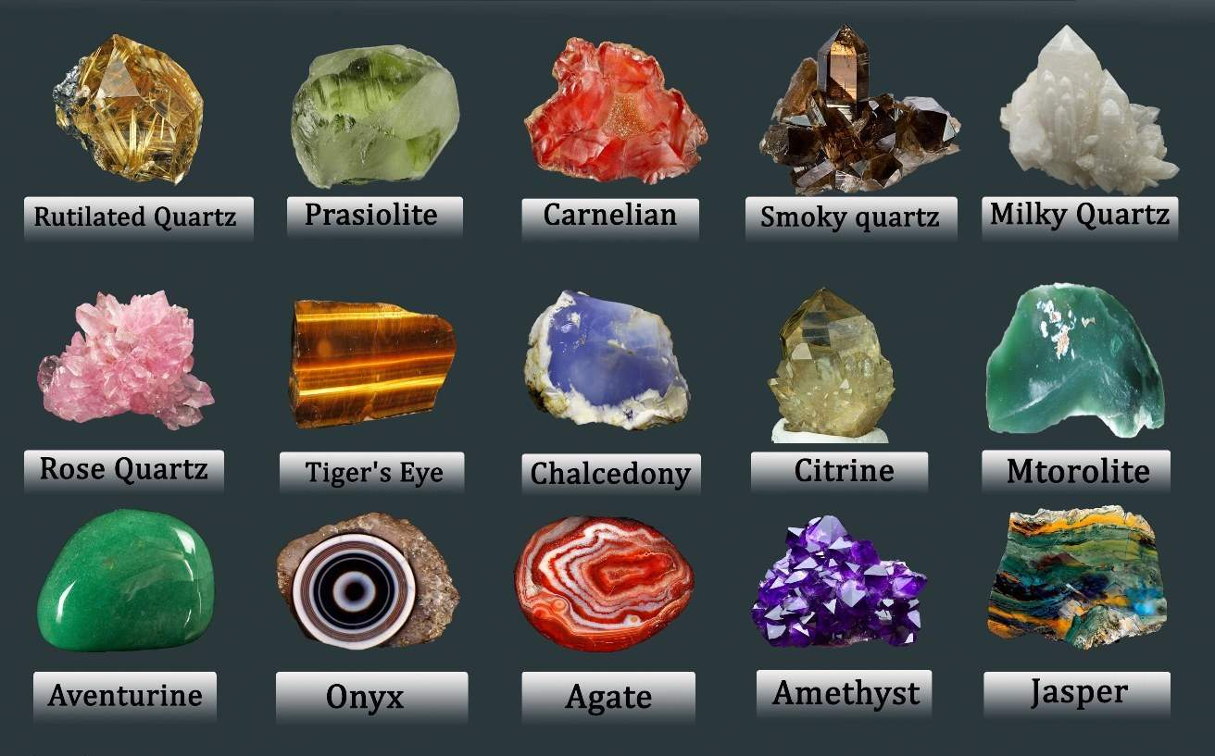
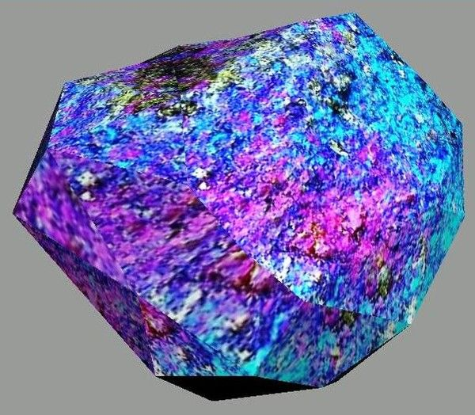
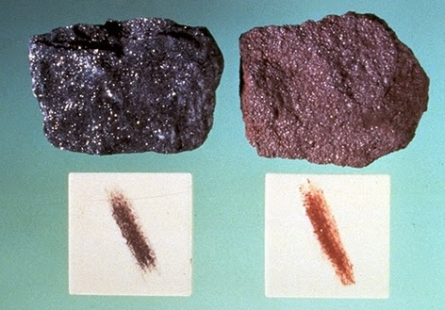
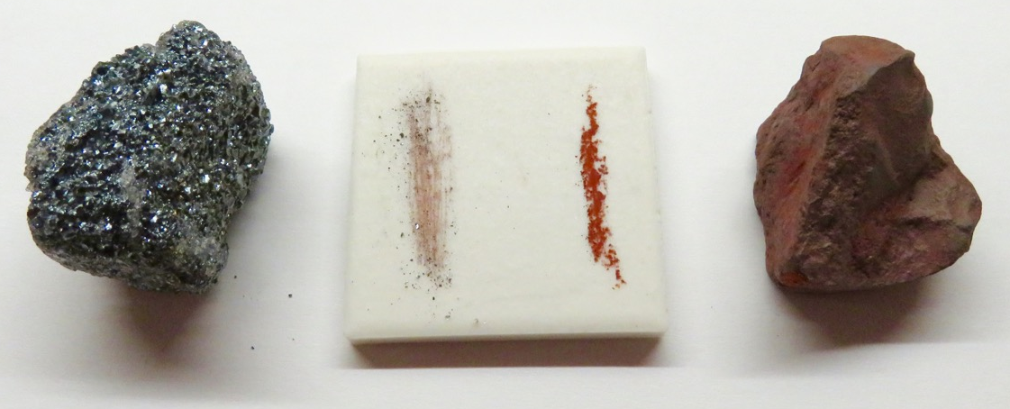
Color and streak
BORNITE

Slide 11
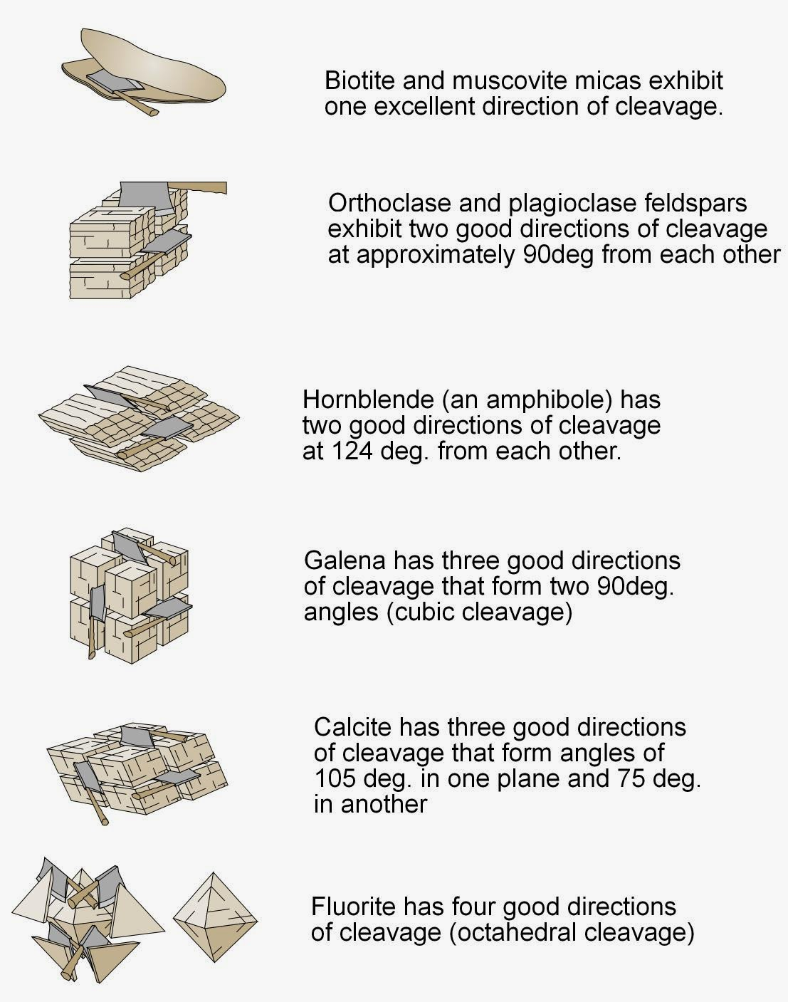
Physical properties of minerals
3. CLEAVAGE
Cleavage is the tendency of a mineral to break (cleave) along planes of weak bonding.
These cleavage directions are usually, but not always, parallel to one of the crystal faces.
Some minerals, such as quartz and garnet, possess no cleavages, whereas others may have one (micas), two (pyroxenes and amphiboles), three (galena) or four (fluorite).

Slide 12
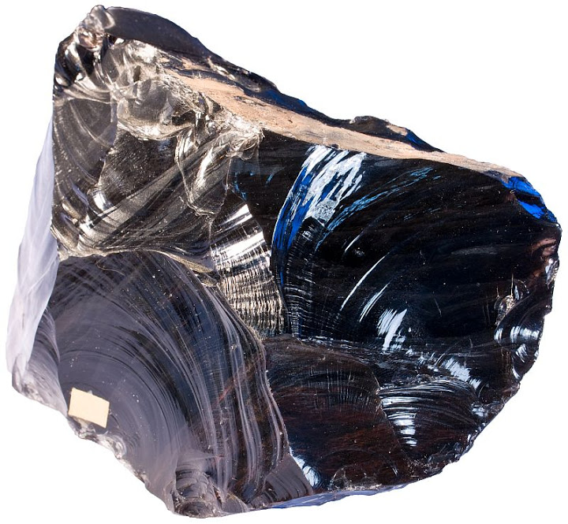
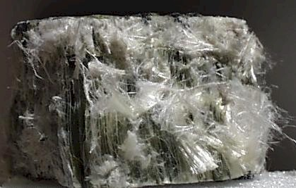
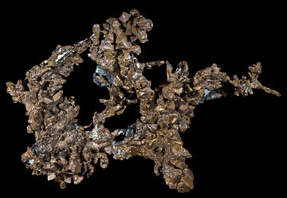
Physical properties of minerals
4. FRACTURE
Surface formed by breaking the mineral along a direction which is not a cleavage is called a fracture and is usually more irregular than a cleavage plane.
A fracture may also occur, for example, in a specimen which is either an aggregate of tiny crystals or glassy (that is, non-crystalline).
A curved, rippled fracture is termed conchoidal (shell-like) and is found in the mineral quartz
CONCHOIDAL FRACTURE
SPLINTERY FRACTURE
HACKLY FRACTURE

Slide 13
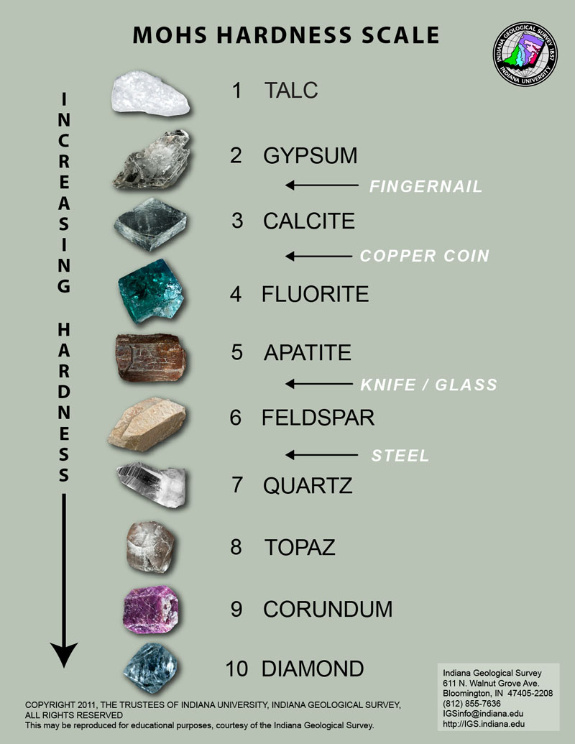
Physical properties of minerals
5. HARDNESS
One of the most useful diagnostic properties is hardness, a measure of the resistance of a mineral to abrasion or scratching.
This property is determined by rubbing a mineral of unknown hardness against one of known hardness, or vice versa.
A numerical value of hardness can by obtained by using the Mohs scale of hardness, which consists of 10 minerals arranged in order from 1 (softest) to 10 (hardest).

Slide 14
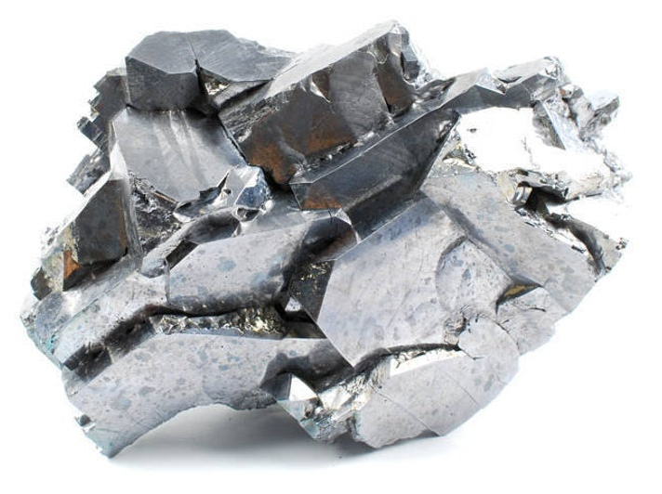
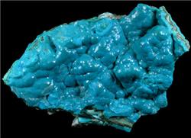
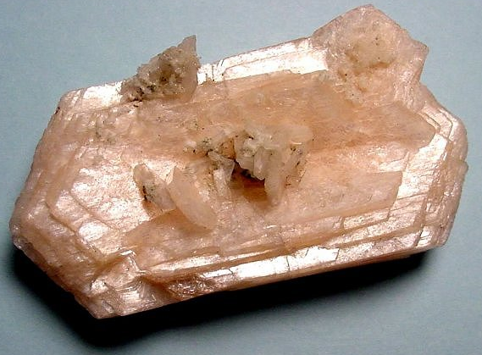
PHYSICAL PROPERTIES OF MINERALS
6. LUSTRE
The appearance or quality of light reflected from the surface of a mineral is known as luster.
Minerals that have the appearance of metals, regardless of color, are said to have a metallic luster.
Some metallic minerals, such as native copper and galena, develop a dull coating or tarnish when exposed to the atmosphere. Because they are not as shiny as samples with freshly broken surfaces, these samples are often said to exhibit a submetallic luster.
Most minerals have a nonmetallic luster and are described using various adjectives such as vitreous or glassy.
Other nonmetallic minerals are described as having a dull or earthy luster (a dull appearance like soil) or a pearly luster (such as a pearl or the inside of a clamshell). Still others exhibit a silky luster (like satin cloth) or a greasy luster (as though coated in oil)
METALLIC
GREASY
PEARLY

Slide 15
Descriptive terms for the luster of minerals
Metallic (also known as splendent)
Submetallic
Vitreous (also known as glassy)
Adamantine (also known as brilliant or diamond like)
Resinous (also known as resin like)
Silky
Pearly (also known as mother-of-pearl)
Greasy (also known as oily)
Waxy (also known as wax like)
Dull (also known as earthy)

Slide 16
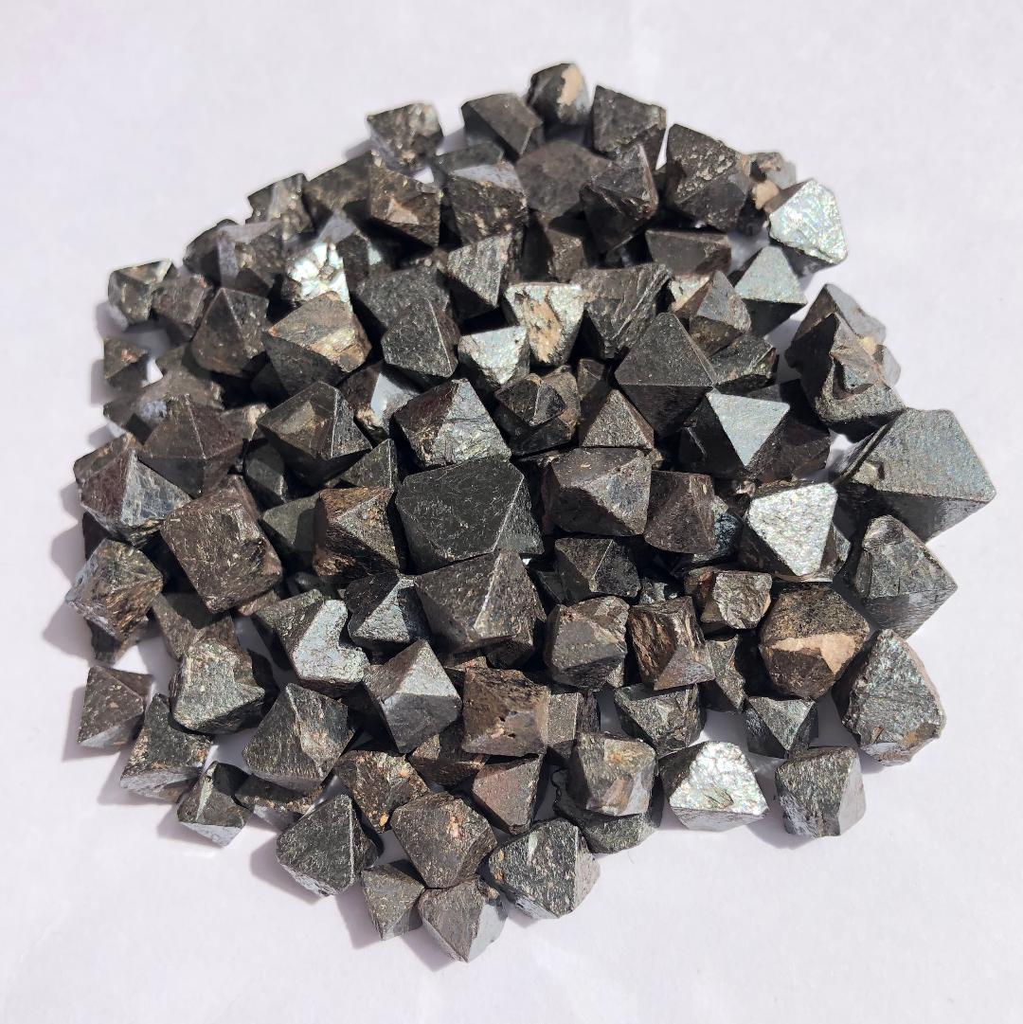
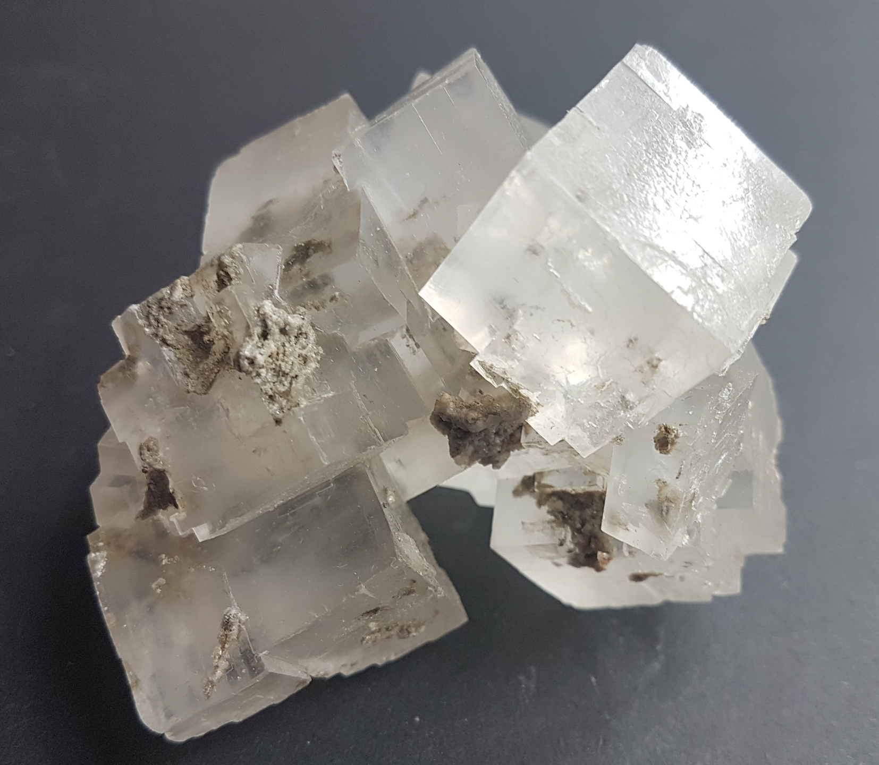
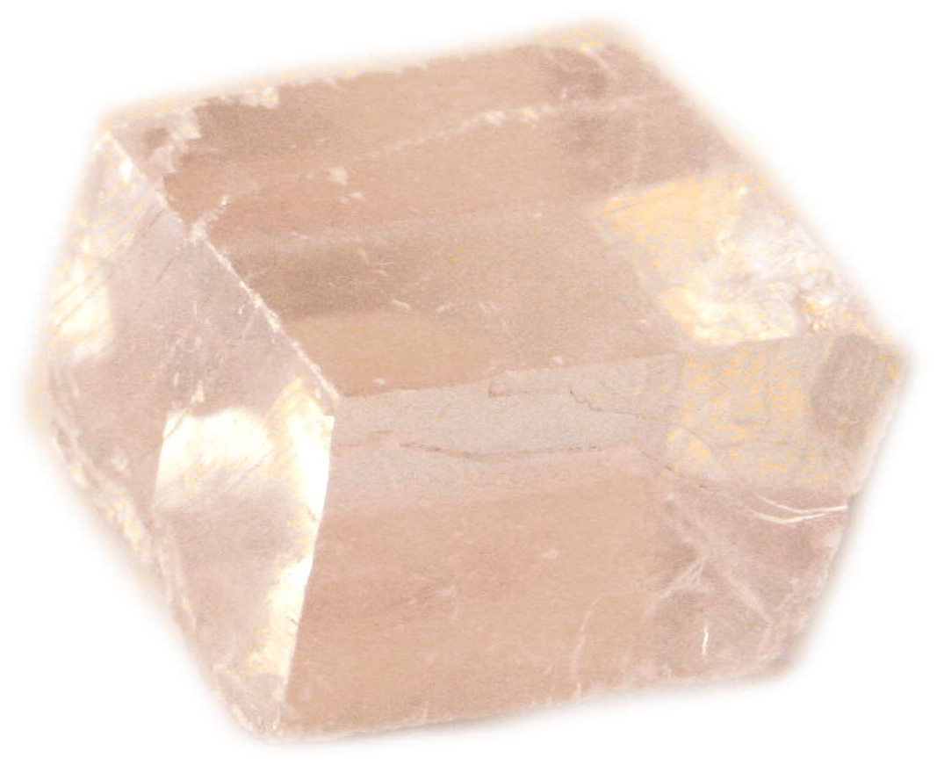
PHYSICAL PROPERTIES OF MINERALS
7. CRYSTAL HABIT/SHAPE
Mineralogists use the term crystal shape or habit to refer to the common or characteristic shape of a crystal or aggregate of crystals.
A few minerals exhibit somewhat regular polygons that are helpful in their identification.
For example, magnetite crystals sometimes occur as octahedrons, garnets often form dodecahedrons, and halite and fluorite crystals tend to grow as cubes or near cubes.
While most minerals have only one common habit, a few have two or more characteristic crystal shapes.
MAGNETITE
HALITE
CALCITE

Slide 17
PHYSICAL PROPERTIES OF MINERALS
8. SPECIFIC GRAVITY
Mineralogists often use a related measure called specific gravity to describe the density of minerals.
Specific gravity is a number representing the ratio of a mineral’s weight to the weight of an equal volume of water.
Most common rock-forming minerals have a specific gravity of between 2 and 3.
For example, quartz has a specific gravity of 2.65.
By contrast, some metallic minerals such as pyrite, native copper, and magnetite are more than twice as dense and thus have more than twice the specific gravity as quartz.
Galena, an ore of lead, has a specific gravity of roughly 7.5, whereas the specific gravity of 24-karat gold is approximately 20.

Slide 18
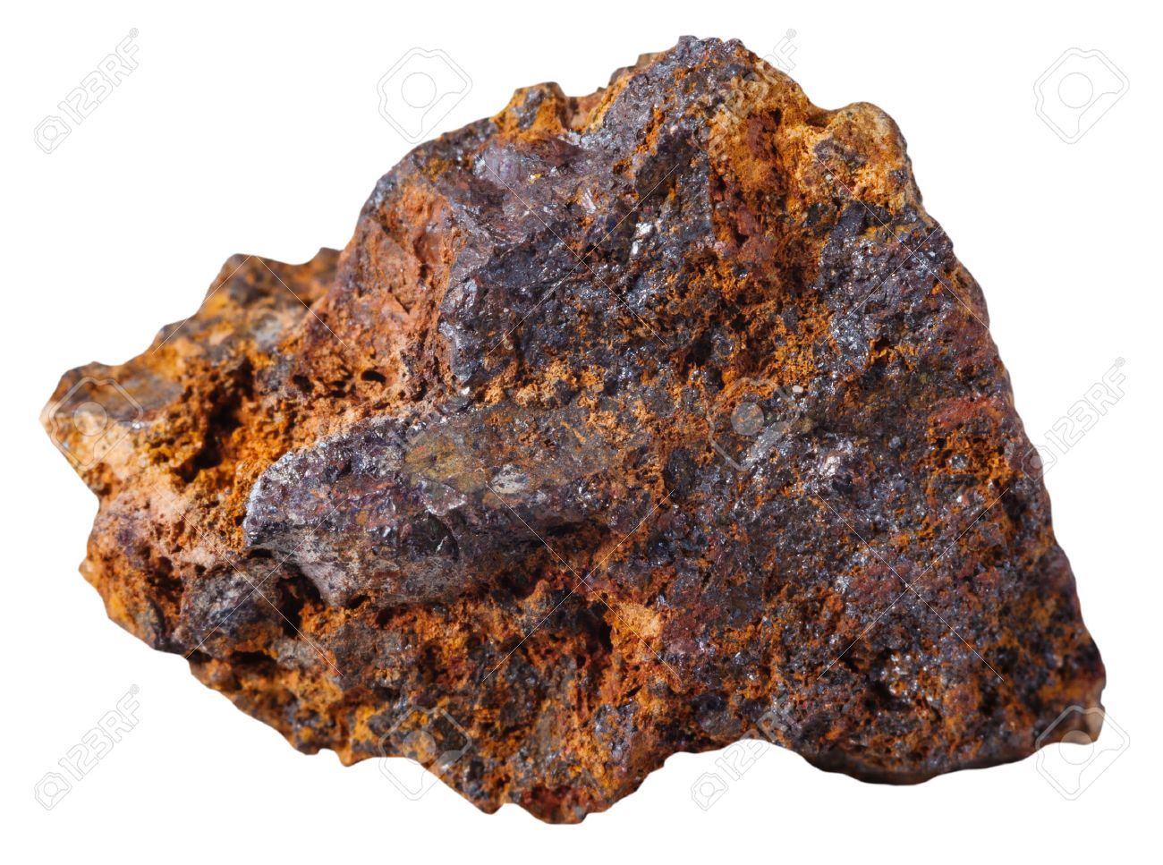
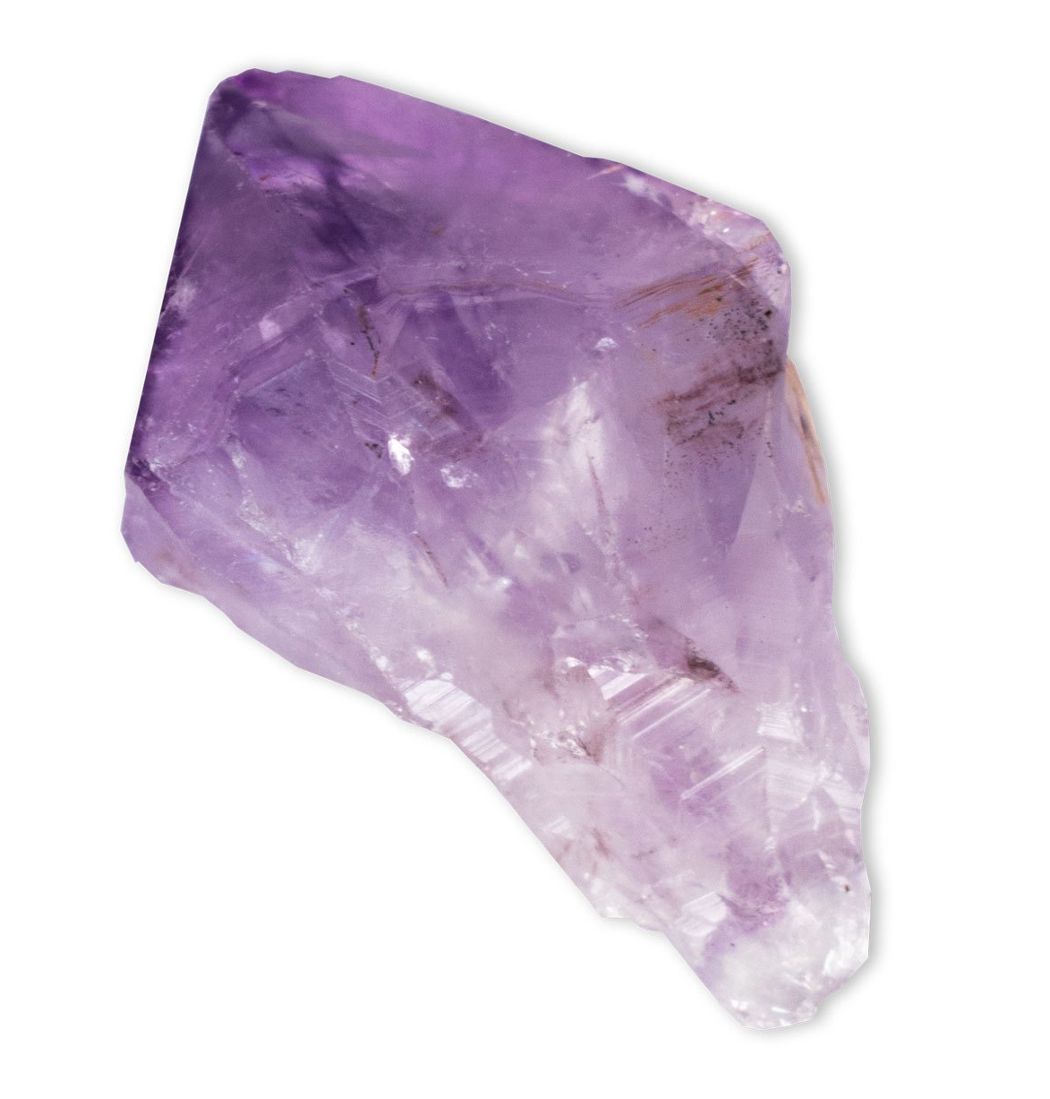
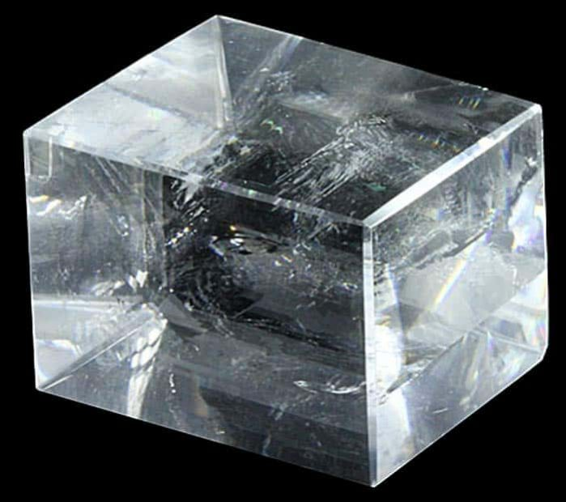
OTHER PROPERTIES OF MINERALS
TRANSPARENCY/ABILITY TO TRANSMIST LIGHT
Transparency is a measure of how clearly an object can be seen through a crystal.
When no light is transmitted, the mineral is described as opaque.
When light, but not an image, is transmitted through a mineral it is said to be translucent.
When both light and an image are visible through the sample, the mineral is described as transparent.

Slide 19
Other properties of minerals (tenacity)
The term tenacity describes a mineral’s toughness, or its resistance to breaking or deforming. The different forms of tenacity are:
Brittle - If a mineral is hammered and the result is a powder or small crumbs, it is considered brittle. The majority of all minerals are brittle. An example is Quartz.
Sectile - Sectile minerals can be separated with a knife, much like wax but usually not as soft. An example is Gypsum.
Malleable and Ductile - If a mineral can be flattened by pounding with a hammer, it is malleable and if it can be stretched into a wire, it is ductile. Silver, Gold
Elastic – Some spring back to their original position when the are bent. An example is Mica.

Slide 20
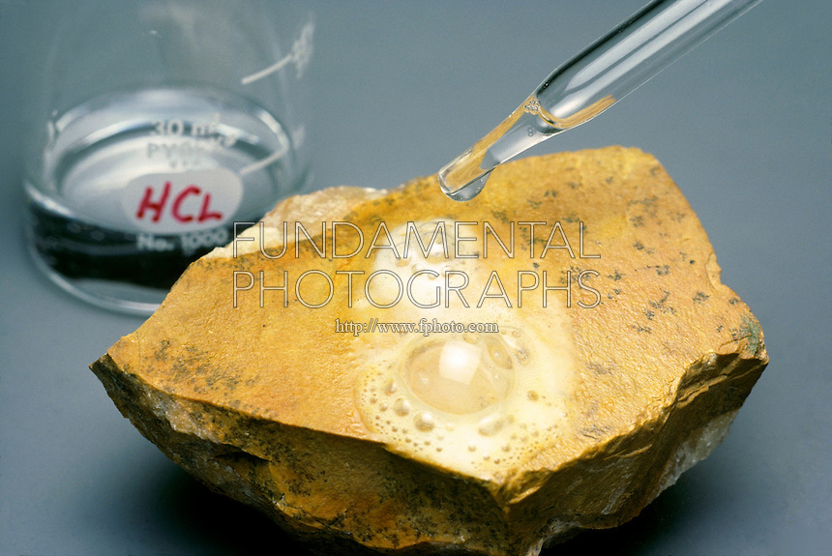
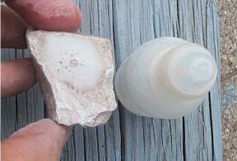
OTHER PROPERTIES OF MINERALS
REACTION WITH ACID
One very simple chemical test involves placing a drop of dilute hydrochloric acid from a dropper bottle onto a freshly broken mineral surface.
Using this technique, certain minerals, called carbonates, will effervesce (fizz) as carbon dioxide gas is released.

Slide 21
Mineral Classification
Mineral classification can be an organizational nightmare.
With over 3,000 different types of minerals a system is needed to make sense of them all.
Mineralogists group minerals into families based on their chemical composition.
Minerals are classified according to their anions i.e. the negatively charged ions.
Anions can be either simple or complex. A simple anion is a single negatively charged ion, such as O2-. Examples of complex ions are silicate, (SiO₄)⁴⁻, and carbonate, (CO₃)²⁻.
Each mineral group (except the native elements) is named for its anion. For example, the oxides all contain O²⁻, the silicates contain (SiO₄)⁴⁻, and the carbonates contain (CO₃)²⁻.

Slide 22
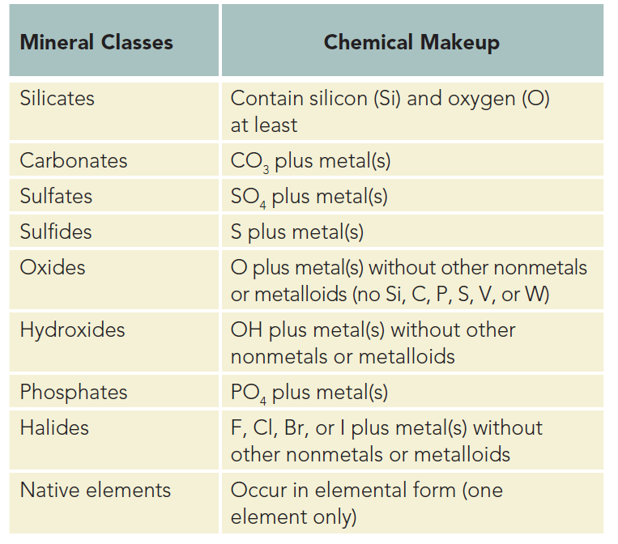
Major mineral groups

Slide 23
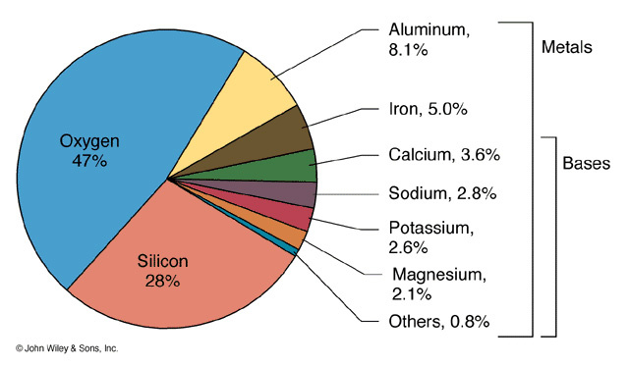
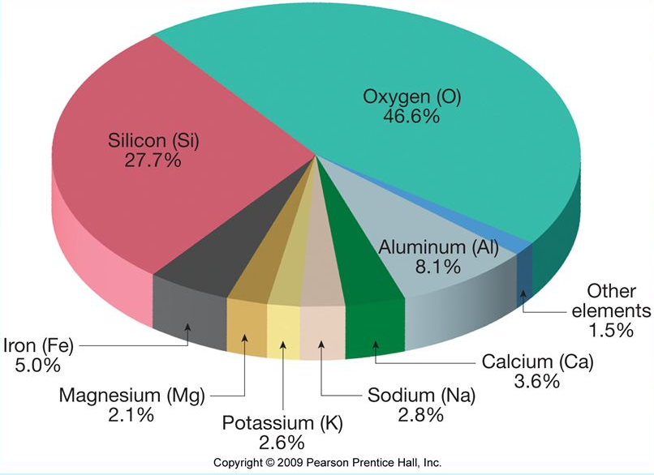
Silicate minerals
Of the hundred or so elements known, only eight are abundant at the Earth’s surface.
These, in decreasing order of abundance, are oxygen (O), silicon (Si), aluminium (Al), iron (Fe), calcium (Ca), sodium (Na), potassium (K) and magnesium (Mg).
The common rock-forming minerals are formed mainly of combinations of these important elements and most of them are silicates.

Slide 24
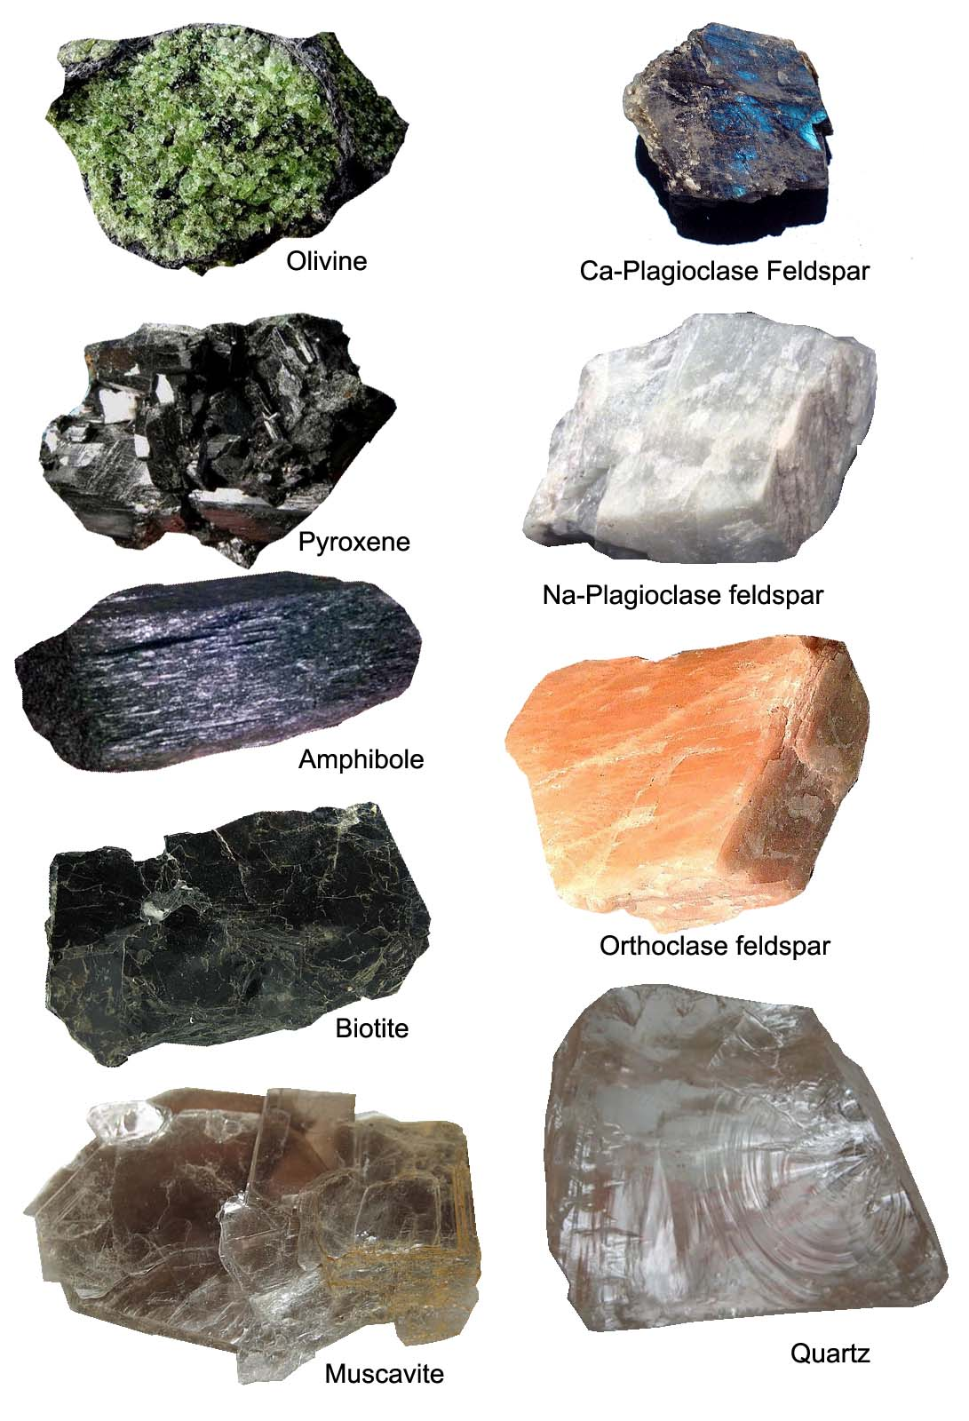
Silicate minerals
Every silicate mineral contains the two most abundant elements of Earth’s crust, oxygen and silicon.
Further, most contain one or more of the other common elements.
Together, these elements give rise to hundreds of silicate minerals with a wide variety of properties, including hard quartz, soft talc, sheet-like mica, fibrous asbestos, green olivine, and blood-red garnet.

Slide 25
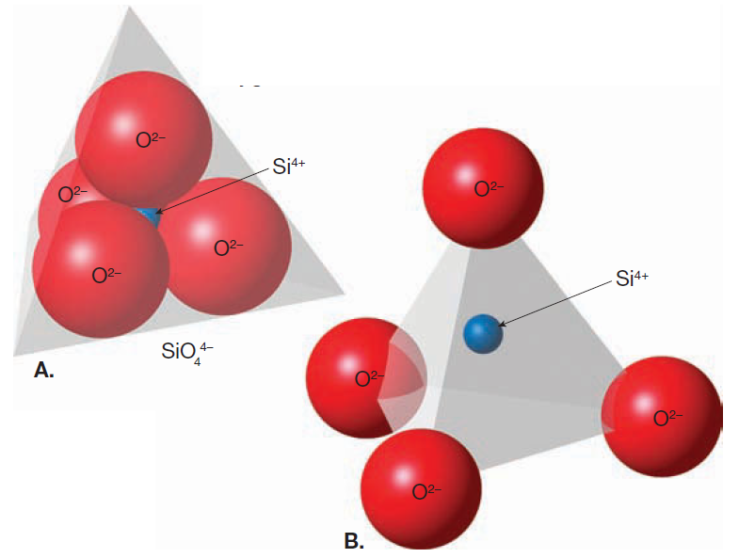
Silicate structure
All silicate minerals have the same fundamental building block, the silicon–oxygen tetrahedron (SiO₄)⁴⁻
This structure consists of four oxygen ions that are covalently bonded to one comparatively small silicon ion forming a tetrahedron: a pyramid shape with four identical faces.
These tetrahedra are not chemical compounds, but rather complex ions (SiO₄)⁴⁻ having a net charge of -4.
To become electrically balanced, these complex ions bond to other positively charged metal ions.
Silicate tetrahedra commonly link together by sharing oxygens. Thus, two tetrahedra may share a single oxygen, bonding the tetrahedra together

Slide 26
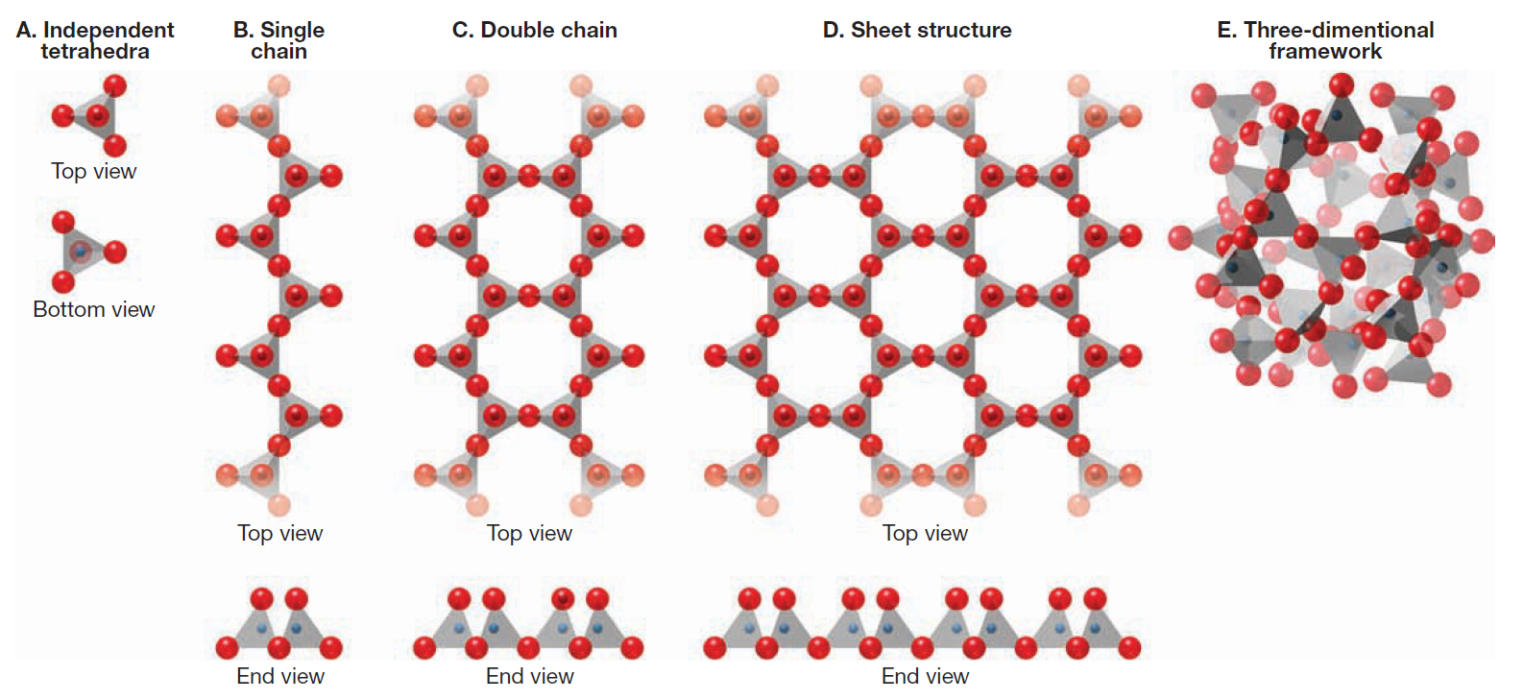
Silicate structure

Slide 27
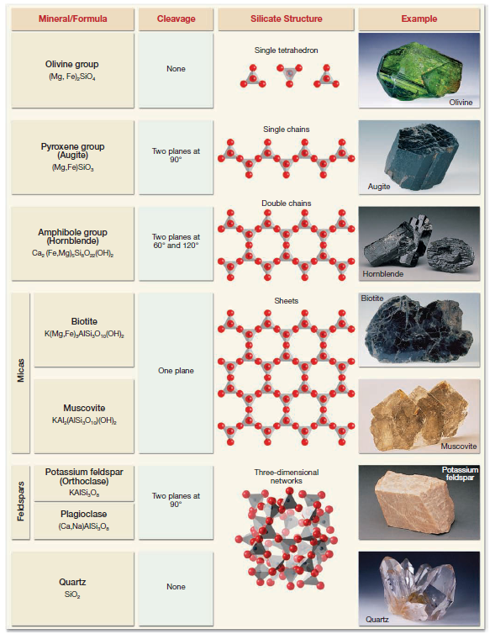
silicate minerals

Slide 28
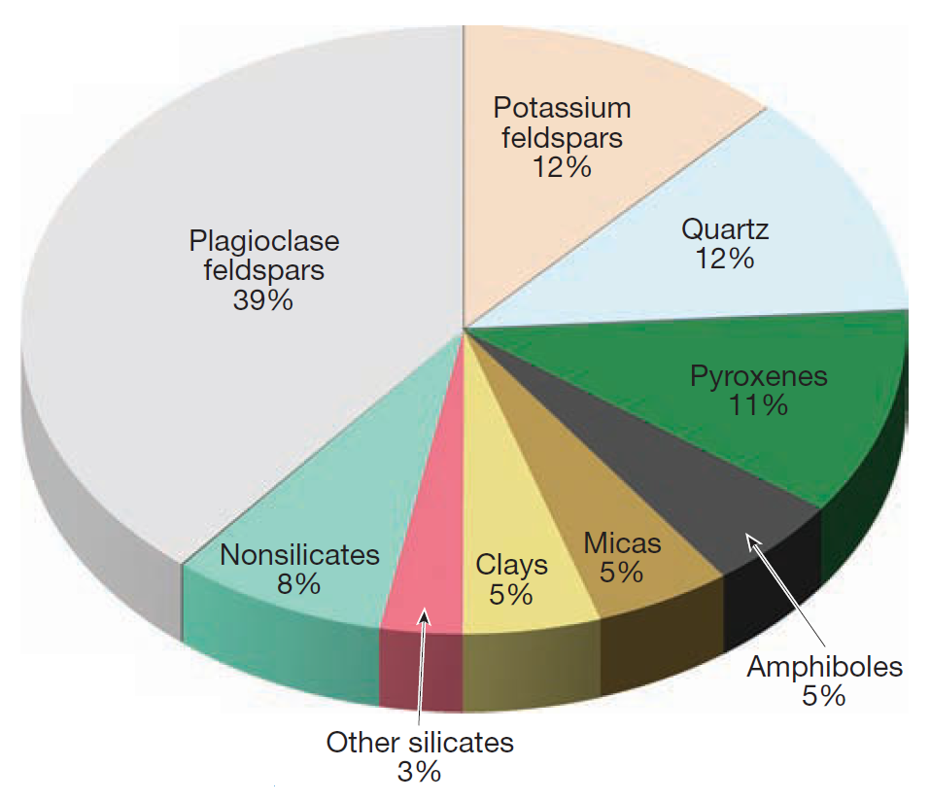
Estimated percentages (by volume) of the most common minerals in Earth’s crust
Based on their chemical makeup the silicate minerals can be classified into two types
The Light Silicates
The Dark Silicates

Slide 29
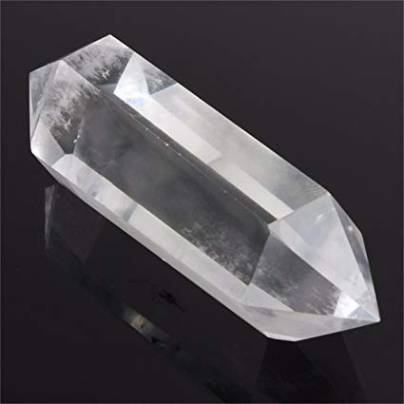
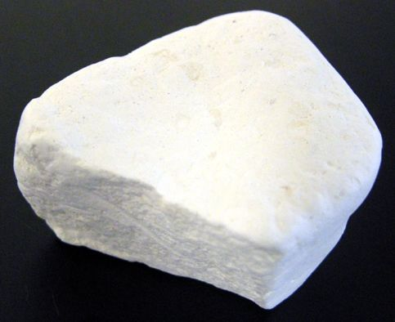
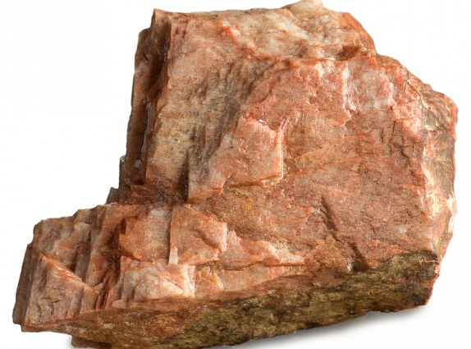
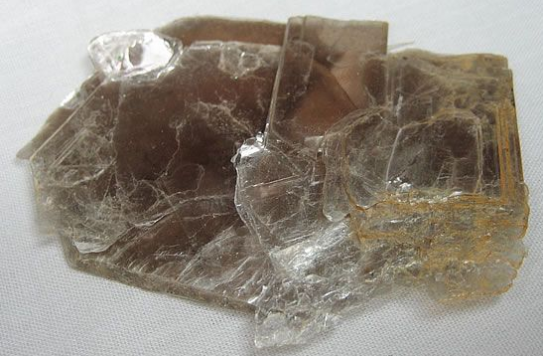
The light silicates
The light (or non-ferromagnesian) silicates are generally light in color and have a specific gravity of about 2.7, which is considerably less than the dark (ferromagnesian) silicates.
These differences are mainly attributable to the presence or absence of iron and magnesium.
The light silicates contain varying amounts of aluminum, potassium, calcium, and sodium rather than iron and magnesium.
QUARTZ
FELDSPAR
CLAY MINERAL
MUSCOVITE

Slide 30
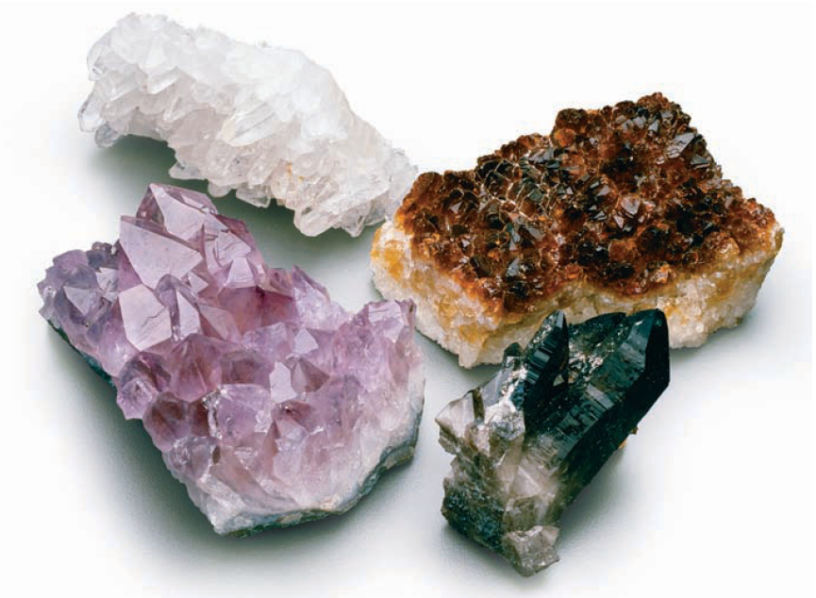
1. QUARTZ
QUARTZ: Quartz is the only common silicate mineral consisting entirely of silicon and oxygen. As such, the term silica is applied to quartz, which has the chemical formula SiO2.
In quartz, a three-dimensional framework is developed through the complete sharing of oxygen by adjacent silicon atoms.
Thus, all of the bonds in quartz are of the strong silicon–oxygen type. Consequently, quartz is hard, resistant to weathering, and does not have cleavage.
When broken, quartz generally exhibits conchoidal fracture.
The most common varieties of quartz are milky (white), smoky (gray), rose (pink), amethyst (purple), and rock crystal (clear)

Slide 31
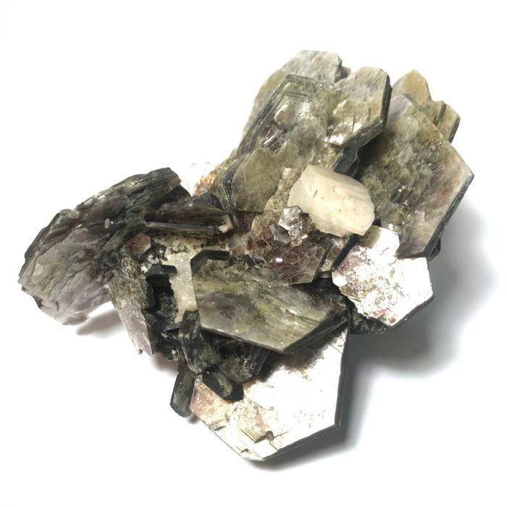
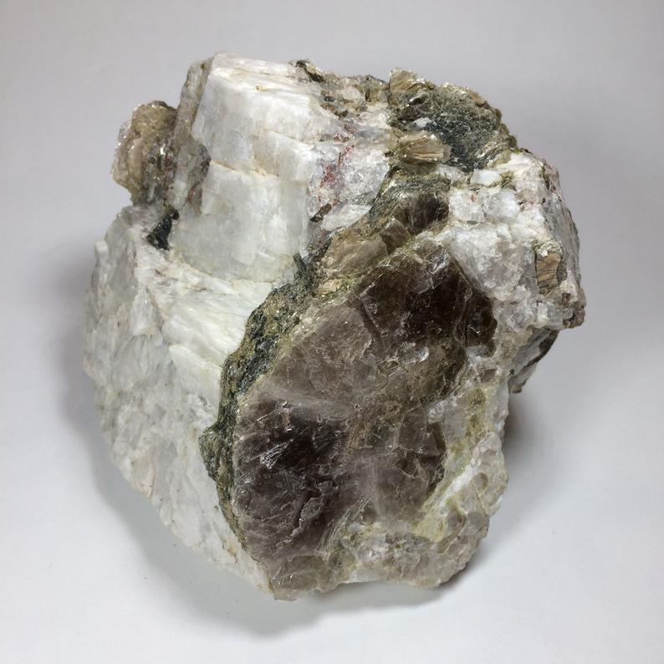
2. MUSCOVITE
Muscovite is a common member of the mica family.
It is light in color and has a pearly luster.
Like other micas, muscovite has excellent cleavage in one direction.
In thin sheets, muscovite is clear.
Because muscovite is very shiny, it can often be identified by the sparkle it gives a rock.
It is particularly common in veins of coarse granite-like rock (pegmatite) and may be mined from them to be used as sheets having good thermal or electrical insulation.
It is also present in many sedimentary and metamorphic rocks.

Slide 32
3. FELDSPARS
Feldspar, the most common mineral group, can form under a wide range of temperatures and pressures, which partially accounts for its abundance
All feldspars have similar physical properties.
They have two planes of cleavage meeting at or near 90-degree angles, are relatively hard (6 on the Mohs scale), and have a luster that ranges from glassy to pearly.
Two different feldspar structures exist.
One group of feldspar minerals contains potassium ions in its structure and is therefore referred to as potassium feldspar. (Orthoclase and microcline are common members of the potassium feldspar group.)
The other group, called plagioclase feldspar, contains both sodium and calcium ions.

Slide 33
4. CLAY MINERALS
Clay is a term used to describe a category of complex minerals that, like the micas, have a sheet structure.
Clay minerals make up a large percentage of the surface material we call soil.
Because of the importance of soil in agriculture, and because of its role as a supporting material for buildings, clay minerals are extremely important to humans.
Their layered structure and weak bonding between layers give them a characteristic feel when wet.
One of the most common clay minerals is kaolinite, which is used in the manufacture of fine china and as a coating for high gloss paper.
Some other examples of clay minerals are Vermiculite, Illite and Montmorillonite.

Slide 34
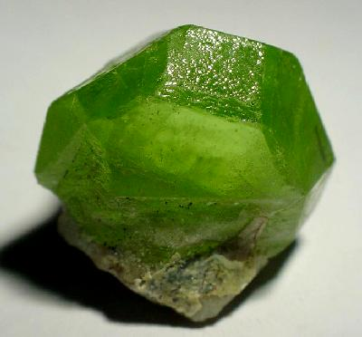
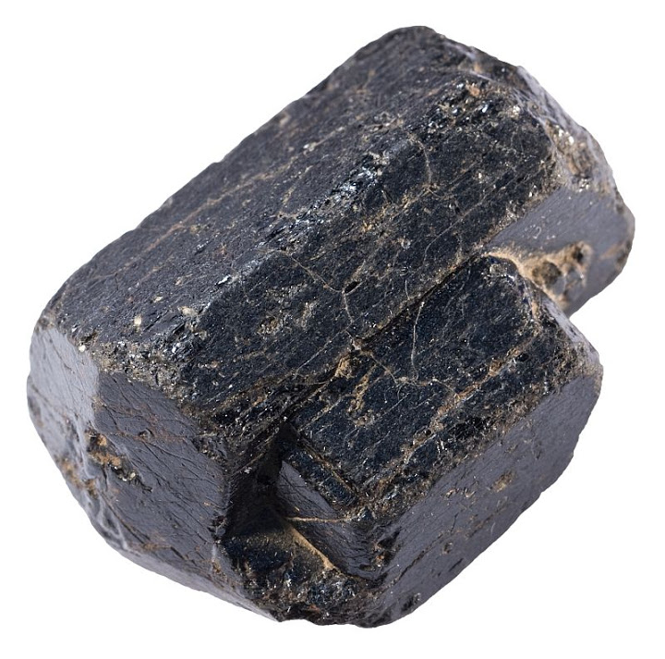
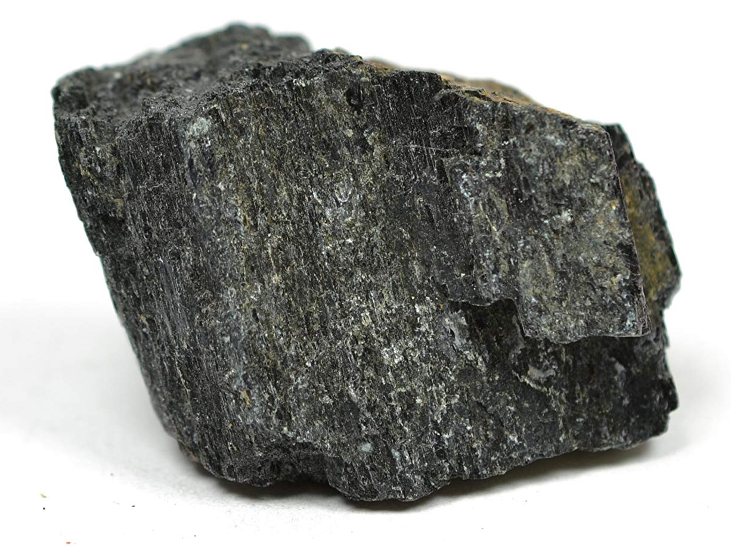
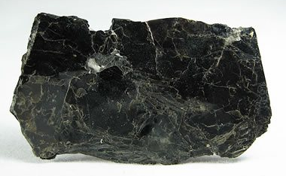
The dark silicates
OLIVINE
The dark (or ferromagnesian) silicates are those minerals containing ions of iron (ferro = iron ) and/or magnesium in their structure.
Because of their iron content, ferromagnesian silicates are dark in color and have a greater specific gravity, (between 3.2 and 3.6) , than non-ferromagnesian silicates.
The most common dark silicate minerals are olivine, the pyroxenes, the amphiboles, dark mica (biotite), and garnet.
PYROXENE
AMPHIBOLE
BIOTITE

Slide 35
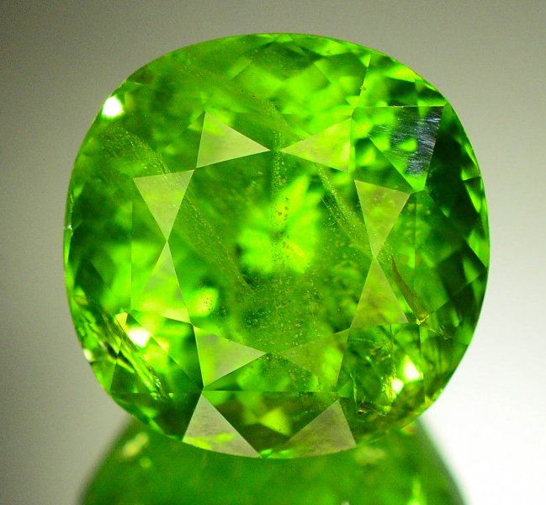
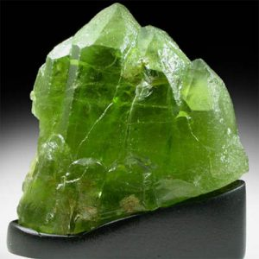

1. Olivine
Olivine is a family of high-temperature silicate minerals that are black to olive green in color and have a glassy luster and a conchoidal fracture.
Transparent olivine is occasionally used as a gemstone called peridot.
Olivine and related forms are thought to constitute up to 50 percent of Earth’s upper mantle.

Slide 36


2. pyroxene
The pyroxenes are a group of complex minerals that are important components in dark colored igneous rocks.
The most common member, augite, is a black, opaque mineral with two directions of cleavage that meet at nearly a 90-degree angle.
Augite is one of the dominant minerals in basalt, a common igneous rock of the oceanic crust and volcanic areas on the continents.

Slide 37


3. amphibole
Hornblende is the most common member of a chemically complex group of minerals called amphiboles
Hornblende is usually dark green to black in color, and except for its cleavage angles, which are about 60 degrees and 120 degrees, it is very similar in appearance to augite.
In a rock, hornblende often forms elongated crystals.
This helps distinguish it from pyroxene, which forms rather blocky crystals.
Hornblende is found in igneous rocks, where it often makes up the dark portion of an otherwise light-colored rock.

Slide 38


4. biotite
Biotite is the dark, iron-rich member of the mica family.
Like other micas, biotite possesses a sheet structure that gives it excellent cleavage in one direction.
Biotite also has a shiny black appearance that helps distinguish it from the other dark ferromagnesian minerals.
Like hornblende, biotite is a common constituent of igneous rocks, including the rock granite.

Slide 39

The non-silicate minerals

