Slide 1
Unite 1 part 4
Editing Your Writing

Slide 2
What is the difference between editing and proofreading?
Editing
Improving the quality of writing
Delete unimportant info
Make stronger arguments
Proofreading
Checking for spelling, punctuation, capitalization.
Checking for structural errors
Part of editing but not the other way around..

Slide 3
What to look for when editing
Paragraph structure (topic sentence, supporting sentences, and concluding sentence.)
Unity and Coherence.
Off topic sentences/ideas
Punctuation
Spelling
Grammatical errors.
Capitalization.
Fragments and run-on sentences.

Slide 4
Exercises to 1 to 4

Slide 5
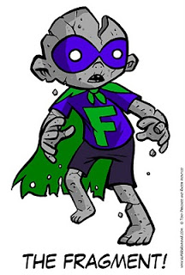
Fragments
Sentences that are missing a verb or a subject.
It is more common in compound and complex sentences than simple sentences.
Examples in the book.

Slide 6
video

Slide 7
Run-on sentence
A run-on sentence is poor grammar.
It exists when two independent clauses (also called main clauses) are incorrectly joined.
More than one independent clause cannot exist in a sentence unless they are properly combined.
To properly combine clauses, correct conjunctions or punctuation must be added to the sentence.
See examples page 22

Slide 8
Exercises 5 to 7

