Slide 1
Types of unconformities
106 Geo

Slide 2
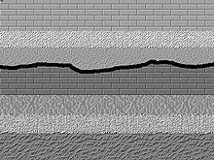
Disconformity A disconformity is an unconformity between parallel layers of sedimentary rocks

Slide 3
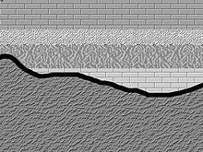
Nonconformity A nonconformity exists between sedimentary rocks and metamorphic or igneous rocks when the sedimentary rock lies above and was deposited on the pre-existing and eroded metamorphic or igneous rock

Slide 4
Angular unconformity An angular unconformity is an unconformity where horizontally parallel strata of sedimentary rock are deposited on tilted and eroded layers, producing an angular discordance with the overlying horizontal layers.

Slide 5
التعاريف
مبدأ التعاقب 1-Principle of Superposition
قانون الأفقية الأصلي 2-The Law of Original
Horizontality
القاطع احدث من المقطوع3-Crosscutting relations
4-Angular unconformity
5-Nonconformity
6-Disconformity
7-Definition of fossils

Slide 6
مصطلحات قد تفيد في الاختبار
Deposit of layers
Erosion of layers
Folding of layers
Faulting of layers
Tilting of layers

