Slide 1
Examples of normalization

Slide 2
Example1 Step 1
Identify a key for the table.
Remove duplicate data

Slide 3
Step 2
Transform a table of unnormalised data into first normal form (1NF). any repeating attributes to a new table. A repeating attribute is a data field within the UNF relation that may occur with multiple values for a single value of the key. The process is as follows:
Identify repeating attributes.
Remove these repeating attributes to a new table together with a copy of the key from the UNF table.
Assign a key to the new table . The key from the original unnormalised table always becomes part of the key of the new table. A compound key is created. The value for this key must be unique for each entity occurrence.

Slide 4
In the previous table the Project Title, Project Manager, Project Budget are repeating. That is, there is potential for more than one occurrence of these attributes for each project code. These are the repeating attributes and have been to a new table together with a copy of the original key (ie: Project Code).

Slide 5
1NF Tables: Repeating Attributes Removed

Slide 6
Step 3
Transform 1NF data into second normal form (2NF). Remove any -key attributes (partial Dependencies) that only depend on part of the table key to a new table. What has to be determined "is field A dependent upon field B or vice versa?" This means: "Given a value for A, do we then have only one possible value for B, and vice versa?" If the answer is yes, A and B should be put into a new relation with A becoming the primary key. A should be left in the original relation and marked as a foreign key.
Ignore tables with (a) a simple key or (b) with no non-key attributes (these go straight to 2NF with no conversion).
The process is as follows:
Take each non-key attribute in turn and ask the question: is this attribute dependent on one part of the key?
If yes, remove the attribute to a new table with a copy of the part of the key it is dependent upon. The key it is dependent upon becomes the key in the new table. Underline the key in this new table.
If no, check against other part of the key and repeat above process
If still no, ie: not dependent on either part of the key, keep attribute in current table.

Slide 7
The first table went straight to 2NF as it has a simple key (Project Code).
Employee name, Department No and Department Name are dependent upon Employee No only. Therefore, they were moved to a new table with Employee No being the key.
However, Hourly Rate is dependent upon both Project Code and Employee No as an employee may have a different hourly rate depending upon which project they are working on. Therefore it remained in the original table.

Slide 8
2NF Tables: Partial Key Dependencies Removed

Slide 9
Step 4
data in second normal form (2NF) into third normal form (3NF).Remove to a new table any non-key attributes that are more dependent on other non-key attributes than the table key.
Ignore tables with zero or only one non-key attribute (these go straight to 3NF with no conversion).
The process is as follows: If a non-key attribute is more dependent on another non-key attribute than the table key:
Move the dependent attribute, together with a copy of the non-key attribute upon which it is dependent, to a new table.
Make the non-key attribute, upon which it is dependent, the key in the new table. Underline the key in this new table.
Leave the non-key attribute, upon which it is dependent, in the original table and mark it a foreign key (*).

Slide 10
The project team table went straight from 2NF to 3NF as it only has one non-key attribute.
Department Name is more dependent upon Department No than Employee No and therefore was moved to a new table. Department No is the key in this new table and a foreign key in the Employee table.

Slide 11
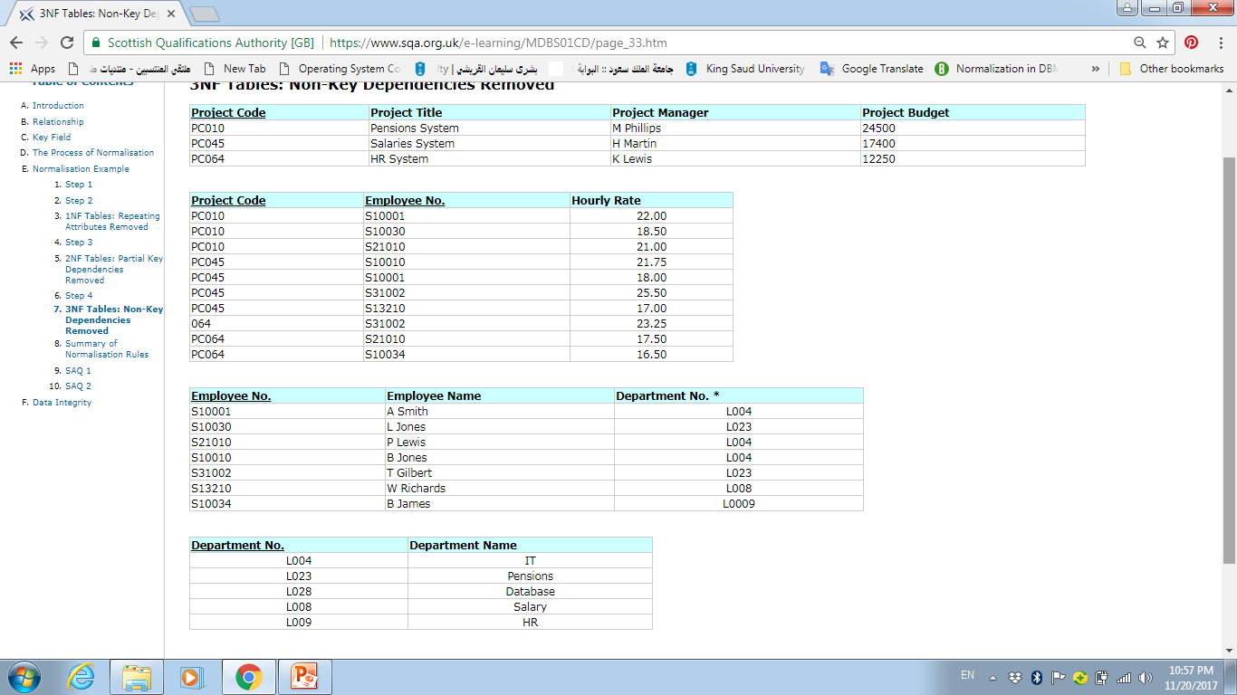
3NF Tables: Non-Key Dependencies Removed

Slide 12
Summary of Normalization Rules
That is the complete process. Having started off with an unnormalised table we finished with four normalized tables in 3NF. You will notice that duplication has been removed (apart from the keys needed to establish the links between those tables).
The process may look complicated. However, if you follow the rules completely, and do not miss out any steps, then you should arrive at the correct solution. If you omit a rule there is a high probability that you will end up with too few tables or incorrect keys.
The following normal forms were discussed in this section:
First normal form: A table is in the first normal form if it contains no repeating columns.
Second normal form: A table is in the second normal form if it is in the first normal form and contains only columns that are dependent on the whole (primary) key.
Third normal form: A table is in the third normal form if it is in the second normal form and all the non-key columns are dependent only on the primary key. If the value of a non-key column is dependent on the value of another non-key column we have a situation known as transitive dependency. This can be resolved by removing the columns dependent on non-key items to another table.

Slide 13
Example2 UNF
In this Relation (STUDENT _REPORT )
Grade | Department | Teacher | TechNo | Hours | Subject | SuCode | Address | Name | St.No
A | Computer | Ali | 7 | 3 | Introduction to computer | csc101 | Riyadh | Fahad | 5
B | Math | Saad | 12 | 4 | Itroduction to Calculation | math102 | Riyadh | Fahad | 5
C+ | Computer | Rashid | 2 | 4 | C++ | csc103 | Riyadh | Fahad | 5
B+ | Computer | Khalid | 2 | 3 | DB1 | csc325 | Riyadh | Fahad | 5
B | Computer | Tariq | 3 | 3 | DB2 | csc426 | Riyadh | Fahad | 5

Slide 14
1NF
Relation STUDENT
Address | Name | St.No
Relation STUDENT Report
Grade | Department | Teacher | TechNo | Hours | Subject | SuCode | St.No

Slide 15
2NF
Relation STUDENT
Address | Name | St.No
Relation STUDENT -Subject
Grade | SuCode | St.No
Relation Subject -Teacher
Department | Teacher | TechNo | Hours | Subject | SuCode

Slide 16
3NF
Relation STUDENT
Address | Name | St.No
Relation STUDENT -Subject
Grade | SuCode | St.No
Relation Teacher-Subject
TechNo | Hours | Subject | SuCode
Relation Teacher
Department | Teacher | TechNo

Slide 17
Example3
StdName | CourseName | Mark | Course_no | Stdno
FD1
FD2
FD3
Describe and illustrate the process of normalization to produce 2NF relations.

Slide 18
Example4
E | D | C | B | A
FD1
FD2
FD3
FD4
Describe and illustrate the process of normalization to produce 3NF relations.

Slide 19
Example5
Grade | Instructor_Location | InstructorName | CourseTitle | CourseID | Major | CampusAddress | StudentName | StudentID
Put this relation in the 3NF.

