Slide 1
Exercise 1

Slide 2
Solution
$X(f)$ is the original baseband spectrum, $Xs(f)$ is its sampled signal spectrum, consisting of the original baseband spectrum $X(f)$ and its replicas $X(f±nf_{s})$.
The sampled signal spectrum in Equation: $T =1/{f_{s}}$

Slide 3
Exercise 2

Slide 4
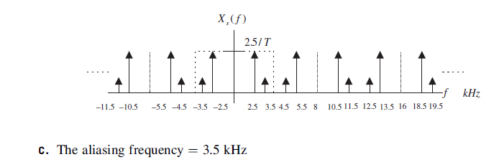
Solution
If an analog signal with a frequency $f$ is under-sampled ($f_{s}<2f_{max}$ ), the aliasing frequency component $f_{alias}$ in the baseband is given by the following expression:

Slide 5
Exercise 3

Slide 6
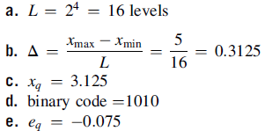
Solution

Slide 7
Exercise 3
If the analog signal to be quantized (unipolar quantization with 32 levels) has a sinusoidal waveform, where its range lies from 0 v to 10 v. Determine:
Number of bits of the ADC,
2. Quantization step (resolution),
3. Quantization level, binary code, and quantization error when the analog
voltage is 6.5 v.
4. Quantization level, binary code, and quantization error when the analog voltage is 2 v.

Slide 8
Solution
1. Number of bits: $L=2^{m}=32 levels$ $m=5$
2. Quantization step: $Δ=\frac{x_{max−}x_{min}}{L}=\frac{10−0}{32}=0.3125 volts$
3. Quantization level when the analogue voltage is 6.5 v, and its binary code.
$x_{e}=6.5 v$, index: $i=round(\frac{x_{e}−x_{min}}{Δ})=round(\frac{6.5}{0.3125})=21$
Quantization level: $x_{q}=x_{min}+i.Δ=0+21×0.3125=6.5625 volts$
$binary code:$ ${(21)}_{2}=10101$
Quantization error: $e_{q}=x_{q}−x_{e}=6.5−6.5625=−0.0625 volts.$
4. Quantization level when the analogue voltage is 2 v, and its binary code.
$x_{e}=2 v$, index: $i=round(\frac{x_{e}−x_{min}}{Δ})=round(\frac{2}{0.3125})=6$
Quantization level: $x_{q}=x_{min}+i.Δ=0+6×0.3125=1.875 volts$
$binary code:$ ${(6)}_{2}=01100$
Quantization error: $e_{q}=x_{q}−x_{e}=2−1.875=0.25 volts.$

