Slide 1
TREMATODES (Flukes)

Slide 2
Common features:
They are flat, provided with suckers as organ of attachment.
Trematodes are usually leaf shaped, and commonly named as flukes. Fluke means flat body with suckers.
No body cavity.
Reproduction: Most species are hermaphroditic (male and female systems are together); schistosomes are an exception.

Slide 3
Liver Fluke (Fasciola)
Habitat: bile ducts.
Epidemiology: worldwide.
Acquired by eating unwashed water vegetations containing the encysted metacercaria.
Definitive host: Man
1st intermediate host: Snail
2nd intermediate host: Water plants as water cress.
Infective stage: encysted metacercaria.

Slide 4
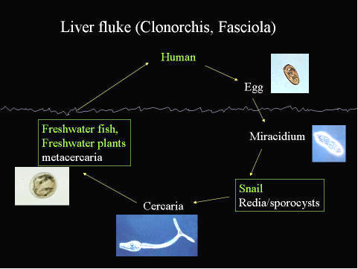
Life cycle:

Slide 5
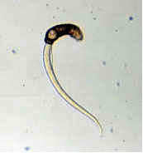
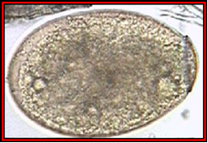
Morphology
There are two species: Fasciola hepatica and Fasciola gigantica.
Both of them are large, have 2 suckers; oral and ventral.
They have 2 testes, one ovary and one uterus.
Fasciola egg: large (150x90 µm ), oval, yellowish, operculated and immature.

Slide 6
Clinical and Diagnosis:
During migratory stage from intestine to liver: Fever, right hypochondrial pain, eosinophilia ( 2-3 months).
Once reaching the bile ducts: Live for years in biliary tree producing obstruction and cholangitis manifested by fever, jaundice, acute epigastric pain, enlargement of the liver and eosinophilia.
1-High eosinophilia
2-Stool examination: egg in stool
3-Serology
4-CT scan, ultrasound.
We have to differentiate between true fascioliasis and false fascioliasis.
Control:
Treatment of infected persons, snail destruction, immersion of raw vegetations in potassium permanganate for 20 minutes.

Slide 7
Intestinal Fluke (Fasciolopsis buski)
Habitat: small intestine.
Epidemiology: China, Taiwan, Vietnam, Indonesia and Malaysia.
Acquired by eating chest nut containing the encysted metacercaria which is the infective stage.
Definitive host: Man
1st intermediate host: Snail
2nd intermediate host: Chest nut.
Infective stage: encysted metacercaria.

Slide 8
Morphology
Adults: large, ovoid in shape, have 2 suckers; oral and ventral which are organs of attachement. The intestine is simple with no branches laterally nor medially.
They have 2 testes, one ovary and one uterus.
Fasciolopsis egg: large, oval, yellowish brown in colour, operculated and immature.

Slide 9
Clinical and diagnosis:
Abdominal pain and diarrhea.
Stool is greenish-yellow and contain undigested food as this worm produces malabsorption.
Complications may occur in the form of bowel obstruction in the presence of large numbers of worms. Also, the parasites may lead to ileus.
1-Stool examination: egg in stool
2-Serology
Control:
Treatment of infected persons, snail destruction, immersion of raw vegetations in boiling water for few seconds before eating.

Slide 10
Lung Fluke – Paragonimus westermani
Habitat: lung.
Epidemiology: Prevalent in the Far East (Japan, Korea and Taiwan); also areas in Central America and Africa. Transmission is related to the consumption of raw or undercooked fresh water crabs and crayfish.
Definitive host: Man
1st intermediate host: Snail
2nd intermediate host: Fresh water crabs and crayfish
Infective stage: encysted metacercaria.

Slide 11
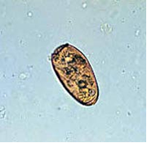
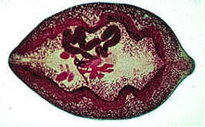
Morphology
Adult: oval, having 2 suckers oral and ventral, testis, ovary and uterus.
Egg: small (100x50 µm), oval operculated, brownish in colour, immature.

Slide 12
Clinical and diagnosis:
Fever, chills, chronic cough, rusty coloured sputum, haemoptysis, pneumonia, lung abscesses.
Examination of sputum and stool for eggs
serology (ELISA is used for detection of Abs or Ags in serum or pleural fluid).
Prevention: Cooking crab meat.

Slide 13
Blood Flukes (Schistosomiasis; Bilharzia)
Schistosoma mansoni; S. haematobium; S. japonicum.
Epidemiology
More than 200 million humans are infected; prevalence increasing
Widely distributed throughout Africa (S.haematobium and S.mansoni), South America and some parts of Asia; distribution increasing with irrigation.
Transmission occurs in fresh water where the cercaria (larval stage of Schistosoma) which is the infective stage come in contact with and penetrates human skin.

Slide 14
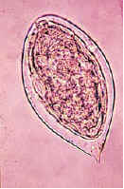
Schistosoma haematobium:
Habitat: Vesicle and pelvic venous plexus around the urinary bladder.
Morphology: Schistosoma differs from other trematodes in being separate sex (not hermaphrodite).
Egg: large, non-operculated, yellow, mature with terminal spine.

Slide 15
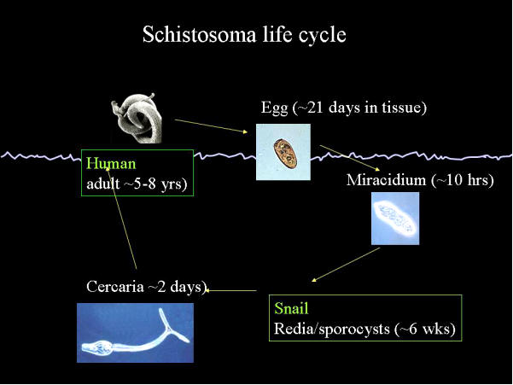
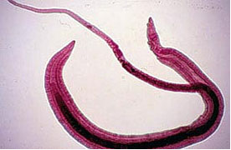
Life cycle:

Slide 16
Clinical and diagnosis:
Terminal hematuria, dysuria and frequency.
Urine examination, show the terminal spine egg.
Serology.

Slide 17
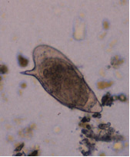
Schistosoma mansoni:
Habitat: Inferior mesenteric veins, draining the large intestine.
Morphology:
Egg: large, non-operculated, yellow, mature with lateral spine.

Slide 18
Clinical and diagnosis:
Dysentery (passage of blood and mucus in the diarrheic stool) + tenesmus.
Stool examination for eggs
Serology
Rectal biopsy

Slide 19
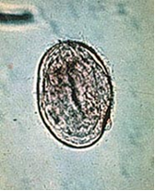
Schistosoma japonicum:
Habitat: Superior mesenteric veins, draining the small intestine.
Morphology:
Egg: small, rounded, mature with lateral spine. S.japonicum is characterized by higher egg production, nearly 3000 eggs/day.

Slide 20
Clinical and diagnosis:
It is serious. Starts by kata Yama fever which is manifested by fever, hepatosplenomegaly and lymphadenopathy.
Severe complications are in the form of cerebral and spinal cord affection leading to epilepsy and hemiplegia.
Stool examination for eggs
Serology.

