Slide 1
Trees

Slide 2
DEFINITION 1
A tree is a connected undirected graph with no simple circuits.
Because a tree cannot have a simple circuit, a tree cannot contain multiple edges or loops. Therefore any tree must be a simple graph.

Slide 3
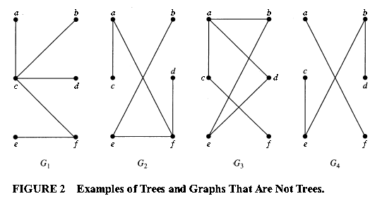
EXAMPLE 1
Which of the graphs shown in Figure 2 are trees?
Solution:

Slide 4
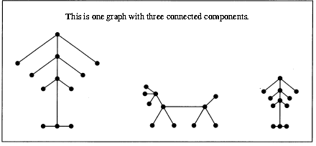
Forests
Any connected graph that contains no simple circuits is a tree.
What about graphs containing no simple circuits that are not necessarily connected?
These graphs are called forests and have the property that each of their connected components is a tree.

Slide 5
THEOREM 1
An undirected graph is a tree if and only if there is a unique simple path between any two of its vertices.

Slide 6
The Root & Rooted Trees
In many applications of trees, a particular vertex of a tree is designated as the root.
Because there is a unique path from the root to each vertex of the graph (by Theorem1), we direct each edge away from the root.
Thus, a tree together with its root produces a directed graph called a rooted tree.

Slide 7
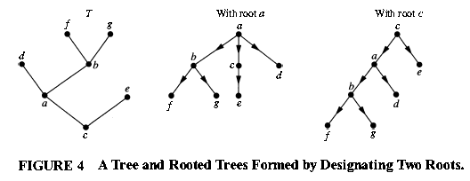
Rooted Tree
DEFINITION 2
A rooted tree is a tree in which one vertex has been designated as the root and every edge is directed away from the root.

Slide 8
m-ary & full m-ary
DEFINITION 3
A rooted tree is called an m -ary tree if every internal vertex has no more than m children.
The tree is called a full m-ary tree if every internal vertex has exactly m children.
An m –ary tree with m = 2 is called a binary tree.

Slide 9
EXAMPLE 3
Are the rooted trees in Figure 7 full m -ary trees for some positive integer m ?
Solution:

Slide 10
Properties of Trees
THEOREM 2
A tree with n vertices has n - 1 edges.
THEOREM 3
A full m-ary tree with i internal vertices contains n=m.i+1 vertices.

Slide 11
Homework
Page 693
1 (a,c)
3 (a,b,c,d,e,f,g,h)
5
17
18

