Slide 1
Analysis of Delay Schedule

Slide 2
Introduction
When scheduling, the schedule must be:
Reliable
Reflect the Intended Plan
Approved
Free from Mistakes
Free from Manipulations
However, project flow of work may not properly executed.
Hence delay can occur

Slide 3
Introduction
Hence, Schedule can be Manipulated by:
Reduce or Increase Activity duration.
Manipulate activities constraints (lag/lead time). Constraint limits the activity start or finish date.
Manipulate the activity status or history [Activity Actual Start or Finish]
Change schedule sequencing.
Schedule the activity based on late start.[This is a feature in Scheduling Software to have all project activities as Critical activity].

Slide 4
Introduction
Three types of project schedule can be idetified:
(As planned schedule): it is schedule at the beginning of project execution.
(Adjusted schedule): it is schedule during the progress of the project.
(As build schedule): It is the schedule at the end of project execution

Slide 5
Introduction
Usually as-built schedule duration is different from as-planned schedule duration,
Hence, it is required to find who responsible about the delay
Who Responsible for Delay?
Contractor
Owner
Subcontractors
Suppliers
Labor unions
Utility companies
Nature

Slide 6
Introduction
Most common causes are
Differing site conditions
Change in requirements or design
Inclement weather
Unavailability of labor, material, or equipment
Defective plans or specifications,
Owner caused delay: permits, owner-supplied, equipment, materials, ..etc.

Slide 7
Project Delay: Defined
Project Delay?
A “Delay” is the time during which some part of the project has been extended or not performed due to an unanticipated circumstance.
It can be critical or non critical
Project Disruption?
Disruption is an interruption in the planned work sequence or flow of work.
It is distinguished from delay in that the duration of work activities or the overall project completion may not be extended.

Slide 8
Project Delay: Defined
Critical Delay:
Delays that result in extended project completion are known as “critical delays,”
Non Critical Delay:
Delays that do not extend the project completion date are called “noncritical delays.”

Slide 9
Project Delay: Defined
Types of Delay and Responsibility:
Excusable Delay
Compensable Delay (EC), (Owner Responsibility)
Non-compensable Delay (EN), (3rd party Responsibility)
Non-excusable Delay (NE), (Contractor Responsibility)
Concurrent Delay:
Delays that happen in two or more parallel Critical path activities in the same time period are classified as concurrent delays.

Slide 10
Project Delay : Defined
Concurrent Delay Example:
Activity A
Activity B
Activity C
Activity D
Activity E
Activity F
Delay
Activity A
EC Delay
Activity B
Activity C
Activity D
NE Delay
Activity E
Activity F

Slide 11
Delay Analysis Schedule Techniques
There are several techniques:
Day by day technique
Simple Technique (does not consider changing of CP)
As-Built Schedule,
But-for,
More advanced Technique (consider changing of CP)
Window/Snapshot,
Window/But-for.
Remark: Only Algorithm of Day-by-Day analysis Technique will be given

Slide 12
Day by Day Schedule Technique
Algorithm of Day-by-Day analysis Technique
Step (1) Prepare the analysis data
Determine AON network at the beginning of project (as planned schedule).
Determine Bar Chart (BC) at the end of the project (as built schedule). Include all delays.
Review as built Bar chart day by day from 1st day and identify delay times.

Slide 13
Day by Day Schedule Technique
Algorithm of Day-by-Day analysis Technique
Step (1) Prepare the analysis data
Build an analysis table as follow and fill all delay day by day in column one
(remark: in case of having identical delay events in 2 or more days in the As-Built schedule, you can combine the analysis of these days together in one step, since it will be repeated).
Day(s) | Affected Activity(s) Step(2a) | Critical Activity(s) Step(2b) | Responsibility Step(2c) |  |  | Project Duration Step(2e)
 |  |  | EC Owner | NE Contractor | EN 3rd party
0 |  |  | - | - | -

Slide 14
Day by Day Schedule Technique
Algorithm of Day-by-Day analysis Technique
Step (2) Carry out repeated process start with first delay day(s) considering day by day until all delays are considered.
The process is as follow:
Identify affected activity(s) at considered delay day(s) and who responsible about the delay.
From the affected activity(s) in part (a), identify the critical activity.

Slide 15
Day by Day Schedule Technique
Algorithm of Day-by-Day analysis Technique
Step (2) The process is as follow:
Based on the delay type of responsibility of critical affected activity(s), assign responsibility of delay according to following condition:
If there is only one critical delay event, assign the delay responsibility based on the responsible party.
If there is two or more critical delay events in the same analysis day, assign the delay responsibility according to concurrent delay rule as illustrated in next Table.

Slide 16
Day by Day Schedule Technique
Algorithm of Day-by-Day analysis Technique
Concurrent Delay Rule
Delay Type | EN (3rd Party) | EC (Owner) | NE (Contractor)
EN (3rd Party) | 3rd Party | 3rd Party | 3rd Party
EC (Owner) | 3rd Party | Owner | 3rd Party
NE (Contractor) | 3rd Party | 3rd Party | Contractor

Slide 17
Day by Day Schedule Technique
Algorithm of Day-by-Day analysis Technique
Step (2) The process is as follow:
Fill column 2 to column 5 for analysis table
Update AON times and determine the project duration and updated critical path(s). Remarks:
If there is a delay on activity start, increase the lag time of finish-start (FS) type and EST of the successor activity is delayed by that delayed time.
If there is a delay on activity duration, increase the duration of the activity and the EFT of the affected activity is delayed by that delayed time.

Slide 18
Day by Day Schedule Technique
Algorithm of Day-by-Day analysis Technique
Step (3) Repeat step (2) until all delay days are considered
Step (4) Check solution; days extended due delay = sum of days assigned to responsibility.

Slide 19
Determine the As-planned & As-built schedule. (STEP 1)
Sort the Delayed Days by Project time. (STEP 1)
First delayed day.
STEP 2.a: Identify the affected activity(s)
STEP 2.b: Identify the critical activity(s)
Are there more than critical delay activity?
No
Yes
STEP 2.c.i: assign the delay responsibilities.
STEP 2.c.ii: assign the concurrent delay responsibilities.
STEP 2.d: Update Analysis Table
STEP 2.e: Update AON network
Next delayed day.
STEP 3
STEP 4: Check Solution
END

Slide 20
Example 1
The following AON network is the As-planned schedule of a project:
ES
t
EF
0
3
3
3
6
9
Activity
A
C
LS
TF
LF
2
2
5
7
4
13
0
0
0
5
8
13
13
2
15
START
D
F
0
0
0
5
0
13
13
0
15
0
5
5
5
3
8
B
E
0
0
5
10
5
13

Slide 21
Example 1
The following Bar Chart is the As-Built schedule of same project:
NE | NE | A | A | A
 |  |  |  |  | C | C | EN | EN | C | C | C | C
 |  |  |  |  | D | D | EC | EC | EC | EC | D | D | D | D | D | D
B | B | B | B | B
 |  |  |  |  | E | E | NE | NE | E
 |  |  |  |  |  |  |  |  |  |  |  |  |  |  |  |  | NE | F | F
1 | 2 | 3 | 4 | 5 | 6 | 7 | 8 | 9 | 10 | 11 | 12 | 13 | 14 | 15 | 16 | 17 | 18 | 19 | 20
3rd party
(within Activity C)
Contractor
(before Activity A)
Owner
(within Activity D)
Contractor
(before Activity F)
Contractor
(within Activity E)
Use day-by day analysis technique to analyze schedule delay

Slide 22
Example 1
Day 0 Analysis
ES
t
EF
0
3
3
3
6
9
Activity
A
C
LS
TF
LF
2
2
5
7
4
13
0
0
0
5
8
13
13
2
15
START
D
F
0
0
0
5
0
13
13
0
15
0
5
5
5
3
8
B
E
0
0
5
10
5
13
Day(s) | Affected Activity(s) | Critical Activity(s) | Responsibility |  |  | Project Duration
 |  |  | EC (Owner) | NE (Contractor) | EN (3rd party)
0 | ------ | -------- | 0 | 0 | 0 | 15

Slide 23
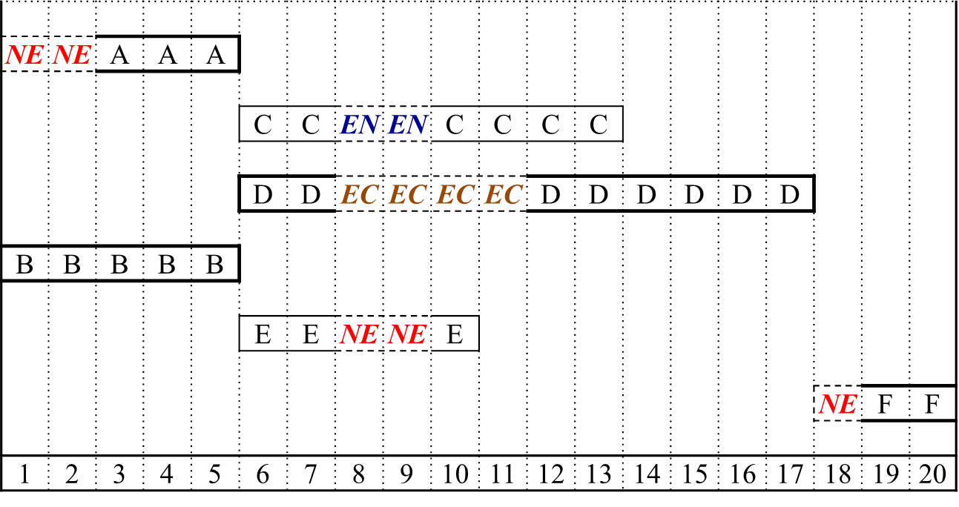
Example 1
Day 1&2 analysis
Delay due to contractor
2 DAYS
ES
t
EF
2
3
5
5
6
11
Activity
A
C
LS
TF
LF
2
0
5
7
2
13
FS2
0
0
0
5
8
13
13
2
15
START
D
F
0
0
0
5
0
13
13
0
15
0
5
5
5
3
8
B
E
0
0
5
10
5
13
Day(s) | Affected Activity(s) | Critical Activity(s) | Responsibility |  |  | Project Duration
 |  |  | EC (Owner) | NE (Contractor) | EN (3rd party)
0 | ------ | -------- | 0 | 0 | 0 | 15
1&2 | A | ------- | 0 | 0 | 0 | 15

Slide 24
Example 1
Day 8&9 analysis
Delay due to 3rd party
2 DAYS
ES
t
EF
2
3
5
5
8
13
Delay due to Owner
2 DAYS
Activity
A
C
LS
TF
LF
2
0
5
7
2
15
0
0
0
5
10
15
15
2
17
START
D
F
0
0
0
5
0
15
15
0
17
0
5
5
5
5
10
B
E
Delay due to contractor
2 DAYS
0
0
5
10
5
15
Day(s) | Affected Activity(s) | Critical Activity(s) | Responsibility |  |  | Project Duration
 |  |  | EC (Owner) | NE (Contractor) | EN (3rd party)
0 | ------ | -------- | 0 | 0 | 0 | 15
1&2 | A | ------- | 0 | 0 | 0 | 15
8&9 | C, D, E | D (EC) | 2 | 0 | 0 | 17

Slide 25
Example 1
Day 10&11 analysis
ES
t
EF
2
3
5
5
8
13
Delay due to Owner
2 DAYS
Activity
A
C
LS
TF
LF
2
0
5
9
4
17
0
0
0
5
12
17
17
2
19
START
D
F
0
0
0
5
0
15
17
0
19
0
5
5
5
5
10
B
E
0
0
5
12
7
17
Day(s) | Affected Activity(s) | Critical Activity(s) | Responsibility |  |  | Project Duration
 |  |  | EC (Owner) | NE (Contractor) | EN (3rd party)
0 | ------ | -------- | 0 | 0 | 0 | 15
1&2 | A | ------- | 0 | 0 | 0 | 15
8&9 | C, D, E | D (EC) | 2 | 0 | 0 | 17
10&11 | D | D (EC) | 2 | 0 | 0 | 19

Slide 26
Example 1
Day 18 analysis
(FINAL RESULT)
ES
t
EF
2
3
5
5
8
13
Activity
A
C
Delay due to contractor
1 DAY
LS
TF
LF
2
0
5
10
5
18
0
0
0
5
12
17
18
2
20
START
D
F
0
0
0
5
0
15
18
0
20
0
5
5
5
5
10
FS1
B
E
0
0
5
13
8
18
Day(s) | Affected Activity(s) | Critical Activity(s) | Responsibility |  |  | Project Duration
 |  |  | EC (Owner) | NE (Contractor) | EN (3rd party)
0 | ------ | -------- | 0 | 0 | 0 | 15
1&2 | A | ------- | 0 | 0 | 0 | 15
8&9 | C, D, E | D (EC) | 2 | 0 | 0 | 17
10&11 | D | D (EC) | 2 | 0 | 0 | 19
18 | F | F (NE) | 0 | 1 | 0 | 20

Slide 27
Example 2
Consider the following As-planned and As-built schedule for a project. Determine the delay responsibilities between the owner and the contractor.
ES
t
EF
0
4
4
4
4
8
8
4
12
Activity
A
B
C
LS
TF
LF
0
0
4
4
0
8
8
0
12
0
0
0
0
3
3
3
2
5
12
0
12
START
D
E
FINISH
0
0
0
3
3
6
6
3
8
12
0
12
0
3
3
3
7
10
F
G
2
2
5
5
2
12
As-planned Schedule

Slide 28
Example 2
As-Built Schedule
A | A | EC | A | A
 |  |  |  |  | B | B | B | B
 |  |  |  |  |  |  |  |  | C | NE | NE | NE | C | C | C
D | D | NE | D
 |  |  |  | E | E
F | F | EC | F
 |  |  |  | NE | NE | G | G | G | G | EC | NE | EN | G | G | G
1 | 2 | 3 | 4 | 5 | 6 | 7 | 8 | 9 | 10 | 11 | 12 | 13 | 14 | 15 | 16
Contractor
(within Activity C)
Owner
(within Activity A)
Owner
(within Activity G)
Contractor
(within Activity D)
Contractor
(within Activity G)
3rd party
(within Activity G)
Contractor
(before Activity G)
Owner
(within Activity F)

Slide 29
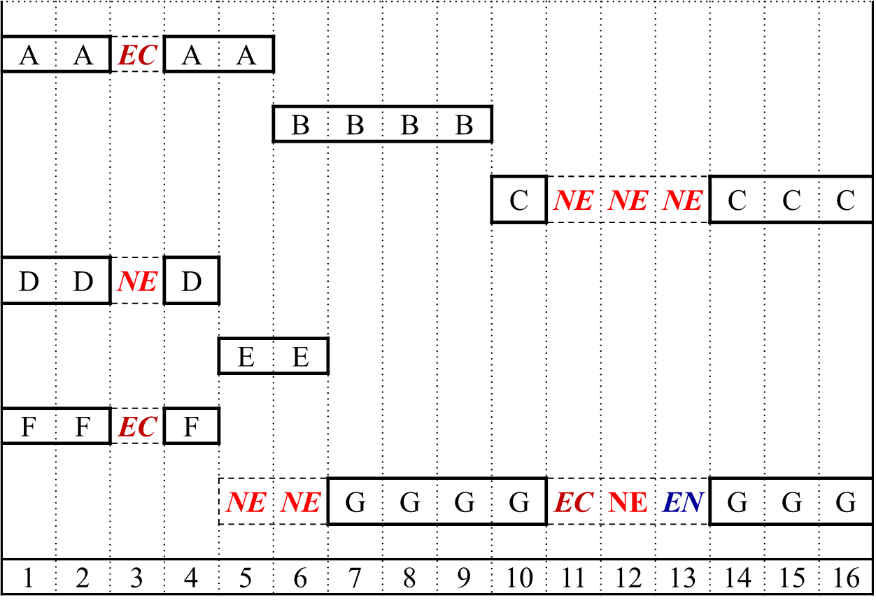
Example 2
Day 0 Analysis
ES
t
EF
0
4
4
4
4
8
8
4
12
Activity
A
B
C
LS
TF
LF
0
0
4
4
0
8
8
0
12
0
0
0
0
3
3
3
2
5
12
0
12
START
D
E
FINISH
0
0
0
3
3
6
6
3
8
12
0
12
0
3
3
3
7
10
F
G
2
2
5
5
2
12
Day(s) | Affected Activity(s) | Critical Activity(s) | Responsibility |  |  | Project Duration
 |  |  | EC (Owner) | NE (Contractor) | EN (3rd party)
0 | ------ | -------- | 0 | 0 | 0 | 12

Slide 30
Example 2
Day 3 Analysis
Delay due to owner
1 DAY
Delay due to contractor
1 DAY
ES
t
EF
0
5
5
5
4
9
9
4
13
Activity
A
B
C
LS
TF
LF
0
0
5
5
0
9
9
0
13
0
0
0
0
4
4
4
2
6
13
0
13
START
D
E
FINISH
0
0
0
4
3
7
7
3
9
13
0
13
Delay due to owner
1 DAY
0
4
4
4
7
11
F
G
2
2
6
6
2
13
Day(s) | Affected Activity(s) | Critical Activity(s) | Responsibility |  |  | Project Duration
 |  |  | EC (Owner) | NE (Contractor) | EN (3rd party)
0 | ------ | -------- | 0 | 0 | 0 | 12
3 | A, D, F | A (EC) | 1 | 0 | 0 | 13

Slide 31
Day 5&6 Analysis
Example 2
ES
t
EF
0
5
5
5
4
9
9
4
13
Activity
A
B
C
LS
TF
LF
0
0
5
5
0
9
9
0
13
0
0
0
0
4
4
4
2
6
13
0
13
START
D
E
Delay due to contractor
1 DAY
FINISH
0
0
0
4
3
7
7
3
9
13
0
13
0
4
4
6
7
13
F
FS 2
G
0
2
4
6
0
13
Day(s) | Affected Activity(s) | Critical Activity(s) | Responsibility |  |  | Project Duration
 |  |  | EC (Owner) | NE (Contractor) | EN (3rd party)
0 | ------ | -------- | 0 | 0 | 0 | 12
3 | A, D, F | A (EC) | 1 | 0 | 0 | 13
5&6 | G | -------- | 0 | 0 | 0 | 13

Slide 32
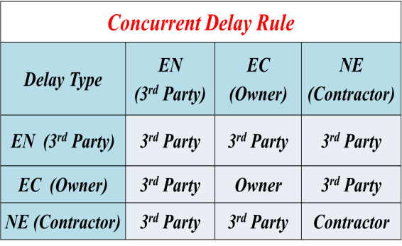
Example 2
Day 11 Analysis
Remark: notice delays of days 11,12,13 are for different reasons for concurrent activities. Hence, consider day by day analysis and concurrent rule. (If the reason is not either owner or contractor, the reason is 3rd party)
ES
t
EF
0
5
5
5
4
9
9
5
14
Delay due to contractor
1 DAY
Activity
A
B
C
LS
TF
LF
0
0
5
5
0
9
9
0
14
0
0
0
0
4
4
4
2
6
Delay due to owner
1 DAY
14
0
14
START
D
E
FINISH
0
0
0
4
3
7
7
3
9
14
0
14
0
4
4
6
8
14
F
FS 2
G
0
2
4
6
0
14
Day(s) | Affected Activity(s) | Critical Activity(s) | Responsibility |  |  | Project Duration
 |  |  | EC (Owner) | NE (Contractor) | EN (3rd party)
0 | ------ | -------- | 0 | 0 | 0 | 12
3 | A, D, F | A (EC) | 1 | 0 | 0 | 13
5&6 | G | -------- | 0 | 0 | 0 | 13
11 | C, G | C(NE), G(EC) | 0 | 0 | 1 | 14

Slide 33
Example 2
Day 12 Analysis
Remark: notice delays of days 11,12,13 are for different reasons for concurrent activities. Hence, consider day by day analysis and concurrent rule. (If the reason is not either owner or contractor, the reason is 3rd party)
ES
t
EF
0
5
5
5
4
9
9
6
15
Activity
A
B
C
Delay due to contractor
1 DAY
LS
TF
LF
0
0
5
5
0
9
9
0
15
0
0
0
0
4
4
4
2
6
Delay due to contractor
1 DAY
15
0
15
START
D
E
FINISH
0
0
0
4
3
7
7
3
9
15
0
15
0
4
4
6
9
15
F
FS 2
G
0
2
4
6
0
15
Day(s) | Affected Activity(s) | Critical Activity(s) | Responsibility |  |  | Project Duration
 |  |  | EC (Owner) | NE (Contractor) | EN (3rd party)
0 | ------ | -------- | 0 | 0 | 0 | 12
3 | A, D, F | A (EC) | 1 | 0 | 0 | 13
5&6 | G | -------- | 0 | 0 | 0 | 13
11 | C, G | C(NE), G(EC) | 0 | 0 | 1 | 14
12 | C, G | C(NE), G(NE) | 0 | 1 | 0 | 15

Slide 34
Example 2
Day 13 Analysis
Remark: notice delays of days 11,12,13 are for different reasons for concurrent activities. Hence, consider day by day analysis and concurrent rule. (If the reason is not either owner or contractor, the reason is 3rd party)
ES
t
EF
0
5
5
5
4
9
9
7
16
A
B
C
Delay due to contractor
1 DAY
(FINAL RESULT)
Activity
0
0
5
5
0
9
9
0
16
LS
TF
LF
0
0
0
0
4
4
4
2
6
Delay due to 3rd party
1 DAY
16
0
16
START
D
E
FINISH
0
0
0
4
3
7
7
3
9
16
0
16
0
4
4
6
10
16
F
FS 2
G
0
2
4
6
0
16
Day(s) | Affected Activity(s) | Critical Activity(s) | Responsibility |  |  | Project Duration
 |  |  | EC (Owner) | NE (Contractor) | EN (3rd party)
0 | ------ | -------- | 0 | 0 | 0 | 12
3 | A, D, F | A (EC) | 1 | 0 | 0 | 13
5&6 | G | -------- | 0 | 0 | 0 | 13
11 | C, G | C(NE), G(EC) | 0 | 0 | 1 | 14
12 | C, G | C(NE), G(NE) | 0 | 1 | 0 | 15
13 | C, G | C(NE), G(en) | 0 | 0 | 1 | 16

Slide 35
Case Study
Table (1) project plan
Activity | Predecessor | Duration (day)
A B C D E F G H | - A - C - C, E B, D F | 8 12 5 10 7 15 8 2
Consider the small contract initial planning shown in table (1). During project execution work changes and delays were recorded as shown in table (2).
Draw the as-planned and as-built schedule, and
Determine how each party is responsible for the contract delayed completion.
Table (2) work change carried out
No. | Category | Description | Effective dates | Delay time | Activities affected
1 | Contractor | Equipment not on site | 1-2 | 2 | E
2 | Contractor | Late supply of materials | 9-13 | 5 | B
3 | Client | Late inspection | 25 | 1 | B
4 | Client | Late supply of drawings due design change (20% extra work) | 10-12 | 3 | F
5 | Contractor | Equipment breakdown | 25-26 | 2 | F

Slide 36
Case Study
As-planned Schedule
ES
t
EF
0
8
8
8
12
20
20
8
28
Activity
A
B
G
LS
TF
LF
0
0
8
8
0
20
20
0
28
0
0
0
0
5
5
5
10
15
28
0
28
START
C
D
FINISH
0
0
0
5
5
10
10
5
20
28
0
28
0
7
7
7
15
22
22
2
24
E
F
H
4
4
11
11
4
26
26
4
28

Slide 37
Case Study
As-Built Schedule
1 | 2 | 3 | 4 | 5 | 6 | 7 | 8 | 9 | 10 | 11 | 12 | 13 | 14 | 15 | 16 | 17 | 18 | 19 | 20 | 21 | 22 | 23 | 24 | 25 | 26 | 27 | 28 | 29 | 30 | 31 | 32 | 33 | 34
A | A | A | A | A | A | A | A
 |  |  |  |  |  |  |  | NE | NE | NE | NE | NE | B | B | B | B | B | B | B | B | B | B | B | EC | B
 |  |  |  |  |  |  |  |  |  |  |  |  |  |  |  |  |  |  |  |  |  |  |  |  |  | G | G | G | G | G | G | G | G
C | C | C | C | C
 |  |  |  |  | D | D | D | D | D | D | D | D | D | D
 |  | E | E | E | E | E | E | E
 |  |  |  |  |  |  |  |  | EC | EC | EC | F | F | F | F | F | F | F | F | F | F | F | F | NE | NE | F | F | F | F | F | F
 |  |  |  |  |  |  |  |  |  |  |  |  |  |  |  |  |  |  |  |  |  |  |  |  |  |  |  |  |  |  |  | H | H

