Slide 1
Time-Cost Trade-Off
(Time Reduction = Time Compression)
(Time Shortening)

Slide 2
Reasons to Reduce Project Durations:
To avoid late penalties (or avoid damaging the company’s relationship),
To realize incentive pay, (monetary incentives for timely or early competition of a project,
To beat the competition to the market, to fit within the contractually required time (influences Bid price)
To free resources for use on other projects. (complete a project early & move on to another project)
To reduce the indirect costs associated with running the project.
To complete a project when weather conditions make it less expensive (Avoid temporary Heating, avoid completing site work during raining season).
Many things make crashing a way of life on some projects (i.e. last minutes changes in client specification, without permission to extend the project deadline by an appropriate increment)
Shortening the duration is called project crashing

Slide 3
Methods to reduce durations
Overtime: Have the existing crew work overtime. This increase the labor costs due to increase pay rate and decrease productivity.
Hiring and/or Subcontracting:
  Bring in additional workers to enlarge crew size. This increases labor costs due to overcrowding and poor learning curve.
  Add subcontracted labor to the activity. This almost always increases the cost of an activity unless the subcontracted labor is for more efficient.
Use of advanced technology: Use better/more advanced equipment. This will usually increase costs due to rental and transport fees. If labor costs (per unit) are reduced, this could reduce costs.

Slide 4
How project cost is estimated?
Practices to Estimate the Project cost
Some company assigns Overhead office as % of direct cost.
Most companies don’t consider profit as a cost of the job.
Cost analysis are completed by using:
  [Direct costs + Indirect costs + Company overhead] vs. Budgeted (estimated costs).
Similar to each activity, the project as a whole has an ideal (Lease expensive) Duration.

Slide 5
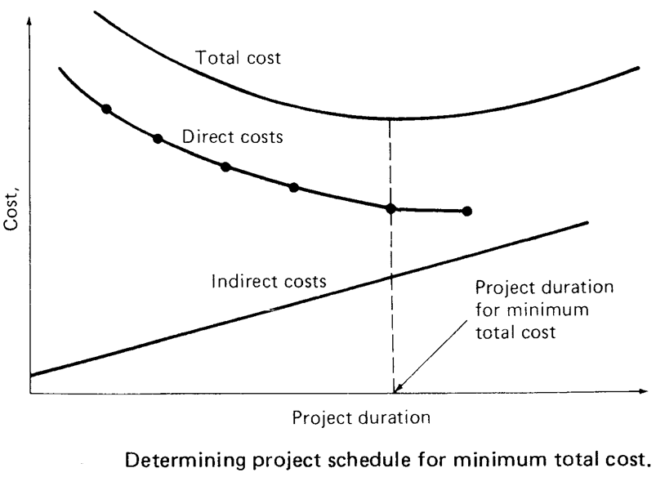
How project cost is estimated?

Slide 6
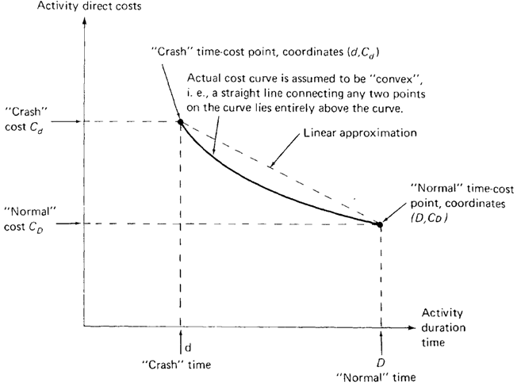
How project is crashed?
Specify 2 activity times and 2 costs
1st time/cost combination (D, C_{D})- called normal [Normal – usual ‘average’ time, resources]
2nd time/cost combination (d, C_{d})- called Crash [expedite by applying additional resources]

Slide 7

Steps in Project Crashing
Basic Steps
Compute the crash cost per time period. If crash costs are linear over time:
Using current activity times, find the critical path and identify the critical activities

Slide 8
Steps in Project Crashing
If there is only one critical path, then select the activity on this critical path that (a) can still be crashed, and (b) has the smallest crash cost per period.
If there is more than one critical path, then select one activity from each critical path such that (a) each selected activity can still be crashed, and (b) the total crash cost of all selected activities is the smallest.
Note that the same activity may be common to more than one critical path.
Update all activity times. If the desired due date has been reached, stop. If not, return to Step 2.

Slide 9
Example1: Crashing The Project
Critical Path for Milwaukee Paper (A, C, E, G, H)
0
2
2
2
2
4
4
3
7
A
C
F
0
0
2
2
0
4
10
6
13
13
15
H
2
0
0
4
8
Start
0
4
E
13
0
15
0
0
0
4
8
0
0
3
3
7
8
13
B
D
G
3
4
5
1
1
4
4
1
8
8
0
13

Slide 10
Example1: Crashing The Project
CALCULATION OF CRAH COST/PERIOD
Crash and Normal Times and Costs for Activity B
Activity Cost
Crash
$34,000 —
$33,000 —
$32,000 —
$31,000 —
$30,000 —
—
Crash Cost – Normal Cost
Normal Time – Crash Time
Crash Cost/Wk =
Crash Cost, C_{d}
=
$34,000 – $30,000
3 – 1
$4,000
2 Wks
= = $2,000/Wk
Normal
Normal Cost, C_{D}
| | |
1 2 3 Time (Weeks)
Crash Time, d
Normal Time, D
Table 3.16 (Frome Heizer/Render; Operation Management)

Slide 11
Example1: Crashing The Project
Time (Wks) Cost ($)
Crash Cost Critical
Activity Normal Crash Normal Crash Per Wk ($) Path?
A 2 1 22,000 22,750 750 Yes
B 3 1 30,000 34,000 2,000 No
C 2 1 26,000 27,000 1,000 Yes
D 4 2 48,000 49,000 1,000 No
E 4 2 56,000 58,000 1,000 Yes
F 3 2 30,000 30,500 500 No
G 5 2 80,000 84,500 1,500 Yes
H 2 1 16,000 19,000 3,000 Yes
Table 3.5 (Frome Heizer/Render; Operation Management)

Slide 12
Example2: Crashing Project (123)
For the small project shown in the table, it is required reduce the project duration.
Reduce by 2 periods.
Reduce by 5 periods.
Activity | Precedence | Normal |  | Crash
 |  | Time, day | Cost, $ | Time, day | Cost, $
A | - | 4 | 210 | 3 | 280
B | - | 8 | 400 | 6 | 560
C | A | 6 | 500 | 4 | 600
D | A | 9 | 540 | 7 | 600
E | B,C | 4 | 500 | 1 | 1100
F | C | 5 | 150 | 4 | 240
G | E | 3 | 150 | 3 | 150
H | D,F | 7 | 600 | 6 | 750
 |  | Σ | 3050 |  | 4280

Slide 13
Example2: Crashing Project (123)
Activity | Precedence | Normal |  | Crash
 |  | Time, day | Cost, $ | Time, day | Cost, $
A | - | 4 | 210 | 3 | 280
B | - | 8 | 400 | 6 | 560
C | A | 6 | 500 | 4 | 600
D | A | 9 | 540 | 7 | 600
E | B,C | 4 | 500 | 1 | 1100
F | C | 5 | 150 | 4 | 240
G | E | 3 | 150 | 3 | 150
H | D,F | 7 | 600 | 6 | 750
 |  | Σ | 3050 |  | 4280
1- develop network
9
D
4
6
5
7
A
C
F
H
START
FINISH
8
4
3
B
E
G

Slide 14
Example2: Crashing Project (123)
2- calculate times, find critical path
4
9
13
D
6
2
15
0
4
4
4
6
10
10
5
15
15
7
22
A
C
F
H
0
0
4
4
0
10
10
0
15
15
0
22
0
0
0
22
0
22
START
FINISH
0
0
0
0
8
8
10
4
14
14
3
17
22
0
22
B
E
G
7
7
15
15
5
19
19
5
22
Project completion time = 22 working days
Critical Path: A, C, F, H.
Activity | A | B | C | D | E | F | G | H
Total float | 0 | 7 | 0 | 2 | 5 | 0 | 5 | 0
Free float | 0 | 2 | 0 | 2 | 0 | 0 | 5 | 0

Slide 15
Example2: Crashing Project (123)
3- calculate cost slope
Activity | Precedence | Normal |  | Crash
 |  | Time, day | Cost, $ | Time, day | Cost, $
A | - | 4 | 210 | 3 | 280
B | - | 8 | 400 | 6 | 560
C | A | 6 | 500 | 4 | 600
D | A | 9 | 540 | 7 | 600
E | B,C | 4 | 500 | 1 | 1100
F | C | 5 | 150 | 4 | 240
G | E | 3 | 150 | 3 | 150
H | D,F | 7 | 600 | 6 | 750
 |  | Σ | 3050 |  | 4280
Cost Slope, $/day
70
80
50
30
200
90
**
150
Remarks
1- [G can not expedite]
2- lowest slope and can be expedited on critical path is activity (C) WITH 2 periods

Slide 16
Example2: Crashing Project (123)
Reduce 2 periods of activity (C) with increase of cost (2*50) =100
Activity | Precedence | Normal |  | Crash |  | Cost Slope,
 |  | Time, day | Cost, $ | Time, day | Cost, $ | $/day
A | - | 4 | 210 | 3 | 280 | 70
B | - | 8 | 400 | 6 | 560 | 80
C | A | 6 | 500 | 4 | 600 | 50
D | A | 9 | 540 | 7 | 600 | 30
E | B,C | 4 | 500 | 1 | 1100 | 200
F | C | 5 | 150 | 4 | 240 | 90
G | E | 3 | 150 | 3 | 150 | **
H | D,F | 7 | 600 | 6 | 750 | 150
 |  | Σ | 3050 |  | 4280
ES
LS
Activity
EF
TF
LF
Crash limit (d @ cost)
4
9
13
D
4
0
13
0
4
4
4
4
8
8
5
13
13
7
20
A
C
F
H
0
0
4
4
0
8
8
0
13
13
0
20
0
0
0
20
0
20
START
FINISH
0
0
0
0
8
8
8
4
12
12
3
15
20
0
20
B
E
G
5
5
13
13
5
17
17
5
20
Project completion time = 20 working days
Critical Path: A, C, F, H. & A, D, H
Activity | A | B | C | D | E | F | G | H
Total float | 0 | 5 | 0 | 0 | 5 | 0 | 5 | 0
Free float | 0 | 0 | 0 | 0 | 0 | 0 | 5 | 0

Slide 17
Example2: Crashing Project (123)
Reduce 1 period of activity (A) with increase of cost =70
Activity | Precedence | Normal |  | Crash |  | Cost Slope,
 |  | Time, day | Cost, $ | Time, day | Cost, $ | $/day
A | - | 4 | 210 | 3 | 280 | 70
B | - | 8 | 400 | 6 | 560 | 80
C | A | 6 | 500 | 4 | 600 | 50
D | A | 9 | 540 | 7 | 600 | 30
E | B,C | 4 | 500 | 1 | 1100 | 200
F | C | 5 | 150 | 4 | 240 | 90
G | E | 3 | 150 | 3 | 150 | **
H | D,F | 7 | 600 | 6 | 750 | 150
 |  | Σ | 3050 |  | 4280
3
9
12
D
3
0
12
0
3
3
3
4
7
7
5
12
12
7
19
A
C
F
H
0
0
3
3
0
7
7
0
12
12
0
19
0
0
0
19
0
19
START
FINISH
0
0
0
0
8
8
7
4
11
11
3
14
19
0
19
B
E
G
8
4
12
12
5
16
16
5
19
Project completion time = 19 working days
Critical Path: A, C, F, H. & A, D, H
Activity | A | B | C | D | E | F | G | H
Total float | 0 | 4 | 0 | 0 | 5 | 0 | 5 | 0
Free float | 0 | 0 | 0 | 0 | 0 | 0 | 5 | 0

Slide 18
Example2: Crashing Project (123)
Activity | Precedence | Normal |  | Crash |  | Cost Slope,
 |  | Time, day | Cost, $ | Time, day | Cost, $ | $/day
A | - | 4 | 210 | 3 | 280 | 70
B | - | 8 | 400 | 6 | 560 | 80
C | A | 6 | 500 | 4 | 600 | 50
D | A | 9 | 540 | 7 | 600 | 30
E | B,C | 4 | 500 | 1 | 1100 | 200
F | C | 5 | 150 | 4 | 240 | 90
G | E | 3 | 150 | 3 | 150 | **
H | D,F | 7 | 600 | 6 | 750 | 150
 |  | Σ | 3050 |  | 4280
Reduce farther 1 period of 2 activities (D,F) with increase of cost (30+90) =120
3
8
11
D
3
0
11
0
3
3
3
4
7
7
4
11
11
7
18
A
C
F
H
0
0
3
3
0
7
7
0
11
11
0
18
0
0
0
18
0
18
START
FINISH
0
0
0
0
8
8
7
4
11
11
3
14
18
0
18
B
E
G
3
3
11
11
4
15
15
4
18
Project completion time = 19 working days
Critical Path: A, C, F, H. & A, D, H
Activity | A | B | C | D | E | F | G | H
Total float | 0 | 3 | 0 | 0 | 4 | 0 | 4 | 0
Free float | 0 | 0 | 0 | 0 | 0 | 0 | 4 | 0

Slide 19
Example2: Crashing Project (123)
Activity | Precedence | Normal |  | Crash |  | Cost Slope,
 |  | Time, day | Cost, $ | Time, day | Cost, $ | $/day
A | - | 4 | 210 | 3 | 280 | 70
B | - | 8 | 400 | 6 | 560 | 80
C | A | 6 | 500 | 4 | 600 | 50
D | A | 9 | 540 | 7 | 600 | 30
E | B,C | 4 | 500 | 1 | 1100 | 200
F | C | 5 | 150 | 4 | 240 | 90
G | E | 3 | 150 | 3 | 150 | **
H | D,F | 7 | 600 | 6 | 750 | 150
 |  | Σ | 3050 |  | 4280
Reduce farther 1 period of activity (H) with increase of cost =150
3
8
11
D
3
0
11
0
3
3
3
4
7
7
4
11
11
6
17
A
C
F
H
0
0
3
3
0
7
7
0
11
11
0
17
0
0
0
17
0
17
START
FINISH
0
0
0
0
8
8
7
4
11
11
3
14
17
0
17
B
E
G
2
2
10
10
3
14
14
3
17
Project completion time = 19 working days
Critical Path: A, C, F, H. & A, D, H
Activity | A | B | C | D | E | F | G | H
Total float | 0 | 2 | 0 | 0 | 3 | 0 | 3 | 0
Free float | 0 | 0 | 0 | 0 | 0 | 0 | 3 | 0

Slide 20
Example2: Crashing Project (123)
Reduction from 22 to 17 increase to 3490
Activity | Precedence | Normal |  | Crash |  | Cost Slope,
 |  | Time, day | Cost, $ | Time, day | Cost, $ | $/day
A | - | 4 | 210 | 3 | 280 | 70
B | - | 8 | 400 | 6 | 560 | 80
C | A | 6 | 500 | 4 | 600 | 50
D | A | 9 | 540 | 7 | 600 | 30
E | B,C | 4 | 500 | 1 | 1100 | 200
F | C | 5 | 150 | 4 | 240 | 90
G | E | 3 | 150 | 3 | 150 | **
H | D,F | 7 | 600 | 6 | 750 | 150
 |  | Σ | 3050 |  | 4280
Cycle | Activity | Time | cost | Total cost | Duration
0 | - |  |  | 3050 | 22
1 | C | 2 | 100 | 3150 | 20
2 | A | 1 | 70 | 3220 | 19
3 | D,F | 1 | 30+90 | 3340 | 18
4 | H | 1 | 150 | 3490 | 17

Slide 21
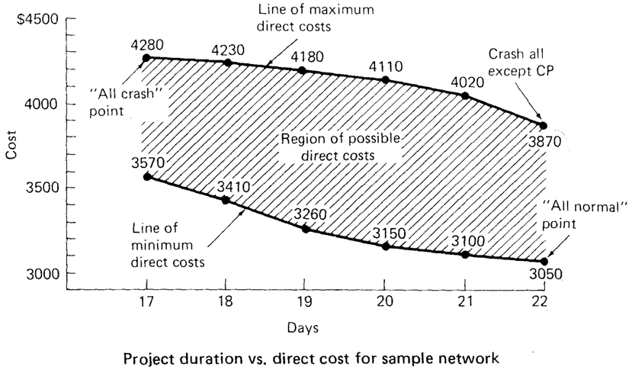

Example2: Crashing Project (123)
Accelerating the Critical and Noncritical path
Activity | Precedence | Normal |  | Crash |  | Cost Slope,
 |  | Time, day | Cost, $ | Time, day | Cost, $ | $/day
A | - | 4 | 210 | 3 | 280 | 70
B | - | 8 | 400 | 6 | 560 | 80
C | A | 6 | 500 | 4 | 600 | 50
D | A | 9 | 540 | 7 | 600 | 30
E | B,C | 4 | 500 | 1 | 1100 | 200
F | C | 5 | 150 | 4 | 240 | 90
G | E | 3 | 150 | 3 | 150 | **
H | D,F | 7 | 600 | 6 | 750 | 150
 |  | Σ | 3050 |  | 4280

Slide 22
How project is crashed?
Network Compression Algorithm
Determine Normal project duration, and cost.
Identify Normal duration Critical Path.
For large network, using CRITICALITY THEORM to eliminate the noncritical paths that do not need to be crashed.
Compute the cost slop

Slide 23
How project is crashed?
Network Compression Algorithm
shortening the CRITICAL ACTIVITIES beginning with the activity having the lowest cost-slope
Determine the compression limit (Nil)
Organize the data as in the following table:

Slide 24
How project is crashed?
Network Compression Algorithm
Update the project network
When a new Critical path is formed:
  Shorten the combination of activity which Falls on Both Critical Paths, OR
  Shorten one activity from each of the critical paths. Use the combined cost of shortening both activities when determining if it is cost effective to shorten the project.
At each shortening cycle, compute the new project duration and project cost
Continue until no further shortening is possible

Slide 25
How project is crashed?
Network Compression Algorithm
Tabulate and Plot the Indirect project Cost on the same time-cost graph
Add direct and indirect cost to find the project cost at each duration.
Use the total project cost-time curve to find the optimum time.

Slide 26
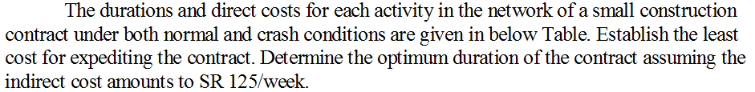
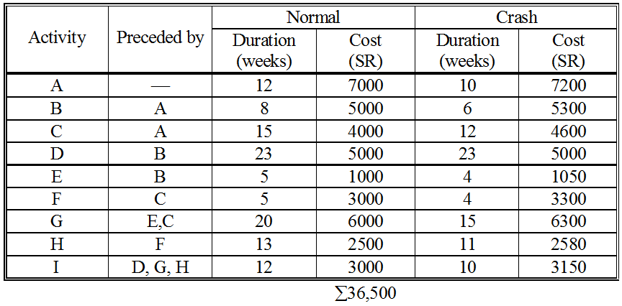
Example 3
38470

Slide 27
Example 3

Slide 28
Example 3

Slide 29
Example 3

Slide 30
Example 3

Slide 31
Example 3

Slide 32
Example 3

Slide 33
Project Optimal Duration
Example 3

Slide 34
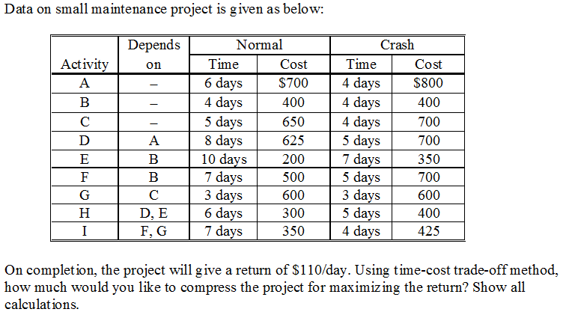
CASE WORK

