Slide 1
GE404 Engineering Management
Topic1. INTRODUCTION

Slide 2
GE404 Course Description
Introduction for project management objectives.
  Project Participants and Project Life Cycle.
Planning Engineering projects.
Scheduling using activity-on-node and precedence methods.
Resource leveling and allocation.
Project time-cost trade-off.
Updating construction schedules.
Project time and cost control.
Contractual and organizational approaches including definition of organizational responsibilities of project participants.

Slide 3
GE404 Course Learning Objectives
Students completing this course successfully will be able to:
Using bar chart technique to formulate a complete plan for a project.
Apply activity-on-node network, and precedence diagram to schedule a project.
Level and allocate project resources.
Shorten project duration.
Monitor an engineering project for purpose of time and cost control.
Use computer software for preparing project schedules
Understand principles of project organization and contractual relationships including definition of professional responsibilities of project participants.

Slide 4
GE404 Course Topics Covered
  Introduction for management of engineering projects.
  Project Participants and Project Life Cycle
  Project time planning
    Planning with bar chart.
  Network model
    Activity-on-node
    precedence diagramming.
    Time-scaled network.
  Resource leveling and allocation.
  Time-cost trade-off.
  Financial Management: Cashflow Forecasting
  Time and cost control.
  Contractual and organizational approaches.

Slide 5
GE404 Textbook(s) and/or Other Required Material
Project Management with CPM, PERT, and Precedence Diagramming, 3rd Edition, by Moder J., Phillips, C., and Davis, E.
Construction Planning and Scheduling (4th Edition) by Jimmie W. Hinze, February 28, 2011
Course lectures are also found on the following website:
http://faculty.ksu.edu.sa/algahtani & LMS (Blackboard)

Slide 6
GE404 Grade Distribution
Mid-term Exams 40 %
Assignments and Quizzes 10 %
Final Examination 50 %

Slide 7
What is a Project?
“A Project is a temporary endeavor undertaken to create a unique product or service or result.” (PMI)
“A Combination of human and non-human resources pooled together to achieve a specific purpose and deliverables.”

Slide 8
What is a Project?
“A Project is a one-shot, time-limited, goal-directed, major undertaking requiring the commitment of varied skills and resources.” PMI
“A Combination of human and non-human resources pooled together to achieve a specific purpose.”

Slide 9
Project Characteristics
Temporary (start, end, project team)
Unique (Product, Service or Result)
Completed (objectives, acceptance& Satisfaction)
Progressive Elaboration
Project variables and parameters (nature, size, budget, resources, complexity)
Project Categories (small, medium, large)
      Source (PMI,2004)

Slide 10
Project Examples
Construction projects of various types:
  Residential projects such as villas and town houses.
  Building projects (non residential) such as retail stores, malls, and hospitals.
  Heavy engineering projects such as dams, tunnels, and bridges.
  Industrial projects such as power plants and refineries.
Engineering Projects:
Product Development, Manufacturing, \construction, Design Engineering, Industrial Engineering, technology, production, or any other field that employs personnel who perform an engineering function.
Research and development projects such as the Stealth fighter plan.
Software Development projects such as the university registration computer program.

Slide 11
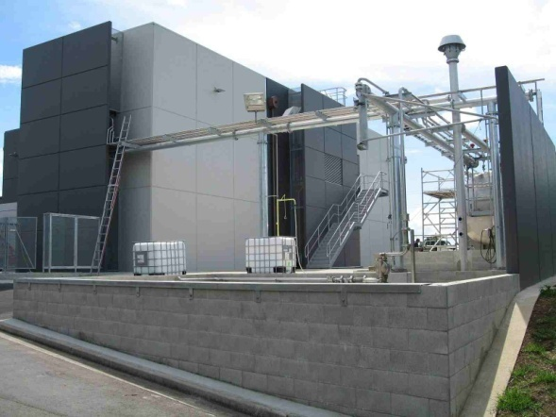
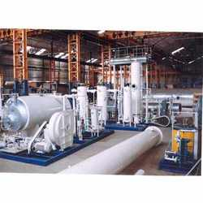
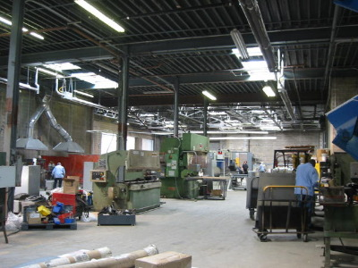
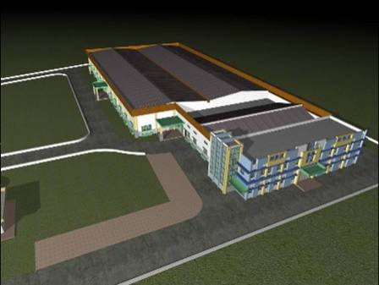
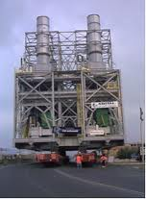
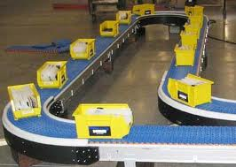
Examples of Projects

Slide 12
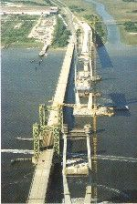
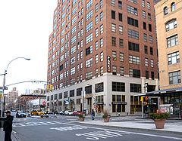
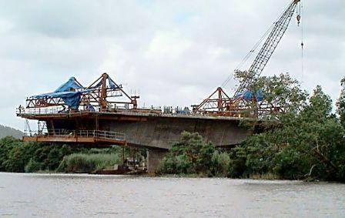
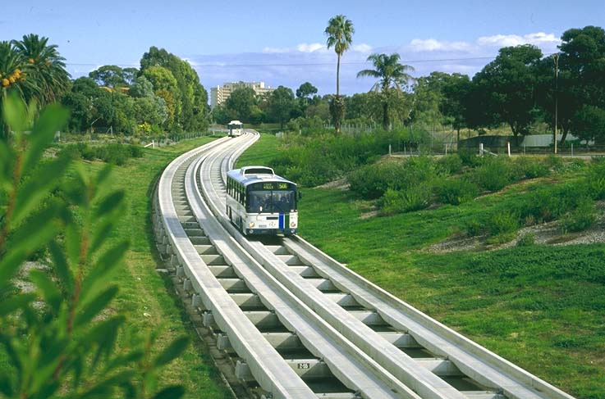
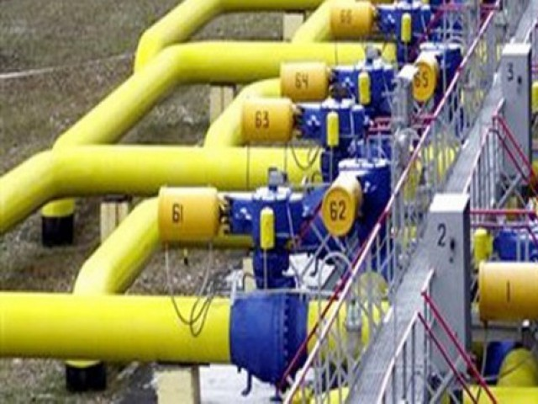
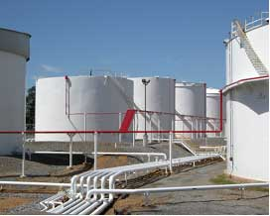
Examples of Projects

Slide 13
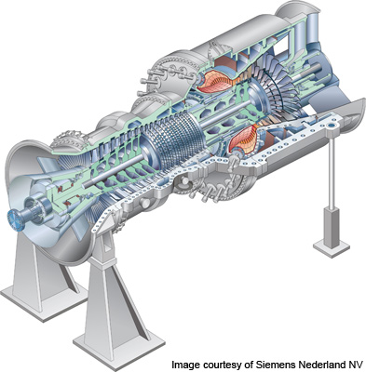
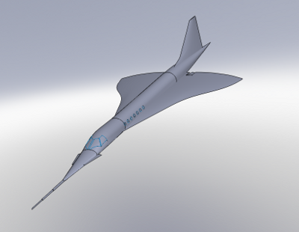
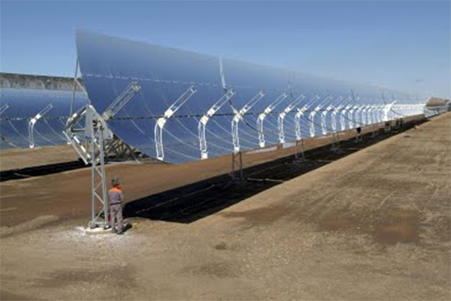
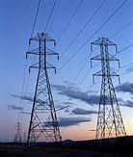
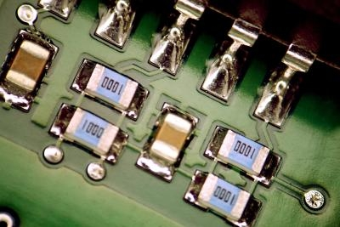
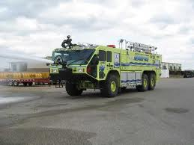
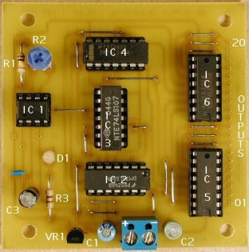
Examples of Projects

Slide 14
What is Management?
  Management is a process concerned with attainment of objectives, i.e., the management functions It is includes
  planning,
  organizing,
  Motivating,
  directing, and
  controlling,.

Slide 15
Levels of Management
Top
Middle
Low
Project Management

Slide 16
Levels of Management
Although the work of management involves the specified functions regardless of level, their purpose, nature, and relative important vary at the different levels, the required skills (conceptual vs. technical) tend to vary as well.

Slide 17
Levels of Management
Planning
Control
Conceptual
Technical
Top
Management
Middle
Management
Low
Management

Slide 18
Management Functions
Planning
  What are we aiming for and why?
Organizing
  What’s involved and why?
Motivation
  What motivates people to do their best work?
Directing
  Who decides what and when?
Control
  Who judges results and by what standards?

Slide 19
Planning
What are we aiming for and why?
  Develop project objectives, goals, and strategies.
  Develop project work breakdown structure.
  Develop precedence diagrams to establish logical relationship of project activities and milestones.
  Develop time-based schedule for the project based on the time precedence diagram.
  Plan for the resource support of the project.

Slide 20
Organizing
What is involved and why?
  Establish organizational structure for the team.
  Identify and assign project roles to members of the project team.
  Define project management policies, procedures, and techniques.
  Prepare project management charter and other delegation instruments.
  Establish standards for authority, responsibility and accountability of the project team.

Slide 21
Motivation
What motivates people to do their best work?
  Determine project team member needs.
  Assess factors that motivate people to do their best work.
  Provide appropriate counseling and mentoring as required.
  Establish rewards program for project team members.
  Conduct initial study of impact of motivation on productivity.

Slide 22
Directing
Who decides what and when?
  Establish “limits” of authority for decision making for the allocation of project resources.
  Develop leadership style.
  Enhance interpersonal skills.
  Prepare plan for increasing participative management techniques in managing the project team.
  Develop consensus decision making techniques for the project team.

Slide 23
Control
Who judges results and by what standards?
  Establish cost, schedule, and technique performance standards for project.
  Prepare plans for means to evaluate project progress.
  Establish a project management information system for the project.
  Prepare project review strategy.
  Evaluate project progress.

Slide 24
What is Project Management?
Project Management involves the coordination of group activity;
wherein the manager plans, organizes, staffs, directs, and controls to achieve an objective with constraints on
  time,
  cost, and
  performance of the end product.

Slide 25
What is Project Management?
Project Management is defined as the application of knowledge, skills, tools, and techniques to project activities to meet project requirements. (PMI,2004)

Slide 26
What is Project Management?
Project Management is process of applying the management functions in the context of a project.
Project Management is optimizing the use of resources to meet the project objectives.

Slide 27
Project Management main Function Activities
  Planning
  Objectives
  Resources
  Work break-down schedule
  Organization
Scheduling
  Project activities
  Start & end times
  Network
  Controlling
  Monitor, compare, revise, action

Slide 28
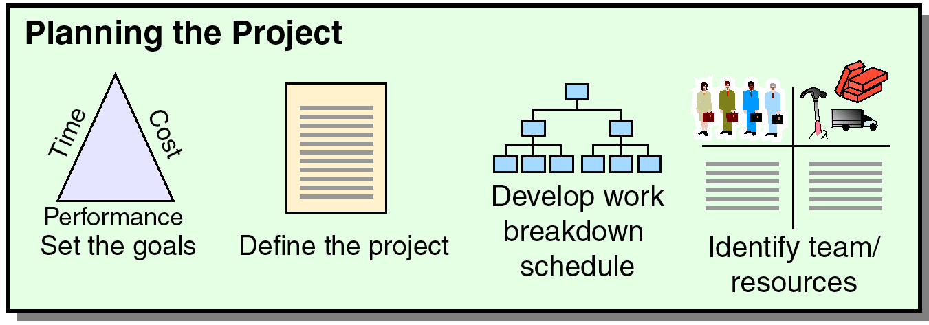
Project Management main Function Activities
Before Start of project During
project Timeline project
Figure 3.1 (from Heizer/Render –Operation Management

Slide 29
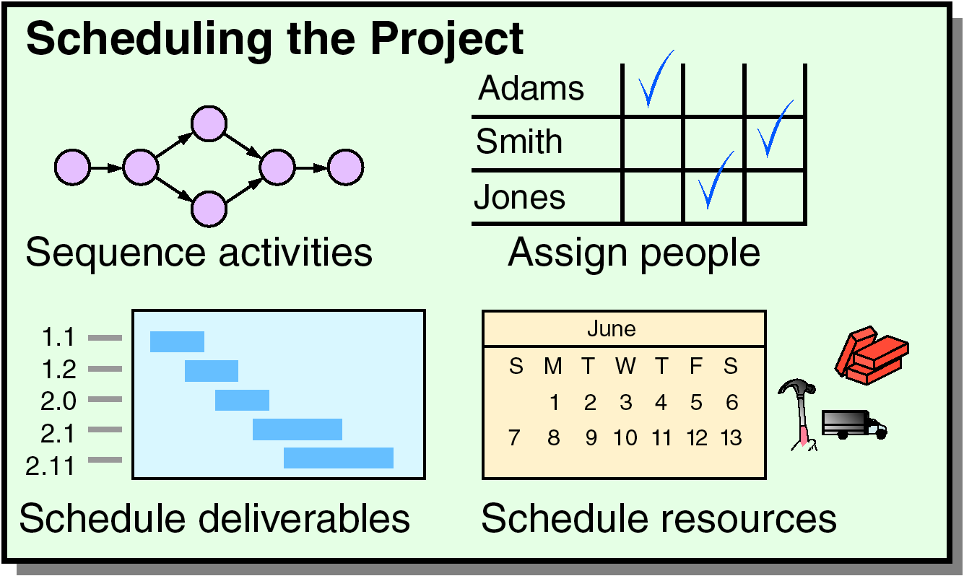
Project Management main Function Activities
Before Start of project During
project Timeline project
Figure 3.1 (from Heizer/Render –Operation Management

Slide 30

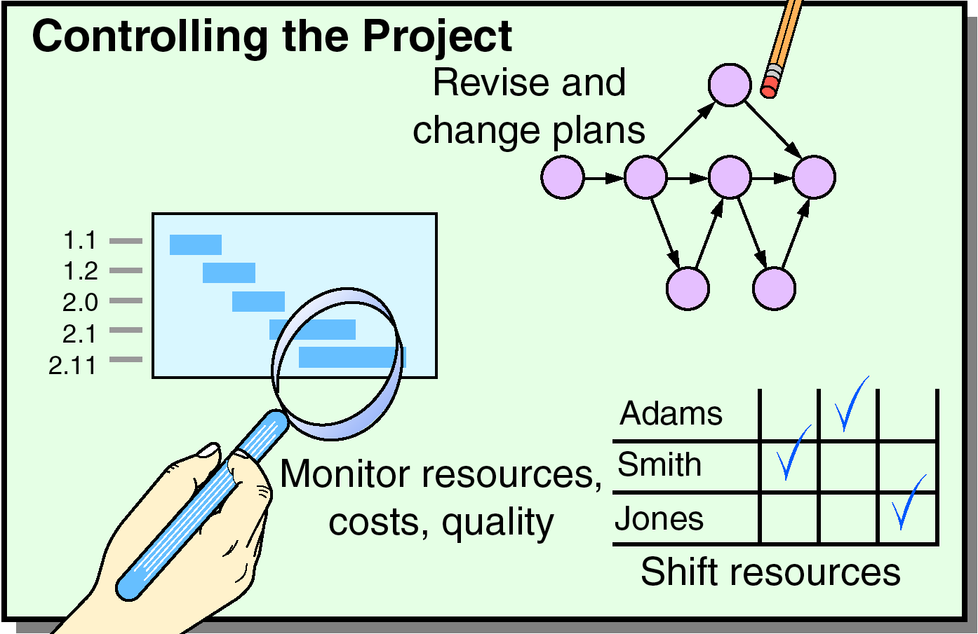
Project Management main Function Activities
Before Start of project During
project Timeline project
Figure 3.1 (from Heizer/Render –Operation Management

Slide 31
Project Management main Function Activities
Before Start of project During
project Timeline project
Figure 3.1 (from Heizer/Render –Operation Management

Slide 32
Project Management main Function Activities
Time/cost estimates
Budgets
Engineering diagrams
Cash flow charts
Material availability details
Budgets
Delayed activities report
Slack activities report
CPM/PERT
Gantt charts
Milestone charts
Cash flow schedules
Before Start of project During
project Timeline project
Figure 3.1 (from Heizer/Render –Operation Management

Slide 33
Project Stakeholders
Project sponsor
Project Owner
Project manager
Customer/user
Functional managers
Performing organization
Project team members
Project management team
Internal and external
Contractors, suppliers and vendors
Government agencies and media

Slide 34
Project Common Resources
The main resources are (3M)
Manpower (People)
Money
Materials And Machines.

Slide 35
Project Key factors
Scope
Quality
Cost
Time
Key factors affect and vary the project
Scope
Cost
Time, and
Quality (affected by balancing the three factors)

Slide 36
Project Management Objective
Cost
Good Will
Quality
Safety
Time

Slide 37
Assessing Project Success
Within Schedule
Within Budget
Meeting Spec requirements
With minimal or agreed upon scope changes
Without disturbing workflow of organization
Acceptance by customer and or user
Customer Satisfaction
Without negatively affecting corporate culture

Slide 38
Project Life Cycle
Concept and feasibility studies.
Engineering design.
Procurement.
Construction.
Start-up and implementation.
Operation or utilization

Slide 39
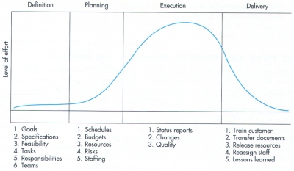
Project Life Cycle
Concept and feasibility studies
Start-up and implementation
Engineering design
Construction
Operation or utilization
Procurement

Slide 40
Concept and feasibility studies
(Owner and Consultant)
Initiate the project idea through recognizing a need for the project which could be:
  Satisfying a future demand (e.g. electricity)
  Improving productivity (new machine)
  Increasing income (real estate), or
  Alleviating existing deficiencies, e.g.:
    long waiting time at a road intersection,
    limited office space,
    small warehouse,
    no competition edge-high competition-(manual vs. computerized word processing)

Slide 41
Concept and feasibility studies
(Owner and Consultant)
Identify the possible alternatives and check their feasibility. Feasibility criteria are:
  Technical: approve the alternative that satisfies the technical restrictions,
  Economical: identify the most economical alternative,
  Financial: identify the source and availability of money to finance the alternative.

Slide 42
Engineering Design
(Owner and consultant)
Preparing blue prints (drawings) and specs (specifications) for the project.

Slide 43
Procurement
It involves contracting with a general contractor and subcontractor and ordering project resources.

Slide 44
Construction
It converts the blue prints and specs into physical structures.

Slide 45
Start-up and implementation
It involves testing the functionality of the components and the whole system. (Special attention in refineries and chemical plant)

Slide 46
Operation and utilization (O&U)
O&U involves the final phase of the project life cycle that will last up to the life of the project.

Slide 47
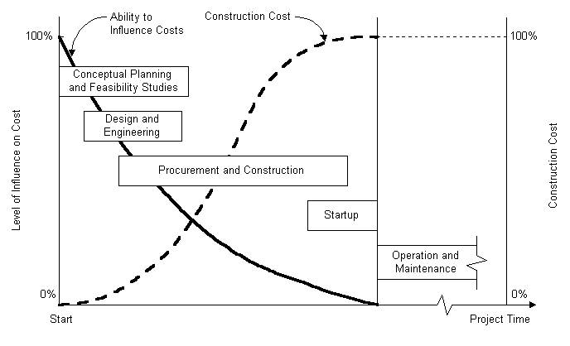

Slide 48
Example of a
Project Management Process
Planning Phase
  Listing of Activities
  Gross Resource Requirements
  Cost Estimates
  Activity Durations

Slide 49
Example of a
Project Management Process
Scheduling
  Time ordering of Activities
  Resource Requirement at each stage
  Expected completion time of each task

Slide 50
Example of a
Project Management Process
Monitoring & Control
  Reviewing the difference between the schedule & actual performance
  Analysis of the difference
  Correction Measures

