Slide 1
Time Series Course
Dr. Maha Omair
Book: Time Series Analysis Univariate and Multivariate
http://ruangbacafmipa.staff.ub.ac.id/files/2012/02/Time-Series-Analysis-by.-Wei.pdf
https://wiki.math.ntnu.no/tma4285/2011h/start
http://astro.temple.edu/~wwei/data.html
By William Wei

Slide 2
Chapter 1
1.1 Introduction

Slide 3
Introduction
A time series is a collection of observations made sequentially through time. Examples occur in a variety of fields, ranging from economics to engineering, and methods of analyzing time series constitute an important area of statistics.

Slide 4
1.2 Examples

Slide 5
1.2 Examples

Slide 6
Terminology
A time series is said to be continuous when observations are made continuously through time.
A time series is said to be discrete when observations are taken only at specific times, usually equally spaced. The term ‘discrete’ is used for series of this type even when the measured variable is a continuous variable.
Time series that vary about a fixed level are said to be stationary in the mean like Figure a
In Figure b the time series does not vary about a fixed level and exhibits an overall trend . Moreover, the variance increases as the level of the series increases. Time series that exhibits these phenomena are said to be nonstationary in mean and variance
Time series containing seasonal variation are called seasonal time series.

Slide 7
Chapter 2
Fundamental Concepts

Slide 8
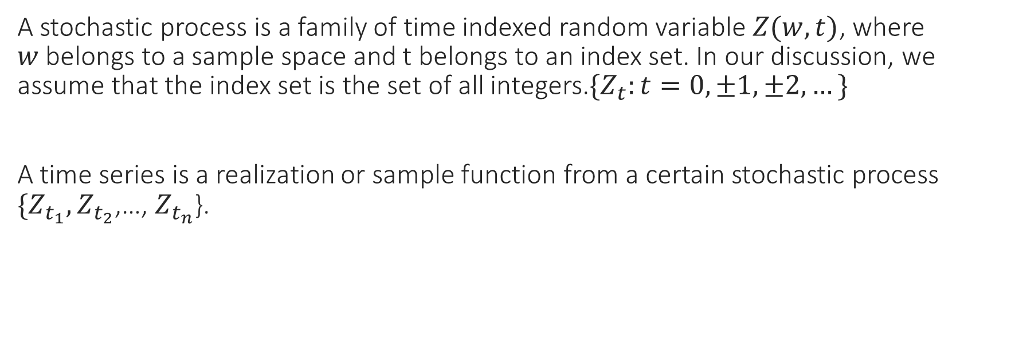
2.1 Stochastic Process
A stochastic process is a family of time indexed random variable $Z(w,t)$, where $w$belongs to a sample space and t belongs to an index set. In our discussion, we assume that the index set is the set of all integers.$\{Z_{t}:t=0,±1,±2,…\}$
A time series is a realization or sample function from a certain stochastic process $\{Z_{t_{1}}, Z_{t_{2}}$,…, $Z_{t_{n}}$}.

Slide 9
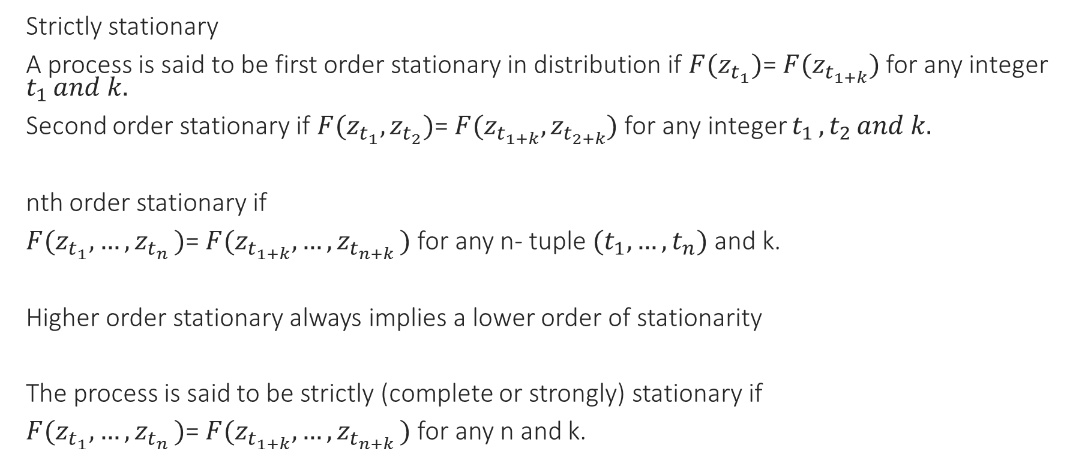
2.1 Stochastic Process
Strictly stationary
A process is said to be first order stationary in distribution if $F(z_{t_{1}})$= $F(z_{t_{1+k}})$ for any integer $t_{1 }and k.$
Second order stationary if $F(z_{t_{1}},z_{t_{2}})$= $F(z_{t_{1+k}},z_{t_{2+k}})$ for any integer $t_{1 },t_{2 }and k.$
nth order stationary if
$F(z_{t_{1}},{…,z}_{t_{n}})$= $F(z_{t_{1+k}},{…,z}_{t_{n+k}})$ for any n- tuple $(t_{1},…,t_{n})$ and k.
Higher order stationary always implies a lower order of stationarity
The process is said to be strictly (complete or strongly) stationary if
$F(z_{t_{1}},{…,z}_{t_{n}})$= $F(z_{t_{1+k}},{…,z}_{t_{n+k}})$ for any n and k.

Slide 10

2.1 Stochastic Process
For a given real valued process $\left\{Z_{t}:t=0,±1,±2,…\right\}, we define the mean function of the process$

Slide 11
2.1 Stochastic Process

Slide 12
n-th order weakly stationary

Slide 13
Example

Slide 14
Example

Slide 15
Example

Slide 16
note

Slide 17
The Autocovariance and Autocorrelation functions

Slide 18
Properties

Slide 19
Properties

Slide 20
The partial autocorrelation function

Slide 21
The partial autocorrelation function

Slide 22
White Noise

Slide 23
Estimation of the mean, autocovariances and autocorrelations

Slide 24
Sample Mean

Slide 25
Sample mean

Slide 26
Sample Autocovariance Function

Slide 27
Sample Autocovariance Function

Slide 28
Sample Autocorrelation Function

Slide 29
Example

Slide 30
Sample Partial Autocorrelation

Slide 31
Example

Slide 32
Moving Average and Autoregressive Representations of Time Series Process

Slide 34
Autoregressive

Slide 36
Chapter 3
Stationary Time Series Models

Slide 37
3.1 Autoregressive Process
The autoregressive model of order p is denoted by AR(p) and is given by

Slide 38
The First order autoregressive AR(1) process

Slide 39
Properties of AR(1)

Slide 40
Example

Slide 41
Example

Slide 42
Second order Autoregressive AR(2)

Slide 43
Properties of AR(2)

Slide 44
Properties of AR(2)

Slide 46
Example

Slide 47
Example

Slide 48
The general pth order autoregressive AR(p) process

Slide 49
Moving Average

Slide 50
Moving Average of Order one MA(1)

Slide 51
MA (1)

Slide 52
Example

Slide 53
Moving Average of Order 2
MA(2)

Slide 54
MA(2)

Slide 55
Example

Slide 56
MA(q)

Slide 58
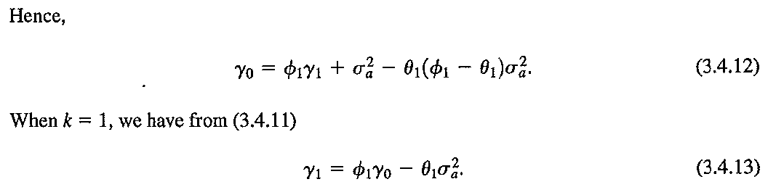

Slide 60
Example

Slide 61
Example

Slide 62
Chapter 4

Slide 63
Non Stationary time series

Slide 64
Deterministic Trend

Slide 65
Stochastic trend and differencing model

Slide 66
ARIMA (Autoregressive integrated moving average)

Slide 67
The random Walk model

Slide 68
The random walk model

Slide 69
Example

Slide 70
The ARIMA (0,1,1) or IMA(1,1)

Slide 71
Example

Slide 72
Variance and autocovariance of the ARIMA

Slide 74
Variance stabilizing transformation

Slide 77
Chapter 6

Slide 78
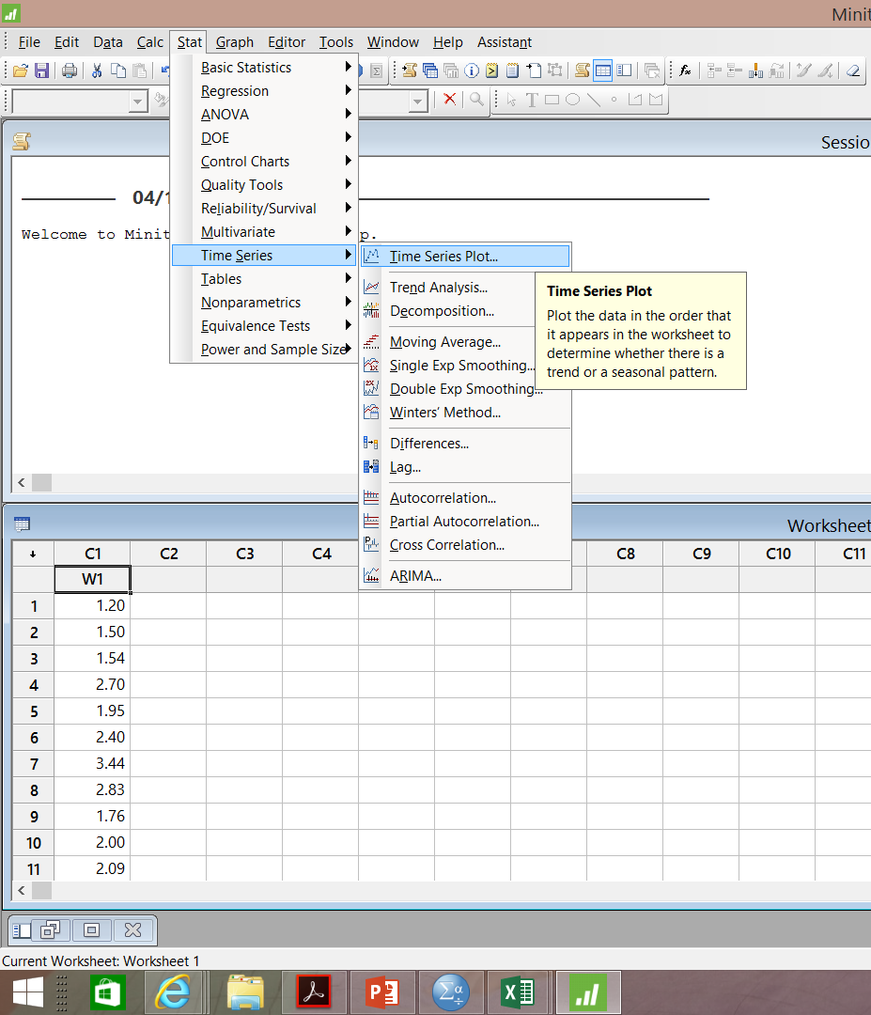

Slide 79
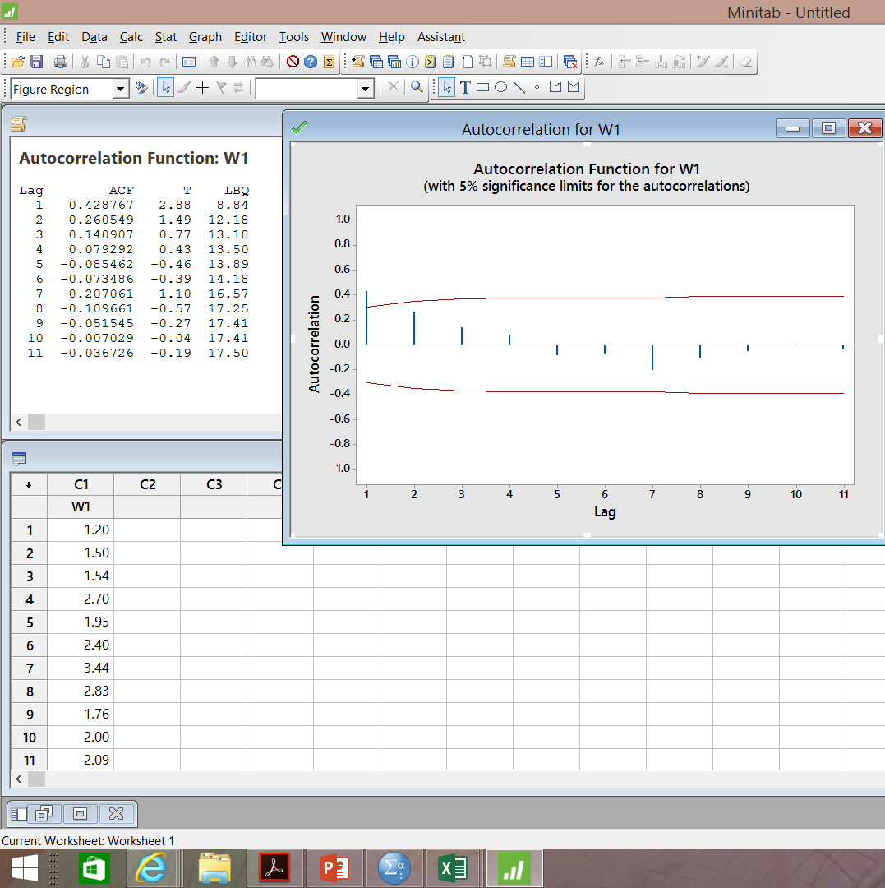
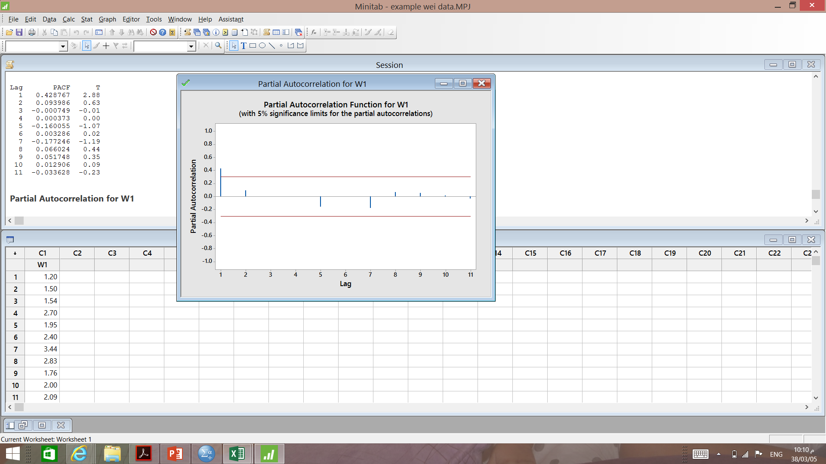
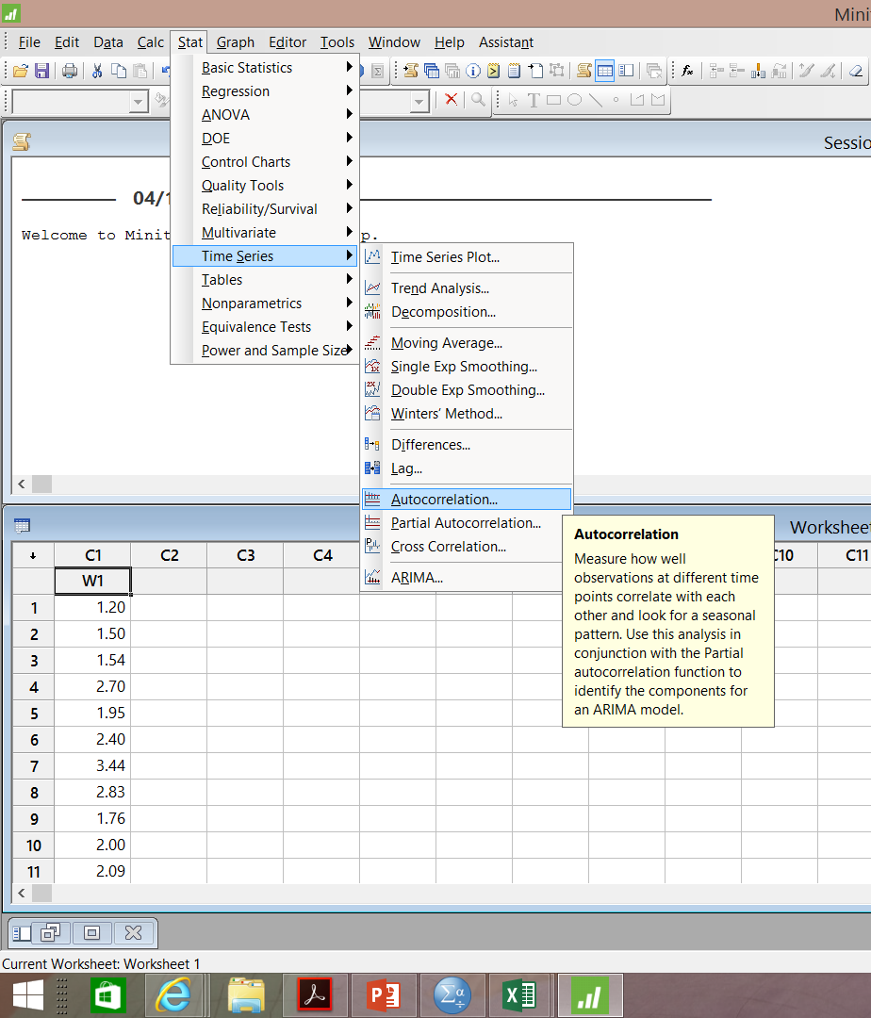

Slide 81
AR(1) & MA(1)

