Slide 1
Thyroid Ultrasound
BY: LAMYAA ALLUHAYDAN

Slide 2
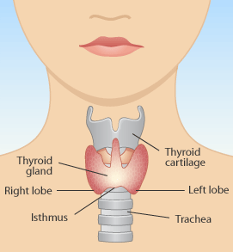
ANATOMY

Slide 3
FUNCTION
The thyroid gland is an organ that produces hormones to enhance metabolism in the body. Unlike gastrointestinal or kidney disorders, many people do not quite have a clear idea about "thyroid disorders." In which part of the body is the thyroid gland found? What is its function? Let's first take a look at the location and function of the thyroid gland in order to understand thyroid disorders.

Slide 4
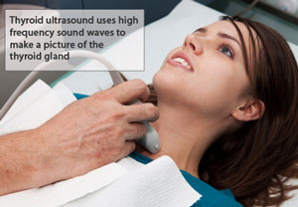
Ultrasound

Slide 5
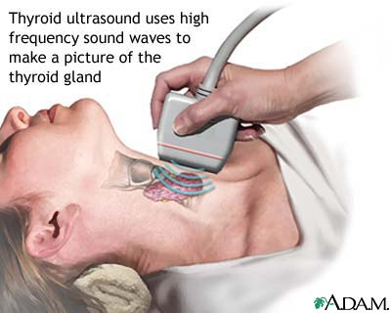
con..

Slide 6
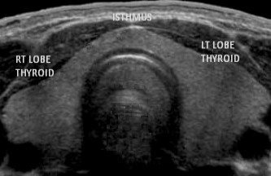
IMAGES

Slide 7
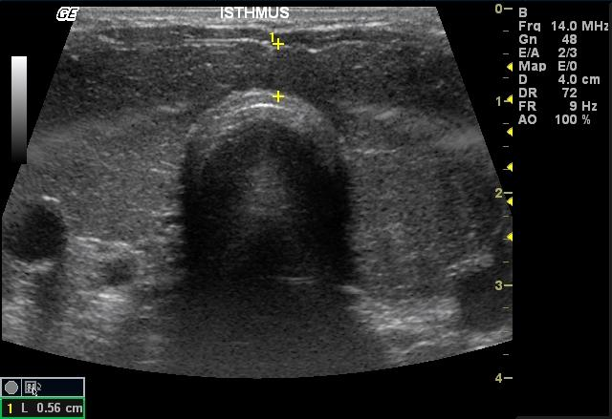
IMAGES

Slide 8
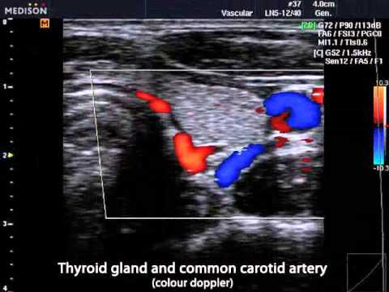
IMAGES

