Slide 1
THERE IS & THERE ARE
Grammar Review Duration: 30 minutes

Slide 2
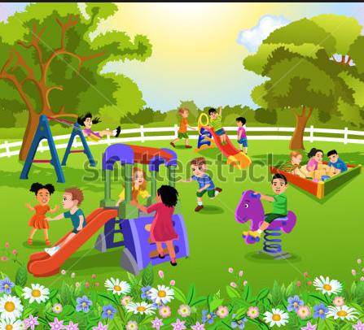
NOTICING TASK
Read the dialogues below , then answer the questions which follow.
Linda: Hi Marsha, let’s go and chat.
Marsha: Okay, there is a coffee shop near my house.
There are children playing in the park.
What is there near Marsha’s house?
Who are there in the park?
Notes:
Answers: She likes that house. / Ben introduces his friend Yousef to Ali.

Slide 3
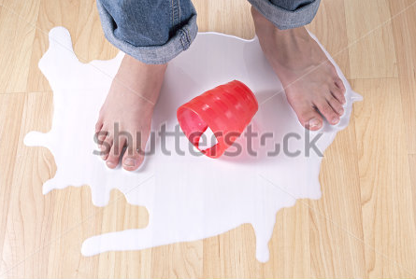
USAGE- THERE IS
We use ‘there is/are’ to state that something does or does not exist.
1. We use there is (singular nouns or one item) to say that something is located in the place or exists:
Ex. There is a book on the desk.
We use there is for uncountable nouns.
Ex. There is milk spilled on the floor.
3. We use there isn’t (singular) / to say that something isn’t located in the place or doesn’t exist:
Ex. There isn’t a book on the desk.
4. We use Is there…? (singular) to ask whether something is located in the place or exists:
Ex. Is there a book on the desk?
Notes:
Answers: She likes that house. / Ben introduces his friend Yousef to Ali.

Slide 4
USAGE- THERE ARE
1. We use there are (plural) to say that something is located in the place or exists:
Ex. There are many books on the shelf.
We use there aren’t (plural) to say that something isn’t located in the place or doesn’t exist:
Ex. There aren’t any books on the shelf.
We use Are there...? (plural) to ask whether something is located in the place or exists:
Ex. Are there any books on the shelf?
Notes:
Answers: She likes that house. / Ben introduces his friend Yousef to Ali.

Slide 5
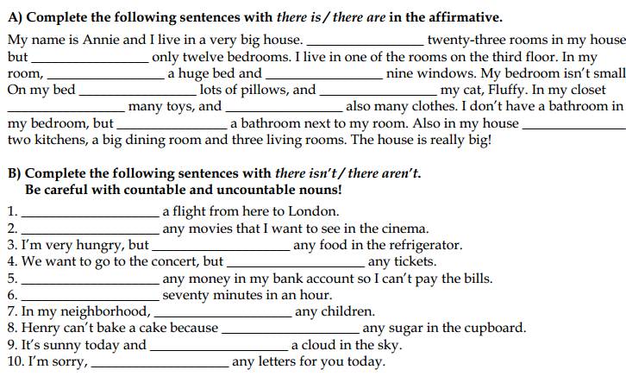
QUICK PRACTICE

Slide 6
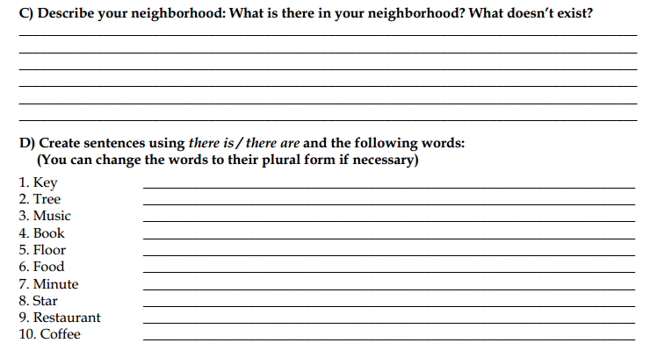
INDEPENDENT PRACTICE
Cake

