Slide 1
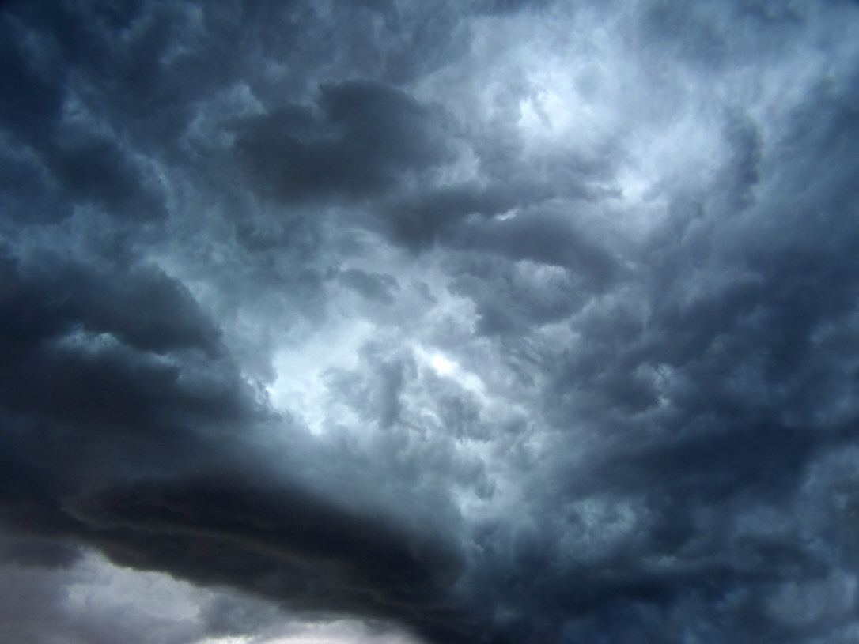
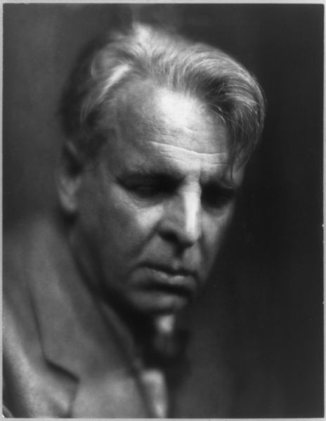
“The Second Coming”
by W.B. Yeats

Slide 2
THE SECOND COMING (1919)
Turning and turning in the widening gyre The falcon cannot hear the falconer; Things fall apart; the centre cannot hold; Mere anarchy is loosed upon the world, The blood-dimmed tide is loosed, and everywhere The ceremony of innocence is drowned; The best lack all conviction, while the worst Are full of passionate intensity.
Surely some revelation is at hand; Surely the Second Coming is at hand. The Second Coming! Hardly are those words out When a vast image out of Spiritus Mundi Troubles my sight: a waste of desert sand; A shape with lion body and the head of a man, A gaze blank and pitiless as the sun, Is moving its slow thighs, while all about it Wind shadows of the indignant desert birds. The darkness drops again but now I know That twenty centuries of stony sleep Were vexed to nightmare by a rocking cradle, And what rough beast, its hour come round at last, Slouches towards Bethlehem to be born?

Slide 3
William Butler Yeats 1865-1939
“There is now overwhelming evidence that man stands between eternities, that of his family and that of his soul. I apply those beliefs to literature and politics and show the change they must make. . . . My belief must go into what I write, even if I estrange friends; some when they see my meaning set out in plain print will hate me for poems which they have thought meant nothing.”

Slide 4
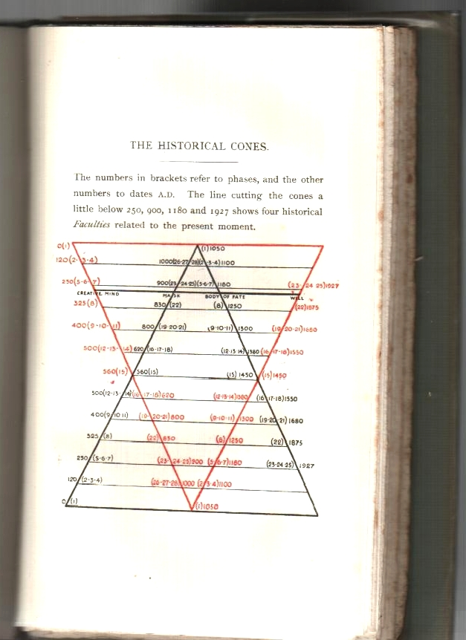
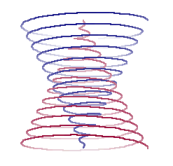
Turning and turning
in the widening gyre
Each circle equals 200 years of history.
Each new gyre (circle) brings about chaos and destruction of the old.
In 1921, Yeats thought that world is on the brink of the end!

Slide 5
The Second Coming
Created an elaborate mythology to explain the entire history of human experience
Uses interest in spiritual and occult to predict the rise of an inhuman world
Poem written after the catastrophe of World War I and with communism and fascism on the rise
History moved in two thousand-year cycles.
The Christian era, which followed that of the ancient world, was about to end and an ominous period was about to begin. ( extracted from Paul Brians)

Slide 6
Yeats was an accomplished Irish poet and was known for the socio-religious ideas he emphasized in his poetry. In "The Second Coming," his ideas unfold in three significant metaphors. The first metaphor relates a falcon and its falconer to the destruction of society. The metaphor has two possible interpretations. One view may be that the falcon represents society and the falconer represents God and morality. By saying "The falcon cannot hear the falconer," Yeats may be implying that society has lost sight of God and has lost the values and morals once held in place by the strong obedience to God.

Slide 7
In another interpretation, Yeats may be saying that the falcon represents a war and the falconer represents the military power that has unleashed it to the point where all control is lost and faith in God has been abandoned. The next line of the poem explains this process; "things fall apart" indicates that the runaway war has sparked disorder in the public. "The centre cannot hold," signifies that the obedience to God has lost its value.

Slide 8
Even though there may be more than one interpretation, the metaphor points up one socio-religious theme that society has lost order and in turn lost faith in God. The second metaphor conveys Yeats' idea that anarchy has taken over. The metaphor begins with "The blood-dimmed tide is loosed," suggesting that the purity of the soul has been corrupted by the destruction that accompanies chaos. Yeats uses the second line of the metaphor, "...and everywhere the ceremony of innocence is drowned," to show how the value of life, health of country, and civilized order have died. In this metaphor Yeats conveys his socio-religious idea that the deterioration of societal morals has led the way for anarchy to corrupt the religious purity of the individual.

Slide 9
The third metaphor brings out Yeats' religious idea of the Second Coming of Christ. But, line 9, the second stanza of the poem begins by setting up a new vision. The speaker takes the violence which has engulfed society as a sign that "the Second Coming is at hand." He imagines a sphinx in the desert, and we are meant to think that this mythical animal, rather than Christ, is what is coming to fulfill the prophecy from the Biblical Book of Revelation. At line 18, the vision ends as "darkness drops again," but the speaker remains troubled.

Slide 10
Finally, at the end of the poem, the speaker asks a rhetorical question which really amounts to a prophecy that the beast is on its way to Bethlehem, the birthplace of Christ, to be born into the world.

Slide 11
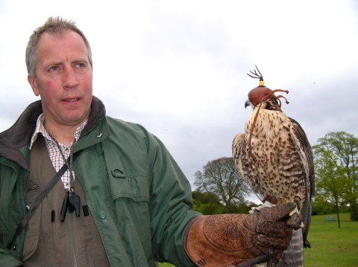
The falcon cannot hear the falconer;
If we = falcon,
What you think is supposed to be represented by the Falconer?
We are at a point in history when we are spiraling out of control.

Slide 12
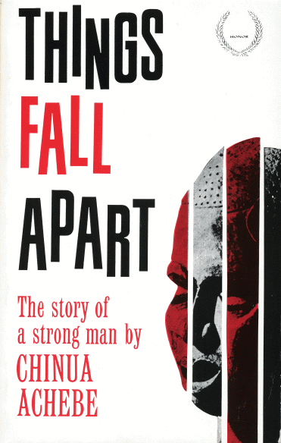
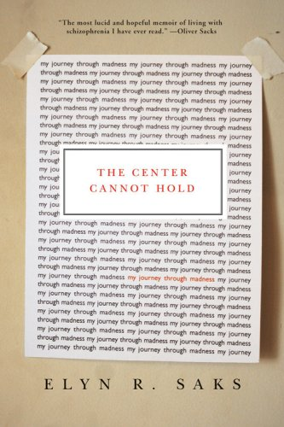
As the spiral widens, we get further from the center, again Yeats presents the idea that we are losing control.
Things fall apart; the centre cannot hold;
Mere anarchy is loosed upon the world

Slide 13
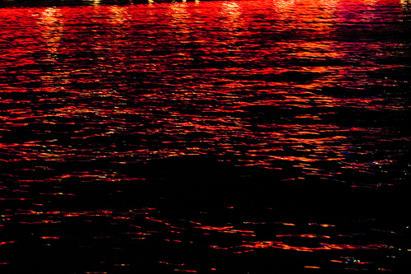
The blood-dimmed
tide is loosed,

Slide 14
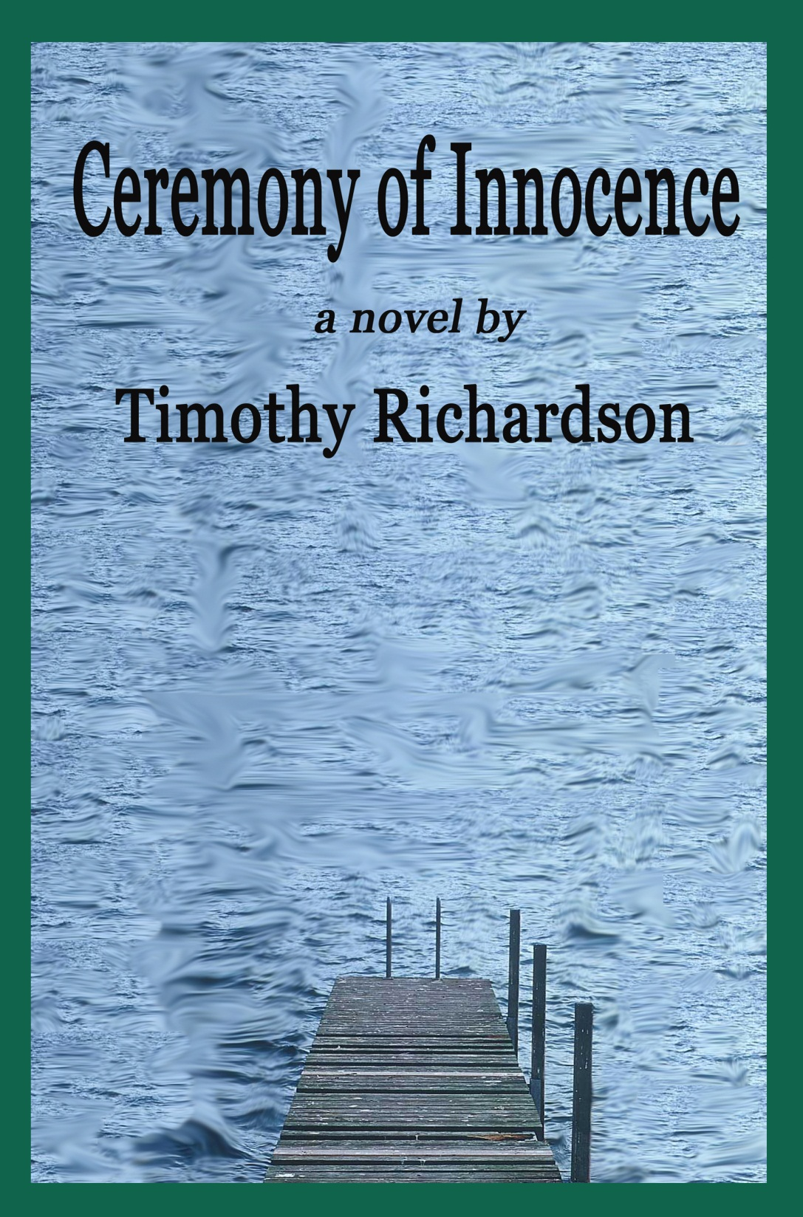
and everywhere The ceremony
of innocence
is drowned;

Slide 15
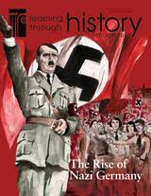
The best lack all conviction, while the worst Are full of passionate intensity

Slide 16
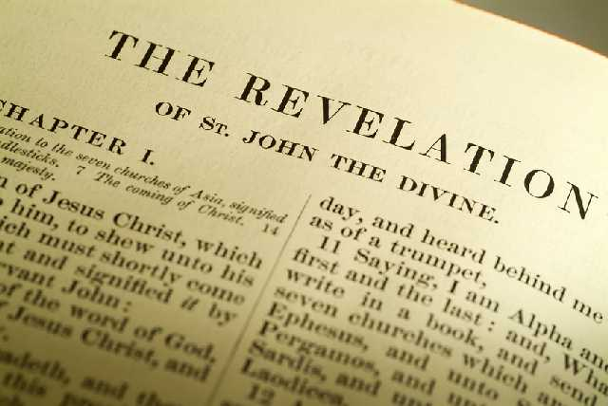
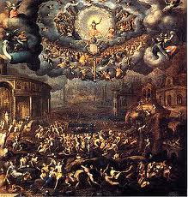
Surely some revelation is at hand; / Surely the Second Coming is at hand.
The Second Coming!

Slide 17
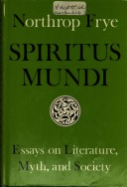
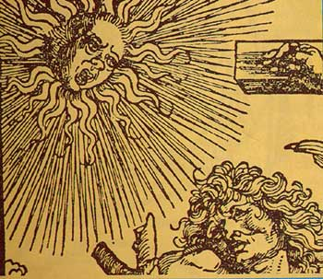
Hardly are those words out When a vast image out of Spiritus Mundi Troubles my sight:
Spiritus Mindi = Spirit World

Slide 18
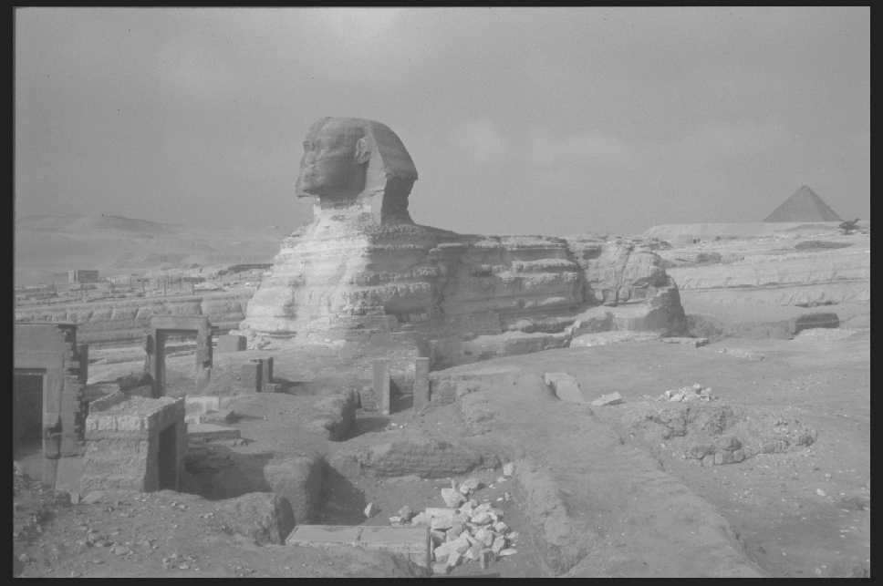
a waste of desert sand; A shape with lion body and the head of a man, A gaze blank and pitiless as the sun,
A metaphor for a monster(perhaps person or people) that is coming in the near future who’s immoral actions will destroy humanity.

Slide 19
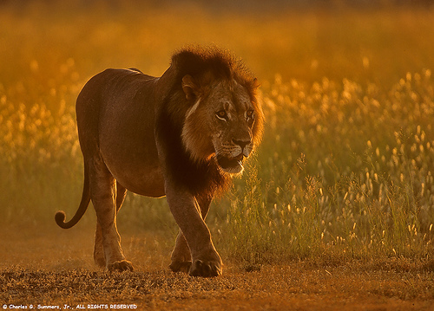
A shape with lion body and the head of a man, A gaze blank and pitiless as the sun…
Is moving its slow thighs

Slide 20
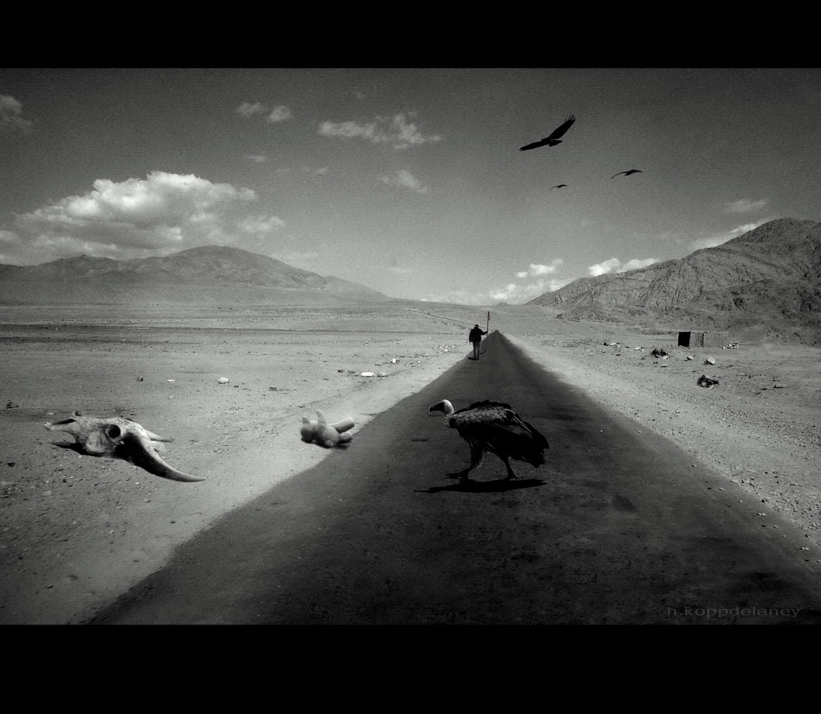
while all about it Wind shadows of the indignant desert birds
The darkness drops again but now I know That twenty centuries of stony sleep Were vexed to nightmare by a rocking cradle,

Slide 21
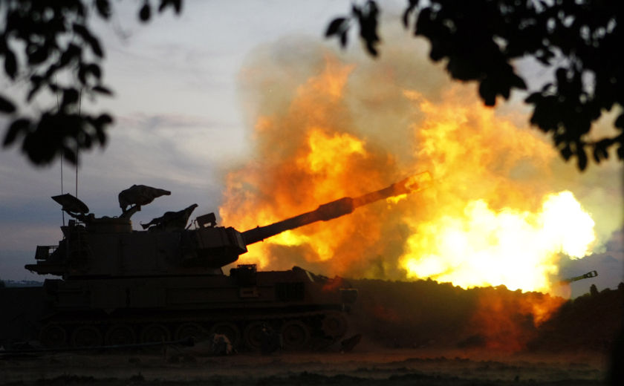
And what rough beast, its hour come round at last, Slouches towards Bethlehem…
Note: Image represents no particular group.

Slide 22
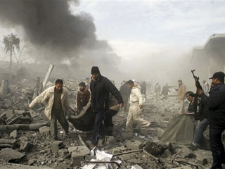
Note: Image represents no particular group.

Slide 23
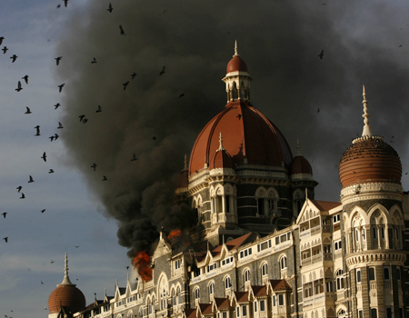
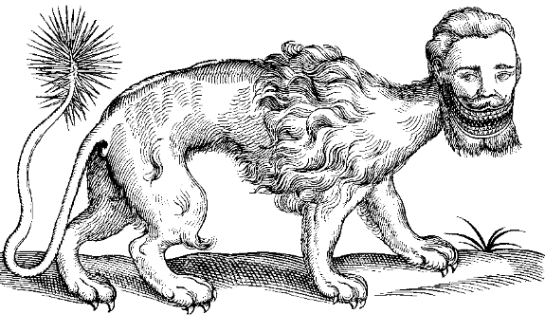
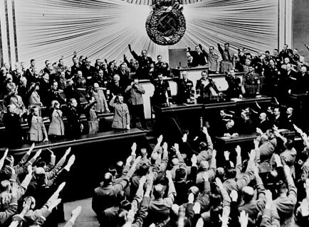
…And what rough beast, its hour come round at last, Slouches towards Bethlehem…
to be born?
(Slouches to be born ??)

Slide 24
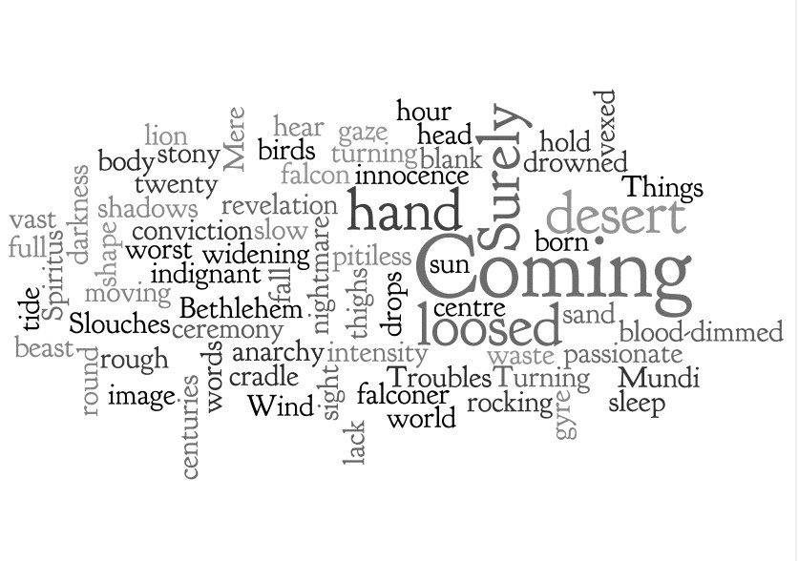

Slide 25
