Slide 1
The Muscular Tissues
Prepared by : Reem Aldossari

Slide 2
The Muscular Tissues
General characteristics of the muscular tissues:
The cells of the muscular tissues are elongated elements, named muscle fibers.
The cytoplasm of the muscle fiber, the sarcoplasm, contains myofibrils. These fibrils are made up of the proteins actin and myosin.
The plasma membrane of the muscle fiber is called the sarcolemma.
There are three types of muscle fiber:
Skeletal muscles, which are voluntary and striated.
Smooth muscle, which are involuntary and non- striated.
Cardiac muscles, which are involuntary and striated.

Slide 3
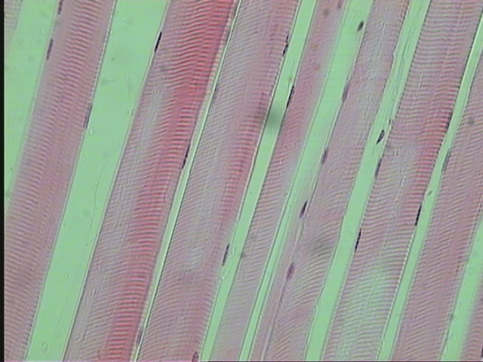
The skeletal or striated muscles L.S of skeletal mucles
the muscle attached to the skeleton.
muscle fibers are transversely striated and are voluntary
Each muscle fiber is elongated, unbranched, cylindrical cell, with numerous peripheral flatten nuclei
sarcolemma
nuclei
Connective
tissue
Dark and light bands
Muscle fiber

Slide 4
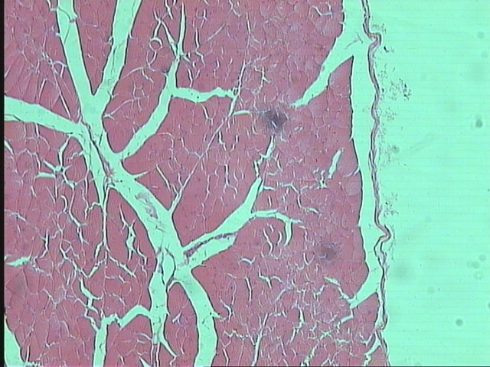
T.S of skeletal mucles
Each individual muscle fiber is surrounded by a delicate connective tissue, the endomysium
Bundles or groups of fibers are wrapped by a dense connective tissue called the perimysium
The whole muscle (formed of several bundles) is covered by a dense connective tissue sheath, the epimysium
1
2
3
T.S. of Striated Muscles Fibers (Skeletal Muscles Fibers)
Endomysium 2-Perimysium -3- Epimysium

Slide 5
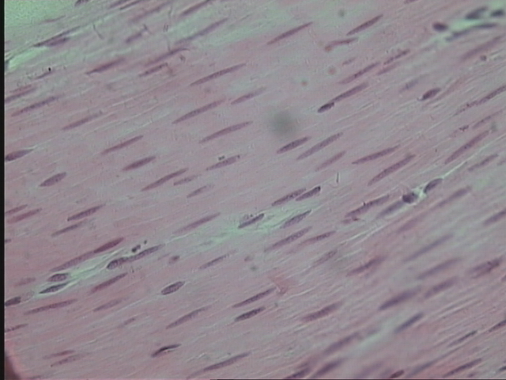
The Smooth Unstriated Muscle
These muscles are present in the wall of blood vessels, and digestive, respiratory, urinary and reproduction systems
The smooth muscle fibers are Unstriated and involuntary
The smooth muscle fibers are elongated, spindle- shaped cells with pointed ends.
The nucleus is elongated or rod-shaped and centrally located in the cytoplasm at the widest part of the cell.
nuclei
Muscle fiber
Connective
tissue

Slide 6
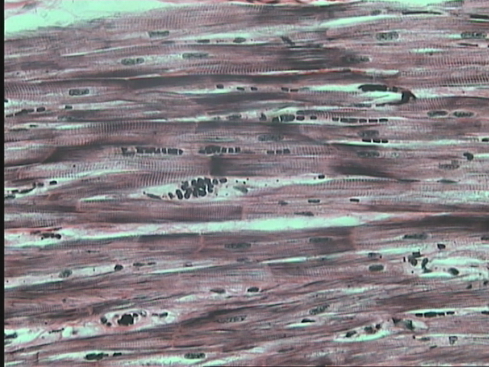
The Cardiac Muscles
These muscles are present in the heart
The cardiac muscle fibers are striated but are involuntary.
cardiac muscle fibers are elongated, branched, mononucleate or binucleate cells.
The nuclei are oval and centrally located.
At the end to end junction of the cells there are intercalated discs.
nuclei
Connective tissue
Dark and light bands
intercalated disc
Muscle fiber

Slide 7
The Nervous Tissues

Slide 8
The nervous system is divided anatomically into:-
The supporting cells (glia cells),
which support, nourishes and insulate the neurons and perform the defense processes in the nervous system.They are mainly of two types:
The central nervous system (CNS)
composed of nerve fibers forming the cranial and spinal nerves and the ganglia
Neuralgia cells inside the CNS.
Schwann cells outside the CNS (in the PNS).

Slide 9
Structure of the Neuron
The cell body: it is also called the perikaryon or soma. It contains the nucleus and much of the metabolic machinery of the cell
The axon: a single, usually long process specialized in conducting nerve impulses to other cells
The dendrites: they are multiple cytoplasmic processes specialized in receiving stimuli and transmitting them to the cell body.

Slide 10
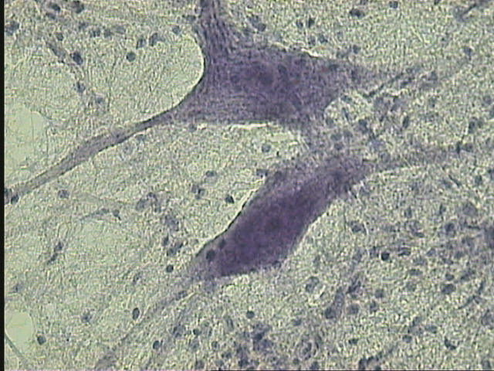
Neurons
Glial cell nucleus
The nervous Tissue
Neurons – Glial cell nucleus

Slide 11
The CELL DIVISTION

Slide 12
The CELL DIVISTION
Cell division is a process by which the cellular material is divided
between 2 new daughter cells.
Mitosis (or indirect division)
occurs in somatic cells of higher organisms.
it is the means of population growth in unicellular organisms.
results in two daughter cells.
have the same number of chromosomes of the mother cell.

Slide 13
Telophase | Anaphase | Metaphase | Prophase
The chromosomes have reached the opposite poles | The centromeres split the 2 chromatids of each chromosome separated and pulled toward the corresponding cell pole | The spindle fibers are fully formed and astral rays appear around the centrioles at the cell poles. | The chromosomal threads become tightly coiled: become shorter and denser
The spindle disperses. | Now each chromatid is a chromosome | The chromosomes are arranged in the equatorial plane and their centromeres appear attached to the spindle fibers. | The nuclear envelope dissolves.
The chromosomes become diffuse. |  | These kinetochores are 2 disk-shaped structures in each centromere. | The nucleolus disappears.
The nucleolus reappears. |  |  | In the cytoplasm of animal cells the centrioles, with a surrounding fan of astral rays
A nuclear envelope reforms nucleus is formed. |  |  | The spindle fibers begin to form.

Slide 14
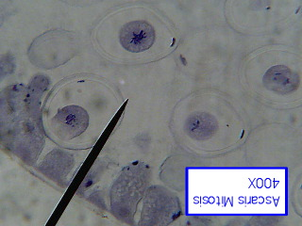
Prophase
Mitosis Division (Animal cell )
Prophase

Slide 15
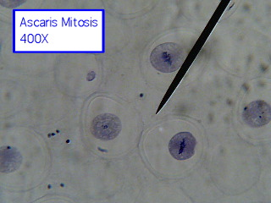
Metaphase
Mitosis Division (Animal cell )
Metaphase

Slide 16
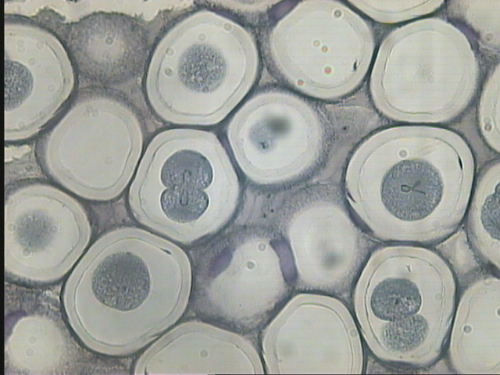
Anaphase
Mitosis Division (Animal cell )
Anaphase

Slide 17
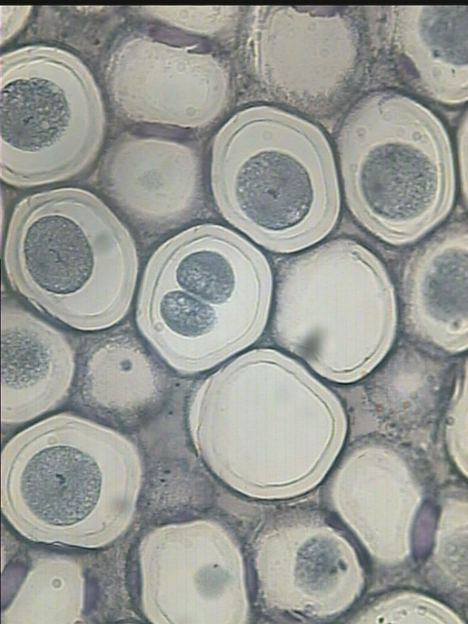
Telophase
Mitosis Division (Animal cell )
Telophase

Slide 18
Thank you
for your attention

