Slide 1
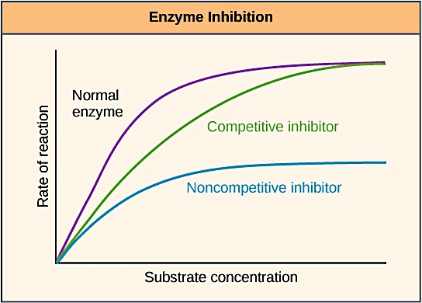
The effect of inhibitors (Inorganic phosphate & Sodium fluoride) on the rate of an enzyme catalyzed reaction
322 BCH
Exp (8)

Slide 2
In this experiment, we will continue to study acid phosphatase kinetics.
Acid phosphatase kinetics
Time
Enzyme concentration
pH
Substrate concentration
Inhibitor
Temperature

Slide 3
Objectives
To study the effect of inhibitors on the rate of an enzymatic reaction.
To determine the type of inhibition of acid phosphatase by inorganic phosphate and sodium fluoride.

Slide 4
Introduction
Inhibitors are chemicals that reduce the rate of enzymatic reactions.
The are usually specific and they work at low concentrations.
They block the enzyme but they do not usually destroy it.
Since blocking an enzyme's activity can kill a pathogen or correct a metabolic imbalance, many drugs are enzyme inhibitors.

Slide 5
Types of inhibitors
Irreversible inhibitors
Reversible inhibitors
Competitive
Noncompetitive
Uncompetitive

Slide 6
 | Irreversible inhibitors | Reversible inhibitors
Type of bonds with E | Inhibitors bind covalently with enzyme | Inhibitors bind non-covalently with enzyme
Removal | Cannot be removed by dialysis or other way | Can be removed by dialysis
Activity Restoration | Permanently modify the active site residues(functional group) which the enzyme become inactive. | Removal of the inhibitor restores enzyme activity

Slide 7
It is relatively simple to distinguish the three types of reversible inhibition by comparing the Michaelis-Menten and Lineweaver-Burke kinetics (Vmax and Km) in the presence and absence of the inhibitor.

Slide 8
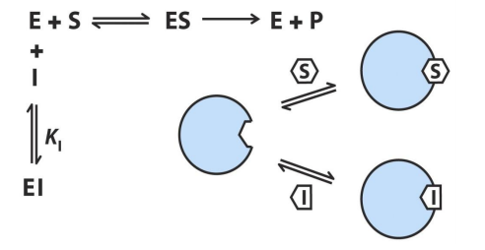
Competitive inhibitors
As the name implies, the inhibitor compete with the substrate for active site of the enzyme.
The structure of substrate and inhibitors are similar
Competitive inhibitor will not affect the Vmax
Increase the Km ---→decrease the affinity
This type of inhibition can be overcome by sufficiently high concentrations of substrate by out-competing the inhibitor

Slide 9
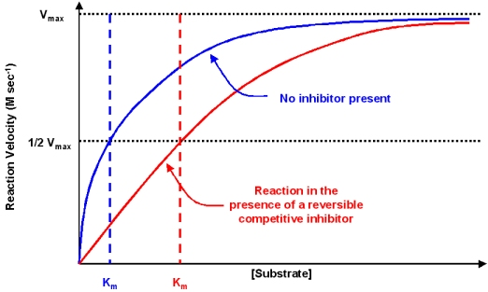
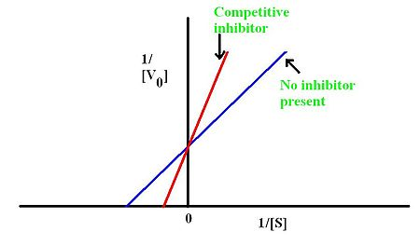
Competitive inhibitors
Michaelis-Menten
Lineweaver-Burke
1/Vmax (same)

Slide 10
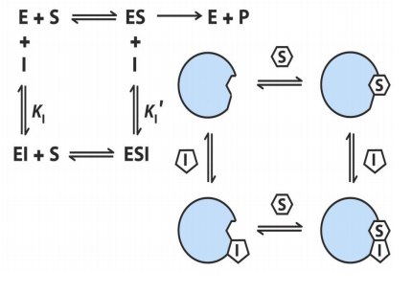
NONCompetitive inhibitors
A noncompetitive inhibitor is one that binds reversibly to the enzyme, but not at the active site itself
They can bind with E or ES complex.
Have the same Km (with I OR without I)
low Vmax (with I)
A noncompetitive inhibitor is one that binds reversibly to the enzyme, but not at the active site itself, so that the substrate can still bind at the active site, but there’s no catalyzed transformation.
This type of inhibition cannot be overcome by a large amount of substrate, thus noncompetitive inhibition.
Km will not change with the inhibitor and the Vmax will increase

Slide 11
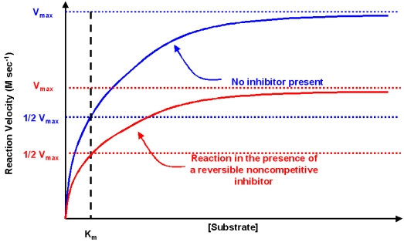
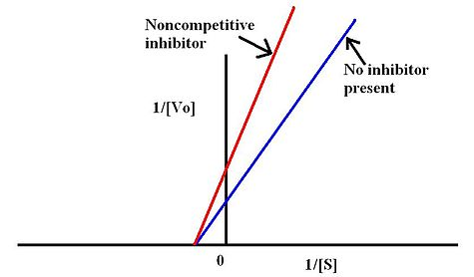
NONCompetitive inhibitors
Michaelis-Menten
Lineweaver-Burke

Slide 12
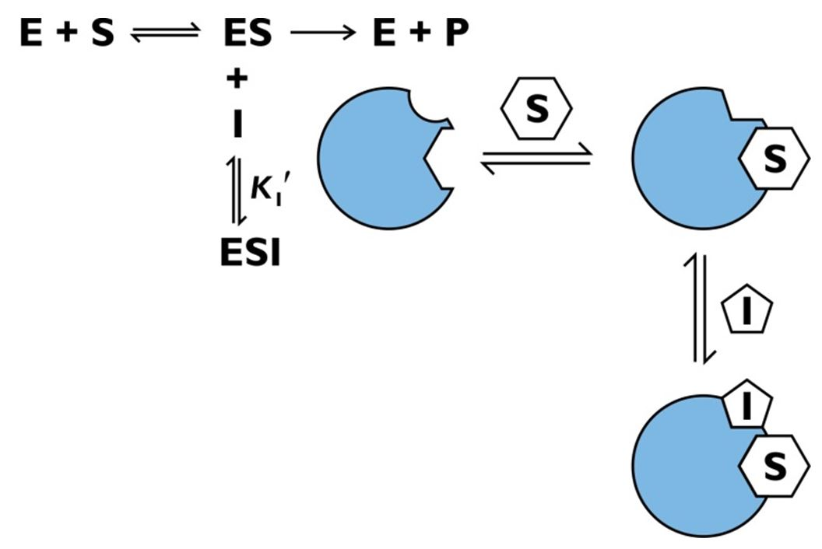
The inhibitor binds only to the substrate-enzyme complex
Both Vmax and Km are low (with I)
UnCompetitive inhibitors

Slide 13
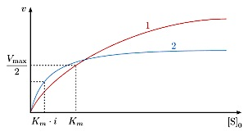
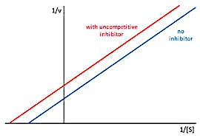
UnCompetitive inhibitors
Michaelis-Menten
Lineweaver-Burke

Slide 14
Method
Inorganic phosphate (Pi) and sodium fluoride are inhibitors of acid phosphatase and it is your task to determine whether they are competitive, noncompetitive, or uncompetitive inhibitor.
The setup is basically the same as in the experiment for the effect of substrate concentration on reaction velocity, except that a constant amount of inhibitor is added.
The kinetics for the uninhibited reactions must be compared with those of reactions run in the presence of the inhibitor.
Determinations of V_{max} and K_{m} will help you to determine the specific mode of inhibition

Slide 15
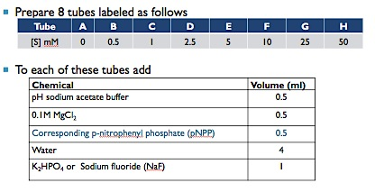
Method
Without I
With I
Place the tubes in a test tube rack situated in 37ºC water bath and let stand for 5 min.

Slide 16
Start the reaction by adding 0.5 ml enzyme and stop it by adding 0.5 ml KOH as in the following table:
Determine the absorbance at 405 nm for each sample, using the first tube (0 mM of S) as the blank.
Tube | Start the reaction | Stop the reaction
A | 0 min | 0 min
B | 0 min | 5 min
C | 2 min | 7 min
D | 4 min | 9min
E | 6 min | 11 min
F | 8 min | 13 min
G | 10 min | 15 min
H | 12 min | 17 min

Slide 17
Results
Tube | [S] (mM) | 1/[S] (1/mM) | Abs at 405 nm |  | V=(A x 10⁶) /(18.8 x 10³x time) (µmole of PNP/min) | 1/V (1/ µmole of PNP/min)
 |  |  | Without I | With I
A | 0
B | 0.5
C | 1
D | 2.5
E | 5
F | 10
G | 25
H | 50

Slide 18
Results
Draw the curve using Michaelis-Menten, determine Vmax and Km for acid phosphatase of both inhibited and not inhibited reaction
Prepare the double –reciprocal plot of Lineweaver-Burk and determine the Km and V max from the x and y intercepts of both inhibited and not inhibited reaction

Slide 19
discussion
An introductory statement [In this experiment, we studied the effect of inhibitors ………..
Principle
Compare the Vmax and Km obtained Michaelis-Menten and Lineweaver-Burk graphs of both inhibited and uninhibited reactions with each other to determine the type of inhibition

Slide 20
Questions
Determine if inorganic phosphate and sodium fluoride are a competitive, noncompetitive, or uncompetitive inhibitor? Justify your answer and discuss the difference you find
Investigate the literature to determine how your results compare with those of previous workers.

