Slide 1
Triglyceride determination

Slide 2
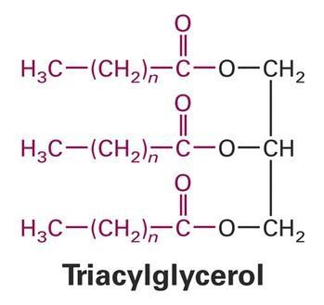
Introduction:
Triglycerides are esters of fatty acids and are hydrolyzed to glycerol and free fatty acids (by lipase)
Triglyceride is body storage form of fat and energy
- Most TG found in adipose tissue
Give energy in case of absence of carbohydrates
- Triglyceride determinations when performed in conjunction with other lipid assays are useful in the diagnosis of primary and secondary hyperlipoproteinemia.

Slide 3
- Hyperlipoproteinemia: abnormally elevated of fat in blood ( disorder in lipid metabolism).
Standard methods for the measurement of triglyceride concentrations involved either enzymatic or alkaline hydrolysis to liberate glycerol.
TG test needs 12 hrs fasting because its level is effected by meal (fatty meal, high carbohydrates meal)

Slide 4
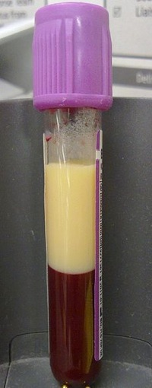
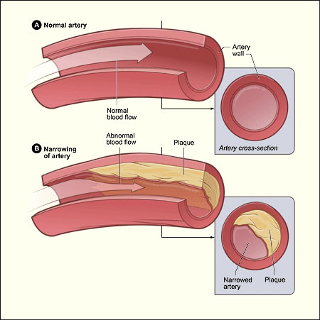
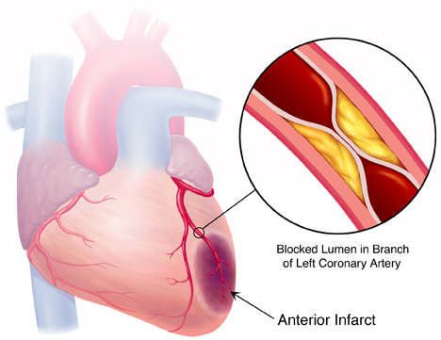
blood (left for 4h)
LDL >40 mmol/L
markedly abnormal

Slide 5
- Principle:
The enzymatic reaction sequence employed in the assay of Triglycerides is as follows:
Triglycerides +
H2O ^{Lipase} >
Glycerol + Fatty Acids
Glycerol + ATP
^{Glycerol Kinase} >
Glycerol-3-Phosphate + ADP
Glycerol-3-Phosphate +
O2 ^{G-1-P} >
DAP + H2O2
oxidase
H2O2 + 4AAP + 4 chlorophenol ^{Peroxidase} >Quinoneimine Dye + 2H2O
- The present procedure involves hydrolysis of triglycerides by lipase.
- The glycerol concentration is then determined by enzymatic assay coupled with Trinder reaction that terminates the formation of a quinoneimine dye.
- The amount of the dye formed, determined by its absorption at 505 nm, is directly proportional to the concentration of triglycerides in the samples.
Notes:
4 aminoantipurin

Slide 6
- Specimen collection and storage:
1. Fresh, non-hemolyzed serum from fasting patients is recommended.
2. Triglycerides in serum appears stable for three days when stored at 2-8 ◦C.
3. Prolonged storage of the samples at room temperature is not recommended since other glycerol containing compounds may hydrolyze, releasing free glycerol with an apparent increase in total triglycerides content.

Slide 7
- Method :
- By Triglyceride reagent kit.
-Follow the table:
 | Blank | Standard | Test
Reconstituted Reagent | 1 ml | 1 ml | 1 ml
Pre-worm at 37◦C for 2 min and add:
Standard Sample | --- --- | 0.01 ml (10 µl) --- | --- 0.01 ml (10 µl)
Mix and incubate at 37ºC for 10 min Read the absorbance of standard and sample at 505 nm against blank

Slide 8
-Calculation:
^{Ab Test}
Ab Std.
Conc. of TG =
X conc.
of Std. ( 200mg/dl)
- Normal range: 10 -190 mg/dl

Slide 9
HDL-Cholesterol determination

Slide 10
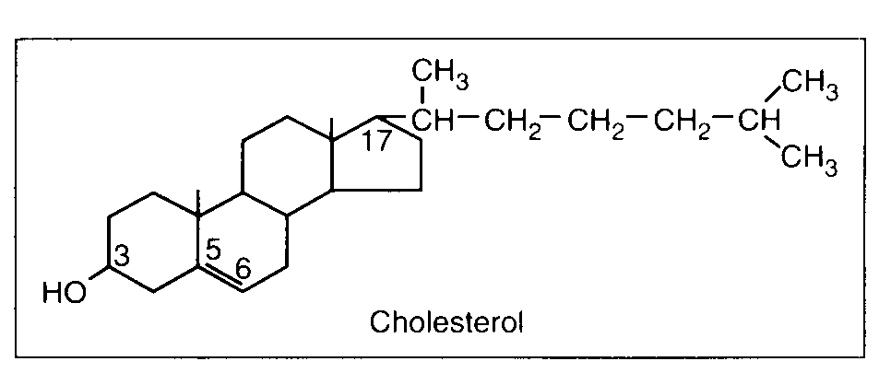
^{- Introduction:}
- Cholesterol is a fatty substance found in blood, bile and brain tissue.
- It serves as a precursor to bile acids, steroids and vitamin D.
- In the plasma, cholesterol is transported by three lipoproteins: high density lipoprotein (HDL-Cholesterol), low density lipoprotein (LDL-Cholesterol), and very low density lipoprotein (VLDL- Cholesterol).
- The concentration of total cholesterol in serum has been associated with metabolic, infectious and coronary heart diseases.

Slide 11
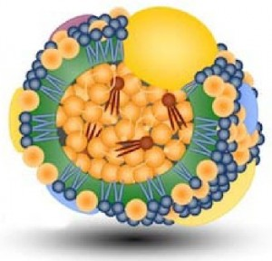
HDL (high density lipoprotein) :
HDL: good cholesterol, carry cholesterol from organs and blood to liver to get rid of it
It removes excess cholesterol from tissues (it cleans blood).
High levels linked to a reduced risk of heart and blood vessel disease. The higher your HDL level, the better.
Notes:
HDL cholesterol (high density lipoprotein) is often called good cholesterol. Called well, because of its binding character of LDL cholesterol which is very easy to make deposits of fatty plaques in blood vessel walls to cause a fatal blockage.
Transport properties of HDL cholesterol levels less protein and capable of carrying excess bad cholesterol in the arteries to be discarded. The conclusion of HDL cholesterol to prevent sediment in the arteries and prevent atherosclerosis (hardening of the arteries).
In addition, HDL also removes cholesterol functions in the cell to the liver and then eliminated from the body. HDL not only removes cholesterol from the cells, but also inhibits the oxidation of LDL.

Slide 12
- The concentration of HDL-cholesterol in serum has important in
diagnosis of the how the level of risk to get coronary heart diseases.
- Castelli and co-workers have indicated that an inverse relationship
exists between serum HDL-Cholesterol and the risk of coronary heart disease.
- The measurement of HDL Cholesterol and triglyceride provides valuable information for the prediction of coronary heart disease and for lipoprotein phenotyping.

Slide 13
- Specimen collection:
1. Specimen should be serum and free from hemolysis.
2. Patient should be fasting for 12-14 hours.

Slide 14
- Principle:
- HDL cholesterol determination
- Enzymatic methods, involving cholesterol esterase and oxidase and Trinders color system.
- The enzymatic reaction sequence employed in the assay of cholesterol is as follows:
Cholesterol Esters
. ESTERASE
Cholesterol + Fatty Acids
Cholesterol + O2
.OXIDASE
Cholesten-3-one + H2O2
2 H2O2 + 4-Aminoantipyrine + Phenol
PEROXIDASE
Quinoneimine + 4 H2O
(red dye)
- Cholesterol Esters are hydrolyzed to produce cholesterol, Hydrogen peroxide is then produced
from the oxidation of cholesterol by cholesterol oxidase. In a coupled reaction catalyzed by peroxidase, quinoneimine red colored dye is formed from 4-aminoantipyrine, phenol and hydrogen peroxide. The absorption of light at 505 + 5 nm of the solution of this dye is proportional to the concentration of cholesterol in the sample.

Slide 15
- Preparing HDL-Cholesterol sample:
- When serum is reacted with the polyethylene glycol reagent, all the low and very low-density lipoproteins (LDL and VLDL) are precipitated.
- The HDL fraction remains in the supernatant.
- The supernatant is then used as a sample for cholesterol assay.

Slide 16
Method :
- HDL Cholesterol:
- Follow
the
Table:
 | Blank | Standard | Test
Cholesterol liquid enzymatic reagent | 1 ml | 1 ml | 1 ml
Pre-worm at 37◦C for 2 min and add:
Distelled water | 100 µl | --- | ---
Standard (50 mg/dl) | --- | 100 µl | ---
Supernatant (serum) | --- | --- | 100 µl
Mix and incubate at 37ºC for 10 min. Read Ab. at 505nm against blank.

Slide 17
^{- Calculation :}
* Determine the HDL Cholesterol conc.
^{Ab Test}
Ab Std.
^{Conc. =}
^{X conc. of Std (50mg/dl)}
- Normal value of :
- HDL-Cholesterol :
- female >45mg/dl
- male >35 mg/dl

