Slide 1
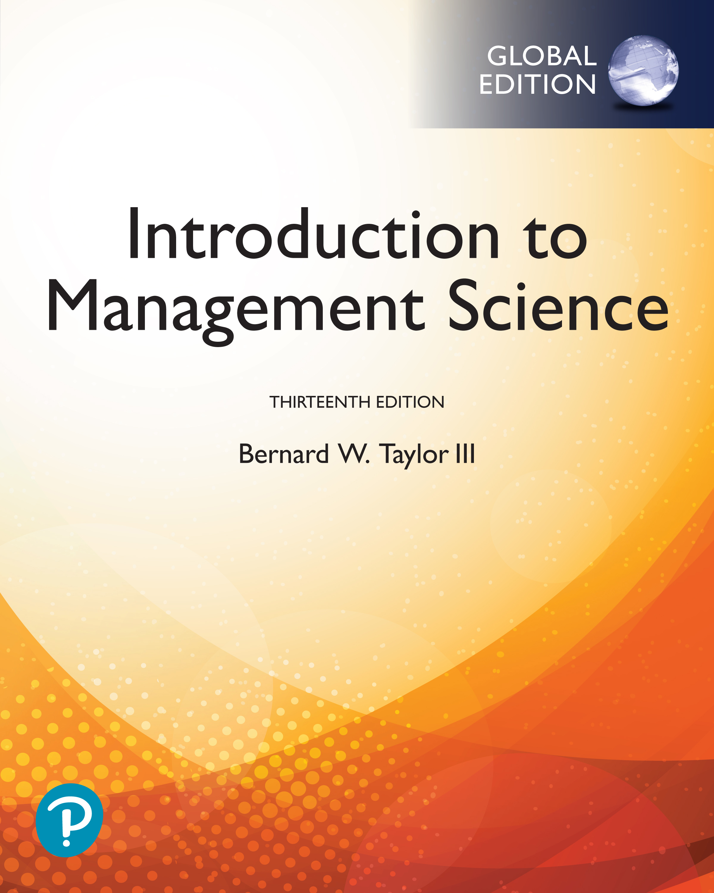
Introduction to Management Science
Thirteenth Edition, Global Edition
Chapter 4
Linear Programming: Modeling Examples
Copyright © 2019 Pearson Education, Ltd. All Rights Reserved
Notes:
If this PowerPoint presentation contains mathematical equations, you may need to check that your computer has the following installed:
1) MathType Plugin
2) Math Player (free versions available)
3) NVDA Reader (free versions available)

Slide 2
Learning Objectives
4.1 A Product Mix Example
4.2 A Diet Example
4.3 An Investment Example
4.4 A Marketing Example
4.5 A Transportation Example
4.6 A Blend Example
4.7 A Multiperiod Scheduling Example
4.8 A Data Envelopment Analysis Example

Slide 3
Learning Objective 4.1
A Product Mix Example

Slide 4
Problem Definition 1
Four-product T-shirt/sweatshirt manufacturing company.
Must complete production within 72 hours
Truck capacity = 1,200 standard sized boxes.
Standard size box holds12 T-shirts.
One-dozen sweatshirts box is three times size of standard box.
$25,000 available for a production run.
500 dozen blank T-shirts and sweatshirts in stock.
How many dozens (boxes) of each type of shirt to produce?

Slide 5
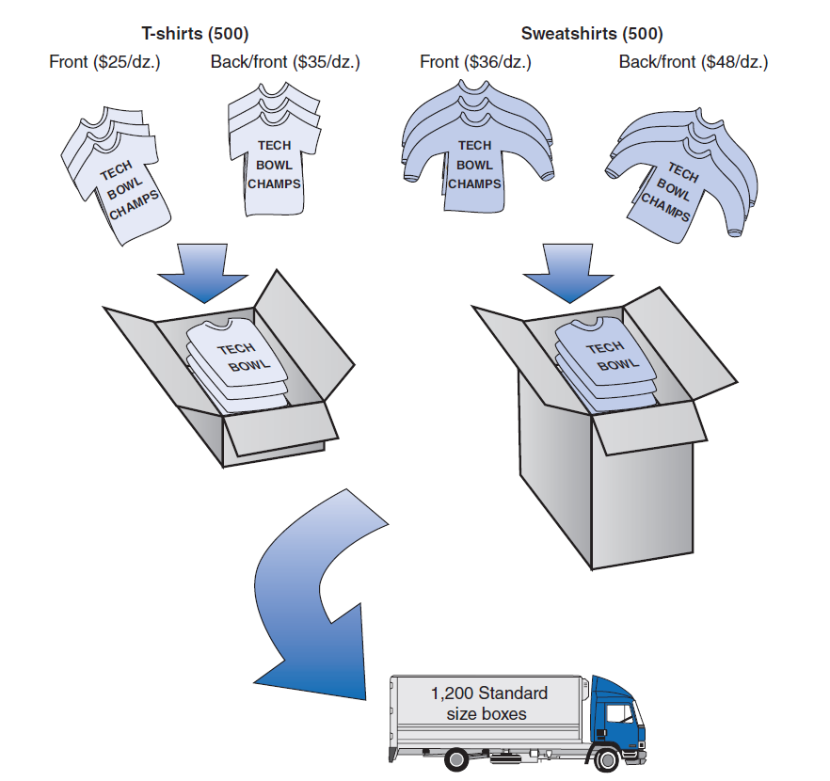
Figure 4.1 Quick-Screen Shirts

Slide 6
Data
Resource requirements for the product mix example.
Blank | Processing Time (hour) per dozen | Cost($) per Dozen | Profit ($) per Dozen
Sweatshirt—F | 0.10 | $36 | $90
Sweatshirt—B/F | 0.25 | 48 | 125
T-shirt—F | 0.08 | 25 | 45
T-shirt—B/F | 0.21 | 35 | 65

Slide 7
Model Construction (1 of 2)
Decision Variables:
x₁ = # of sweatshirts, front printing
x₂ = # of sweatshirts, back and front printing
x₃ = # of T-shirts, front printing
x₄ = # of T-shirts, back and front printing
Objective Function:

Slide 8
Model Construction (2 of 2)
Model Constraints:

Slide 9
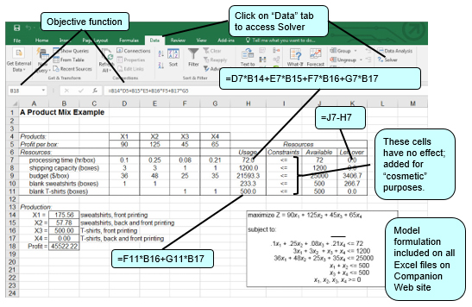
Computer Solution with Excel 1
Exhibit 4.1

Slide 10
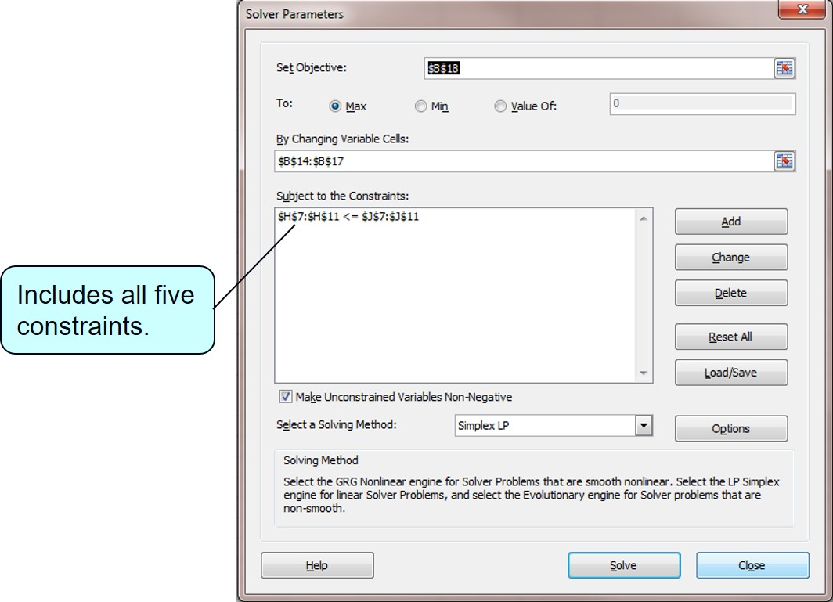
Solution with Excel Solver Window 1
Exhibit 4.2

Slide 11
Solution with Q M for Windows (1 of 2)
Exhibit 4.3
Model solution is:
x₁=175.56 boxes of front-only sweatshirts
x₂=57.78 boxes of front and back sweatshirts
x₃=500 boxes of front-only t-shirts
Z=$45,522.22 profit

Slide 12
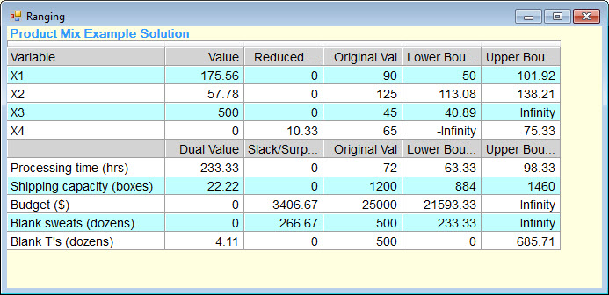
Solution with Q M for Windows (2 of 2)
Exhibit 4.4

Slide 13
Learning Objective 4.2
A Diet Example

Slide 14
Data and Problem Definition 1
Breakfast Food | Calories | Fat (g) | Cholesterol (mg) | Iron (mg) | Calcium (mg) | Protein (g) | Fiber (g) | Cost ($)
1. Bran cereal (cup) | 90 | 0 | 0 | 6 | 20 | 3 | 5 | 0.18
2. Dry cereal (cup) | 110 | 2 | 0 | 4 | 48 | 4 | 2 | 0.22
3. Oatmeal (cup) | 100 | 2 | 0 | 2 | 12 | 5 | 3 | 0.10
4. Oat bran (cup) | 90 | 2 | 0 | 3 | 8 | 6 | 4 | 0.12
5. Egg | 75 | 5 | 270 | 1 | 30 | 7 | 0 | 0.10
6. Bacon (slice) | 35 | 3 | 8 | 0 | 0 | 2 | 0 | 0.09
7. Orange | 65 | 0 | 0 | 1 | 52 | 1 | 1 | 0.40
8. Milk—2% (cup) | 100 | 4 | 12 | 0 | 250 | 9 | 0 | 0.16
9. Orange juice (cup) | 120 | 0 | 0 | 0 | 3 | 1 | 0 | 0.50
10. Wheat toast (slice) | 65 | 1 | 0 | 1 | 26 | 3 | 3 | 0.07
Breakfast to include at least 420 calories, 5 milligrams of iron, 400 milligrams of calcium, 20 grams of protein, 12 grams of fiber, and must have no more than 20 grams of fat and 30 milligrams of cholesterol.

Slide 15
Model Construction – Decision Variables
x₁ = cups of bran cereal
x₂ = cups of dry cereal
x₃ = cups of oatmeal
x₄ = cups of oat bran
x₅ = eggs
x₆ = slices of bacon
x₇ = oranges
x₈ = cups of milk
x₉ = cups of orange juice
x₁₀ = slices of wheat toast

Slide 16
Model Summary 1
subject to:

Slide 17
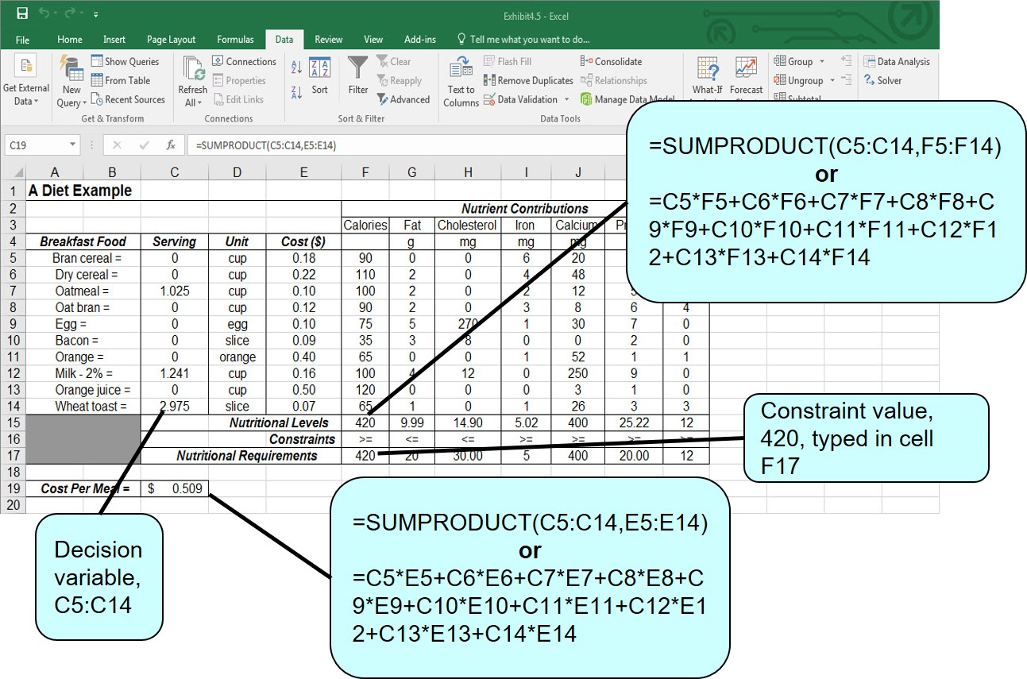
Computer Solution with Excel 2
Exhibit 4.5

Slide 18
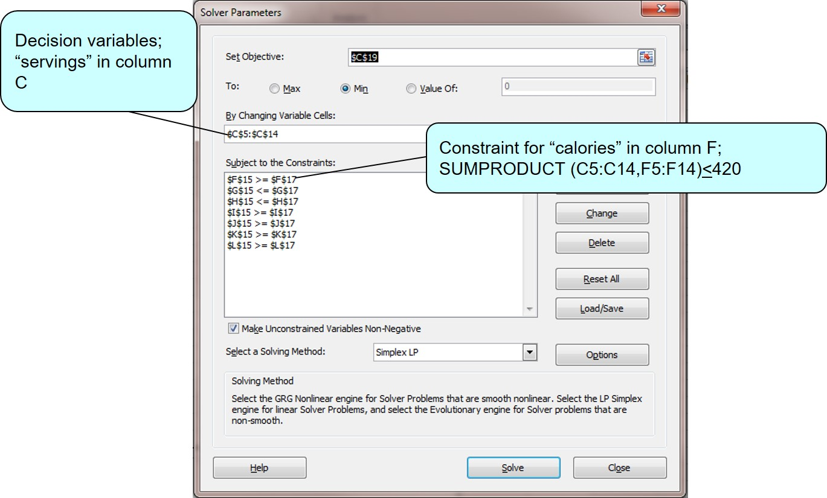
Solution with Excel Solver Window 2
Exhibit 4.6

Slide 19
Learning Objective 4.3
An Investment Example

Slide 20
Model Summary 2 (1 of 2)
An investor has $70,000 to divide among several instruments. Municipal bonds have an 8.5% return, C D’s a 5% return, t-bills a 6.5% return, and growth stock 13%.
The following guidelines have been established:
No more than 20% in municipal bonds
Investment in C D s should not exceed the other three alternatives
At least 30% invested in treasury bills and C D s
More should be invested in C D s and treasury bills than in municipal bonds and growth stocks by a ratio of 1.2 to 1
All $70,000 should be invested.

Slide 21
Model Summary 2 (2 of 2)
subject to:
where
x₁ = amount ($) invested in municipal bonds
x₂ = amount ($) invested in certificates of deposit
x₃ = amount ($) invested in treasury bills
x₄ = amount ($) invested in growth stock fund

Slide 22
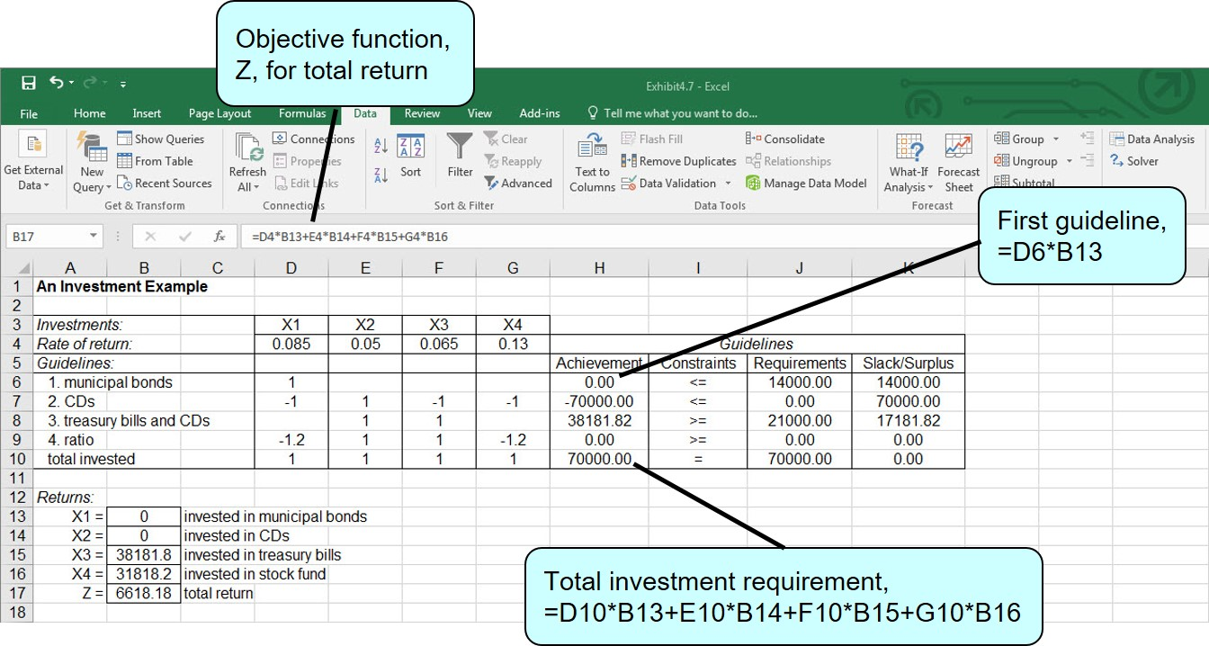
Computer Solution with Excel 3
Exhibit 4.7

Slide 23
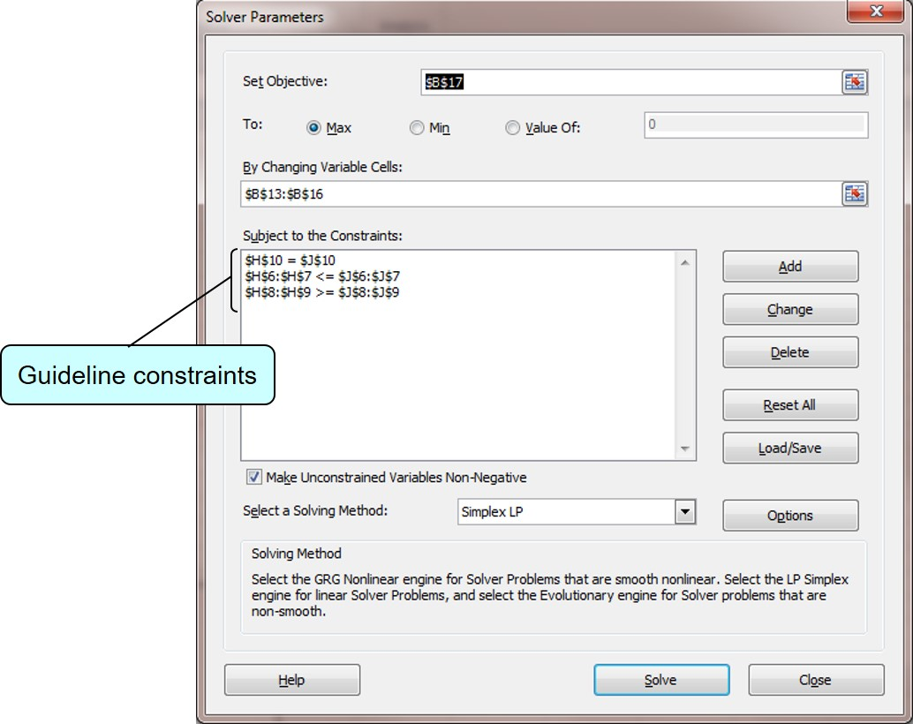
Solution with Excel Solver Window 3
Exhibit 4.8

Slide 24
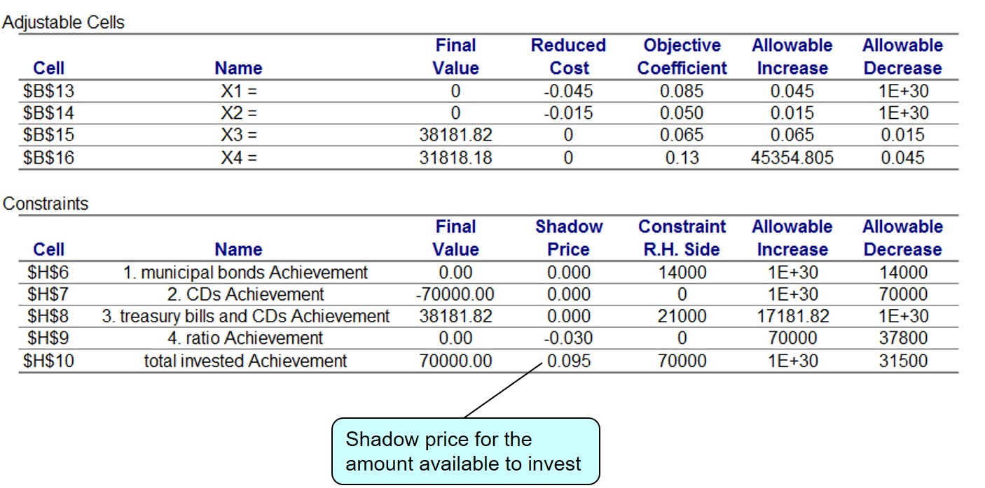
Sensitivity Report 1
Exhibit 4.9

Slide 25
Learning Objective 4.4
A Marketing Example

Slide 26
Data and Problem Definition 2
Blank | Exposure (people/ad or commercial) | Cost
Television commercial | 20,000 | $15,000
Radio commercial | 12,000 | 6,000
Newspaper ad | 9,000 | 4,000
Budget limit $100,000
Television time for four commercials
Radio time for 10 commercials
Newspaper space for 7 ads
Resources for no more than 15 commercials and/or ads

Slide 27
Model Summary 3
subject to:
where
x₁ = number of television commercials
x₂ = number of radio commercials
x₃ = number of newspaper ads

Slide 28
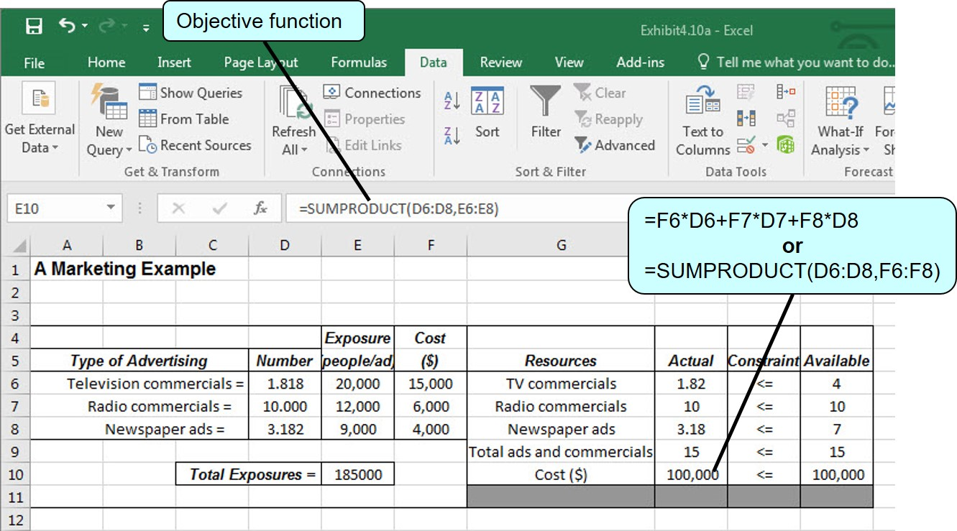
Solution with Excel 1
Exhibit 4.10

Slide 29
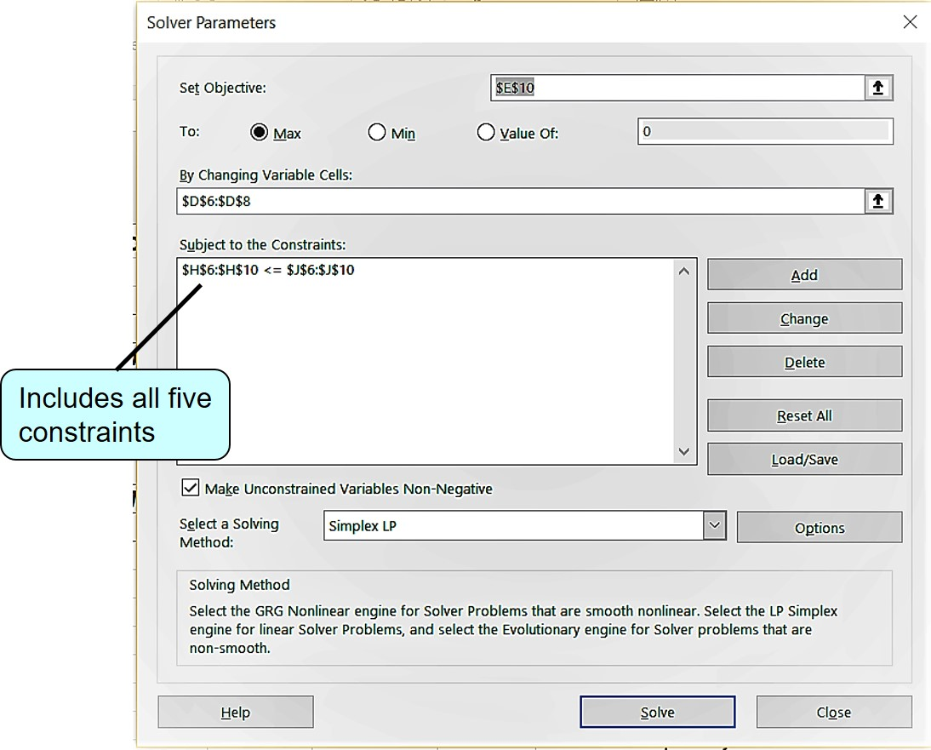
Solution with Excel Solver Window 4
Exhibit 4.11

Slide 30
Integer Solution with Excel (1 of 3)
Exhibit 4.12

Slide 31
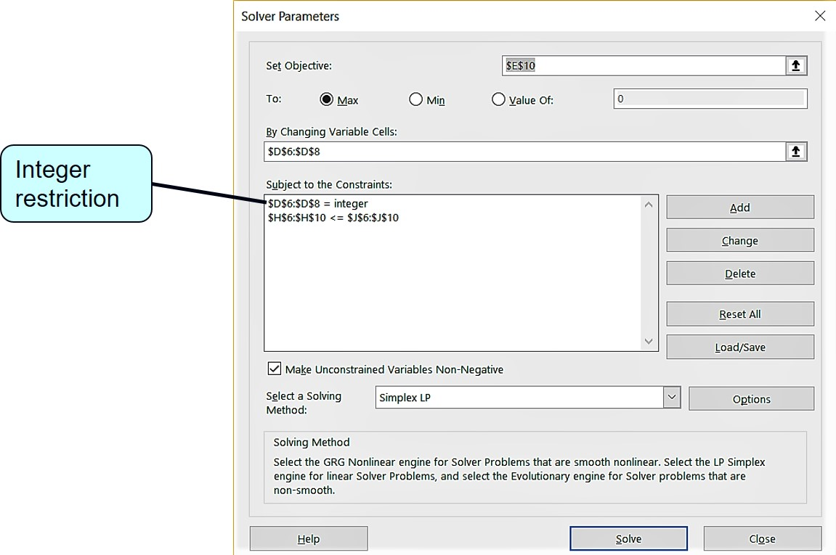
Integer Solution with Excel (2 of 3)
Exhibit 4.13

Slide 32
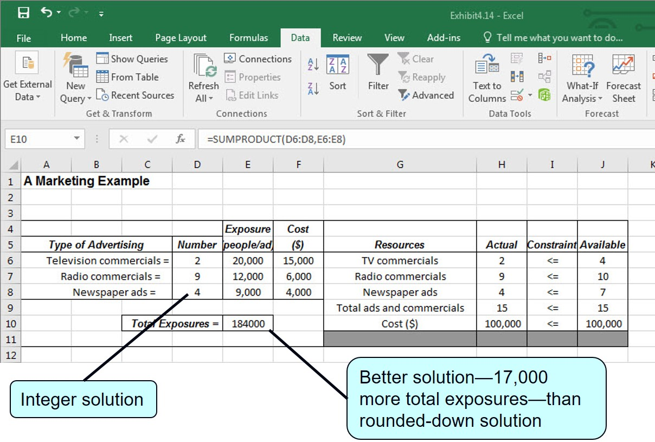
Integer Solution with Excel (3 of 3)
Exhibit 4.14

Slide 33
Learning Objective 4.5
A Transportation Example

Slide 34
Problem Definition and Data 1
Warehouse supply of Television Sets:
Retail store demand for television sets:
1 - Cincinnati | 300
2 - Atlanta | 200
3 - Pittsburgh | 200
Total | 700
A - New York | 150
B - Dallas | 250
C - Detroit | 200
Total | 600
Unit Shipping Costs:
From Warehouse | To Store(A) | To Store(B) | To Store(C)
1 | $16 | $18 | $11
2 | 14 | 12 | 13
3 | 13 | 15 | 17

Slide 35
Model Summary 4
subject to:

Slide 36
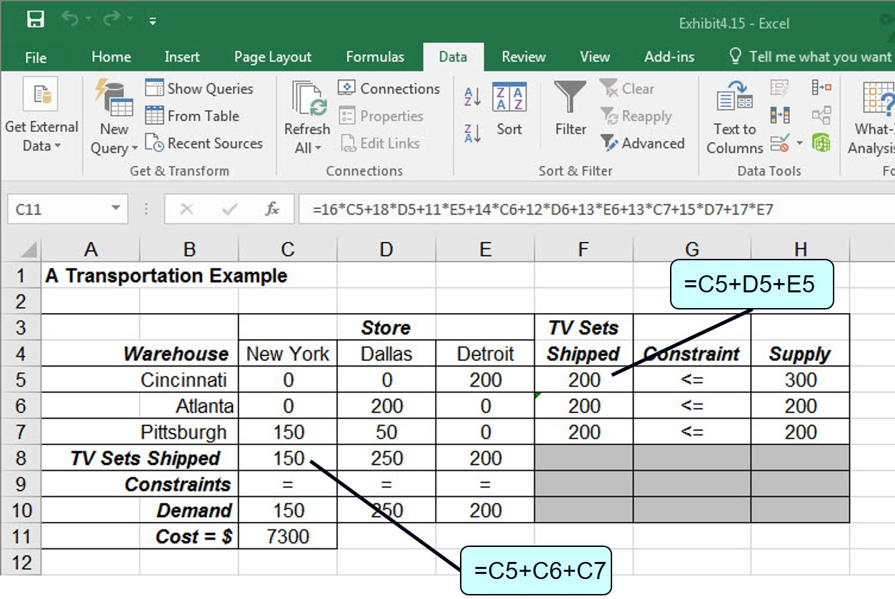
Solution with Excel 2
Exhibit 4.15

Slide 37
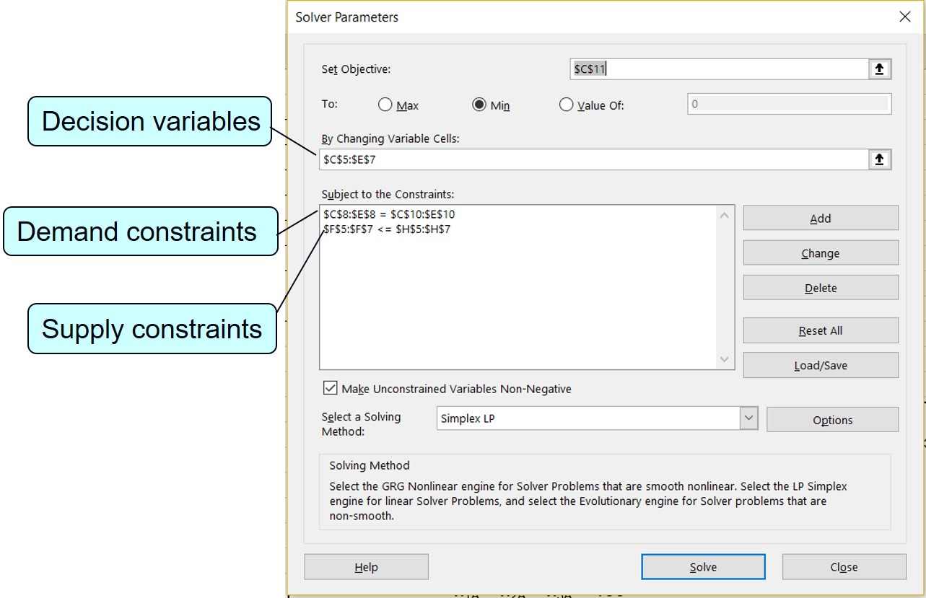
Solution with Solver Window 1
Exhibit 4.16

Slide 38
Learning Objective 4.6
A Blend Example

Slide 39
Problem Definition and Data 2
Component | Maximum Barrels Available/Day | Cost/barrel
1 | 4,500 | $12
2 | 2,700 | $10
3 | 3,500 | $14
Grade | Component Specifications | Selling Price/Barrel
Super | At least 50% of 1 Not more than 30% of 2 | $23
Premium | At least 40% of 1 Not more than 25% of 3 | $20
Extra | At least 60% of 1 At least 10% of 2 | $18

Slide 40
Problem Statement and Variables 1
Determine the optimal mix of the three components in each grade of motor oil that will maximize profit. Company wants to produce at least 3,000 barrels of each grade of motor oil.
Decision variables: The quantity of each of the three components used in each grade of gasoline (9 decision variables); x_{ij} = barrels of component i used in motor oil grade j per day, where i = 1, 2, 3 and j = s (super), p (premium), and e (extra).

Slide 41
Problem Statement and Variables 2
Blend specification constraint for super, which must contain 50% of component 1.
Convert to standard form, a linear function on the left side and numeric value on the right.
Multiply both sides by the denominator and collect terms

Slide 42
Model Summary 5 (1 of 2)
subject to:

Slide 43
Model Summary 5 (2 of 2)

Slide 44
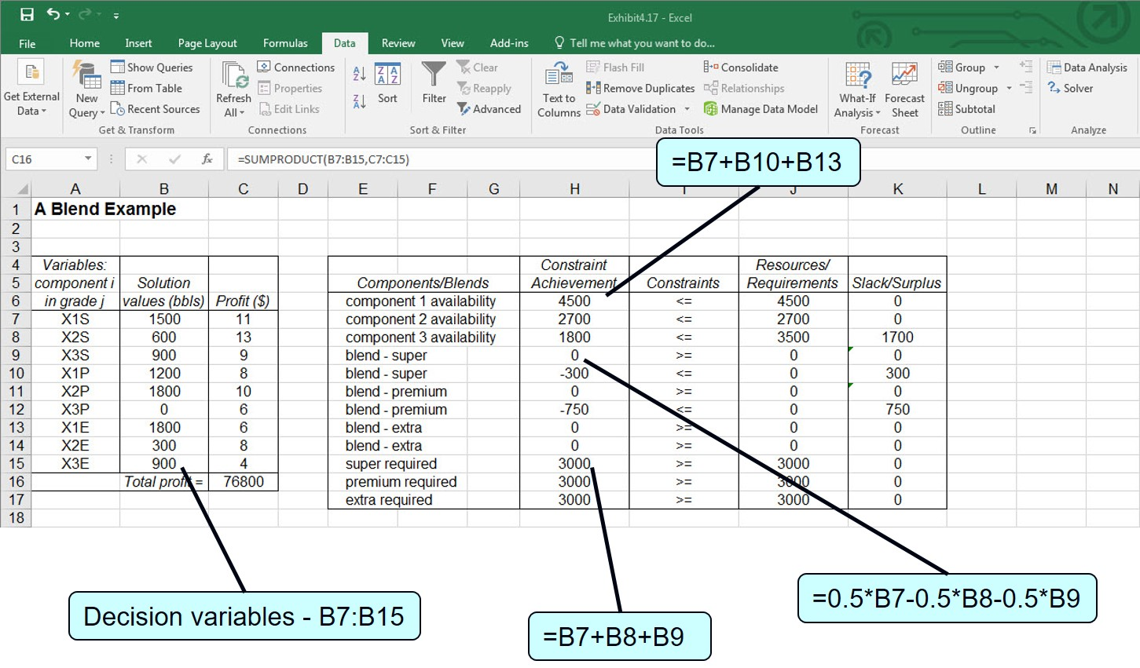
Solution with Excel 3
Exhibit 4.17

Slide 45
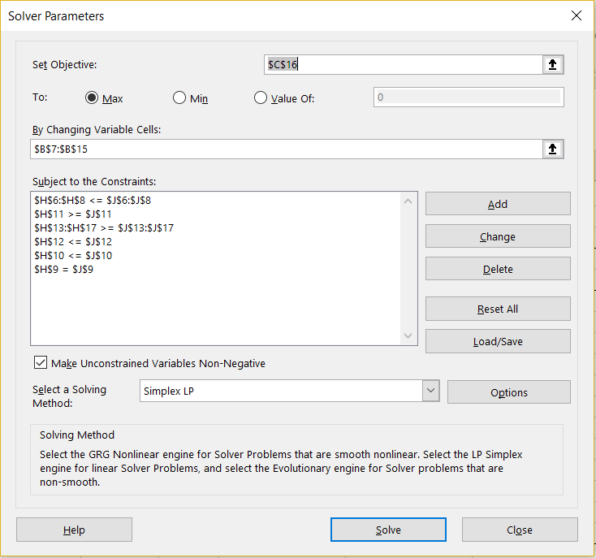
Solution with Solver Window 2
Exhibit 4.18

Slide 46
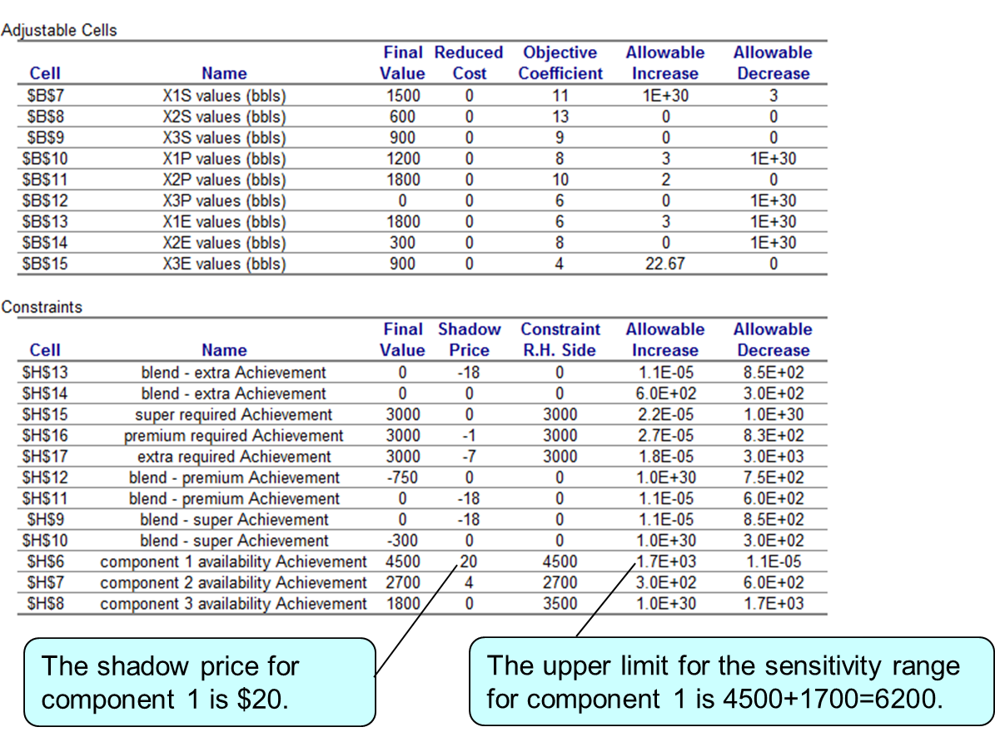
Sensitivity Report 2
Exhibit 4.19

Slide 47
Learning Objective 4.7
A Multiperiod Scheduling Example

Slide 48
Problem Definition and Data 3
Production Capacity: 160 computers per week
50 more computers with overtime
Assembly Costs: $190 per computer regular time;
$260 per computer overtime
Inventory Holding Cost:
Order schedule:
Week | Computer Orders
1 | 105
2 | 170
3 | 230
4 | 180
5 | 150
6 | 250

Slide 49
Decision Variables
Decision Variables:
r_{j} = regular production of computers in week j
(j = 1, 2, …, 6)
o_{j} = overtime production of computers in week j
(j = 1, 2, …, 6)
i_{j} = extra computers carried over as inventory in week j
(j = 1, 2, …, 5)

Slide 50
Model Summary 6
subject to:

Slide 51
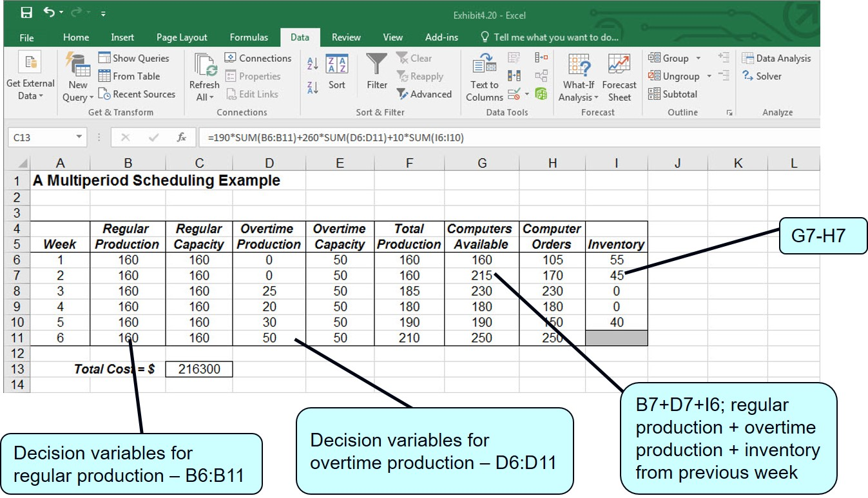
Solution with Excel 4
Exhibit 4.20

Slide 52
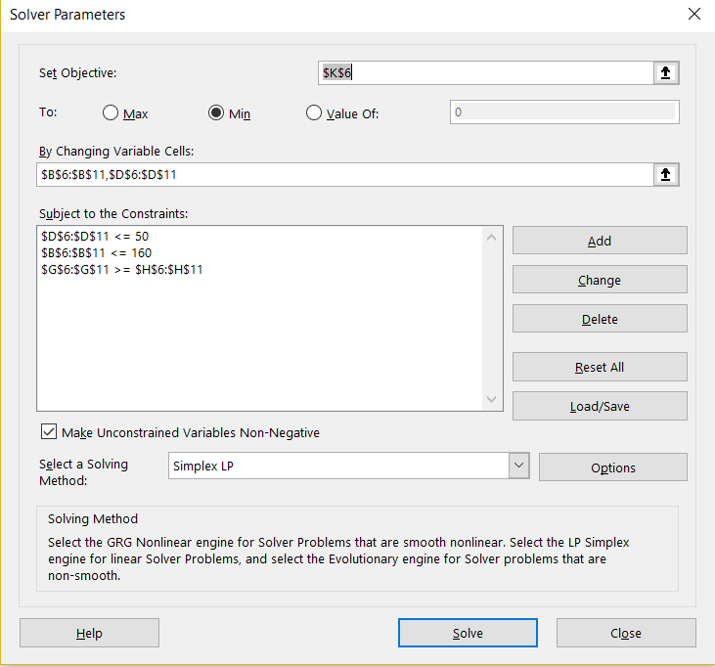
Solution with Solver Window 3 (1 of 3)
Exhibit 4.21

Slide 53
Solution with Solver Window 3 (2 of 3)
r₁=160 computers produced in regular time in week 1
r₂=160 computers produced in regular time in week 2
r₃=160 computers produced in regular time in week 3
r₄=160 computers produced in regular time in week 4
r₅=160 computers produced in regular time in week 5
r₆=160 computers produced in regular time in week 6

Slide 54
Solution with Solver Window 3 (3 of 3)
o₃=25 computers produced with overtime in week 3
o₃=20 computers produced with overtime in week 4
o₃=30 computers produced with overtime in week 5
o₃=50 computers produced with overtime in week 6
i₁=55 computers carried over in inventory in week 1
i₁=45 computers carried over in inventory in week 2
i₁=40 computers carried over in inventory in week 5

Slide 55
Learning Objective 4.8
A Data Envelopment Analysis Example

Slide 56
Problem Definition 2
D E A compares a number of service units of the same type based on their inputs (resources) and outputs. The result indicates if a particular unit is less productive, or efficient, than other units.
Elementary school comparison:
Input 1 = teacher to student ratio
Input 2 = supplementary funds/student
Input 3 = average educational level of parents
Output 1 = average reading S O L score
Output 2 = average math S O L score
Output 3 = average history S O L score

Slide 57
Problem Data Summary
School | Input 1 | Input 2 | Input 3 | Output 1 | Output 2 | Output 3
Alton | .06 | $260 | 11.3 | 86 | 75 | 71
Beeks | .05 | 320 | 10.5 | 82 | 72 | 67
Carey | .08 | 340 | 12.0 | 81 | 79 | 80
Delancey | .06 | 460 | 13.1 | 81 | 73 | 69

Slide 58
Decision Variables and Model Summary
Decision Variables:
x_{i} = a price per unit of each output where i = 1, 2, 3 y_{i} = a price per unit of each input where i = 1, 2, 3
Model Summary:
subject to:

Slide 59
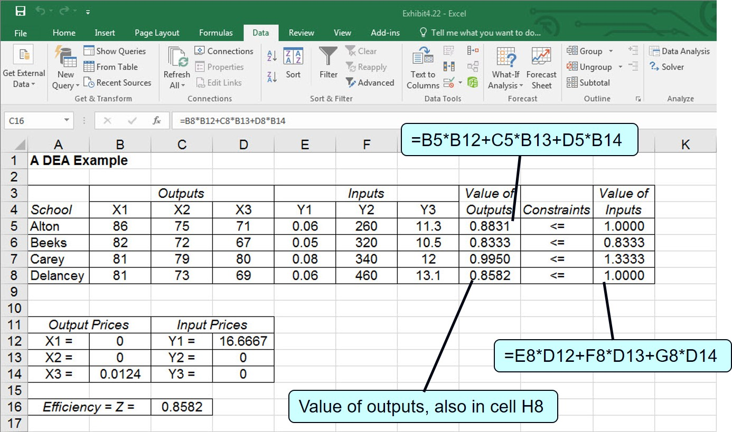
Solution with Excel 5
Exhibit 4.22

Slide 60
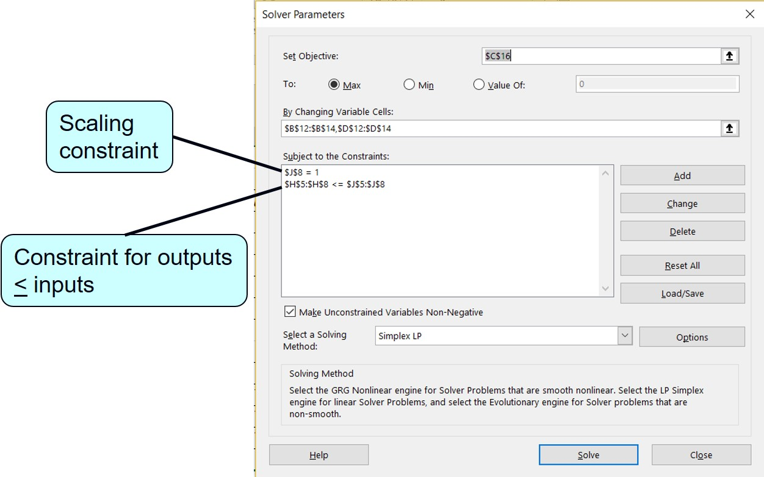
Solution with Solver Window 4
Exhibit 4.23

Slide 61
Example Problem Solution: Problem Statement and Data
Canned cat food, Meow Chow; dog food, Bow Chow.
Ingredients/week: 600 lb. horse meat; 800 lb. fish; 1,000 lb. cereal.
Recipe requirement: Meow Chow at least half fish
Bow Chow at least half horse meat.
2,250 sixteen-ounce cans available each week.
Profit /can: Meow Chow $0.80
Bow Chow $0.96.
How many cans of Bow Chow and Meow Chow should be produced each week in order to maximize profit?

Slide 62
Example Problem Solution: Model Formulation (1 of 3)
Step 1: Define the Decision Variables
x_{ij} = ounces of ingredient i in pet food j per week,
where i = h (horse meat), f (fish) and c (cereal),
and j = m (Meow chow) and b (Bow Chow).
Step 2: Formulate the Objective Function

Slide 63
Example Problem Solution: Model Formulation (2 of 3)
Step 3: Formulate the Model Constraints
Amount of each ingredient available each week:
Recipe requirements:

Slide 64
Example Problem Solution: Model Formulation (3 of 3)
Step 4: Model Summary
subject to:

Slide 65
Example Problem Solution: Solution with Q M for Windows (1 of 2)
Solution to the Bark’s Pet Food Company problem using Q M for Windows. To determine the number of cans of each flavor, we must sum the ingredient amounts for each and divide by 16 ounces (the size of a can).

Slide 66
Example Problem Solution: Solution with Q M for Windows (2 of 2)
of Meow Chow
= 1,050 cans of Meow Chow
of Bow Chow
= 1,200 cans of Bow Chow
Note that there are multiple optimal solutions to this model.

