Slide 1
“TaqMan genotyping Assay’’
Dr. Reddy
Genome Research Chair
nparine@ksu.edu.sa
‘‘5’-nuclease Allelic Discrimination Assay’’

Slide 2
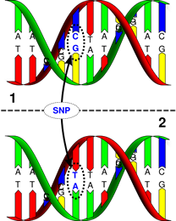
SNPs - Introduction
Single Nucleotide Polymorphism
Occurs once in human evolution
Estimate of 1 bp in 600 – 1000 bp
Occur mostly in introns (2/3)
Regulatory regions, leading to cancer
Often lethal when in exons (1/3)
Leading to a fatal amino acid substitution

Slide 3
What are Single Nucleotide Polymorphisms (SNPs)
ATGGTAAGCCTGAGCTGACTTAGCGT-AT
ATGGTAAACCTGAGTTGACTTAGCGTCAT
↑ ↑
SNP SNP
SNPs result from replication errors and DNA damage

Slide 4
Why are ‘SNP’ Polymorphisms Useful?
It’s sometimes possible to correlate a SNP with a particular trait or disease
This is known as association genetics
Susceptibility to disease may also be described as an ‘unfortunate trait’
SNPs in (regulatory) introgenic regions may be as important as (coding) exons

Slide 5
Disease resistant population
Disease susceptible population
Genotype all individuals for thousands of SNPs
ATGATTATAG
geneX
ATGTTTATAG
Resistant people all have an ‘A’ at position 4 in geneX,
while susceptible people have a ‘T’ (A/T are the SNPs)

Slide 6
SNP Applications in Medicine
Gene discovery and allele mapping
Association-based (drug) candidate
polymorphism testing of a trait pool
Diagnostics / risk profiling
Drug response prediction
Homogeneity testing / study design
Gene function identification

Slide 7
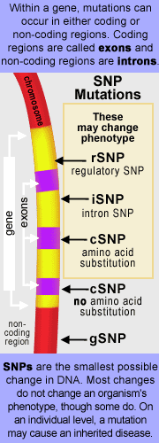
Coding Region SNPs
Types of coding region SNPs:
Synonymous: the substitution causes no amino acid change to the protein it produces. This is also called a silent mutation.
Non-Synonymous: the substitution results in an alteration of the encoded amino acid. A missense mutation changes the protein by causing a change of codon. A nonsense mutation results in a misplaced termination.
One half of all coding sequence SNPs result in non-synonymous codon changes.

Slide 8
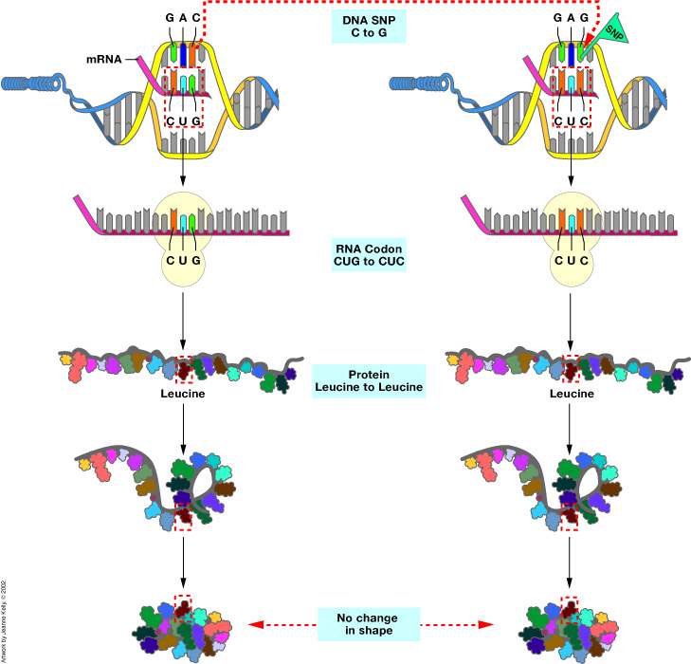
SNPs and Protein Structure

Slide 9
Why Create SNP Profiles?
Genome of each individual contains a distinct SNP pattern (haplotype block).
People can be grouped based on their SNP profiles (association studies).
SNP profiles may be important for identifying response to drug therapy.
Correlations might emerge between certain SNP profiles and specific responses to treatment (good and bad).

Slide 10
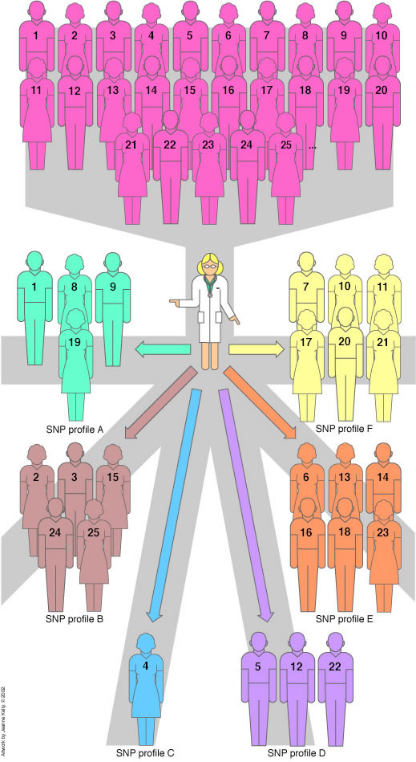
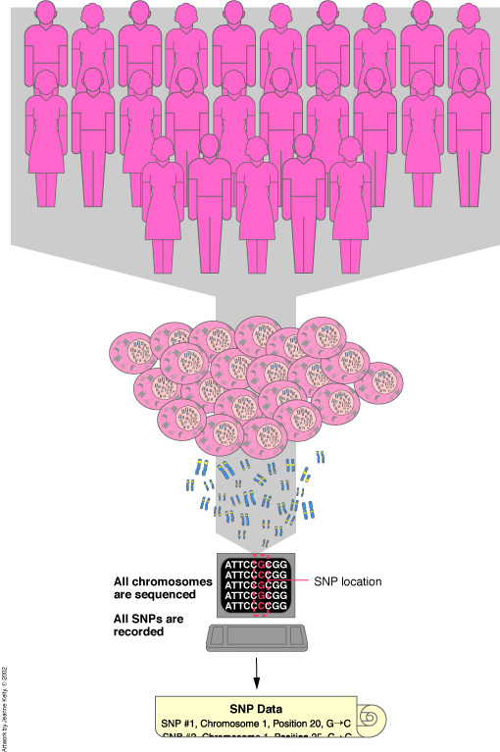
Populations Based on SNPs

Slide 11
TaqMan SNP Genotyping Assays Protocol

Slide 12
What’s the procedure
Require only three components:
– 1 to 20 ng of purified gDNA sample per well
– 20✕, 40✕, or 80✕ SNP Genotyping Assay (depending on
product and assay scale)
– TaqMan® Universal PCR Master
Two TaqMan® MGB probes:
–One probe labeled with VIC® dye detects the Allele 1 sequence
–One probe labeled with FAM™ dye detects the Allele 2 sequence
TaqMan minor groove binder (MGB) probes

Slide 13
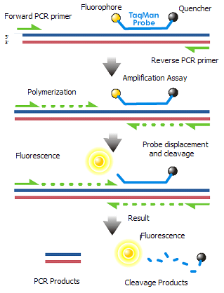
Biallelic SNP is located in the middle third of the probe
Each allele-specific is labeled with a fluorescent reporter dye a FAM or a VIC (reporte molecule) at 5’ and is attached with a fluorescence quencher at 3’ end.
a probe specifically binds with its target
Taq DNA polymerase cleaves the reporter dye (FAM or VIC) from an probe that is completely hybridized to the DNA strand
Taq DNA polymerase encounters a probe at its target and unwinds it and cleaves the partially unwound probe and liberates the reporter fluor from the quencher
For the intact probe, the reporter dye is
Quenched (no fluorescence)
Principle

Slide 14
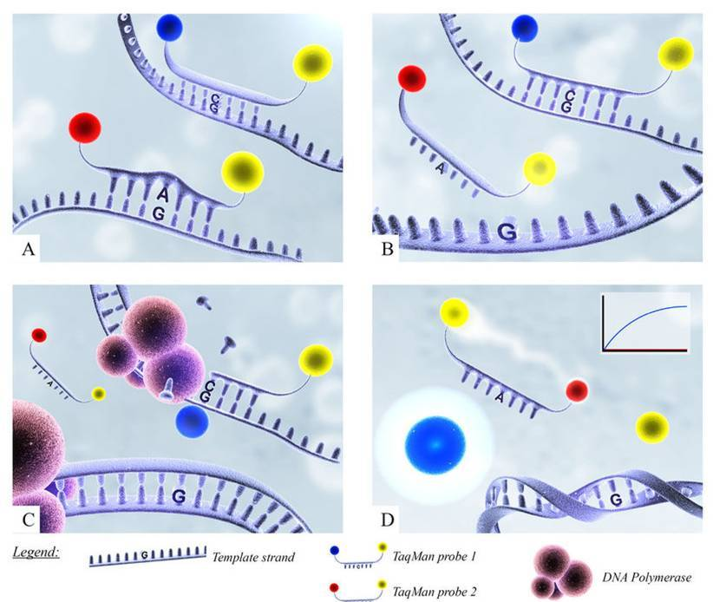
An increase in either FAM or VIC dye fluorescence indicates homozygosity for FAM- or VIC specific alleles (X:X or Y:Y)
An increase in the fluorescence of both dyes indicates heterozygosity (X:Y)

Slide 15
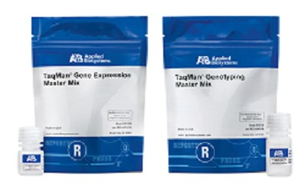
Preparation
Recommended:
TaqMan Universal PCR Master Mix (2✕) : 12.50
20✕ SNP Genotyping assay : 1.25
Total Volume per Well : 13.75
Standardized:
TaqMan Universal PCR Master Mix (2✕) : 5.6
20✕ SNP Genotyping assay : 0.28
DNAse free water : 3.12
Total Volume per Well : 9
protected from light

Slide 16
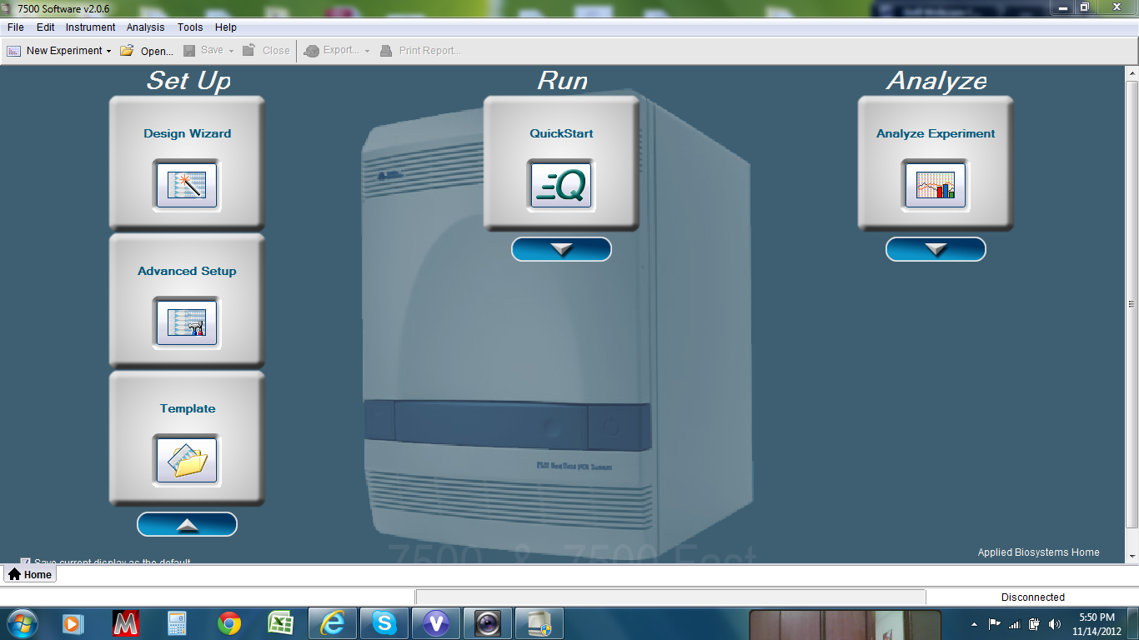

Slide 17
Conditions
Time | Temp | Step | Cycles
10 min | 95 C | Hold (enzyme activation)
15 sec | 92 C | Denatuaration (DNA) | 40 Cycles
1 min | 60 | Anneal/Extension

Slide 18
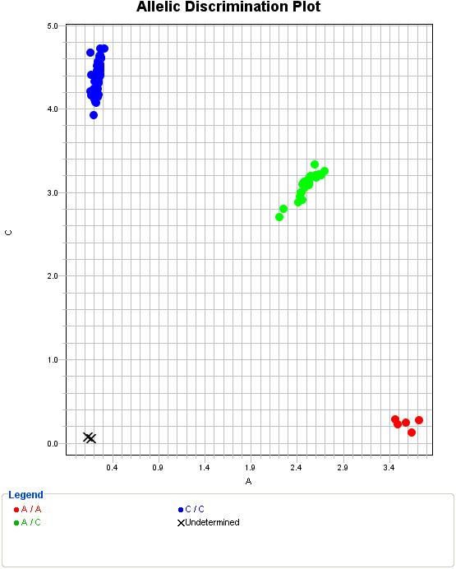
TAQMAN Genotyping assay
BB- Homozygous
AB- Heterozygous
AA- Homozygous

Slide 19
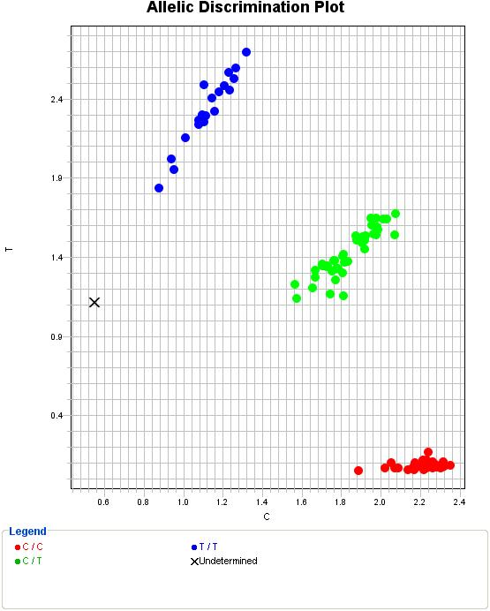
Based on amplification
and copy number

Slide 20
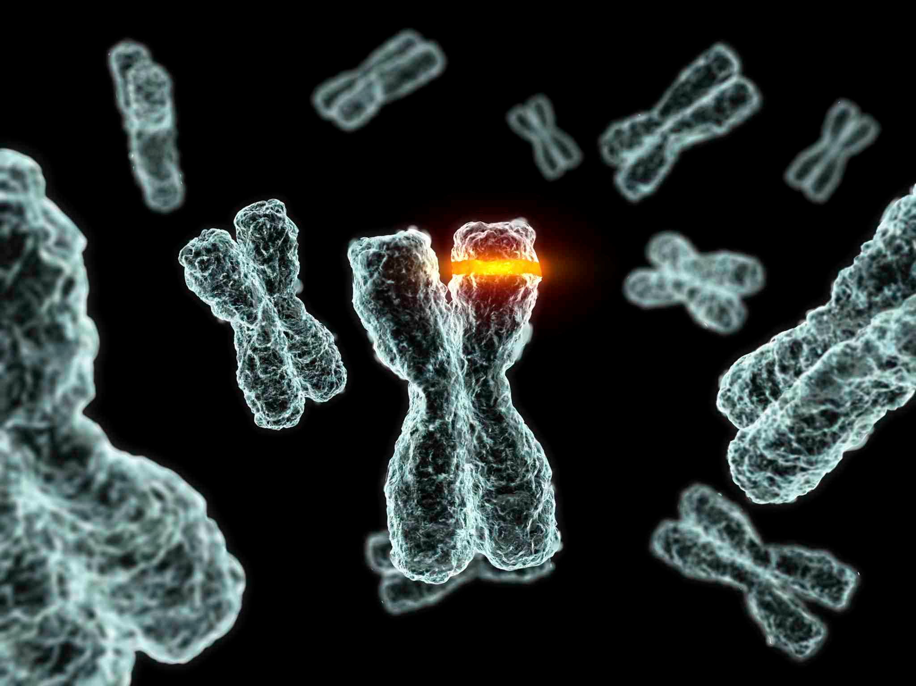
Thank you

