Slide 1
History Taking
Prepared by T/ Nawal Alsulami

Slide 2
Information about a child is elicited for several reasons
1- To establish relationship with a child and family.
2- To assess what a family understands about their child health.
3- To formulate an individual plan of care.
4- To correct any misinformation the family may have.

Slide 3
IDENTIFYING INFORMATION
Type of information needed
1. Date and time.
2. Hospital name, registration number and tele-
phone number, if known.
3. Patient's name, address, telephone number,
birth date.
4. Referring agency, general practitioner, accident
and emergency

Slide 4
Method of recording
Write an exact description of the concern.
Quotation of the parent's or care person's exact
Words.

Slide 5
1_ Begin with a helpful open-ended question. That
is the first overture made to dis patient.
a. 'How may I help you? '
b. 'Please tell me the reason for your coming
here today.'
c. 'What do you think is wrong with the baby? '
2_ Avoid confusing questions that may elicit funny-
sounding or 'smart' answers.
a. 'What brings you here?' (Answer: 'The bus.')
b. ' 'Why are you here'?' ('That's what I came to
find out.')

Slide 6
Chife complaint
A Chief complaint is the medical term used to describe the primary problem of the patient that led the patient to seek medical attention and of which they are most concerned.

Slide 7
HISTORY OF PRESENT ILLNESS
1. Body location - of pain, itching, weakness, etc.
2. Quality of complaint - both type (a burning pain)
and severity (knife-like, comes and goes).
3. Degree of symptom - e.g., pain, how severe,
cough, day and night; eye drainage, how much.
4. Chronology - indicate time sequence and whether
problem is episodic (lasts for a while and then
clears up completely).
5. Environment or setting - where and when the
symptoms occur,
6. Aggravating and alleviating factors ... what
makes the pain worse or better?
7. Associated manifestations or symptoms accompanied by vomiting, blurred vision, etc.

Slide 8
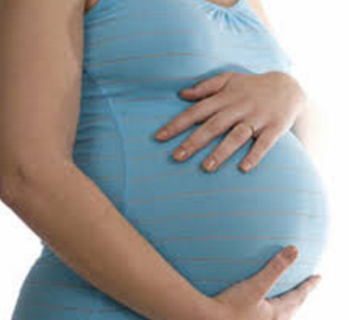
PAST HISTORY
Antenatal
Pregnancy
'Were there any unusual problems related to
your Pregnancy or delivery? '
2. Maternal health .- includes illnesses and dates,
abnormal symptoms (e.g., fever, rash, vaginal
bleeding, edema, hypertension, urine abnor-
malities, sexually transmitted disease). Any
family history of diabetes, tuberculosis.

Slide 9
3-Medicines taken - e.g. vitamins, iron, calcium,
aspirin, cold preparations, tranquillizes (nerve
medicine), antibiotics; use of ointments, hor-
mones, injections during pregnancy, special or
unusual diet, radiation exposure, stenography,
amniocentesis.

Slide 10
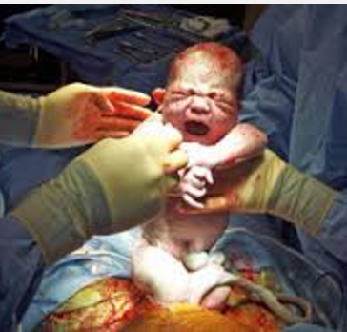
Birth details
1. Expected date of delivery.
2. Place of delivery.
3.Labour _ spontaneous or induced; duration and
intensity.
4. Analgesia or anesthesia.
5. Presentation - vaginal, breech, or vertex, caesarean
delivery, forceps.
6. Episiotomy.
7. Complications (e.g., need for blood transfusion
delay in delivery, etc.).

Slide 11
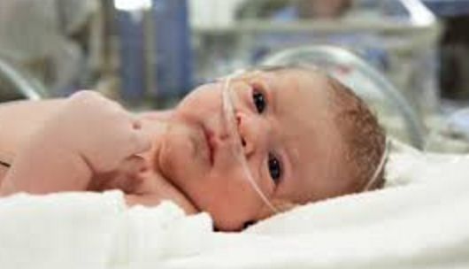
Neonatal
1. Condition of infant.
2. Colour (if seen) at delivery,
3. Activity of infant.
4. Crying heard.
5. Breathing abnormality.
6. Birth weight and length.
7. Problems occurring

Slide 12
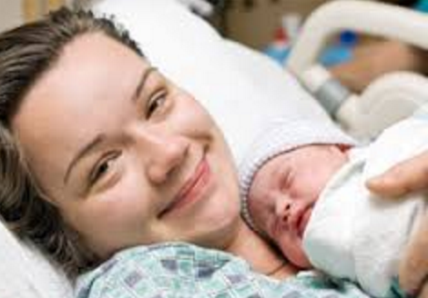
Postnatal
1. Duration of hospitalization of the mother and
infant.
2. Problems with baby' s breathing or feeding.
3. Need of supportive care (e.g., oxygen, incubator,
special care nursery, isolation, medications).
4. Weight changes, weight at discharge if known.
5. Colour - cyanosis or jaundice.
6. Bowel movements _ when
7. Problems-seizures, d formities.

Slide 13
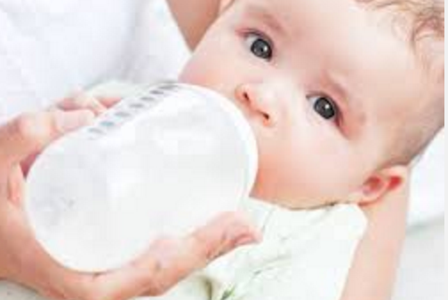
Nutrition
1-Breast or bottle-fed; what formula?
2. Amounts offered and consumed.
3. Frequency of feeding; weight gain.
4. Addition of juice and/or solid foods.
5. Food preferences or allergies.
6. Feeding problems - variations in appetite.
7. Age of weaning.
8. Vitamins - type, amount, regularity.
9. Pattern of weight gain.
10. Current diet; frequency and content of meals.

Slide 14
Growth and development
1. Past weights and lengths if available.
2. Milestones - sat alone unsupported; walked
alone; used words, then sentences.
3. Teeth -eruption, difficulty, cavities.
4. Toilet training.
5. Current motor, social, and language skills.

Slide 15
Health maintenance
1.Immunizations rubella, measles, mumps,
polio, diphtheria, pertussis, tetanus toroid,
Bacillus of Calmette-Guérin (BCG). Indicate
number and dates.
2. Screening procedures - tuberculin testing; visual
and auditory acuity; Guthrie test.
3. Name of health visitor, if known.
4. Dental care - source and frequency of care,
fillings or extractions.

Slide 16
Acute infectious diseases
Rubella, measles, mumps, chickenpox, scarlet fever,
rheumatic fever, hepatitis, infectious mononucleo-
sis, sexually transmitted disease, tuberculosis.
Recent exposure to communicable disease.

Slide 17
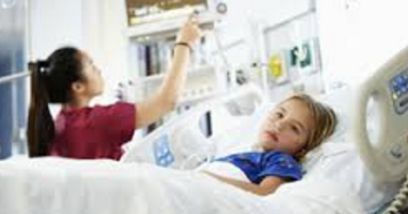
Hospitalizations and operations
1. Dates, hospital.
2. Indications, diagnosis, procedures.
3. Complications.

Slide 18
Injuries
1. Accident and emergency department visits
frequency and diagnosis.
2. Fractures - location and treatment.
3. Trauma, burns, bruises.
4. Ingestions.

Slide 19
Medications
1. For general use such as vitamins, antihistamines,
laxatives.
2. Special diets.
3. Recent antibiotics.
4. Routine use of aspirin.
5. Oral contraceptives - types and dose, duration.

