Slide 1
Tablets coating

Slide 2
Reasons for coating: (WHY? Coating)
1- Protection of the drug from the surrounding (environment) (air, light and moisture) and thus improve stability.
2- Modifying drug release, as in enteric coating and extended-release formulation.
3- Masking unpleasant taste or odour of the drug.
4- Improving product appearance and helping in brand identification.
5- Facilitating rapid identification by the manufacturer, the pharmacist and the patient (mostly colored).
6- Increasing the mechanical strength of the product.
7- Masking batch differences in the appearance of raw materials.
• To minimise irritation of the oesophagus and stomach.
• Minimise inactivation in the stomach.
• Improve drug effectiveness.
• Improve patient compliance e.g. easier to swallow, masks unpleasant taste.
Therapy
• Minimise dust formation and contamination with respect to tablets.
• Masks batch differences in the appearance of raw materials.
• Facilitates their handling on high speed automated filling and packaging equipment.
• Improves drug stability e.g. Protection of active ingredient
from environment such as sunlight, moisture.
Technology

Slide 3
• Aid sales appeal as improved appearance and acceptability with respect to gloss and colouration.
• Mask unpleasant taste.
• Improve product identity.
Marketing
Definition
• Coated tablets are defined as tablets covered with one or more layers of mixture of
various substances with the intention of (adding) conferring benefits and properties to the dosage form over the uncoated one.
Types of coating processes:
Three main types are used in the pharmaceutical industry
today;
- Film coating
- Sugar coating
- Compression coating
- Gelatin coating (not common)

Slide 4
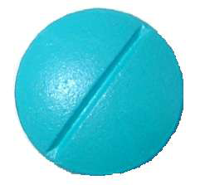
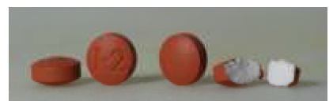
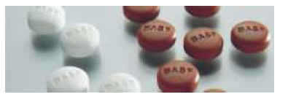
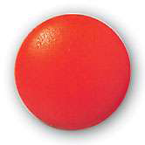
1- Film coating (the most popular today)
It involves the deposition, usually by spraying method, of a thin uniform film of a polymer formulation surrounding a tablet.
2- Sugar coating (traditional)
It involves successive application of sucrose-based coating formulations to tablet cores, in suitable coating equipment. Water evaporates from the syrup leaving a thick sugar layer around each tablet. Sugar coats are often shiny and highly colored.
Traditionally sugar coatings formed the bulk of coated tablets but today film coatings are the more modern technology in tablet coating.
• Description of tablets: Smooth, rounded and polished to a high gloss.
• Process: Multistage process involving 6 separate operations.

Slide 5
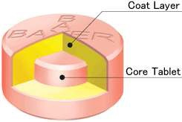
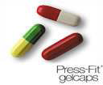
3- Compression coating (less popular)
Although less popular, it gained increased interest in the recent years for creating modified released products. It involves the compaction of granular materials around a preformed tablet core using specially designed tableting equipment. Compression coating is a dry process.
4- Gelatin-coated tablets
The innovator product, the gelcap, is a capsule shaped compressed tablet coated with gelatin layer.

Slide 6
1- Film coating
It involves the deposition, usually by spraying method, of a thin uniform film of a polymer formulation surrounding a tablet.
Types of film coating:
1- Immediate-release (non-functional) film coating:
They do not affect the biopharmaceutical properties of the tablet. They are readily soluble in water.
2- Modified-release (functional) film coating:
They allow the drug to be delivered in a specific manner; i.e. they affect drug release behavior. Modified release film coatings are sub-classified into;
- Delayed-release coating (enteric coating)
- Extended-release coating

Slide 7
Film coating
• Modern approach to coating tablets, capsules, or pellets by surrounding them with a thin layer of polymeric material.
• Description of tablets: Shape dictated by contour of original core.
• Process: Single stage process, which involves spraying a coating solution containing the following;
1. Polymer
2. Solvent
3. Plasticizer
4. Colourant
The solution is sprayed onto a rotating tablet bed followed by drying, which facilitates the removal of the solvent leaving behind the deposition of thin film of coating materials around each tablet.
Advantages
Produce tablets in a single step process in relatively short period of time. Process enables functional coatings to be incorporated into the dosage form.
Disadvantages
There are environmental and safety implications of using organic solvents as well as their financial expense.

Slide 10
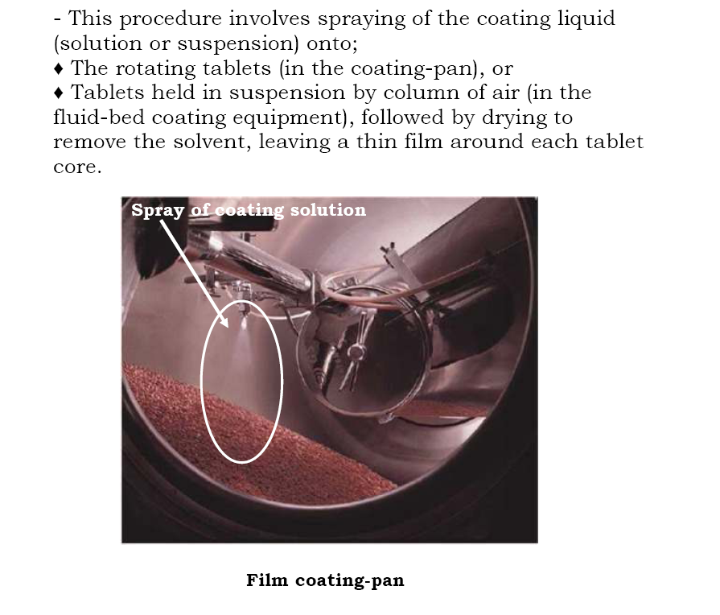
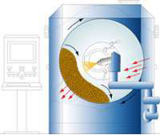
Accela Cota

Slide 14
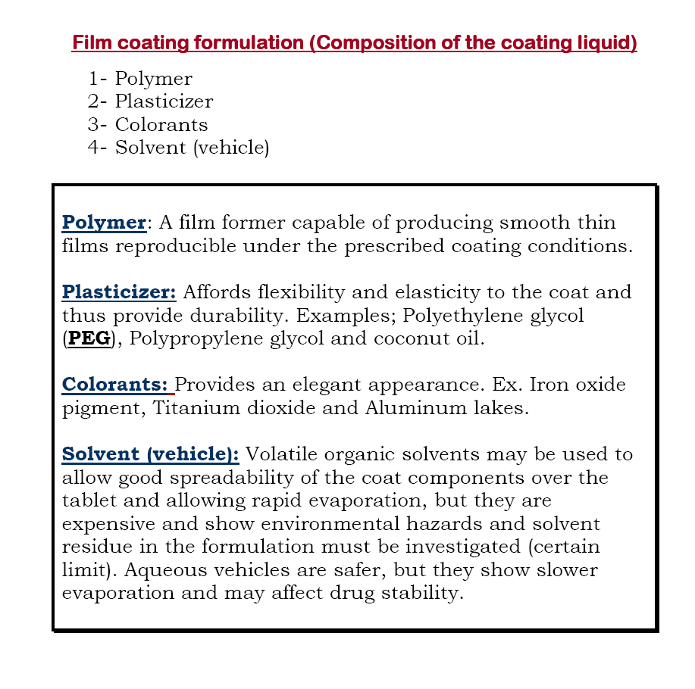

Slide 15
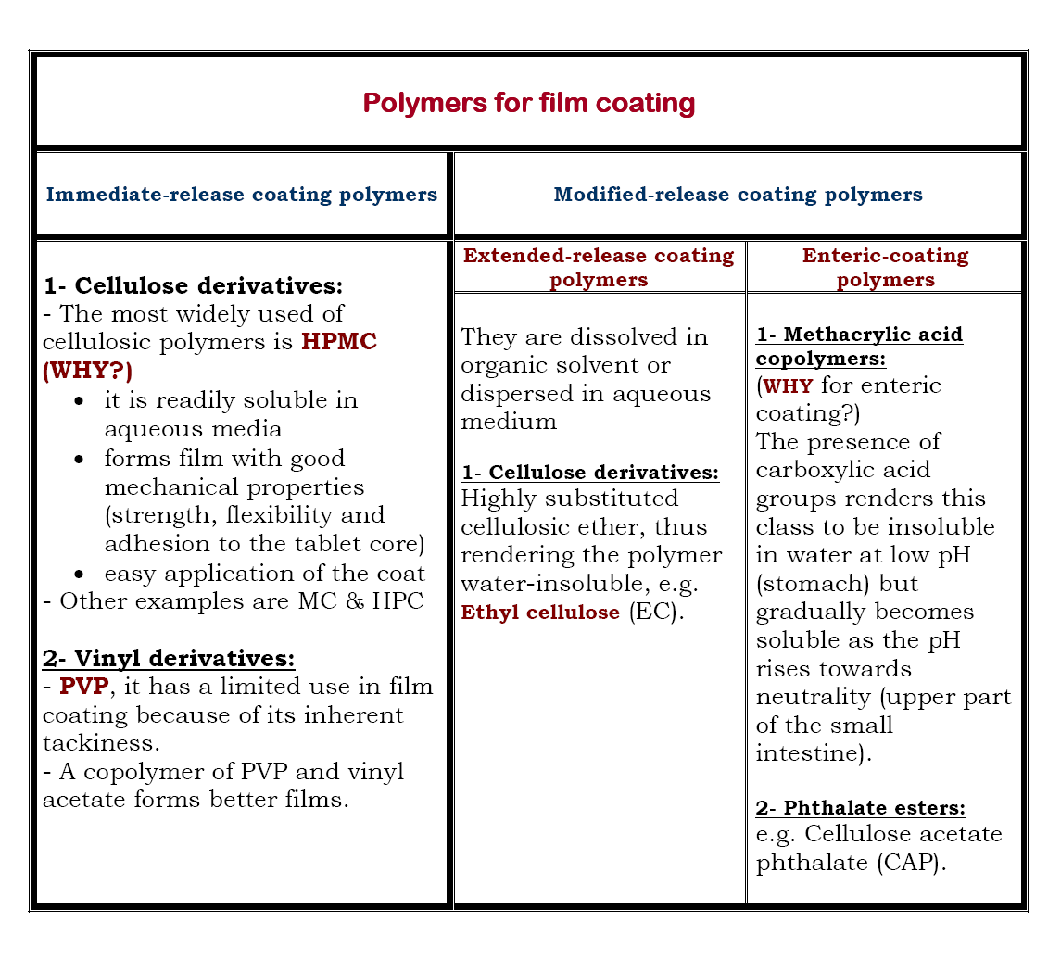

Slide 20
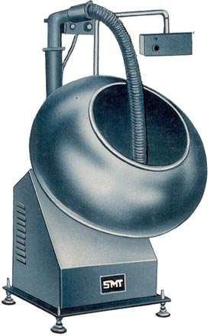
Multistage process
1. Sealing tablet core- application of a water impermeable polymer such as Shellac, cellulose acetate phthalate and polyvinyl acetate phthalate, which protects the core from moisture, increasing its shelf life.
2. Sub coating -by adding bulking agents such as calcium carbonate or talc in combination with sucrose solution.
3. Smoothing process -remove rough layers formed in step 2 with the application of sucrose syrup.
4. Colouring - for aesthetic purposes often titanium based pigments are included.
5. Polishing - effectively polished to give characteristic shine, commonly using beeswax, carnauba wax.
6. Printing -permanent ink for characterization.
Sugar coating Pans (drum coating)

Slide 21
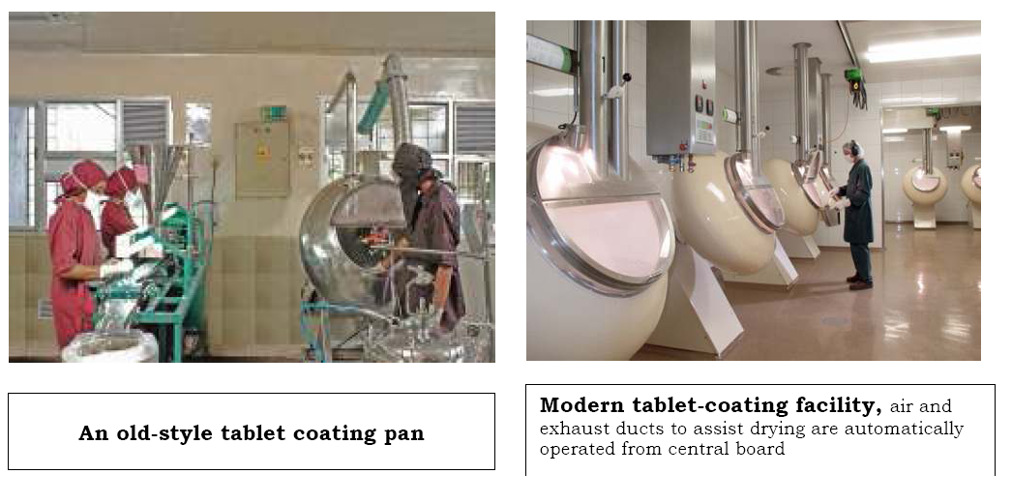

Slide 22
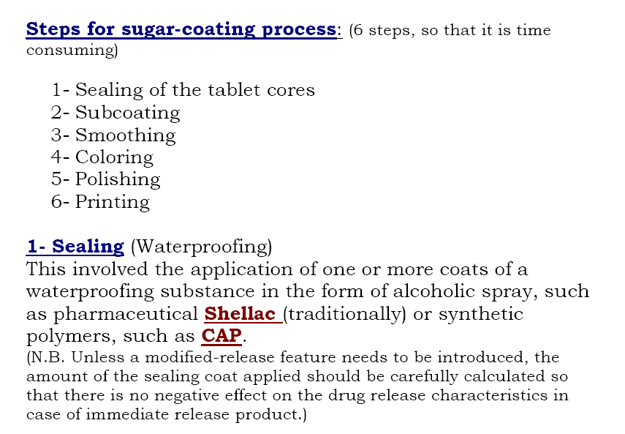
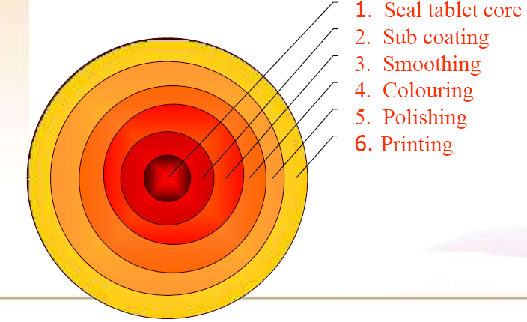

Slide 25
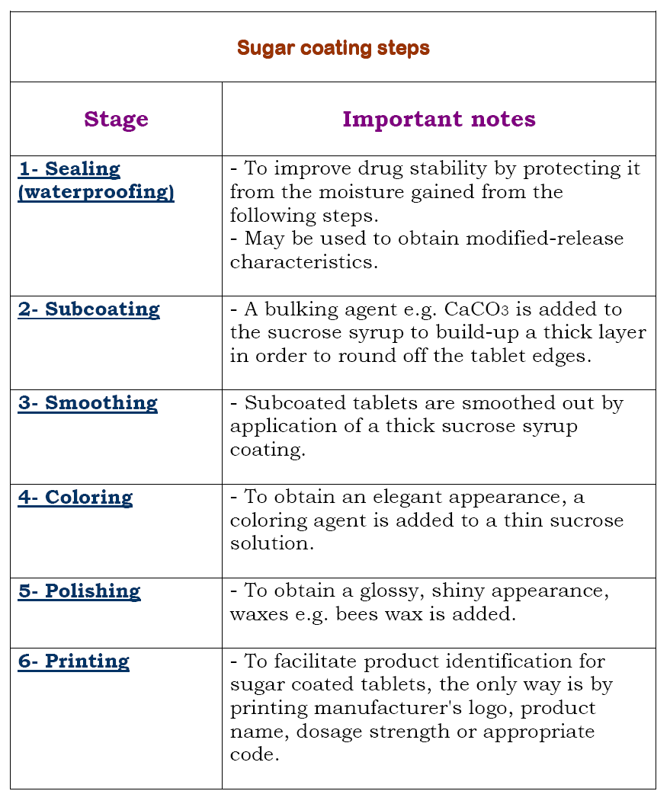

Slide 28
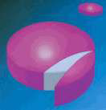
• Ideal properties of sugar coating
- Perfect smooth rounded countour
- Even colour coverage
- Polish to high gloss
• Coating faults
• Coat splitting caused by inadequate drying of coat during application

Slide 29
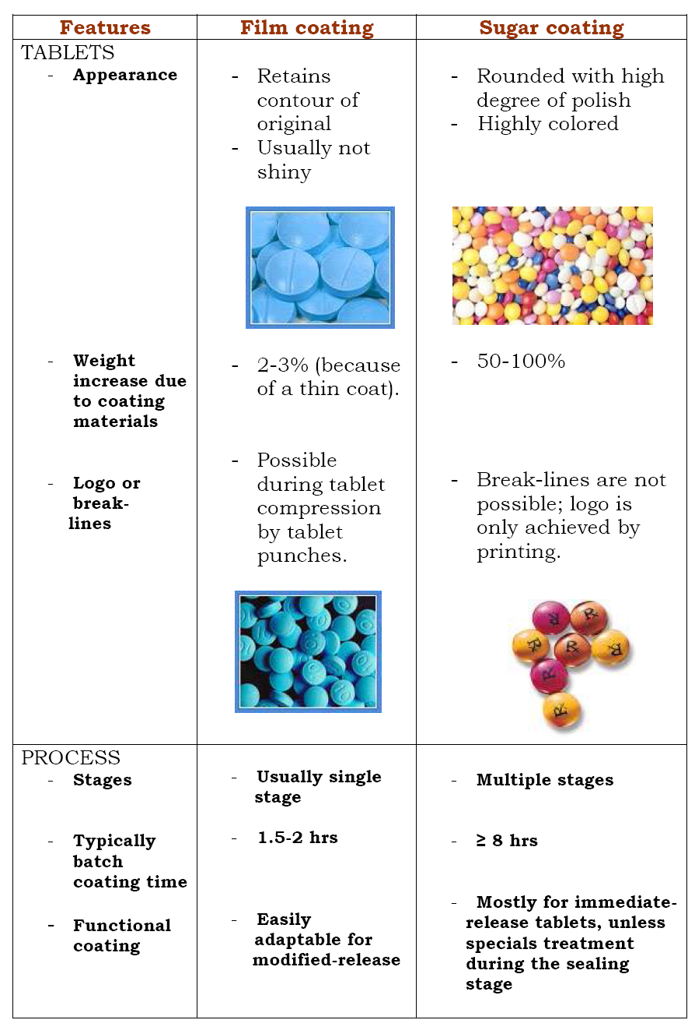

Slide 31
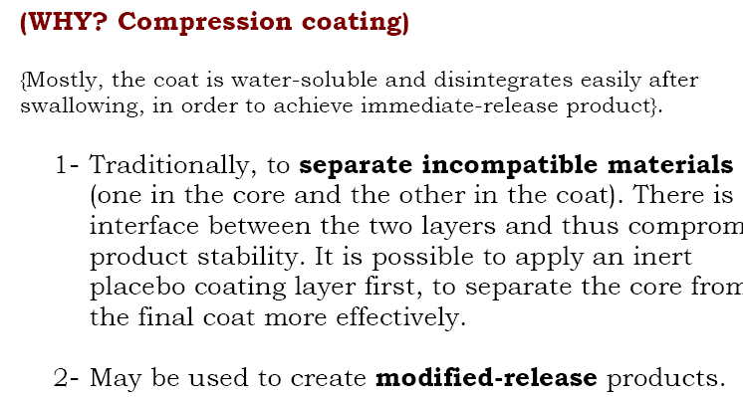

Slide 35
Press coating
Press coating process involves compaction of coating material around a preformed
core. The technique differs from sugar and film coating process.
Advantages
This coating process enables incompatible materials to be formulated together, such
that one chemical or more is placed in the core and the other (s) in the coating
material.
Disadvantages
Formulation and processing of the coating layer requires some care and relative complexities of the mechanism used in the compressing equipment.
Functional coatings
Functional coatings are coatings, which perform a pharmaceutical function.
These include;
• Enteric coating
• Controlled release coating

Slide 36
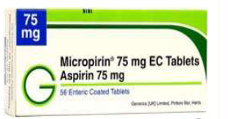
Enteric coating
The technique involved in enteric coating is protection of the tablet core from disintegration in the acidic environment of the stomach by employing pH sensitive polymer, which swell or solubilize in response to an increase in pH to release the drug.
Aims of Enteric protection:
✓ Protection of active ingredients, from the acidic environment of the stomach.
✓ Protection from local irritation of the stomach mucosa.
✓ Release of active ingredient in specific target area within gastrointestinal tract.
• Enteric coating
• An enteric coating is a barrier applied to oral medication that controls the location in the digestive system where it is absorbed.
• Enteric refers to the small intestine, therefore enteric coatings prevent release of
medication before it reaches the small intestine.
• used for drugs that are unstable, irritating to stomach
Examples of enteric coated OTC products
• Enteric coated aspirin E.g.
Micropirin® 75mg EC
tablets
• Enteric coated peppermint
oil E.g. Colpermin®

Slide 38
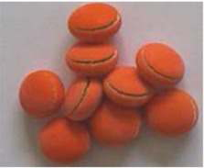
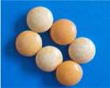
Quality control testing for coated tablets:
1- Irrespective to the method used in coating, all tablets are visually or electronically inspected for physical imperfection.
2- Drug availability is also tested.
Explosion of the sugar coated tablet (Caused by insufficient drying or bad insulation)
Color is not uniform

