Slide 1
Systemic and local antimicrobial agents in Periodontal Therapy
Dr. Dalal Alotaibi. BDS,MDS, PhD
Dalalotaibi@ksu.edu.sa
Division of Periodontics

Slide 2
Comprehend the systemic administration of antibiotics in periodontal diseases
Judge when to apply single or combination of antibiotic therapy
Apply local delivery of antibiotics
Apply local delivery of antiseptic agent.
REFERENCE: CARRANZA’s Clinical Periodontology 11th Edition. Antiinfective therapy.Chapter 47 pg 482

Slide 3
Outline
Discuss the rationale for the use of antimicrobial
agents in the treatment of periodontal diseases
Advantages of the specific antibiotics
Dosage used in treating periodontal disease
Types of controlled release systems (local antibiotic)

Slide 4
Definitions
An antiinfective agent is a chemotherapeutic agent that acts by reducing the number of bacteria present.
An antibiotic is a naturally occurring, semisynthetic, or synthetic type of antiinfective agent that destroys or inhibits the growth of selective microorganisms, generally at low concentrations.
An antiseptic is a chemical antimicrobial agent applied topically or subgingivally to mucous membranes, wounds, or intact dermal surfaces to destroy microorganisms.
Disinfectants, a subcategory of antiseptics, are antimicrobial agents that are generally applied to inanimate surfaces to destroy microorganisms

Slide 5
Bactericidal: kill bacteria by interfering with bacterial cell wall (penicillins and cephalosporins) or the cell membrane (polymyxins)
Bacteriostatic: target protein or DNAsynthesis
Spirochetes and motile rods
Anaerobic bacteria: is any organism that does not require oxygen for growth

Slide 6
"Narrow-spectrum" antibacterial antibiotics target specific types of bacteria, such as Gram-negative or Gram-positive bacteria
broad-spectrum antibiotics affect a wide range of bacteria

Slide 7
Ideal requisites of an antibiotic
Bacterial specificity
Should not produce resistant strains
Does not cause allergy or toxicity
Does not cause side effects
Does not eliminate normal oral flora
Cost effective

Slide 8
Mechanism of action
Antibiotics Categories
Bactericidal
Inhibition Cell
Wall Synthesis
Interfere with
Cell Membrane
Bacteriostatic
Interfere with
Protein Synthesis
Interfere with
Nucleic Synthesis

Slide 9
Antiinfective therapy in Periodontics
Host's own immunologic response to this bacterial infection can cause even more bone destruction (“indirect bone loss”) than that caused by pathogenic bacteria and their by-products.
Mainly influenced by environmental (e.g., tobacco use), acquired (e.g., systemic disease), and genetic risk factors.
Chemotherapeutic agents can modulate the host's immune response to bacteria and reduce the host's self-destructive immunologic response.

Slide 10
Antibiotics in Periodontics
Specific for periodontal pathogens, allogenic, nontoxic, and inexpensive.
No single antibiotic at concentrations achieved in body fluids inhibits all putative periodontal pathogens.
A combination of antibiotics may be necessary to eliminate all putative pathogens from some periodontal pockets

Slide 11
Commonly prescribed Antibiotics in Periodontal therapy
Tetracycline's – Minocycline, Doxycycline
Metronidazole
Amoxicillin, Augmentin
Ciprofloxacin
Clindamycin
Doxycycline
Azithromycin

Slide 12
Tetracycline
Clinical Use:
Refractory periodontitis
Localized aggressive periodontitis
Use in combination therapies – more effective

Slide 13
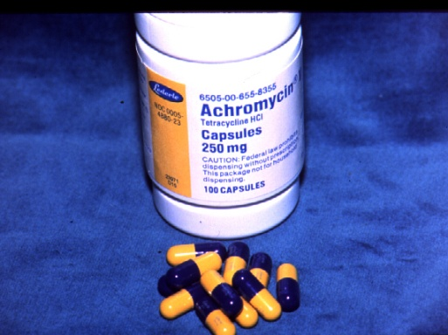
Tetracycline
Mechanism of action:
Bacteriostatic, broad spectrum
More effective against gram + positive bacteria
Concentration in the gingival crevice is 2 to 10 times that in
serum allowing a high drug concentration to be delivered into periodontal pockets
Inhibit the growth of Aggregatibacter actinomycetemcomitans
Inhibits production & secretion of collagenase
Inhibits bone resorption
Dosage
250 mg capsules 4 times a day (qid)

Slide 14
Tetracycline – Side Effects
Intrinsic tooth staining
GI upset, abdominal pain
Diarrhea, vomiting
Fungal overgrowth
Resistant bacterial strains
Interferes with bactericidal activity of penicillin's
& Cephalosporin

Slide 15
Minocycline
Broad-spectrum tetracycline antibiotic
It is a bacteriostatic antibiotic
It suppresses spirochetes and motile rods as effectively as scaling and root planing, up to 3 months after therapy
Dose : 200 mg twice daily (bid)
Adverse Effect:
It may cause reversible vertigo
It is the only tetracycline that can discolor permanently erupted teeth and gingival tissue when administered orally.

Slide 16
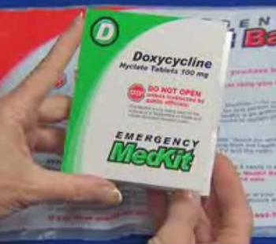
Doxycycline
Broad-spectrum tetracycline antibiotic
Same spectrum of activity as minocycline
It can be given once daily
Absorption from the GIT is not altered by
calcium, metal ions, or antacids
Dosage: 100 mg daily

Slide 17
Metronidazole
Mechanism of action:
Bactericidal/Bacteriostatic antimicrobial
used particularly for anaerobic bacteria
Disrupts DNA synthesis leading to cell death
Selectively kills bacterial associated with periodontal disease
Used as monotherapy and also in combination with both root planing and surgery or with other antibiotics
Dosage:
250 mg tid for 7-10 days

Slide 18
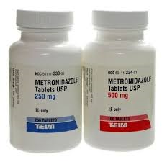
Metronidazole
Clinical use:
Refractory periodontitis
(in combination with amoxicillin/ augmentin)
Necrotizing ulcerative gingivitis
Moderate – severe periodontitis
Aggressive periodontitis
Following periodontal surgery

Slide 19
Metronidazole
Side Effects
GI disturbances, Nausea, diarrhea
Head ache
Metallic taste, Dry mouth
Candida infections
Adverse interaction with alcohol consumption

Slide 20
Clindamycin & Ciprofloxacin
Clindamycin
Clindamycin is effective against anaerobic bacteria and has a strong affinity for osseous tissue.
It is effective in situations in which the patient is allergic to penicillin
Dosage : 150 mg qid for 10 days.
Ciprofloxacin
Ciprofloxacin is active against gram-negative rods and anaerobic putative periodontal pathogens.
Ciprofloxacin is the only antibiotic in which all strains of A. actinomycetemcomitans are susceptible.
Dosage : 500mg bid for 8 days

Slide 21
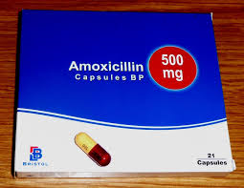
Amoxicillin
Is a semi synthetic penicillin
Broad spectrum – gram positive and negative bacteria.
Excellent absorption after oral administration.
Management of patients with aggressive periodontitis
Dosage : 500 mg tid

Slide 22
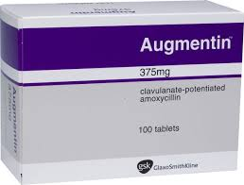
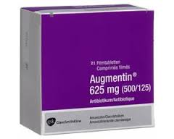
Amoxicillin - Clavulanate (Augmentin)
The combination of amoxicillin with Clavulanate potassium makes Augmentin resistant to penicillinase enzymes produced by some bacteria.
Useful in the management of patients with refractory or localized aggressive periodontitis
Dosage: 375-625mg tid for 7 days

Slide 23
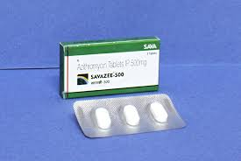
Azithromycin
Azithromycin is a macrolide antibiotic effective against the most common periodontopathogens.
Azithromycin have a triple role in the treatment and resolution of periodontal diseases:
-suppressing periodontopathogens,
-anti-inflammatory activity
-healing through persistence at
low levels in macrophages and
fibroblasts in periodontal
tissues, even after a
single course of three tablets
Dosage: 500mg once daily

Slide 24
Common Antibiotic Regimens Used to Treat Periodontal Diseases
Single Agent
Amoxicillin 500 mg Three times daily for 8 days
Azithromycin 500 mg Once daily for 3–7 days
Ciprofloxacin 500 mg Twice daily for 8 days
Clindamycin 300 mg Three times daily 10 days
Doxycycline 100–200 mg Once daily for 21 days
Metronidazole 500 mg Three times daily for 8 days
Combination Therapy*
Amoxicillin-metronidazole (250 mg amoxicillin-375 mg metronidazole, 3 times daily for 8 days) is the most common antibiotic combination in periodontics.
Ciprofloxacin-metronidazole (500 mg of each, twice daily for 8 days)
* Slots J. Systemic antibiotics in periodontics. J Periodontol. 2004:75;1553-1565.

Slide 25
Controlled Release Agents (local delivery systems)
Suppressing destructive enzymes produced during inflammatory process or by suppressing microbes
Considered mainly for localized periodontitis

Slide 26
Advantages of local drug delivery
Concentration achievable locally is higher
Better patient compliance
GCF concentration greater than serum levels
Delivery is localized – reduces systemic effects
No systemic drug resistance

Slide 27
Currently available Systems
Actisite (tetracycline fiber)
Atridox (doxycycline gel)
Arestin (minocycline HCl 1mg)
Dentamycin (2% minocycline hydrochloride)
PerioCline (2% minocycline hydrochloride)
Elyzol (25 % Metronidazole gel)
Periochip (2.5 mg of Chlorhexidine gluconate)

Slide 28
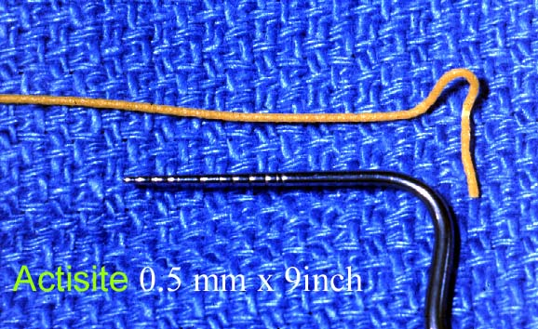
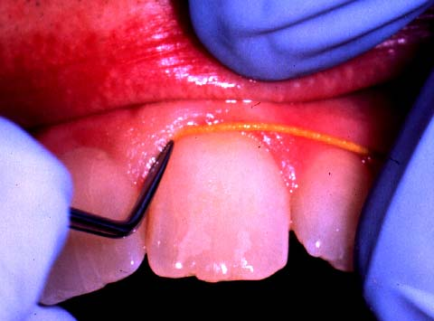
Actisite Periodontal Fiber (Tetracycline)
Ethylene / vinyl acetate copolymer fiber, diameter 0.5 mm, containing tetracycline (12.7 mg)
releases tetracycline concentrations exceeding 1300 µg/ml
Fiber inserted into the pocket
Removed after 7 to 10 days after placement

Slide 29
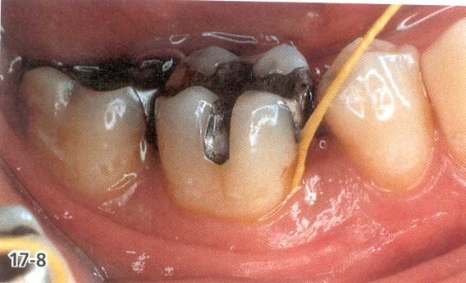
Actisite
Clinical Efficacy:
Reduction in bleeding on probing and pocket depth
Reduction in periodontal pathogens
Adverse effects:
Discomfort
Local erythema
Occasional systemic reaction
Oral Candidiasis

Slide 30
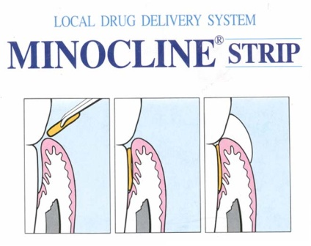
Minocycline - Arestin
Clinical indication:
Periodontitis with pockets more than 5 mm
Mechanism of action:
Broad spectrum
Bacteriostatic
GCF levels maintained at high levels for at least 14 days

Slide 31
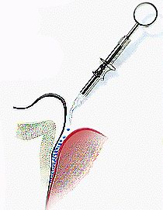
Arestin - method of application

Slide 32
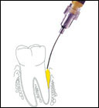
Atridox (Doxycycline)
10% Doxycycline hyclate
Biodegradable – syringe system

Slide 33
Metronidazole Gel (Elyzol)
It is a bio-absorbable delivery device containing
25% Metronidazole benzoate in a matrix consisting of a mixture of glyceryl monooleate and sesame oil.

Slide 34
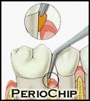
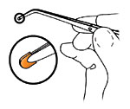
PerioChip
Description:
Rectangular chip, supplied in boxes of 10
Contains 2.5 mg Chlorhexidine D-gluconate
Biodegradable matrix of hydrolyzed gelatin

Slide 35
PerioChip
Mechanism of action:
Bactericidal antiseptic agent
Binds with tissue – no need for surgical dressing
Chip gradually biodegrades releasing CHX
Sustained release over period of 7-10 days
GCF concentrations vary among clients
Peaks at (2- 4) hours after insertion
Peaks again at approx. 72 hours
Concentrations gradually decline over 7-10 day period

Slide 36
Summary – Antimicrobial agents
The decision as to when to use local or systemic
antimicrobials should be based on
the clinicians consideration of the clinical findings
patient's medical and dental history
patient preferences
benefits of adjunctive therapy with these agents.

