Slide 1
PHYS 103
(classical mechanics)

Slide 2
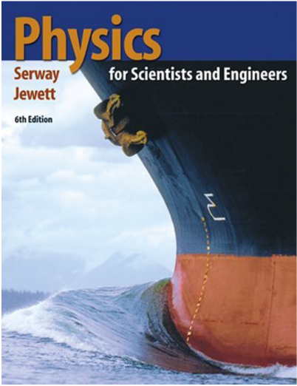
Reference and Syllabus
COURSE TEXTBOOK
Physics for Scientists and Engineers
6th Edition • Raymond A. Serway & John W. Jewett
Ch. | Topic | Sections | Suggested Problems
1 | Physics and Measurement | 1.1, 1.4, 1.5 | 13, 15, 21, 25, 31
2 | Motion in One Dimension | 2.1–2.3, 2.5, 2.6 | 4, 5, 11, 15, 16, 20, 21, 22, 23, 25, 27, 28, 29, 32, 33, 40, 42, 43, 46, 48, 51, 52
3 | Vectors | 3.1 to 3.4 | 1, 4, 19, 21, 27, 30, 31, 33, 39, 49, 50
4 | Motion in Two Dimensions | 4.1 to 4.5 | 1, 3, 5, 6, 8, 14, 15, 17, 19, 20, 22, 23, 25, 29
5 | The Laws of Motion | 5.1 to 5.8 | 3, 7, 11, 16, 18, 24, 25, 26, 28, 30, 31, 37, 41, 44, 45, 46, 68
6 | Circular Motion & Applications of Newton’s Laws | 6.1 | 1, 2, 5, 7, 59
7 | Energy and Energy Transfer | 7.2 to 7.8 | 1, 4, 7, 13, 14, 15, 16, 19, 21, 24, 25, 26, 28, 31, 32, 33, 35, 37, 40
8 | Potential Energy | 8.1 to 8.5 | 2, 5, 6, 11, 13, 17, 31, 33, 36, 38, 42, 55, 57, 59, 60
9 | Linear Momentum and Collisions | 9.1 to 9.4 | 1, 2, 4, 5, 7, 8, 9, 10, 13, 15, 16, 17, 18, 21, 25, 27, 32, 33, 35
10 | Rotation of a Rigid Object About a Fixed Axis | 10.1 to 10.8 | 1, 3, 5, 6, 8, 12, 13, 16, 17, 18, 20, 21, 31, 35, 37, 46, 70, 71
Primary reference for lectures and problem sets
Course roadmap • Chapters 1–10

Slide 3
Grading and Absence
ASSESSMENT & COURSE REQUIREMENTS
Assessment | Mark | Schedule | Location
Lab | 30 | Every week | Different
Two Midterms | 15 + 15 | — | —
Final Exam | 40 | — | —
Total | 100 | — | —
Attendance Policy
Students whose absence exceeds 25% of total course lectures will be banned from the Final Exam.
Attendance will be taken at the exact beginning of class.
Key threshold: absence > 25%
ABSENCE FROM EXAMINATIONS
Authorized absence
Makeup exam
If you cannot attend an examination because of illness or other unavoidable circumstances, you must provide acceptable evidence of “good cause” to the competent commission. If the absence is authorized, a Makeup Exam will be granted only once.
No other Makeup Exam will be offered in the same semester. If you miss the Makeup Exam, the exam mark will be zero.
Please refer to the official course and university regulations for final policy interpretation.

