Slide 1

STATICS
(ENGINEERING MECHANICS-I)
بسم الله الرحمن الرحيم
Lecture #1
Course Description and Introduction
By
Dr. Fahed Alrshoudi
Notes:
This is a title slide.

Slide 2
Objectives of the Present lecture
To give an induction of the class policy
To provide statistics numbers
To provide an overview of the course contents
To explain the learning outcomes of the present course
To provide important dates
To explain what the “Statics” is.
To define scalar and vector quantities
To provide an overview of most common vector operations

Slide 3
About the Instructor
Name: Dr. Fahed Alrshoudi
Designation: Assistant Professor
Department: Civil Engineering
Office: 2A69
Email: falrshoudi@ksu.edu.sa
Website: http://fac.ksu.edu.sa/falrshoudi
Office Hours: Displayed on the office wall.

Slide 4
Class Rubric
No tick attendance after 10 min of the beginning of lecture.
No Phone
Email!!!
Bonus
Free to get in or out of the classroom
Attendance (90%)

Slide 5
Statistic Numbers
Number of Students | A+ | A | B+ | B | C+ | C | D+ | D | F
85 | 3 | 7 | 10 | 10 | 13 | 14 | 10 | 6 | 12
% | 12 |  | 24 |  | 32 |  | 19 |  | 14

Slide 6
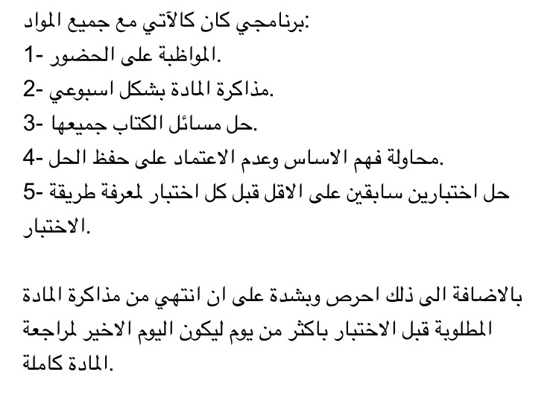
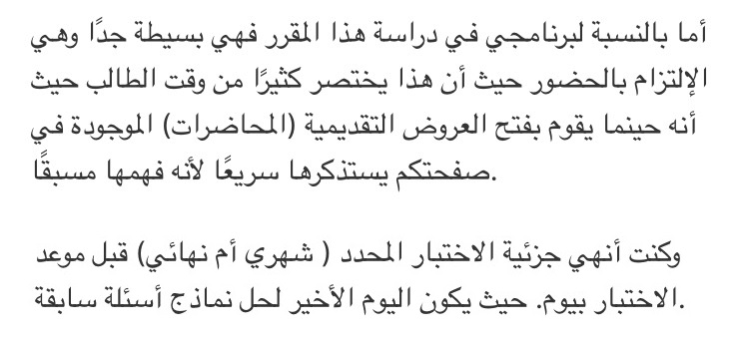
A+ and A, How?

Slide 7
Fail (F), Why?
1st Mid | 2nd Mid | MD | Tut | Total sem. | Final Mark | Total | #Absent
22.5 | 22.5 | 5 | 10 | 60
13.75 | 10.5 | 5 | 0 | 29.25 | 20.2 | 49.45 | 8
14 | 8.5 | 5 | 4 | 31.5 | 20.4 | 51.9 | 10
12.25 | 9 | 5 | 0 | 26.25 | 28.8 | 55.05 | 10

Slide 8
Course Description
Force systems; vector analysis, moments and couples in 2D and 3D
Equilibrium of force systems
Analysis of structures; plane trusses and frames.
Distributed force system
Centroid of simple and composite bodies
Area moments of inertia
Analysis of beams
Friction

Slide 9
Course Learning Outcomes
Students completing this course will be able to
Analyze 2D and 3D force system and calculate moment in a 2D and 3D structures
Analyze beam, and frame structures using equilibrium equations
Analyze truss structures using various methods
Locate centroid of regular and composite cross sections
Evaluate area moment of inertia of engineering cross sections about different axes.
Analyze and solve friction related equilibrium problems

Slide 10
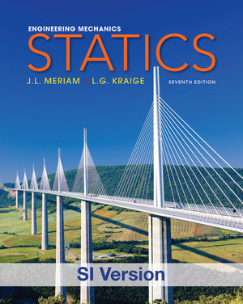
Text Book
STATICS
Authors: JL Meriam & LG Kraige
Publisher: John Wiley & Sons.
Edition: Seventh (in SI Units)

Slide 11
Outcome Assessment
Two Midterm Exams 45%
Model Demonstration and Report Writing 5%
Tutorial and Homework 10%
Final Exam 40%

Slide 12
Midterm Exams
First Midterm
Date: 15 Shawwal 1437H (20 July 2016)
Day: Wednesday
Time: 7:00 – 8:30 pm
Second Midterm
Date: 29 Shawwal 1437H (03 August 2016)
Day: Wednesday
Time: 7:00 – 8:30 pm
Final Exam
Date: 15- Thul-Qedah (18-August)
Day: Thursday

Slide 13
Engineering Mechanics
A branch of science concerned with the action of forces on material bodies in rest or in motion
Categories of Mechanics:
  Rigid bodies
    Statics (deals with equilibrium of bodies at rest)
    Dynamics (deals with the accelerated motion of bodies)
  Deformable bodies
  Fluids

Slide 14
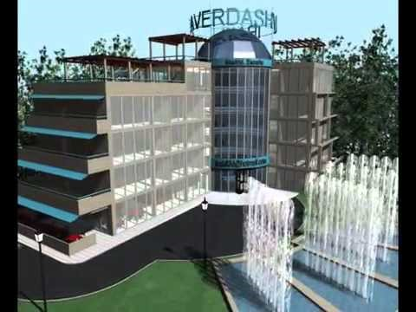
A Real Life Application
Engineering Design of a building is an application of Statics knowledge.
Design of its various components are primarily based on the Principles of Static equilibrium and Strain compatibility.

Slide 15
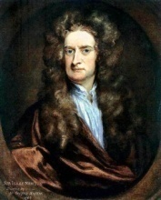
Newton’s Laws
Law I: If the resultant force on a particle is zero, the particle will remain at rest (if originally at rest) or will move with constant speed in a straight line (if originally in motion).
Law II: The acceleration of a particle is proportional to the resultant force acting on it in the direction of this force.
  If above Law (II law) is applied to a particle of mass m, it may be stated as
Law III: The forces of action and reaction between interacting bodies are equal in magnitude, opposite in direction, and collinear.

Slide 16
Weight of the body
The gravitational attraction of the earth on a body is known as the weight of the body. This force exists whether the body is at rest or in motion.
Since this attraction is a force, the weight of a body should be expressed in Newtons (N) in SI units and in pounds (lb) in U.S. customary units.
Note: Unfortunately in common practice the mass unit kilogram (kg) has been frequently used as a measure of weight. This usage should disappear in time because in SI units the kilogram is used exclusively for mass and the Newton is used for force, including weight.

Slide 17
Law of sines and cosines
Law of sines
Law of cosines

Slide 18
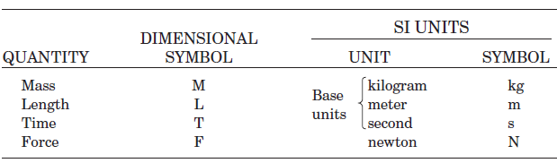
Systems of Units
ENGINEERING MECHANICS : STATICS
International System of Units (SI) or Metric System :
The basic units of length, time, and mass which are defined as meter (m), second (s), and kilogram (kg).
The unit of Force is derived as below,
June 14, 2016

Slide 19
U. S. Customary UNITS
U.S. Customary units (or foot-pound-second (FPS) units):
  Mass : slugs ( No symbol)
  Length: foot (symbol ft)
  Time: second (symbol sec)
  Force: pound ( symbol lb)
Note: In U.S. units the pound is also used on occasion as a unit of mass. When distinction between the two units is necessary, the force unit is frequently written as lbf and the mass unit as lbm.
Other units of force in the U.S. system which are in frequent use, are the kilopound (= 1000 lb), and the ton (= 2000 lb)

Slide 20
Scalars and Vectors
ENGINEERING MECHANICS : STATICS
SCALAR QUANTITIES
A scalar is a quantity that has only magnitude, either positive or negative.
For example; mass, length, area, volume and speed are the scalar quantities frequently used in Statics.
Scalars are indicated by letters in Itallic type, such as the scalar ‘A’.

Slide 21
Scalars and Vectors
ENGINEERING MECHANICS : STATICS
VECTOR QUANTITIES
A vector is a quantity that has both a magnitude and a direction.
For example; weight, force, moment, velocity and acceleration are the vector quantities frequently used in Statics.
Vectors are indicated by bold letters, such as ‘A’ or A or A
The magnitude of a vector is always a positive quantity

Slide 22
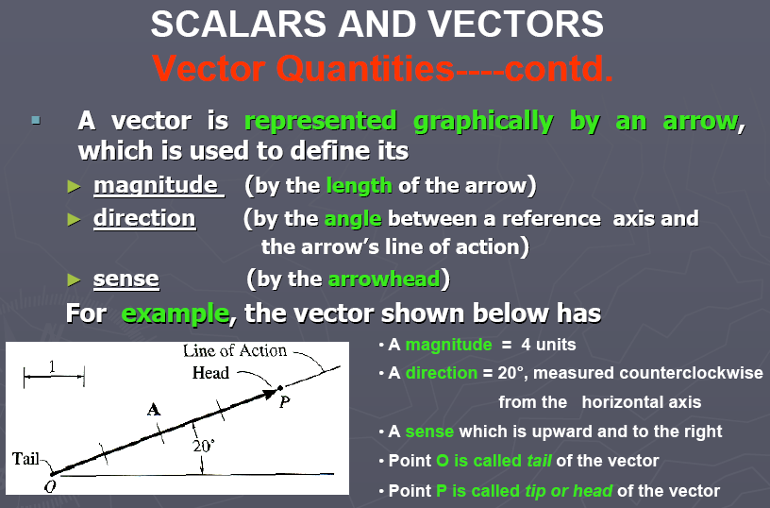
Scalars and Vectors
ENGINEERING MECHANICS : STATICS
1 - 22

Slide 23
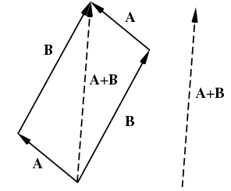
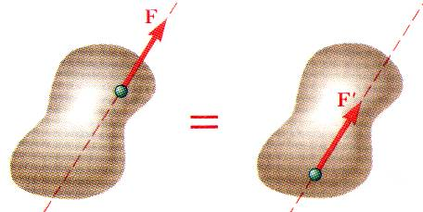
Fundamental Principles – Paralellogram Law & Transmissibility
ENGINEERING MECHANICS : STATICS
Vectors must obey the parallelogram law of combination. This law states that two vectors
A and B, treated as free vectors, may be replaced by their equivalent vector (A+B), which is the diagonal of the parelellogram formed by A and B as its two sides, as shown in the figure.
Principle of Transmissibility
Conditions of equilibrium or motion are not affected by transmitting a force along its line of action.
NOTE: F and F’ are equivalent forces.

Slide 24
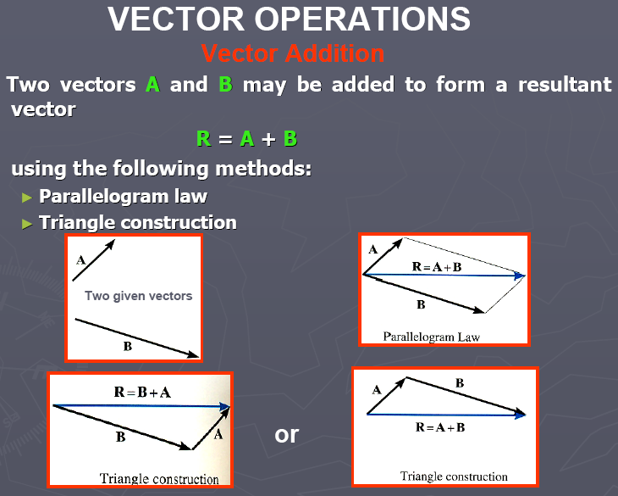

Slide 25
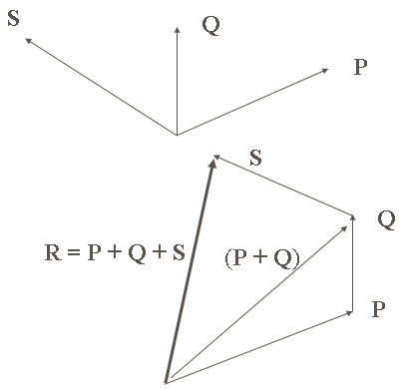
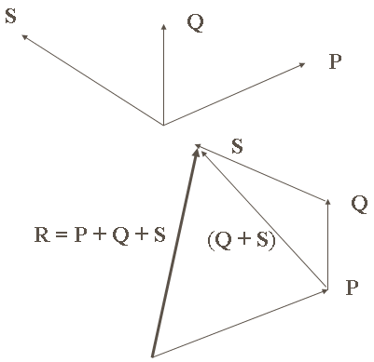
Polygon Rule:
can be used for the addition of more than two vectors. Two vectors are actually summed and added to the third and so on...
P + Q + S = (P + Q) + S = P + (Q + S)
This is the Associative Law of Vector Addition

Slide 26
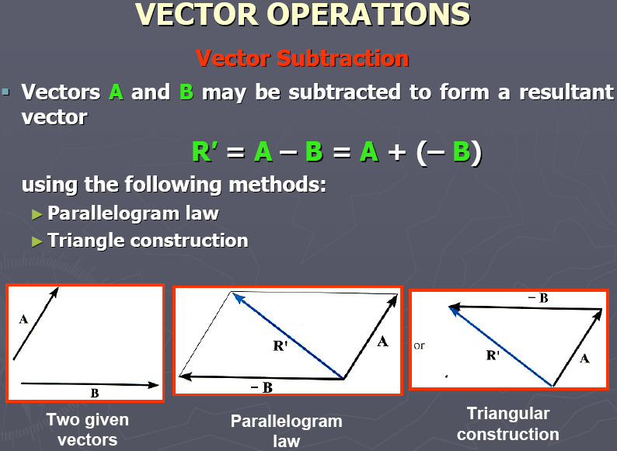

Slide 27
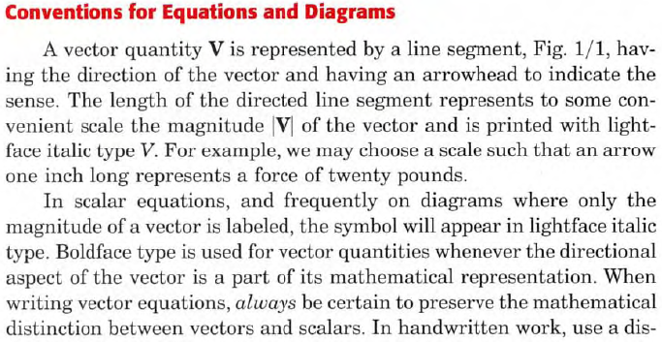
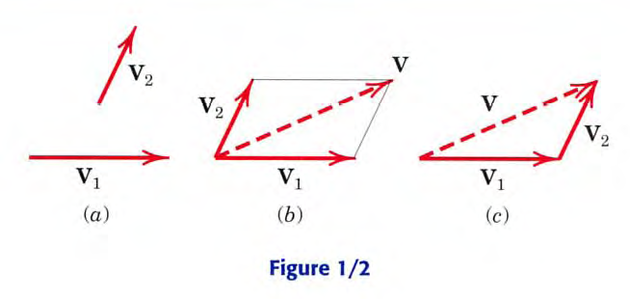
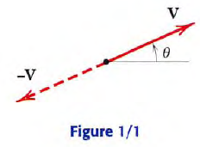
ENGINEERING MECHANICS : STATICS

Slide 28
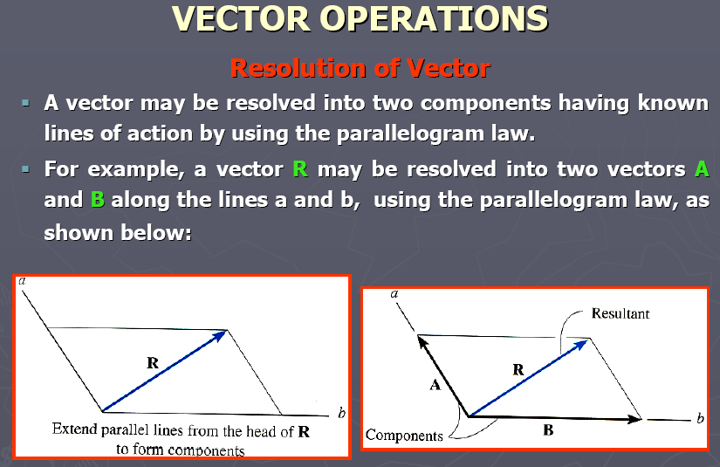

Slide 29
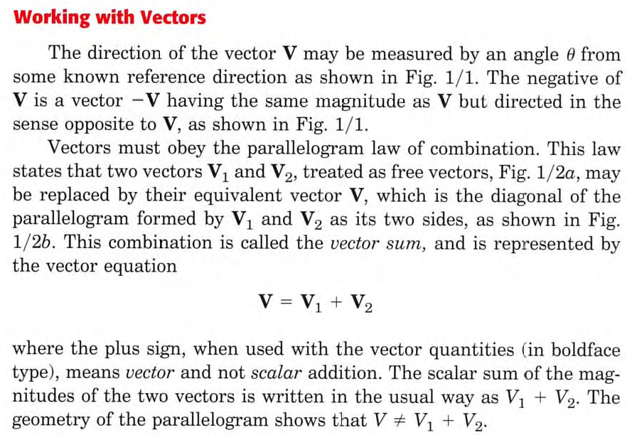
ENGINEERING MECHANICS : STATICS

Slide 30
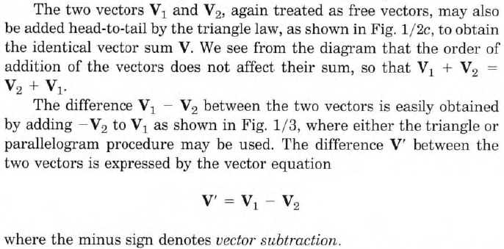
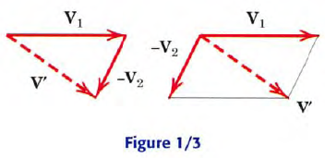
ENGINEERING MECHANICS : STATICS

Slide 31
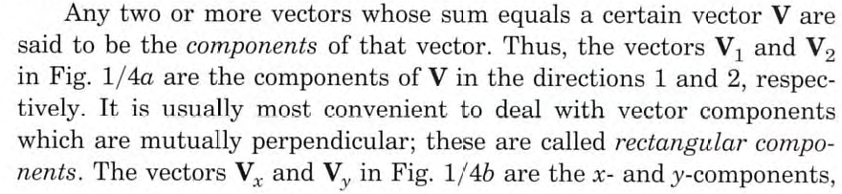
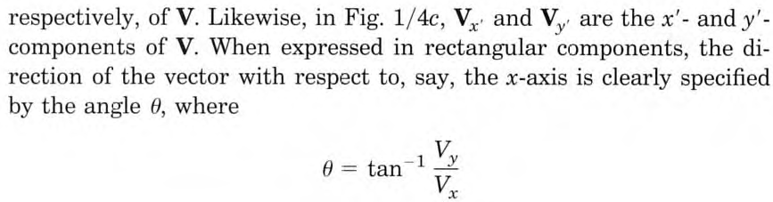
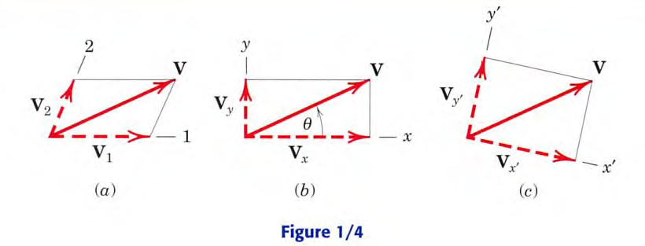
ENGINEERING MECHANICS : STATICS

Slide 32
Unit Vector(s)
Cartesian or Standard Unit Vectors

Slide 33
Direction Cosines

Slide 34
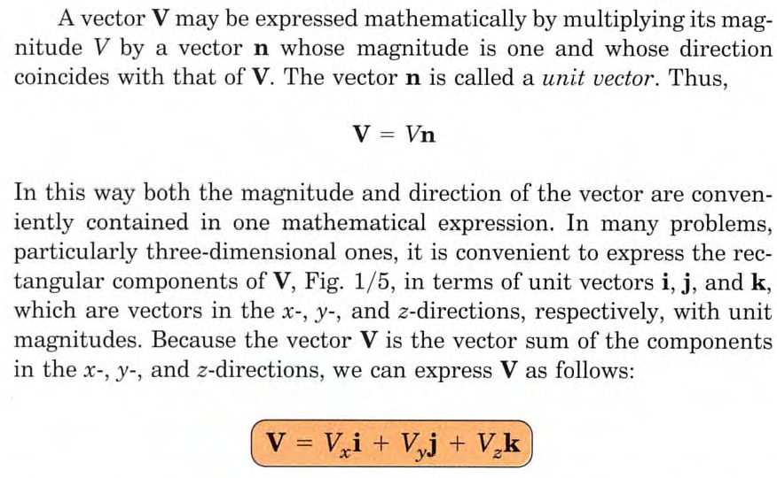
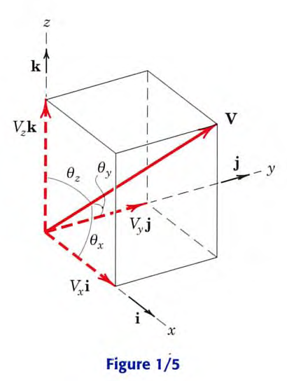
ENGINEERING MECHANICS : STATICS

Slide 35
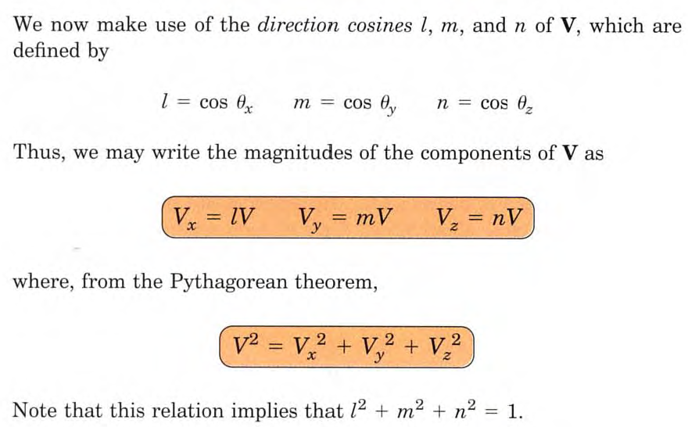
ENGINEERING MECHANICS : STATICS

Slide 36
Vector Multiplications
Cross or Vector Product
Dot or Scalar Product
The cross product of the two vectors is defined as a vector with magnitude AB sinθ and a direction specified by the right hand rule.

Slide 37
Position Vector
A position vector locates one point in space relative to another.
is a position vector that runs from point A to another point B.

