Slide 1
Studio 12. Engineering Ethics: Case Studies
GE105
Introduction to Engineering Design College of Engineering
King Saud University
Spring 2016

Slide 2
Case Study: Murder
Legal?
Moral?
Ethical?
Good Etiquette?
Answers:
Illegal
Immoral
Unethical
Bad etiquette!

Slide 3
Case Study: Driving over the speed limit when you are late for class
Legal?
Moral?
Ethical?
Good Etiquette?
Answers:
Illegal
Moral to some, immoral to others
Unethical
Bad etiquette if it effects other drivers
Notes:
Note, Ethics: are the science of morals, and Morals: are the practice of ethics

Slide 4
Case Study: Driving over the speed limit going to hospital for an emergency case.
Legal?
Moral?
Ethical?
Good Etiquette?
Answers:
Illegal
Moral
Ethical
Etiquette does not apply

Slide 5
Question
Ahmed was showing Ali a copy of a software package he got from a friend.
Ali says, “this is great, but you didn’t pay for it, you shouldn’t really be using it.”
Ahmed says, “Look, I can’t buy it because it is too expensive, so the company hasn’t lost a sale. Besides I didn’t take a physical object, so it isn’t stealing.”
What do you think:
Ahmed is right – there is no problem, he isn’t stealing from the company?
Ahmed should delete the software from his computer?
Ahmed shouldn’t pirate software, but the company is not going to find out, so he should not delete it?

Slide 6
Question
On his way home from work, Ahmed goes into a store, picks up a candy bar and walks out without paying. Ethically, is this the same as pirating software?
YES
NO
In some ways yes and some ways no

Slide 7
Question
A chemical company develops a new process that results in some waste. Their internal studies show this waste can cause cancer.
However, this type of waste is not on a government list of banned chemicals because it is new.
Legal? Moral?
Answers:
Legal but immoral

Slide 8
Question
Government self-regulations require that all purchases be made through purchasing agents.
An engineer wishes to purchase an old alternator from a junkyard and does so with his own money.
He reimburses himself with computer disks of equivalent value.
Legal? Moral?
Answers:
Moral but illegal

Slide 9
Case study: Protecting the Safety of Society
Your employer asks you to design a bridge that will not exceed $1 million to build. After doing a study you determine the following:
An ideal bridge can be built for $1.5 million.
Given the design constraints, a bridge built for $1 million will collapse in a moderate earthquake.
Your employer says, “if we don’t build the bridge for $1 million, then we are going to have to fire half of the staff, including you.”
He further asks you to go ahead with the next stage of the project
What do you do?

Slide 10
What is the conflict?
Your duty to your fellow employees vs. your duty to your boss
Your duty to society vs. your loyalty to your own career
Uncertainty about the maximum magnitude of an earthquake vs. the need to ensure a safe structure.
Your duty to be honest to clients vs. your duty to complete the project

Slide 11
What is more important?
The conflict is between your future employment and the employment of others in your company, and the welfare of society.
The code of ethics for engineers requires You to take the safety of society as being of paramount importance.
In a case like this the welfare of society comes first.

Slide 12
Case 2: Truth In Public Statements
You are asked by the government to verify that a certain industry will not leak toxic substances into the environment
After doing a study you discover that:
The industry will likely cause harm within the coming 5 years, but there is significant uncertainty.
The industry cannot be evaluated more carefully unless it is shut down immediately.
Both the environment and the neighboring community are at risk

Slide 13
After reading your report, the boss asks you to modify your report so as to reflect that the industry is actually safe.
He claims that changing the report will protect the public in the area, preventing panic while the government attempts to shut down and fix the facility.
What do you do?

Slide 14
What is the Conflict?
The conflict is between your obligations as an engineer and your obligations as a citizen.
The code of ethics requires that you safeguard the public’s welfare. It also requires that you tell the truth when making public statements concerning your area of engineering.
This means that you cannot alter data as an engineer, and that you must tell the truth about the facility.
In this case your duty as an engineer to tell the truth when making public statement should win over your civic duty
Role conflicts are hard!!!

Slide 15
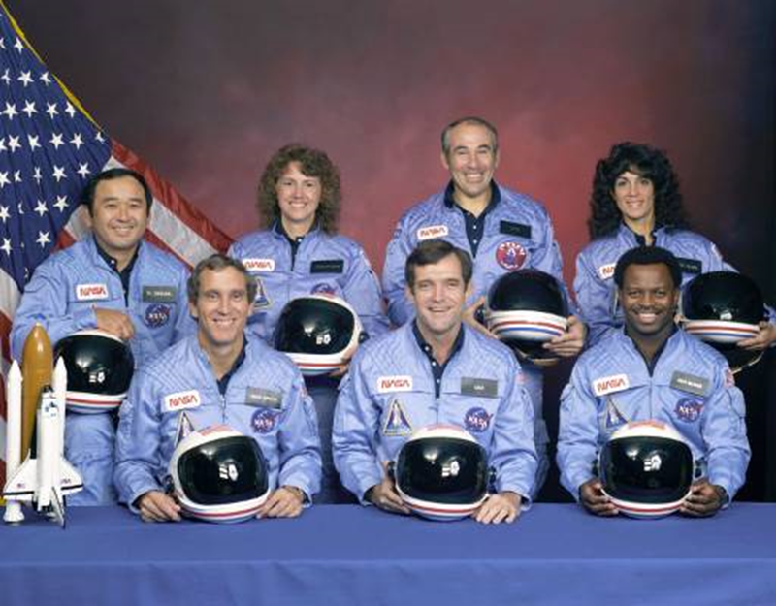
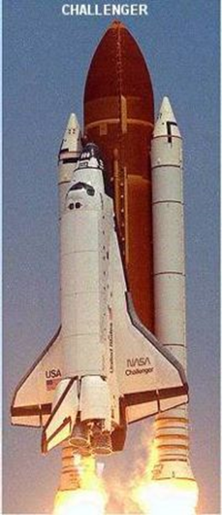
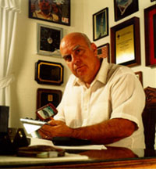
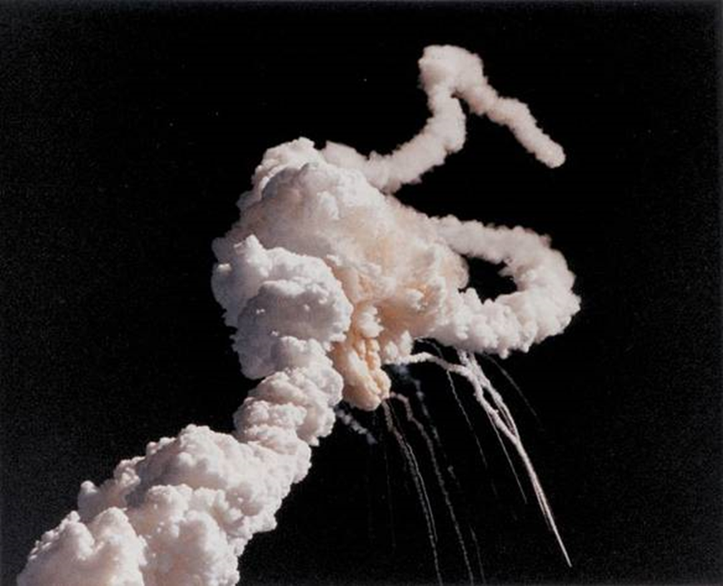
A famous case The Challenger Disaster (January 28, 1986) :
Economic considerations
Political pressures
Scheduling difficulties → NASA decides to launch anyway
O-rings
Roger Boisjoly, chief O-ring engineer, had warned his colleagues that O-rings fail at relatively low temperatures
Challenger lifts off at 11:37 AM
Explodes 73 seconds after launching

Slide 16
O-ring seal indeed failed, flames burned the adjacent components and ignited the liquid hydrogen and oxygen in the external fuel tank; which caused orbiter to break apart
Do you think NASA should have launched? Is there a clear moral issue here?
Did NASA take unnecessary risks because of external pressure?
Did the engineers violate their duty to put public safety first?

Slide 17
Did NASA manager think of the potential costs?
Human lives
His reputation
Criminal charges
100% of the blame on him
Suspension of the shuttle program
How about other elements such as “whistle blowing”?
It is a hard choice. You have to choose between the lesser of two evils.
In the Challenger disaster, obviously the lesser of two evils choice should have been to delay the launch.

