Slide 1
Studio 3. Tips for Writing Reports
GE105
Introduction to Engineering Design College of Engineering
King Saud University
FALL 2016

Slide 2
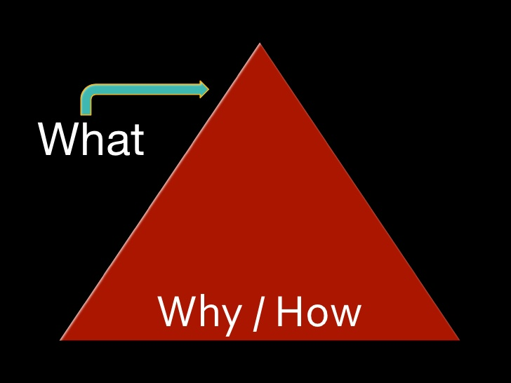
What is a good report?
Meets the audience’s needs
Well organised
Readable
Answers the questions:
What is the purpose of the document?
What is to be achieved?

Slide 3
Final Report Layout*
Front Matter
Title Page
Abstract
Table of Contents
List of Figures
List of Tables
Body
Introduction
Need Analysis: Problem statement, Objectives, Criteria, and Constraints
Morphological Analysis
Design Concept Generation
Design Evaluation/Selection
Detailed Design
End
Conclusions/ Recommendations
References
Appendices
Notes:
Morphological Analysis التحليل الصرفي
Watch the following movie on youtube regarding report writing https://youtu.be/AFGNKJruxdg

Slide 4
Title
The title is more important than most people think.
Choose a title using as few words as possible (less than 10) to clearly describe the content
It is also a good idea to read through your title and think about how it might be interpreted
The title page should contain the following: course name, project title, the authors' full names and ID numbers, the name of the instructor, the date of submission

Slide 5
Abstract (Problem Definition)
The abstract is the second level at which a potential reader can filter out reports that s/he is or is not interested in reading
The abstract is generally limited to 150 words (or so). It must be a self-contained description of the report
It includes a short summary of the design problem and the most important results and conclusions of the project

Slide 6
Conclusions, Summary and Recommendations
Summarize what has been done
Highlight the features of the design
Are there any limitations in your design?
What are the implications of your findings?
Recommend a follow-up study for any remaining problems

Slide 7
Referencing
Always cite sources within the report
Use a unified system of referencing*
Be careful of web sources
Plagiarism** = cheating = penalty
DO NOT copy-and-paste
Give list of references according to a standard style
Notes:
try the following reference generator: http://www.qub.ac.uk/cite2write/harvard3l.html
Plagiarism = الإنتحال

Slide 8
Some Citation Standards
Books
[1] B. Klaus and P. Horn, Robot Vision. Cambridge, MA: MIT Press, 1986. Handbooks
[7] Motorola Semiconductor Data Manual, Motorola Semiconductor Products Inc., Phoenix, AZ, 1989. Reports
[4] P. Diament and W. L. Lupatkin, “V-line surface-wave radiation and scanning,” Dept. Elect. Eng., New York, Sci. Rep. 85, Aug. 1991. Journals
[3] W. Rafferty, “Ground antennas in NASA’s deep space telecommunications,” Proc. IEEE vol. 82, pp. 636-640, May 1994. Standards
[2] Letter Symbols for Quantities, ANSI Standard Y10.5-1968. Patents
[1] J. P. Wilkinson, “Nonlinear resonant circuit devices,” U.S. Patent 3 624 125, July 16, 1990.

Slide 9
Appendices
Things that are related to the project, but not contained in the main components
Examples are:
Computer codes
Lengthy specifications
Supporting tables or other material

Slide 10
Figure/Table Captions
All necessary figures/tables must be included within the main components
ALWAYS include a figure/table caption and number
If the figure (or table) is not yours, put the reference number at the end of the caption
Give the source of data (e.g., data from [5])
The caption of the figure is centered below the figure
The caption of the table is centered above the table
Notes:
10

Slide 11
Document Formatting
Leave one-inch margins all around
Use 1.5 spacing between lines
Title of Report in Initial Capital Letters: (16 points, Boldface)
Sections titles are 14 points, flush left, and boldfaced. Use initial capitals
The text should all be with font size 12pt (Times New Roman is recommended)
Notes:
* Do you know the significance of 1.5 spacing: it’s to be able to include comments, and read paper more easily (this is proved scientifically)

Slide 12
Important Notes
Use a predefined style when writing a report to allow for easy modification without the need of renumbering or reformatting
No title should be directly followed by “bullets” or independent sentences”; a paragraph must be used first
The writer should include all the information required for the reader to understand the details without the need to ask questions.

Slide 13
Important Notes (contn’d)
A paragraph must contain at least three sentences
Every reference listed at the end of your report needs to be cited in your text.
Every figure and table must be mentioned in the text. You should not have a figure that just appears out of nowhere.
Numbers less than ten should be written in letters (use “three” not “3”)

Slide 14
Important Notes (contn’d)
Always use complete sentences, except for a figure or table caption.
Do not use contractions; use it is (not it’s) and cannot (not can’t) ; similarly, do not use haven’t, doesn’t, wouldn’t, etc.
The semicolon is used to separate two sentences that are closely related. If you use a semicolon, look at the expressions on each side.

Slide 15
Checklist (Before Submission)
Check The following points before submitting your report:
The cover page has all the required information
The report has all the necessary components
The entire document is proofread*
The document is checked for spelling errors
The document is checked for grammar and there are no sentence fragments or run-on sentences in the text.
Notes:
* Try the two-day approach: print the report, keep hidden in a drawer somewhere, then read it again. You will be surprised by what you wrote!

Slide 16
Checklist (contn’d)
There are no contractions (do a global search for the apostrophe and make sure it occurs only in possessives).*
You used paragraphs with more than three sentences
All of the references that are given at the end of the report are explicitly cited within the report
All of the figures and tables are mentioned within the text.
Notes:
e.g. sun’s rays

